Slide 1

xUnit Testing
.NET

Slide 2
xUnit.net is a free, open-source, community-focused unit testing tool for .NET.
https://xunit.net/

Slide 3
Compare Xunit with other frameworks https://xunit.net/docs/comparisons

Slide 4
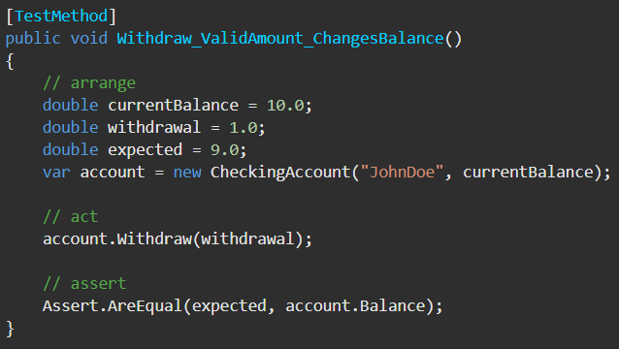
Arrange, Act, Assert https://docs.microsoft.com/en-us/visualstudio/test/unit-test-basics?view=vs-2019 https://xunit.net/#documentation
The Arrange-Act-Assert pattern is a common way of writing unit tests.
The Arrange section of a unit test method initializes objects and sets the value of the data that is passed to the method under test.
The Act section invokes the method under test with the arranged parameters.
The Assert section verifies that the action of the method under test behaves as expected.

Slide 5
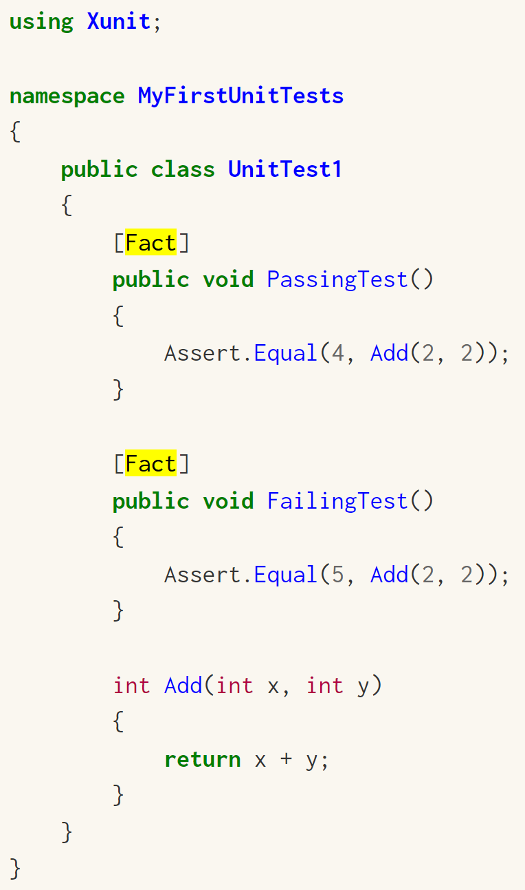
xUnit [Fact] https://xunit.net/docs/getting-started/netcore/cmdline#:~:text=tests https://xunit.net/docs/getting-started/netfx/visual-studio#write-first-tests
Facts are tests which are always true. They test invariant conditions.
A good example of a Fact-type test is when testing numeric algorithms.
EX. You want to test an algorithm which determines whether a number is odd or even. If you're writing the positive-side tests (odd numbers), then feeding even numbers into the test would cause it fail, and not because the test or algorithm is wrong.

Slide 6
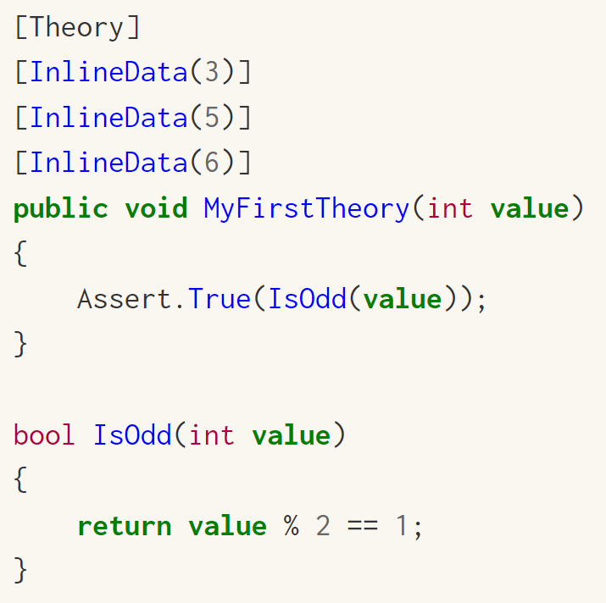
xUnit [Theory] https://xunit.net/docs/getting-started/netcore/cmdline
Theories are tests which are only true for a particular set of data.

Slide 7
Assert
Assert.Equal(<expected>,<result>)
Assert.Equal(<expected>,<result>, <roundedToHowManyDecimals>)
Assert.Equal(<expected>,<result>, true) => Set the ignoreCase property to true to be case insensitive.
Assert.Contains(<substring>, <result>); => check is some some string is present
Assert.Contains(<substring>, <result>, StringComparison.InvariantCultureIgnoreCase); => to be case insensitive
Assert.StartsWith(<substring>,<result>); => check if the result begins with some substring
Assert.EndsWith(<substring>,<result>); => check if the result ends with some substring
Assert.Matches(<regEx>, <result>); => check is the result matches a regular expression.
Assert.Null(<nullResult>); Passes if the value is true
Assert.NotNull(<result>); Passes if the value is not null
Assert.True(<trueResult>);
Assert.False(<falseResult>);

Slide 8
InlineData

Slide 9
Manually mocking Dependencies

Slide 10
Capturing output https://xunit.net/docs/capturing-output

Slide 11
Config files https://xunit.net/docs/configuration-file

Slide 12
Getting Test Results in Azure DevOps https://xunit.net/docs/getting-test-results-in-azure-devops

Slide 13
Command line https://xunit.net/docs/getting-started/netcore/cmdline

Slide 14
xUnit Testing in Visual Studio https://docs.microsoft.com/en-us/dotnet/core/testing/unit-testing-with-dotnet-test#create-a-test
Open a Solution in Visual Studio.
Right-Click the Solution.
Add >> new project
Search “xunit” in the search box and select “xUnit Test Project(.NET Core)”.
By convention, the name the test app should be the same name as the application under test, but with “-test” appended.
Ex. “Rock_paper_scissors-test”
Right-Click ‘Dependencies’ in the test project.
Click ‘Add Reference’
In the left pane of the Add References window, click ‘Projects’
In the center pane, select the project(s) containing methods you want to test.
Click ‘OK’
Add your tests to the Test project.

Slide 15
xUnit Testing using .NET CLI https://docs.microsoft.com/en-us/dotnet/core/testing/unit-testing-with-dotnet-test
Create a .sln and a directory of the same name holding that .sln to which you will add the various projects with
dotnet new sln -o [.sln name] -
2. Enter the new directory with:
cd [newDirectoryName]
Create the App project to be tested. Skip this step if you already have an app project created.
dotnet new console -o [projectName]
Add the App project to the .sln with:
dotnet sln add <relativePathToProject>.csproj
Add code to the project (i.e. methods to test).
Create the testing project with:
dotnet new xunit -o [testingProjectName].Tests
Add the testing project to the solution with
dotnet sln add ./[directoryOfTestingProject]/[NameOfTestingProject].csproj
Add the project as a dependency to the testing project with
dotnet add <relativePathToXunitProj>.csproj reference <relativePathToAppProj>.csproj
Make sure your project classes are public.
Reference the App project inside the Xunit project with
using [App project namespace];
Create tests in the testing project
Enter the testing project folder with
cd TestingProjectFolderName
From the testing project directory, run dotnet test to run the tests.

Slide 16
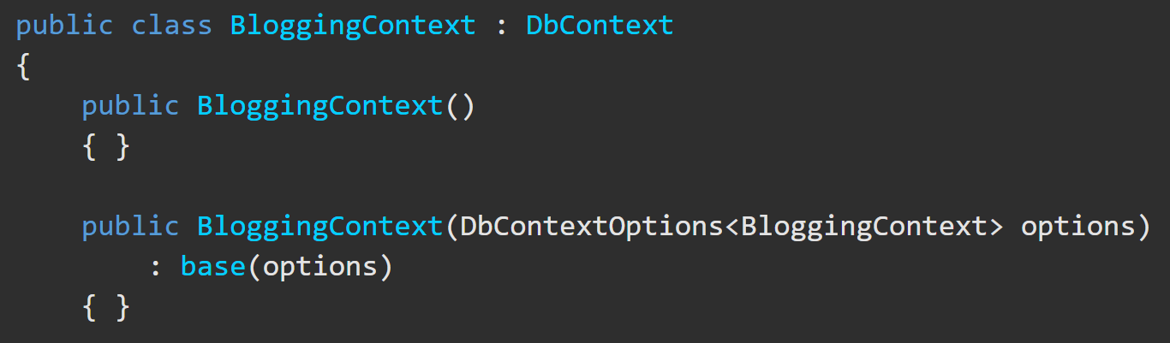
InMemory DB - Step-by-Step https://docs.microsoft.com/en-us/ef/core/miscellaneous/testing/in-memory https://www.thereformedprogrammer.net/using-in-memory-databases-for-unit-testing-ef-core-applications/
EF Core database providers do not have to be relational databases. InMemory is designed to be a general-purpose database for testing. It is not designed to mimic a relational database.
There are a few steps to setting up a InMemory DB.
1. Set up the constructor in your DB Context class to accept a DB configuration parameter called DbContextOptions.

Slide 17
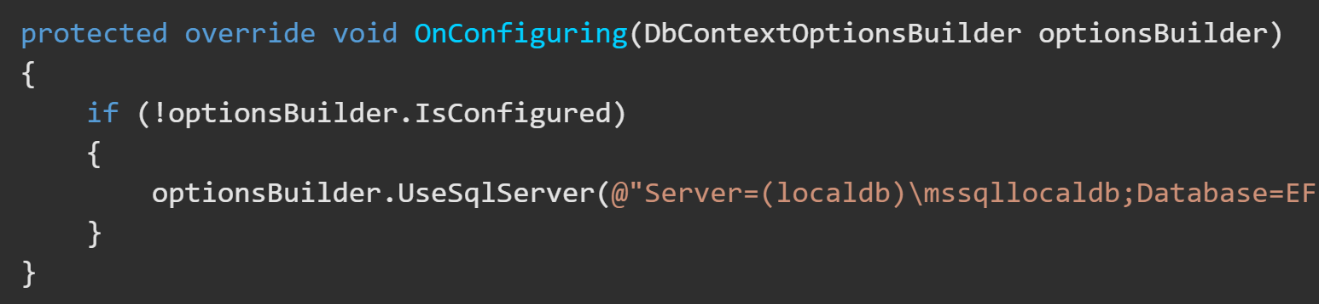
InMemory DB - Step-by-Step https://docs.microsoft.com/en-us/ef/core/miscellaneous/testing/in-memory
2. Alter your DbContext.OnConfiguring() to check for an already configured DB and to not use your production DB if there’s already a DB configured.

Slide 18
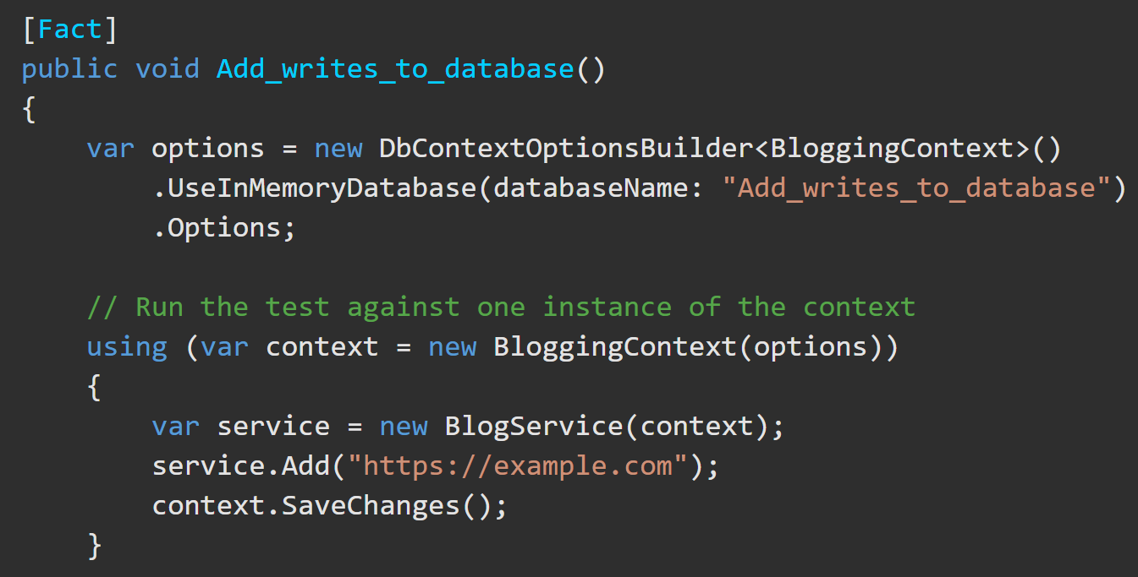
InMemory DB - Step-by-Step https://docs.microsoft.com/en-us/ef/core/miscellaneous/testing/in-memory
Right-click your test project to download the NuGet Package Microsoft.EntityFrameworkCore.InMemory.
In the test project, configure a new, clean context for every test.
Instead of creating a new Database for each test you can create the InMemory Db above all tests, then, in each test, call:
context.Database.EnsureDeleted(); // delete any Db from a previous test
context.Database.EnsureCreated(); // create anew the Db. You will need to seed the Db again.
The configurations for this InMemory DB must be sent to the Database context constructor on instantiation.

Slide 19
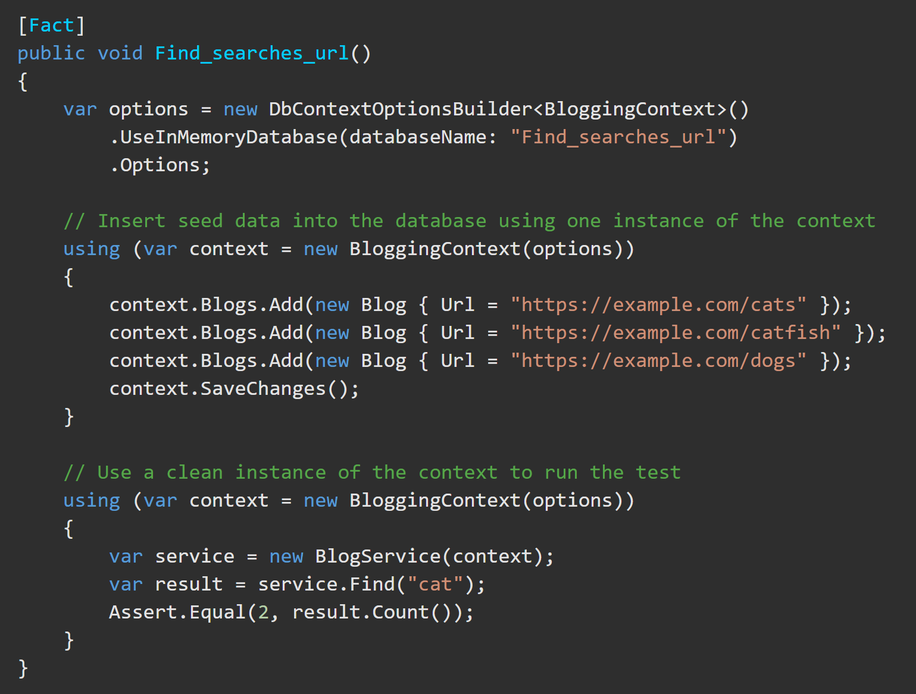
InMemory DB - Step-by-Step https://docs.microsoft.com/en-us/ef/core/miscellaneous/testing/in-memory
Here is a sample test for comparison.
Arrange
Act
Assert

Slide 20
Assert()
Assert.Equal(<expected>,<result>)
Assert.Equal(<expected>,<result>, <roundedToHowManyDecimals>)
Assert.Equal(<expected>,<result>, true) => Set the ignoreCase property to true to be case insensitive.
Assert.Contains(<substring>, <result>); => check is some some string is present
Assert.Contains(<substring>, <result>, StringComparison.InvariantCultureIgnoreCase); => to be case insensitive
Assert.StartsWith(<substring>,<result>); => check if the result begins with some substring
Assert.EndsWith(<substring>,<result>); => check if the result ends with some substring
Assert.Matches(<regEx>, <result>); => check is the result matches a regular expression.

Slide 21
Assert()
Assert.Null(<nullResult>); Passes if the value is true
Assert.NotNull(<result>); Passes if the value is not null
Assert.True(<trueResult>);
Assert.False(<falseResult>);

Slide 22
Types of tests. https://xunit.net/docs/getting-started/netfx/visual-studio#write-first-tests
[Fact], [Theory], [InlineDate()],

