Slide 1

Angular Binding, Routing, Directives
.net

Slide 2
Data-binding is a mechanism used for coordinating what the user sees with what values the Angular Component contains.
https://angular.io/guide/binding-syntax#binding-syntax-an-overview

Slide 3
Modeling – Data Binding (1/2) https://angular.io/guide/template-syntax#property-binding https://angular.io/tutorial/toh-pt3#update-the-heroescomponent-template
The double curly braces ({{ }}) are Angular's interpolation binding syntax. Interpolation binding presents the component’s (.ts file) property values inside the accompanying .html template.
Binding properties or events have a target name to the left of the = sign. The target of a binding is a property or event, which are enclosed in square brackets ([]), parentheses (()), or both [()]. The binding punctuation of [], (), and [()] specify the direction of data flow.

Slide 4
Modeling – Data Binding (2/2) https://angular.io/guide/template-syntax#property-binding https://angular.io/tutorial/toh-pt3#update-the-heroescomponent-template
Property binding with [] around the property to be bound. This is one-way.
Event binding (in ()) binds events like ‘click’ or ‘hover’ to methods in the .ts file using ().
Two-Way Binding (banana-box, [()]) binds changes on either side so of one changes the other will also change.

Slide 5
Property Binding (One-Way) https://angular.io/guide/binding-syntax#binding-types-and-targets
Binding Type | Explanation | Example
Property | The src property of this img element will be set to the image property of the component class. | <img [src]=“image">
Property | The property in the parent (in []) will be bound to the property of the child. | <app-details [parentGuy]=“childGuy"></app-details>
Attribute | Applies a value to the noted property | <button [attr.aria-label]="help">help</button>
Class | Adds a class name to the element when the right side evaluates to true. | <div [class.c1]=“c1Class">Guy</div>
Style | Adds a style to the style property of the element | <button [style.color]=“c1Class ? 'red' : 'green’”>

Slide 6
CSS Class Binding (one-way) https://angular.io/guide/template-syntax#class-binding
You can add and remove CSS class designations from an element with class binding.
To create a single class binding, start with the prefix ‘class’ followed by ‘.nameOfCssClass’ ( [class.selected]=“True or False condition”) .
Angular adds the CSS class label when the bound expression is truthy, and it removes the class label when the expression is falsy.

Slide 7
Event Binding (one-way) https://angular.io/tutorial/toh-pt2#add-a-click-event-binding https://angular.io/guide/template-syntax#event-binding
The parentheses around click tell Angular to listen for a ‘click’ event on the <li> element. When the user clicks in the <li> element, Angular executes the onSelect(hero) function (in the class) on the element.
In this example, the structural directive *ngFor will create a <li> for each hero object in the heroes collection. Each <li> will have a click event attached to that hero and submit that hero as an argument to the onSelect() function.

Slide 8
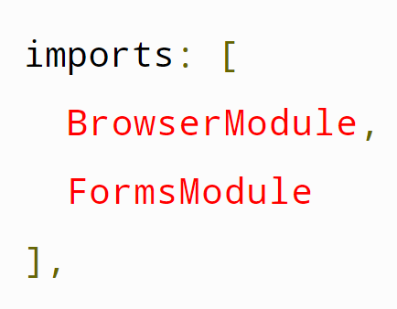
Two-Way Data Binding https://angular.io/tutorial/toh-pt1#two-way-binding
[(ngModel)] is Angular's two-way data binding syntax. It binds the class property to the HTML syntax so that data flows in both directions.
@ngModule decorators have the metadata needed for an Angular app to function. The most important @NgModule decorator is in the AppModule class.
To use forms, in app.module.ts import FormsModule, then add FormsModule to the imports array in the same file (app.module.ts ).

Slide 9
Angular LifeCycle Hooks https://angular.io/guide/lifecycle-hooks#oninit

Slide 10
Angular Directives https://angular.io/guide/built-in-directives
Directives - classes that add additional behavior to elements in your Angular applications.
Angular has three types of Directives:
Component Directive – @Component has a template..
Attribute Directive – Another way to change the appearance or behavior of DOM elements and Angular components when certain classes are present.
Structural Directive – Change the structure of your .html templates. *NgIf, *NgForOf, and *NgSwitch are examples of Structural Directives. They are called Decorators. You can also create custom Structural Directives.

Slide 11
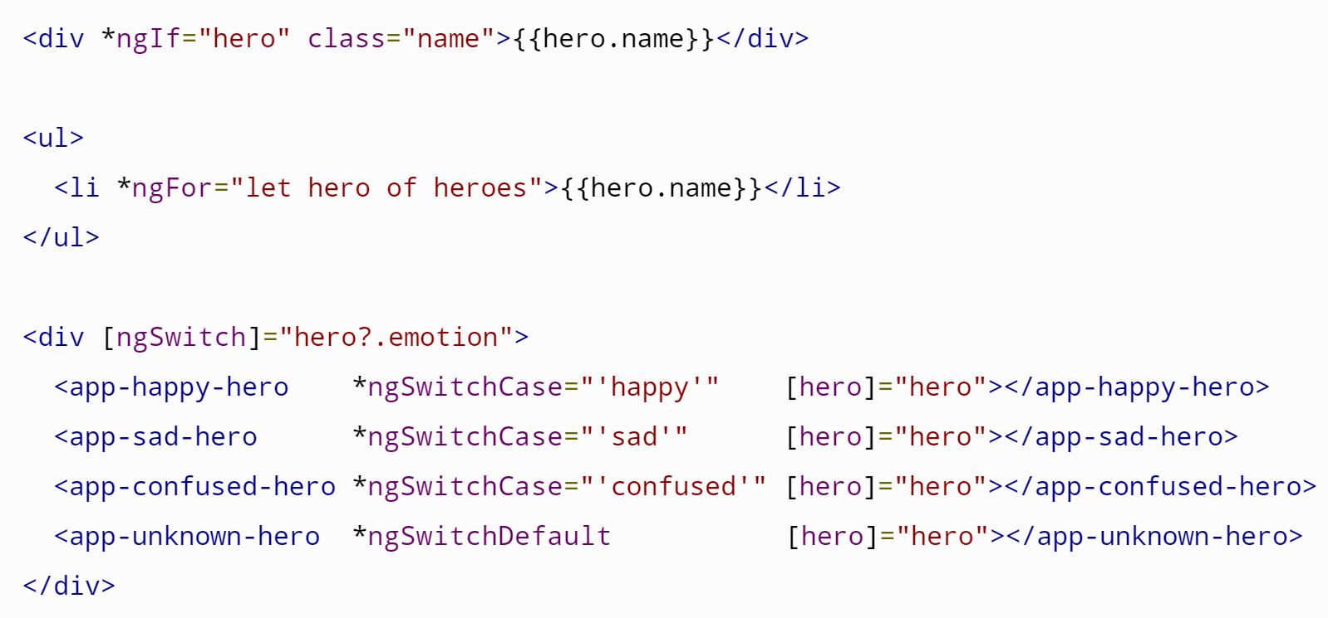
Structural Directives https://angular.io/api/common/NgIf https://angular.io/api/common/NgForOf https://angular.io/guide/template-syntax#ngSwitch https://angular.io/guide/structural-directives
Structural directives shape or reshape the DOM's structure by adding,
removing, and manipulating the elements to which they are attached. Directives with an asterisk, *, are structural directives.

Slide 12
Attribute Directives https://angular.io/guide/attribute-directives#attribute-directives
To add changes* to CSS or HTML syntax within a component other than the component where the change will actually happen:
Create a directive with:
ng generate directive highlight
Import the Directive and ElementRef modules into the new custom Directive Class with
import { Directive, ElementRef } from '@angular/core’;
Call for Injection of the target element in the constructor.
Add logic to modify the element inside the constructor.
Add the Directive name to the target element:
<p appHighlight>Highlight me!</p>
The Angular Engine handles any other connections.
import { Directive, ElementRef } from '@angular/core';
@Directive({
selector: '[appHighlight]'
})
export class HighlightDirective {
constructor(el: ElementRef) {
el.nativeElement.style.backgroundColor = 'yellow';
}
}
* You can apply Attribute directives to Events also.

Slide 13
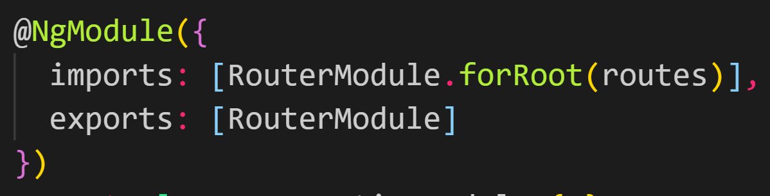
Angular Routing https://angular.io/start/start-routing https://angular.io/guide/router
Routes tell the Router which view to display when a user clicks a link.
A typical Angular Route has two properties:
path: a string that matches the URL in the browser address bar.
component: the component that the router should create when navigating to this route.
@NgModule metadata initializes the router and starts it listening for browser location changes.
The forRoot() method on the RouterModule object (globally available) supplies the service providers and directives needed for routing and performs the initial navigation based on the current browser URL

Slide 14
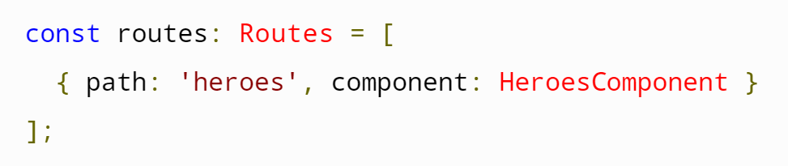
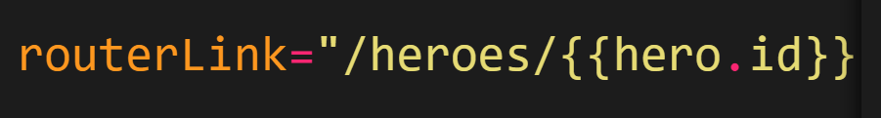
Angular Routing https://angular.io/start/start-routing https://angular.io/guide/router https://angular.io/start/start-data#services
Route - Associates a URL path(s) with a component that serves as the base of that page.
Register a new route in app.module.ts or in an app-routing.module file using a Routes type array.
Route Guard – the default, catch-all, route for random urls that don’t match other routes.
The routerLink directive in the .html template gives the router control over the html element.
Insert routerLink into an element when you want to redirect to a registered URL within the same application.

Slide 15
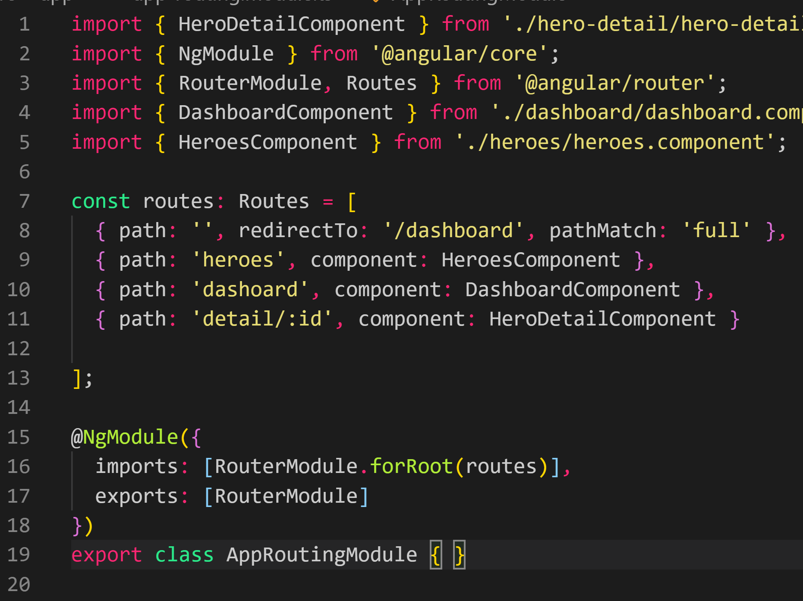
Routing Step-by-step https://angular.io/tutorial/toh-pt5#add-the-approutingmodule
Add a new module called app-routing with
ng generate module app-routing --flat --module=app
Import RouterModule and Routes into app-routing.module with:
import { RouterModule, Routes } from '@angular/router’;
When creating routes, import whichever component is the target of the routing from its relative location into app-routing.module.ts
Delete the CommonModule reference and the declarations array.
In app-routing.module.ts, configure routes with
const routes: Routes = [ { path:’link’, component: AssociatedComponent } ];
Under @NgModule({}), add imports: [ RouterModule.forRoot(routes) ],.
Under @NgModule({}), add exports: [ RouterModule ].
In app.component.html, add:
<router-outlet></router-outlet>
Add <a routerLink="/[link]">NameOfLink</a> to whatever component you want to add a link to.
Route Guard!

