Slide 1

Angular Forms with Validation
.net

Slide 2
Reactive forms provide a model-driven approach to handling form inputs whose values change over time.
https://angular.io/guide/reactive-forms

Slide 3
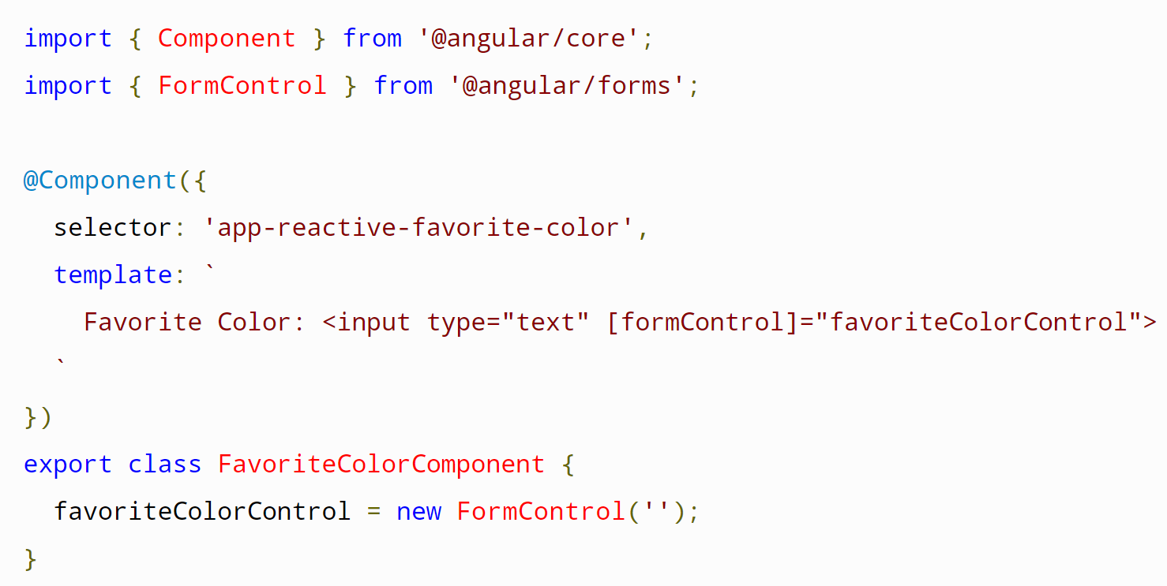
Angular Forms - Overview https://angular.io/start/start-forms#forms-in-angular https://angular.io/api/forms/FormBuilder https://angular.io/guide/forms-overview
Angular provides two different form types: reactive and template-driven. Both capture user input events from the view (template), validate the user input, create a form model and data model to update, and provide a way to track changes.
Reactive forms are more robust: they're more scalable, reusable, and testable. If forms are a key part of your application, use Reactive Forms.
Template-driven forms are useful for adding a simple form to an app but don't scale as well as Reactive Forms. If you have very basic form requirements and logic that can be managed solely in the template, use Template-Driven Forms.
Reactive and Template-Driven Forms both use a form model to track value changes between Angular forms and form input elements.
This example shows how a FormControl is defined and created.

Slide 4
Form Model Classes https://angular.io/guide/forms-overview#testing
Reactive and template-driven forms differ in how form-control instances are created and managed.
Both form types are built using these four base classes:
Class Name | Details
FormControl | Tracks the value and validation status of an individual form control.
FormGroup | Tracks the values and status for a collection of form controls.
FormArray | Tracks the value and validity state of an array of FormControl, FormGroup or FormArray instances.
ControlValueAccessor | Creates a bridge between Angular FormControl instances and native DOM elements.

Slide 5
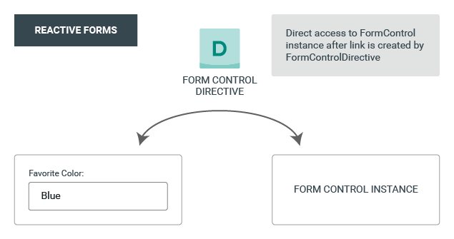
Reactive (Model-Driven) Forms https://angular.io/start/start-forms#forms-in-angular https://angular.io/api/forms/FormBuilder https://angular.io/guide/forms-overview
Reactive forms are built around observable streams, where form inputs and values are provided as streams of input values. Reactive forms provide a model-driven approach to handling form inputs whose values change over time.
There are two parts to an Angular Reactive form:
The objects in Component to store and manage the form.
The visualization of the form in the HTML template.
The ReactiveFormsModule provides the FormBuilder service.
The form model is the “source of truth” and provides the value and status of the form element at a given point in time.

Slide 6
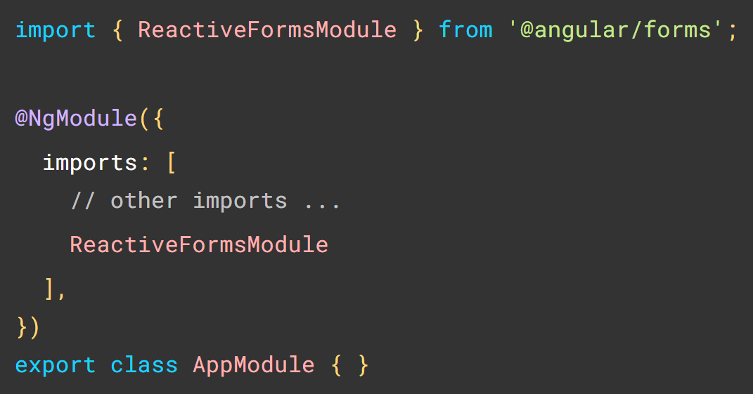
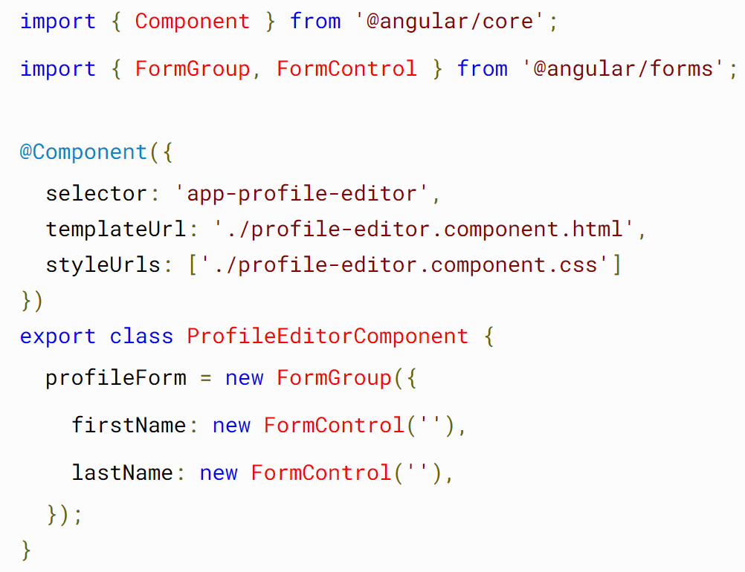
Reactive Form Setup (1/2) https://angular.io/guide/reactive-forms#adding-a-basic-form-control https://codecraft.tv/courses/angular/forms/model-driven/
Import ReactiveFormsModule to app.module.ts. Also add it to imports[] in NgModule():
import { ReactiveFormsModule } from '@angular/forms’;
Generate the new component that will have the form:
ng generate component [ComponentName].
Import FormControl and FormGroup into the new component:
import { FormControl, FormGroup } from '@angular/forms’;.
Create an instance of FormGroup in your component class to represent the form itself.
Create FormControl properties matching the <input> elements of the form in the .html template.

Slide 7
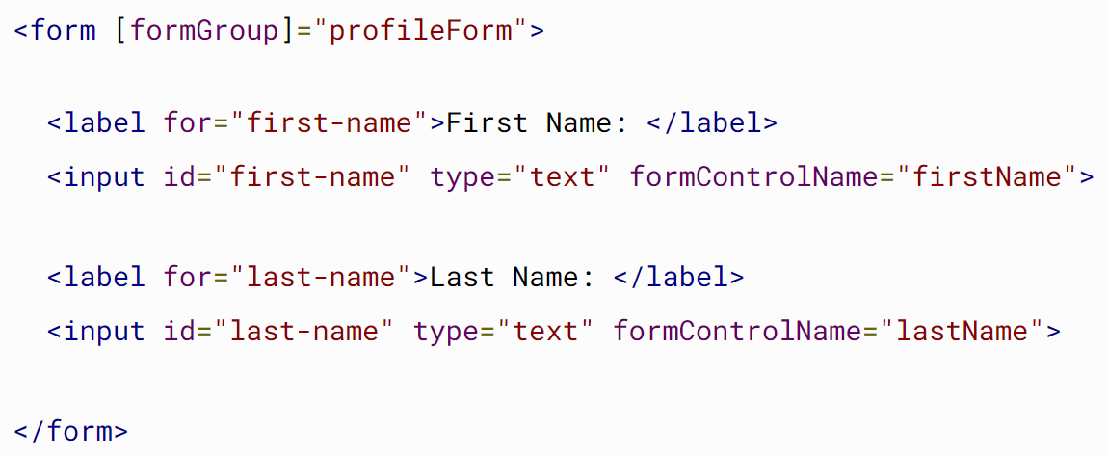
Reactive Form Setup (2/2) https://angular.io/guide/reactive-forms#adding-a-basic-form-control https://codecraft.tv/courses/angular/forms/model-driven/
In the HTML template, add the FormControl to the <form> with:
[formGroup] =“<formGroupName>”
Add the formControlName to each <input> of the form with:
[formControlName]=“<inputName>“
Add an action to complete when the form is submitted.
Add the submit button to the bottom of the form.
Add form validation as needed.
Now, whatever input you place in the input field will be transferred to the FormGroup’s FormControls on the component.

Slide 8
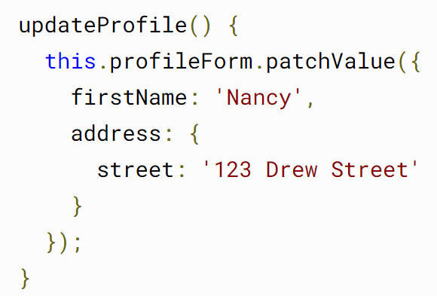
Reactive Forms – Changing Values https://angular.io/guide/reactive-forms#replacing-a-form-control-value
There are two ways to update the model value:
Use the setValue() method to set a new value for an individual control. The setValue() method strictly adheres to the structure of the form group and replaces the entire value for the control.
Use the patchValue() method to replace any properties defined in the object that have changed in the form model.
..

Slide 9
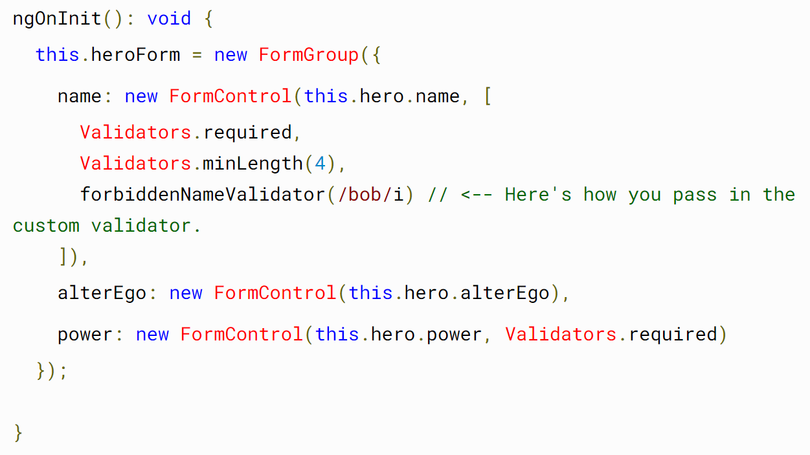
Reactive Form Validation https://angular.io/guide/forms-overview#form-validation https://angular.io/guide/reactive-forms#validating-form-input https://angular.io/guide/form-validation#validating-input-in-reactive-forms
Form validation is used to ensure that user input is complete and correct. Reactive Forms include a set of validator functions for common use cases. These functions receive a control to validate against and return an error object or a null value based on the validation check.
In a reactive form, you add validator functions directly to the form control model in the component class. Angular then calls these functions whenever the value of the control changes.
When giving user inputted values to FormControl properties, use the .setValue() function to set them. This function will validate the value against your preset FormControl validations.

Slide 10
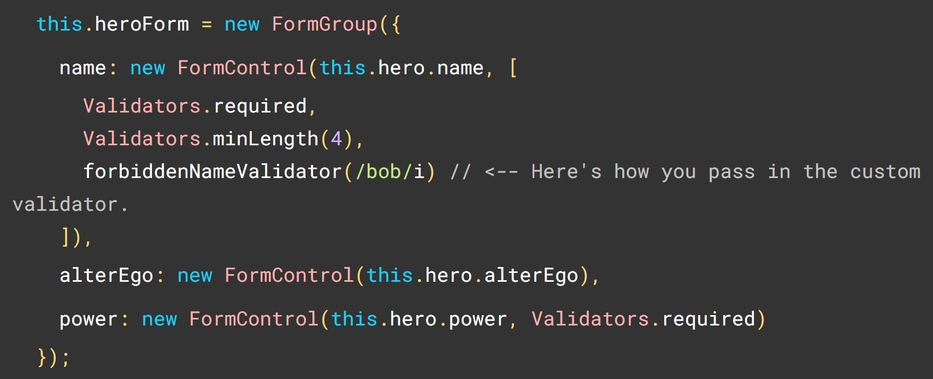
Reactive Form Validation https://angular.io/guide/forms-overview#form-validation https://angular.io/guide/form-validation https://angular.io/guide/reactive-forms#validating-form-input
Validator functions can be either synchronous or asynchronous.
Sync validators: Synchronous functions that take a control instance and immediately return either a set of validation errors or null. Pass these in as the second argument when you instantiate a FormControl.
Async validators: Asynchronous functions that take a control instance and return an Observable that later emits a set of validation errors or null. You can pass these in as the third argument when you instantiate a FormControl.
Angular only runs async validators if all sync validators pass.

Slide 11
Reactive Form Validation https://angular.io/api/forms/Validators https://angular.io/guide/reactive-forms#validating-form-input
Validator | Description
Min(min:number) | requires the control's value to be greater than or equal to the provided number. [Validators.min(3)]
Max(max:number) | requires the control's value to be less than or equal to the provided number. [Validators.max(15)]
Required() | requires the control have a non-empty value. [Validators.required]
requiredTrue() | requires the control's value be true. This validator is commonly used for required checkboxes. [Validators.requiredTrue]
Email() | Requires the control's value pass an email validation test. Tests the value using a regular expression pattern for common use cases. Use Validators.pattern() to validate the value against a different pattern. [Validators.email]

Slide 12
Reactive Form Validation https://angular.io/api/forms/Validators https://angular.io/guide/reactive-forms#validating-form-input
Validator | Description
minLength() | Requires the length of the control's value to be greater than or equal to the provided minimum length. Use only for types with a numeric length property. [Validators.Minlength(3)]
maxLength() | Requires the length of the control's value to be less than or equal to the provided maximum length. Use only for types with a numeric length property. [Validators.Maxlength(15)]
Pattern() | Requires the control's value to match a regex pattern. [Validators.Pattern('[a-za-z ]*’)]

Slide 13
Reactive Form Validation https://angular.io/guide/form-validation#control-status-css-classes https://docs.angularjs.org/api/ng/directive/ngModel
Angular maintains the state of control properties in the form control element as CSS classes. Use these classes to style form control elements according to the state of the form.
State syntax | Meaning
.ng-valid | The value in the field is within range.
.ng-invalid | The value in the field is not within range.
.ng-pending | $asyncValidator(s) are unfulfilled
.ng-pristine | The form has not yet been modified by the user.
.ng-dirty | If the user changes the value in the field.
.ng-untouched | The field before any user interaction
.ng-touched | When the user blurs the form control element.
.ng-submitted | Only valid for the form. The form has been submitted.

Slide 14
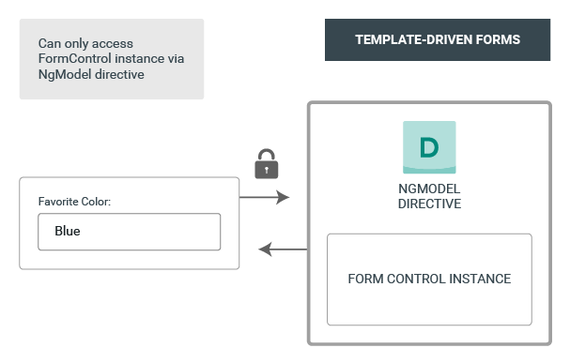
Template Driven Forms https://angular.io/start/start-forms#forms-in-angular https://angular.io/api/forms/FormBuilder https://angular.io/guide/forms-overview
Angular makes the form creation process easy by handling many of the repetitive, boilerplate tasks you'd otherwise code yourself.
You can build almost any form with an Angular template.
You can lay out the controls, bind them to data, specify validation rules, and display validation errors.

Slide 15
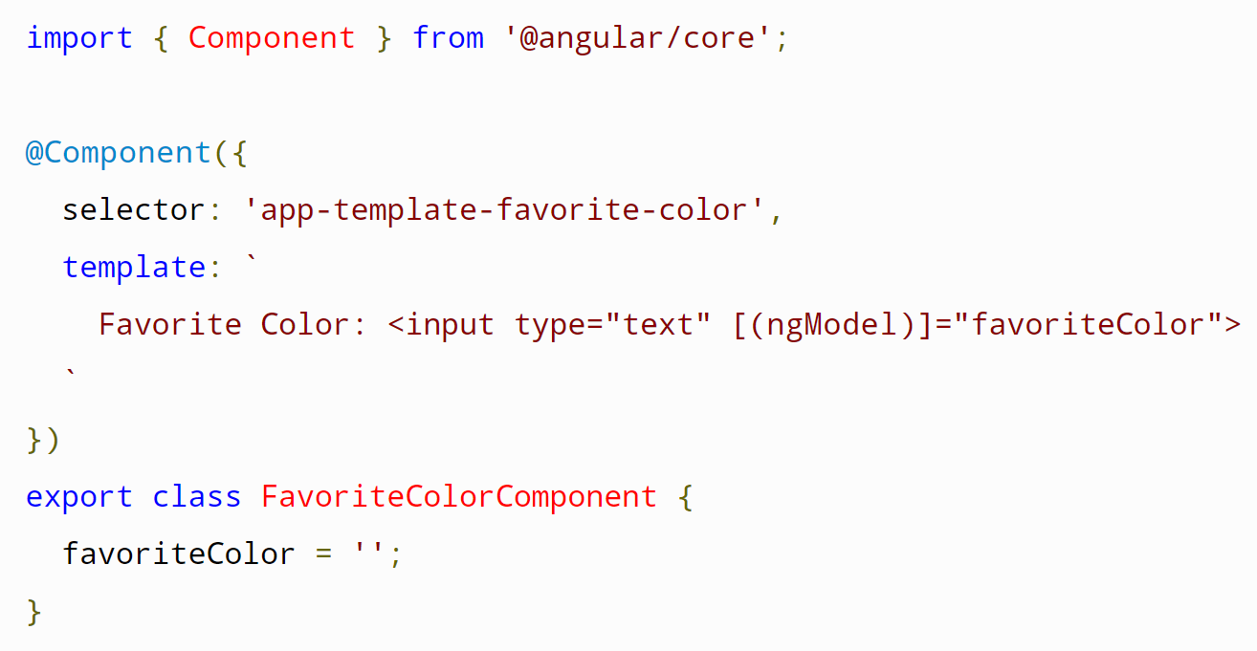
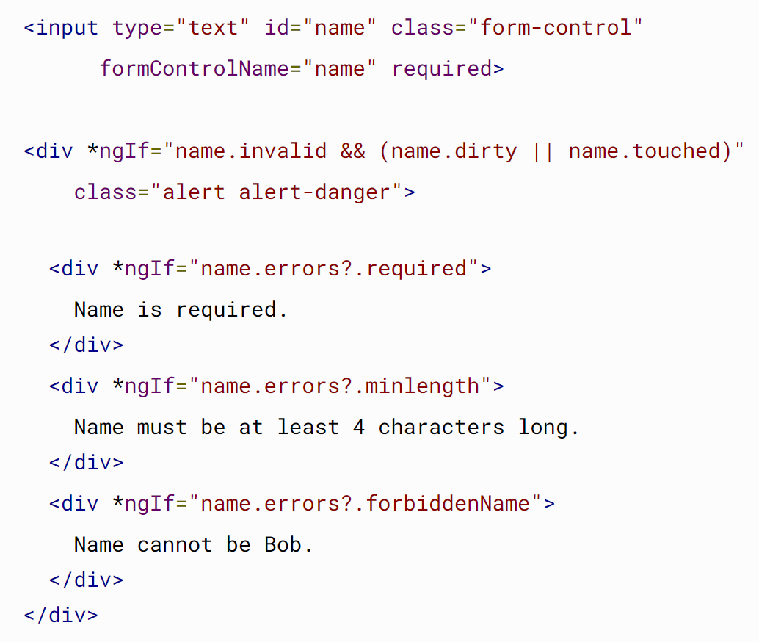
Template Driven Forms https://angular.io/start/start-forms#forms-in-angular https://angular.io/api/forms/FormBuilder https://angular.io/guide/forms-overview
Place a getter in the .ts class to use the ‘name’ variable

Slide 16
Template-Driven Forms Validation https://angular.io/guide/form-validation#validating-input-in-template-driven-forms
#name=“ngModel” exports the html element status to the local class scope where the <div> elements below can use Structural Directives to change their display status.
To prevent the validator from displaying errors before the user has a chance to edit the form, you should first check for either the dirty or touched states in a control.
<input type="text" id="name" name="name" class="form-control"
required minlength="4" appForbiddenName="bob"
[(ngModel)]="hero.name" #name="ngModel">
<div *ngIf="name.invalid && (name.dirty || name.touched)"
class="alert">
<div *ngIf="name.errors?.required">
Name is required.
</div>
<div *ngIf="name.errors?.minlength">
Name must be at least 4 characters long.
</div>
<div *ngIf="name.errors?.forbiddenName">
Name cannot be Bob.
</div>
</div>

Slide 17
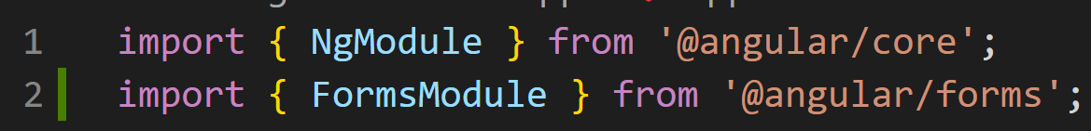

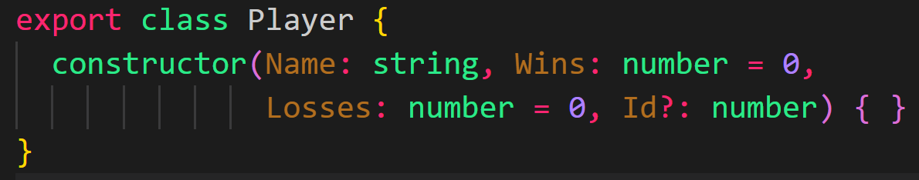



Template Driven Forms Setup (1/2) https://angular.io/guide/forms#introduction-to-template-driven-forms
In app.module.ts, import NgModule and FormsModule.
import { NgModule } from '@angular/core’;
Add FormsModule to the imports array.
Create a new class with the properties that the form will populate:
ng generate class <className>.
Create a new component with:
ng generate component <componentName>
import the Class (step 2) into the component.
Create an instance of the class in the component.

Slide 18

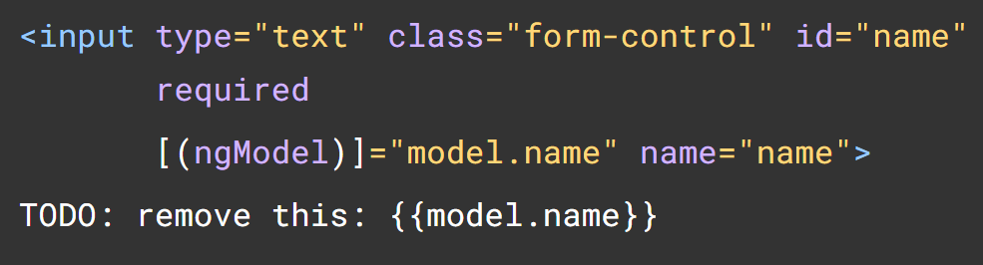
Template Driven Forms Setup (2/2) https://angular.io/guide/forms#introduction-to-template-driven-forms
Add @ngModel to the forms <input> elements that correspond to the fields in the Class instantiation (step 4) with:
[(ngModel)]=“<modelName.fieldName>”
(optional) add the component selector to a parent view template (.html)
(optional) Add a “check value” below your input element text box to see what you are entering live.

Slide 19
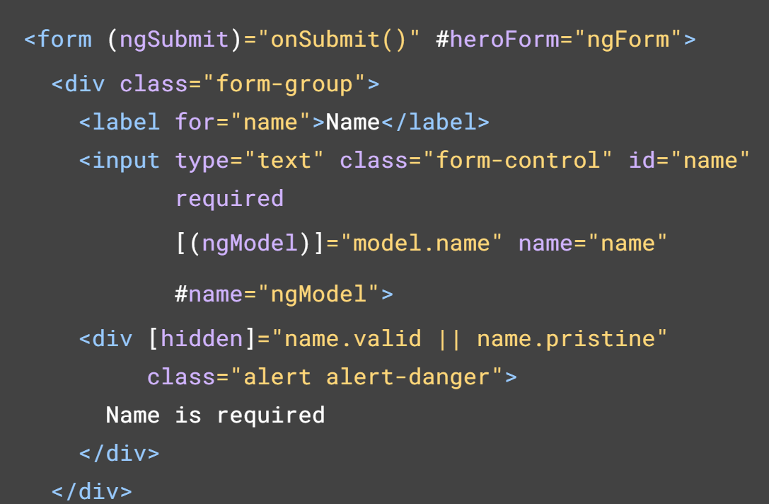
Template Reference Variables https://angular.io/guide/template-reference-variables
A Template Reference variable is the #varName in an element in the .html file.
Template variables help you use data from one element of a template in another part of the same template. Template Variables allow the code to be more responsive to the the actions of the user and the state of the elements of the template.
<input #phone placeholder="phone number"/>
<!-- phone refers to the input element; pass
its `value` to an event handler -->
<button (click)="callPhone(phone.value)">
Call your muhthah! She misses you!
</button>

Slide 20
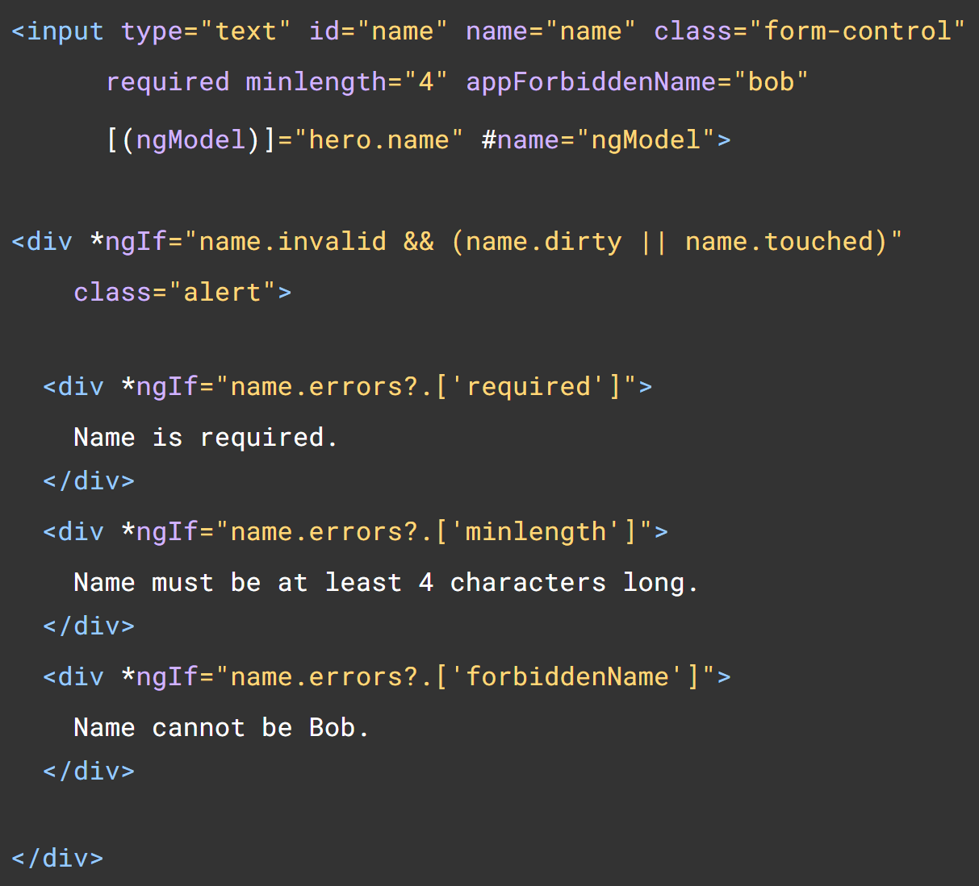
Check the state of a template element https://angular.io/api/forms/NgControlStatus https://angular.io/guide/form-validation https://angular.io/api/forms/FormControlStatus
NgControlStatus is a directive automatically applied to Angular form controls that sets CSS classes based on control status. You must check the Boolean value of the property and apply classes for styling or display.
ng-valid – Are the intput values valid?
ng-invalid - Do errors exist in the input value?
ng-pending – Is an async validation occurring and errors are not yet available for the input value?
ng-pristine – Are the elements contents unchanged?
ng-dirty – Have the elements contents been changed?
ng-untouched – Is the element unvisited (not clicked on yet)?
ng-touched – Has the element been clicked on?

