Slide 1

Angular Fundamentals
.NEt

Slide 2
Angular is an application design framework and development platform for creating efficient and sophisticated single-page applications.
https://angular.io/docs

Slide 3
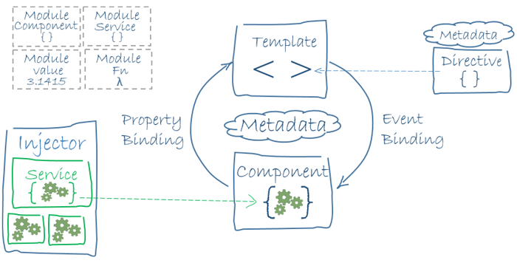
What is Angular https://hackr.io/blog/angular-interview-questions https://angular.io/guide/aot-compiler https://www.geeksforgeeks.org/what-is-spa-single-page-application-in-angularjs/
AngularJS is a JavaScript-based front-end web framework that bases data transfer on bi-directional UI data binding. Angular is used to design Single Page Applications and leverages Ahead-of-Time Compiling to render webpages more quickly.

Slide 4
Angular main features https://hackr.io/blog/angular-interview-questions https://angular.io/guide/aot-compiler https://www.geeksforgeeks.org/what-is-spa-single-page-application-in-angularjs/
PWA – this is to be added.
Single-Page Application – Single Page Applications are web applications that load a single HTML page and only a part of the page instead of the entire page gets updated with every click of the mouse. The page does not reload or transfer control to another page during the process. This ensures high performance and faster load times.
Ahead-of-Time Compiling – Angular component templates cannot be directly rendered by the browser. Therefore, Angular applications require a compilation process before they can run in a browser. The Angular ahead-of-time (AOT) compiler converts Angular HTML and TypeScript code into JavaScript during the build phase before the browser downloads and runs that code. This provides a faster rendering in the browser.

Slide 5
TS/Angular Workspace SetUp (1/2) https://angular.io/guide/setup-local https://code.visualstudio.com/docs/typescript/typescript-compiling https://angular.io/tutorial/toh-pt0#create-a-new-workspace-and-an-initial-application
Following the steps from here to create your first Angular App.
Make sure you have Node.js with node –v in Command Line. If not, go to nodejs.org to get it.
If needed, install Angular CLI globally with:
npm install -g @angular/cli
Create a WorkSpace (accept all the default settings) for your app and install the default starter app with:
ng new <my-app-name>
App name must start with a letter and only contain numbers, letters, and dashes.
Install the Angular npm packages needed with:
ng new

Slide 6
TS/Angular Workspace SetUp (2/2) https://angular.io/guide/setup-local https://code.visualstudio.com/docs/typescript/typescript-compiling https://angular.io/tutorial/toh-pt0#create-a-new-workspace-and-an-initial-application
Navigate in the CLI to your app folder with:
cd <my-app-name>
Launch the server and open the browser with the default sample project with:
ng serve --open (2 dashes)
In VS Code, you can install the Angular Extension Pack to get additional useful tools.
VS Code extensions recommendations: C#, C# Extensions, Bracket Pair Colorizer 2, Nuget Gallery, Material Icon Theme,
Use this Angular Cheat Sheet for quick reference!

Slide 7
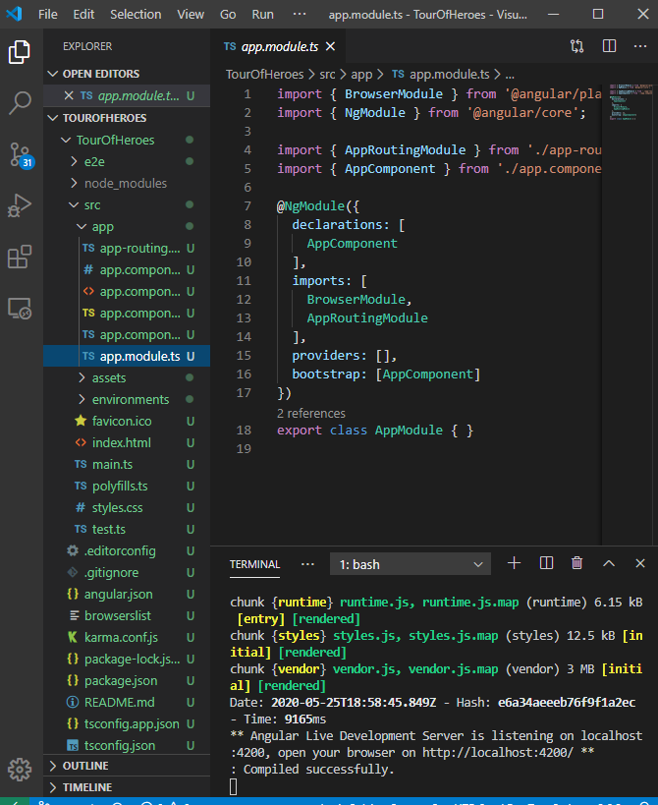
Angular WorkSpace https://angular.io/tutorial/toh-pt0#set-up-your-environment
A workspace contains all the files for one or more projects. A project is the set of files that comprise an app, a library, unit tests, integrations tests, or end-to-end (e2e) tests.

Slide 8
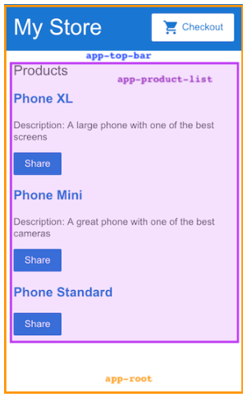
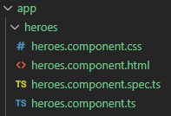
Angular Component https://angular.io/tutorial/toh-pt0#set-up-your-environment https://angular.io/guide/component-interaction
Components are the fundamental building blocks of Angular applications. They display data on the screen, listen for user input, and act based on that input.
Create a new component with:
ng generate component [component name]
An Angular application comprises a tree of components. Each Angular component has a specific purpose and responsibility. In the example to the right, there are 3 components displayed:
app-root (orange box) is the application shell. This is the first component to load and the parent of all other components. You can think of it as the base page.
app-top-bar (blue banner) is the store name and checkout button.
app-product-list (purple box) is the product list.

Slide 9
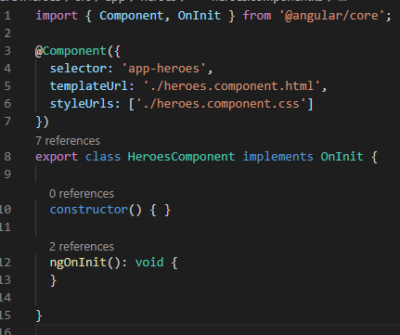
Angular Component https://angular.io/tutorial/toh-pt1#create-the-heroes-component
The command ng generate component <name> creates a new component. The CLI creates a new folder for each component and generates a .css, .ts, and .html, .spec.ts inside it.
Always import { Component, OnInit } from @angular/core;
Annotate the component class with @Component(). @Component is a decorator function that specifies the Angular metadata for the component:
The selector name to use for CSS and if importing this component into a .html page.
The relative .html location.
The relative .css location.
Use export to make the class available for import by other components.
ngOnInit() is a lifecycle hook. It’s the best place for @Component initialization logic, such as getting current data from a Service or initializing variables.

Slide 10
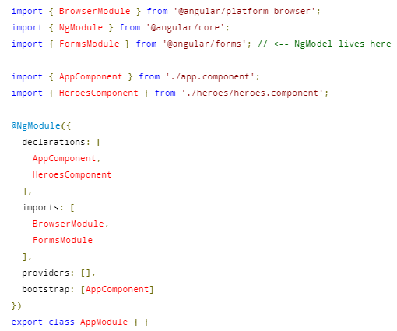
Connect a new Component https://angular.io/tutorial/toh-pt1#show-the-heroescomponent-view
Every component must be declared in the app.module.ts @NgModule to function.
Angular CLI automatically imports new components into app.module.ts and declares them under the @NgModule.declarations array.

Slide 11

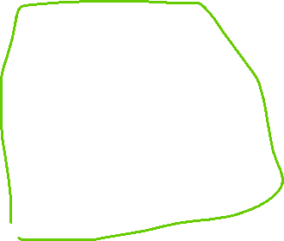

Angular Components Structure Diagram
Ex. This App Root Component has 3 buttons. Each button links to a different route. That route exposes a component that can have nested components.
‘/rectangle’ Component
When you enter data, you can pass it to the child
‘/triangle’
Component
‘/circle’ Component
*ngif= “myCircle”
Display a Circle Component
Display a Triangle Component
*ngif=“myTriangle”
Display a Rectange Component
*ngif=“myTriangle1”
Display a Rectange Component

Slide 12
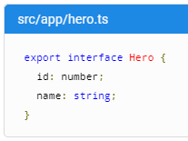

Angular TypeScript Interface https://angular.io/tutorial/toh-pt1#create-a-hero-interface
Interfaces are useful for when you want to define a class or object (with its types), then import it into components where needed.
Create an interface with:
ng generate interface [ComponentName].
Then import that interface into the Component in which you want to use it from the relative file location.

Slide 13
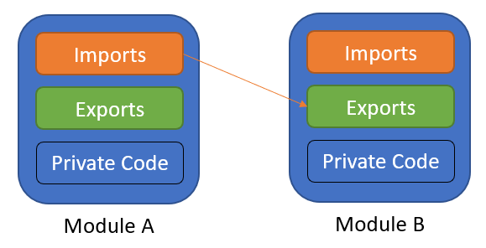
TypeScript Module Concept https://www.typescriptlang.org/docs/handbook/modules.html
TS shares the JS concept of Modules. Modules in TS have their own scope. A module must be explicitly exported to make its members and fields visible.
To consume a property exported from a different module, it must be imported using an import method.
The relationships between modules are specified in terms of imports and exports at the file level.
In TS, any file containing a top-level import or export is considered a module.
A file without any top-level import or export declarations is treated as a script whose contents are available in the global scope (and therefore in modules as well).

Slide 14

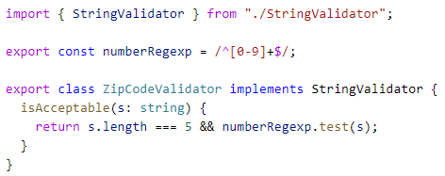
TypeScript - Exporting a Declaration https://www.typescriptlang.org/docs/handbook/modules.html#export
Any declaration (variable, function, class, type alias, interface) can be exported.
Use the export keyword to make a class, function, or variable available to other modules from within the module (component).
Import the class, function, or variable into the module (component) where you want to implement it.

Slide 15
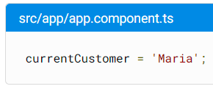
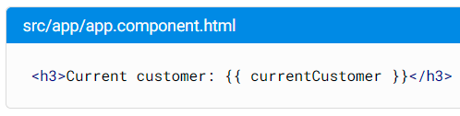

Angular Interpolation https://angular.io/guide/interpolation
Text interpolation allows you to incorporate dynamic string values into your HTML templates.
Interpolation refers to embedding template expressions into HTML markup. This allows the components .ts file to contain information that the components .html file will display dynamically.
By default, interpolation uses the double curly braces {{ and }} as delimiters.

Slide 16
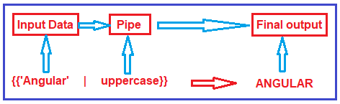
Angular Pipes (1/2) https://angular.io/guide/pipes
Use Angular pipes in the template .html file of a component to transform how strings, currency amounts, dates, and other data display in a browser.
Pipes are simple functions you can use in template expressions to accept an input value and return a transformed value.
Angular provides built-in pipes for typical data transformations

Slide 17
Angular Pipes (2/2) https://angular.io/guide/pipes https://angular.io/api/common#pipes
Command | Name | Useage
…| date }} | Datepipe | Formats a date based on locale. Ex. {{ dateObj | date:'mm:ss' }}
…| uppercase }} | UpperCasePipe | Transforms text to all upper case. Ex. {{ value | uppercase }}
…| lowercase }} | LowerCasePipe | Transforms text to all lower case. Ex. {{ value | lowercase }}
…| currency }} | CurrencyPipe | Transforms a number to a currency string based on locale. Ex. {{ b | currency:'CAD':'symbol':’4.2-2’ }}
…| number }} | DecimalPipe | Transforms a number into a string with a decimal point based on locale. Ex. {{ pi | number:’4.1-3’ }}
…| percent }} | PercentPipe | Transforms a number to a percentage string based on locale. Ex. {{ b | percent:’4.3-5’ }}
…| titlecase }} | TitlecasePipe | Capitalizes the first letter of each word and transforms the rest of the word to lower case. Ex. {{ ‘a string’ | titlecase }}

Slide 18
How to stop a running Angular Process https://anthonygiretti.com/2018/03/26/how-to-avoid-port-4200-is-already-in-use-error-with-angular-cli/
In Command Line, use netstat -ano | findstr :yourPortNumber. (Usually it’s 4200 with Angular.) to get your process number (PID). It’s on the right or ‘Listening’
In Command Line, use tskill <yourPID#>.
In Command Line, use ng serve –open to recompile and reopen your app.

Slide 19
Deployment https://angular.io/start/start-deployment
trigger:
branches:
include:
- main
#the below is required only if you have multiple .sln files in your repo.
paths:
include:
- AngularDemo/memesaver
pool:
vmImage: 'windows-latest'
variables:
solution: 'AngularDemo/memesaver'
buildPlatform: 'Any CPU'
buildConfiguration: 'Release'
steps:
- task: SonarCloudPrepare@1
displayName: sonarcloud prepare
inputs:
SonarCloud: 'sonarclourangular'
organization: '03012021batch'
scannerMode: 'CLI'
configMode: 'manual'
cliProjectKey: '03012021Batch_memesaverangular'
cliProjectName: 'memesaverangular'
cliSources: '$(solution)/src'
extraProperties: 'sonar.javascript.lcov.reportPaths=$(solution)/coverage/memesaver/lcov.info'
- task: NodeTool@0
inputs:
versionSpec: '10.x'
displayName: 'Install Node.js'
- task: Npm@1
displayName: 'NPM Install'
inputs:
command: 'install'
workingDir: $(solution)
- task: Npm@1
displayName: 'NPM Build Angular'
inputs:
command: 'custom'
workingDir: $(solution)
customCommand: 'run build-prod'
- task: Npm@1
displayName: 'NPM Test'
inputs:
command: 'custom'
workingDir: $(solution)
customCommand: 'run test-headless'
- task: SonarCloudAnalyze@1
displayName: 'SonarCloud Analyze'
- task: SonarCloudPublish@1
displayName: 'SonarCloud Publish'
inputs:
pollingTimeoutSec: '300'
karma.config changes still needed.

Slide 20
Complete Deployment example without docker
https://github.com/12142020-dotnet-uta/P2_RepeatCommitters/blob/main/azure-pipelines-1.yml

Slide 21

Assignment – Rock, Paper, Scissors in Angular https://www.codementor.io/@brijmcq/creating-a-rock-paper-scissors-game-in-angular-fmmrknce8

