Slide 1

HttpClient and Observables
.net

Slide 2
Angular provides a client HTTP API for Angular applications. The HttpClient service class provides HTTP communication functionality for Angular Programs.
https://angular.io/tutorial/toh-pt4#why-services

Slide 3
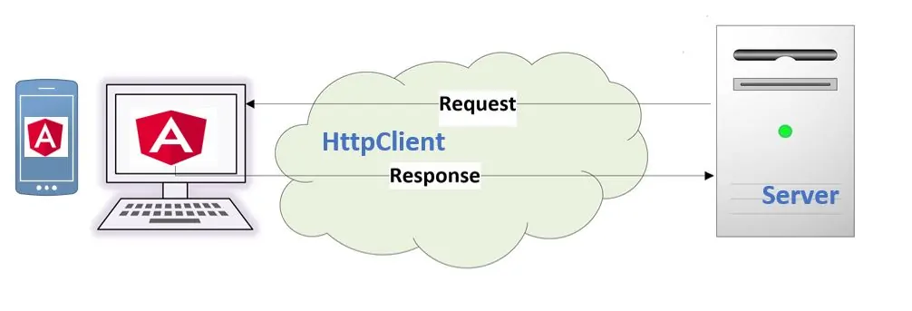
HttpClient - Overview https://angular.io/guide/http https://angular.io/start/start-data
Most front-end applications need to communicate with a server over HTTP in order to download or upload data and access other back-end services. Angular provides a client HTTP API for Angular applications, the HttpClient service class in @angular/common/http.
The HTTP client service offers the following major features.
The ability to request typed response objects.
Streamlined error handling.
Testability features.
Request and response interception.

Slide 4
HttpClient – Set-up https://angular.io/guide/http#communicating-with-backend-services-using-http
In app.module.ts, import HttpClientModule.
import { HttpClientModule } from '@angular/common/http’;
Add HttpClientModule to the imports array of app.module.ts.
Import and inject HttpClient as a dependency of a service class that will be making Http requests.
import { HttpClient } from '@angular/common/http’;
constructor(private http: HttpClient) { }
Import the following into the service class.
import { Observable, throwError } from 'rxjs';
import { catchError, retry } from 'rxjs/operators’;

Slide 5
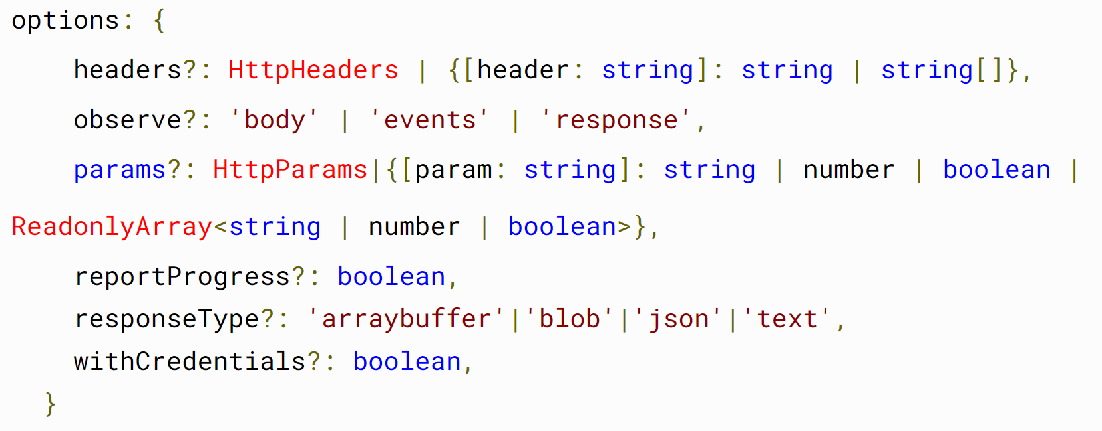
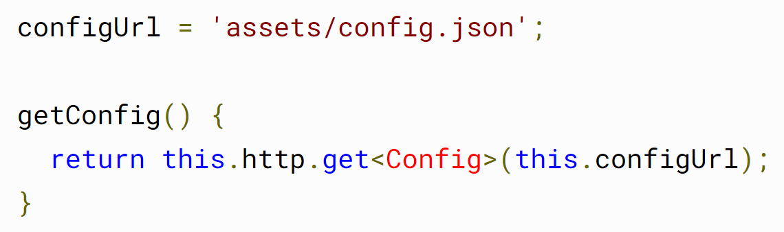
HttpClient.get<> https://angular.io/guide/http#requesting-data-from-a-server
HttpClient.get<>() is asynchronous. It sends an HTTP GET request and returns an Observable that emits the requested data when the response is received. The return type varies based on the observe and responseType values passed to the call.
HttpClient.get<>() takes two arguments; the endpoint URL from which to fetch and an options object that you can use to configure the request.

Slide 6
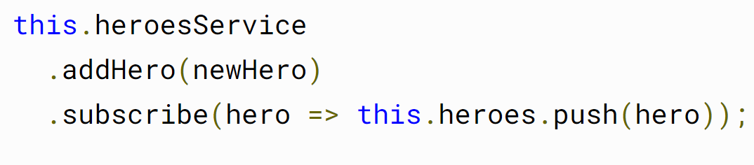
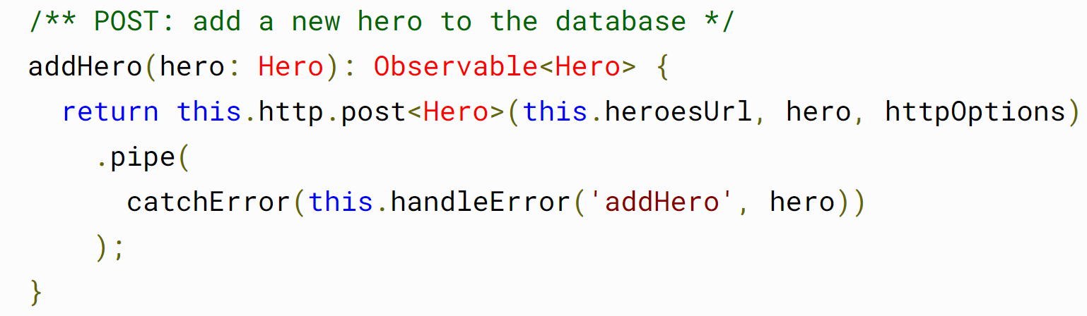
HttpClient.post<> https://angular.io/guide/http#making-a-post-request
The HttpClient.post<>() method is similar to get<>() in that it has a type parameter which you use to specify the data type you expect the server to return. The method takes 3 parameters.
a resource URL
body - The data to POST in the body of the request.
options - An object containing method options which specify required headers, etc.

Slide 7
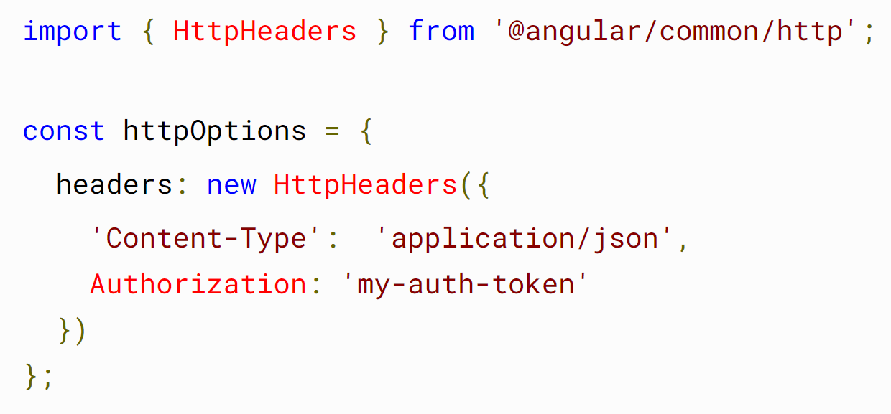
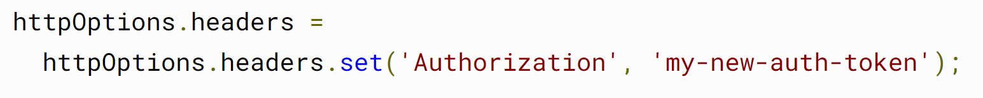
HttpClient - Headers https://angular.io/guide/http#adding-headers
Many servers require extra headers for operations that save or add data. For example, a server might require an authorization token or "Content-Type" header to explicitly declare the MIME type of the request body.
Instances of the HttpHeaders class are immutable. Use the .set() method to change existing headers.

Slide 8
Obsevable vs Promise (and others) https://rxjs-dev.firebaseapp.com/guide/observable https://angular.io/guide/comparing-observables#observables-compared-to-other-techniques

Slide 9
Angular is case sensitive.
Make sure your class property names match exactly what is being returned form the API!
You can also use the (I think, [jsonName]?) attribute in ASP.NET to convert from json to the C# class name.

