Slide 1

Angular Services and Dependency Injection
.net

Slide 2
Services are a great way to share information among classes that don't know each other and to make requests to an API. Components should never fetch or save data directly.
https://angular.io/tutorial/toh-pt4#why-services

Slide 3
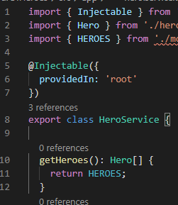
Dependency Injection – Services and Injectables https://angular.io/guide/glossary#dependency-injection-di https://angular.io/guide/dependency-injection
Components should always delegate data access to a Service. A Service can get data from an API web service, local storage, a mock data source, and more.
Services are integral to Angular. A service is an instance of a class that you can make available to any part of your application using Angular’s Dependency Injection system.
A Service is your portal to persist data and have methods to access that data.
The @Injectable() decorator accepts a metadata object for the service, the same way the @Component() decorator does for component classes.

Slide 4
Dependency Injection – Services and Injectables https://angular.io/tutorial/toh-pt4#provide-the-heroservice https://angular.io/guide/dependency-injection https://angular.io/guide/architecture-services
Services must be registered with Angular’s Dependency Injection system before they can be injected into a Component.
By default, the Angular CLI command ng generate service registers a provider with the root injector for your Service by including provider metadata that’s providedIn: 'root' in the @Injectable() decorator of the Service Component.
When a Service is provided at the root level, Angular creates a single, shared instance of the Service and injects it into any class that asks for it.
Angular will also remove any unused Services.

Slide 5

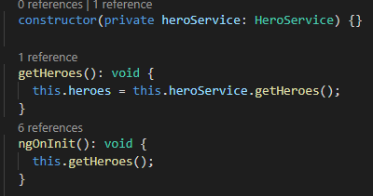
Angular – Use DI to Get a Service https://angular.io/tutorial/toh-pt4
Create a service:
Create a Service:
ng generate service <ServiceName>.
Import the Injectable symbol into the Service Component To allow the Service to be injected into Components:
import { Injectable } from '@angular/core’;
Import the Service into the Component where it will be used:
import { ServiceName } from ‘../relative/location’;.
Inject the Service into the constructor of the Component where it will be used:
constructor(private ServiceVariableName: ServiceName) {}.
Use ngOnInit() to access and retrieve data from a service on instantiation of the Component instead of using the constructor.

