Slide 1

Testing in Angular
.NET

Slide 2
Testing an application offers the benefits of improved application design, preemptive refactoring, and helps prevent breaking legacy code when adding new features
https://medium.com/swlh/angular-unit-testing-jasmine-karma-step-by-step-e3376d110ab4

Slide 3



Testing in Angular – Overview https://angular.io/guide/testing https://jasmine.github.io/pages/docs_home.html
When you run ng new, the Angular CLI downloads, installs, and configures everything needed to test an Angular application with the Jasmine test framework and Karma test runner. The default project is ready to test and have test suites built.
The ng test command builds the app in “watch mode” and launches the Karma test runner.
Jasmine and Karma work together to run and output tests and results to both:
the command line
a browser window.
ng test also watches for any code changes and re-runs the tests every time there are new saved changes to the code base.

Slide 4
Jasmine Testing Framework https://jasmine.github.io/ https://jasmine.github.io/setup/nodejs.html
Jasmine is a development framework for testing JavaScript code. It does not depend on any other JavaScript frameworks. It does not require a DOM and it has a simple syntax for easily written tests.
Jasmine is installed along with the default Angular Application created with ng new.
You can also add it locally to your project as a Node.js package.
There is also a global install.
If needed, install Jasmine locally.
npm install --save-dev jasmine
Initialize a Jasmine project with default configuration.
npx jasmine init
Generate Jasmine folders and spec (test) files.
jasmine examples
Run tests.
npx jasmine

Slide 5
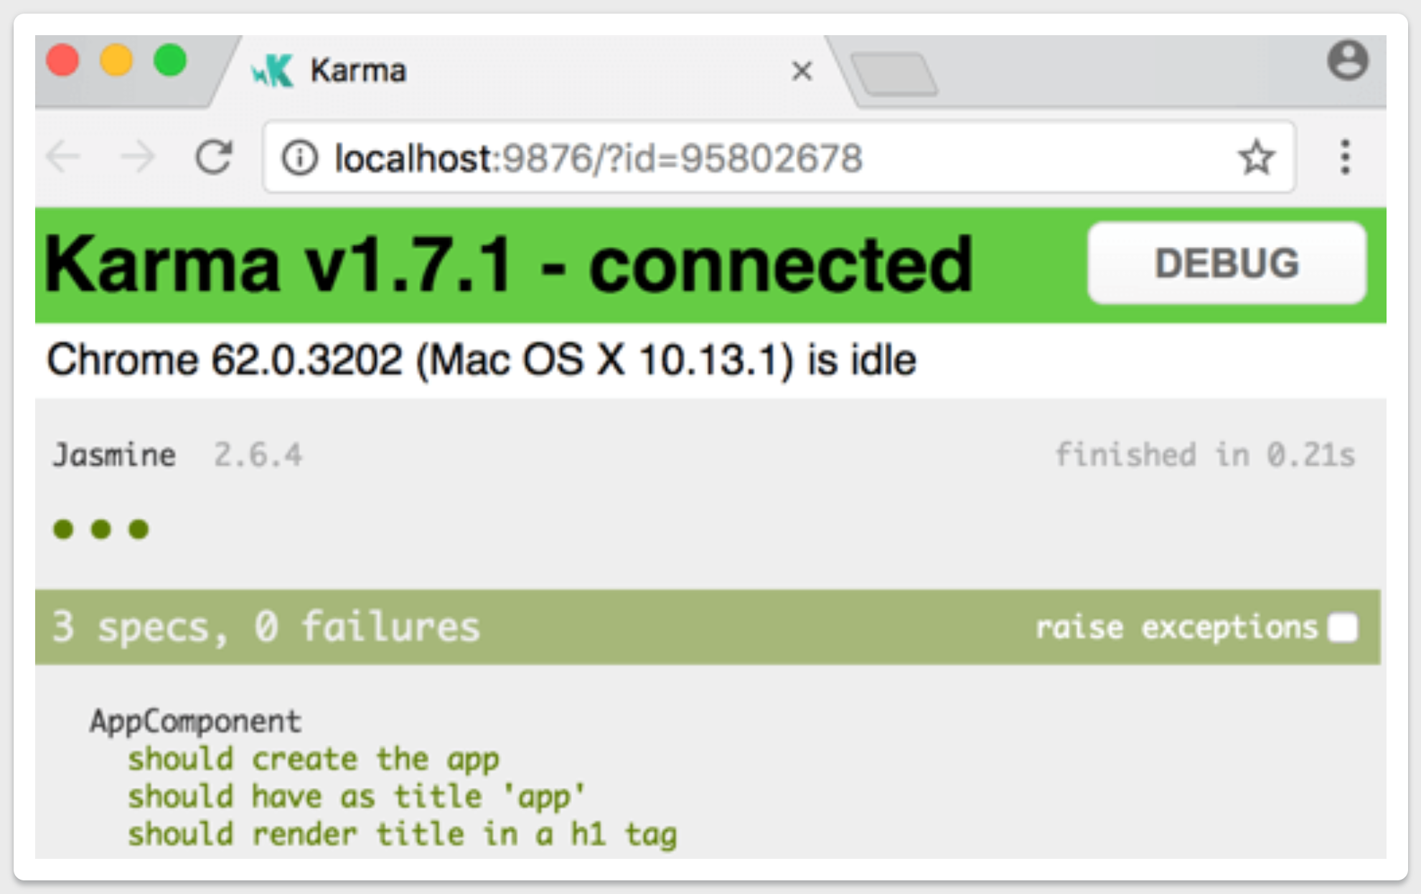
Karma Test Runner https://karma-runner.github.io/latest/index.html
Jasmine and Karma work together to run tests and display results.
Karma launches a browser window with a context page that spawns a web server that executes source code against test code. The results of each test are displayed on the command line to the developer.
Jasmine runs the ‘spec’ tests and reports results by messaging through the client page. Karma watches all files specified in its configuration file.
When changes are saved to these files, Jasmine reruns the tests and Karma reports the new results.

Slide 6
Karma – Manual Installation https://karma-runner.github.io/latest/index.html https://karma-runner.github.io/5.0/intro/installation.html
Jasmine and Angular install Karma automatically. Angular does this along with the default Angular Application created with ng new.
If needed, karma, karma-jasmine, karma-chrome-launcher and jasmine-core can be installed as npm packages. When installing Karma manually, it is recommended to install locally (not globally with -g) in the target project’s root directory.
Install Karma in the app root directory
npm install karma --save-dev
Install plugins that your project needs
npm install karma-jasmine karma-chrome-launcher jasmine-core --save-dev
Run Karma:
./node_modules/karma/bin/karma start

Slide 7
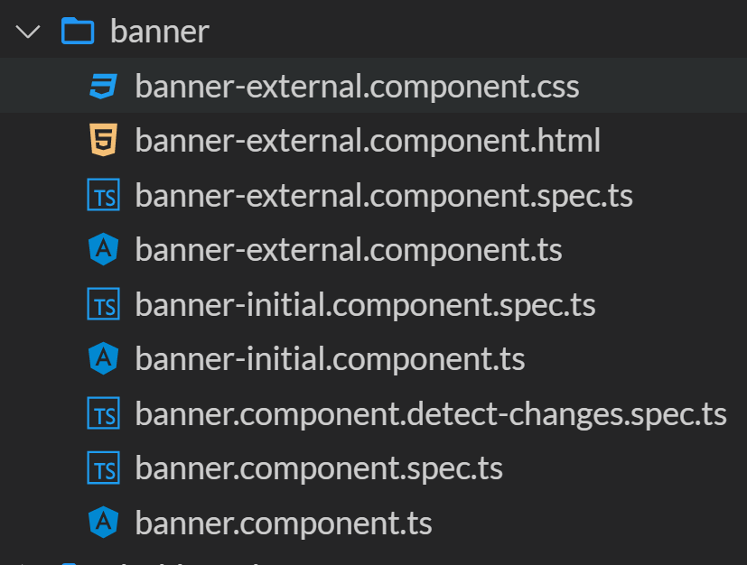
Angular Testing – Set-up https://angular.io/guide/testing#test-file-name-and-location
Testing best practices:
Put Unit Test “spec” files in the same folder as the component or source code files they test.
Put Integration Test “spec” files in a general “Tests” folder.
Implement Continuous Integration with Circle CI or Travis CI.
All test files have extension .spec.ts.
This example shows the banner component. It contains all the associated files for the component.

Slide 8
Testing Components https://angular.io/guide/testing-components-basics#cli-generated-tests https://jasmine.github.io/tutorials/mocking_ajax
ng generate component <componentName> creates a new component in the app/<componentName> folder with a .css, .html, .spec.ts, and .ts files preconfigured.
The testing file is the .spec.ts file. It has testing preconfigured.
import { async, ComponentFixture, TestBed } from '@angular/core/testing';
import { BannerComponent } from './banner.component';
describe('BannerComponent', () => {
let component: BannerComponent;
let fixture: ComponentFixture<BannerComponent>;
beforeEach(async(() => {
TestBed.configureTestingModule({
declarations: [ BannerComponent ] // declares which component to test
})
.compileComponents();
}));
beforeEach(() => {
fixture = TestBed.createComponent(BannerComponent);
component = fixture.componentInstance;
fixture.detectChanges();
});
it('should create', () => {
expect(component).toBeDefined(); // verify the component is created
});
});

Slide 9
Angular Testing Template https://angular.io/guide/testing-components-basics#cli-generated-tests https://medium.com/swlh/angular-unit-testing-jasmine-karma-step-by-step-e3376d110ab4
describe('BannerComponent (inline template)', () => {
let component: BannerComponent;
let fixture: ComponentFixture<BannerComponent>;
let h1: HTMLElement;
beforeEach(() => {
TestBed.configureTestingModule({
declarations: [ BannerComponent ],
});
fixture = TestBed.createComponent(BannerComponent);
// BannerComponent test instance
component = fixture.componentInstance;
h1 = fixture.nativeElement.querySelector('h1');
});
it('no title in DOM after createComponent()', () => {
expect(h1.textContent).toEqual('');
});
it('should display original title', () => {
fixture.detectChanges();
expect(h1.textContent).toContain(component.title);
});
});
The whole Angular test suite is contained within describe(). describe() has two parameters:
A string. It declares the function or component to test.
A callback function containing the actions to take.
describe()’s callback function has zero parameters but lists all the actions to take on the component.
beforeEach() sets up the test environment.
it() declares an individual test. it() has two parameters:
The first is a string that states the expected result.
The second contains a callback with an expect() assertion.
expect() is similar to assert() in C#.

Slide 10
beforeEach(), beforeAll() https://angular.io/guide/testing-components-basics#beforeeach https://jasmine.github.io/api/edge/global.html#beforeAll https://jasmine.github.io/api/edge/global.html#beforeEach
describe('BannerComponent (inline template)', () => {
let component: BannerComponent;
let fixture: ComponentFixture<BannerComponent>;
let h1: HTMLElement;
beforeEach(() => {
TestBed.configureTestingModule({
declarations: [ BannerComponent ],
});
fixture = TestBed.createComponent(BannerComponent);
// BannerComponent test instance
component = fixture.componentInstance;
h1 = fixture.nativeElement.querySelector('h1');
});
it('no title in DOM after createComponent()', () => {
expect(h1.textContent).toEqual('');
});
it('should display original title', () => {
fixture.detectChanges();
expect(h1.textContent).toContain(component.title);
});
});
Rather than duplicate the TestBed configuration for each test, Jasmine provides beforeEach() and beforeAll() to set up the testing environment. beforeEach() runs before each it(). beforeAll() runs just once before all it()’s.
Here, in beforeEach(),
Testbed declares which component will be tested.
Testbed creates fixture, a complete component environment.
Extracts the component class from fixture.
Extracts the ‘h1’ tag from the component .html.

Slide 11
it() and expect() https://jasmine.github.io/tutorials/your_first_suite https://jasmine.github.io/api/edge/global.html#it
Specs (tests) are defined by calling the Jasmine function it(). it() takes a string and a callback function.
The string serves as the title of the spec and describes what the spec does and expects.
The callback function is the actual spec. It contains one or more expect() assertions.
An expect() is an assertion that evaluates to true or false.
expect() takes an “actual” value to be evaluated.
It is chained with a “Matcher” function (toBe(), toEqual(), toHaveBeenCalled(), etc), which takes the “expected” value.
A spec with all true expectations passes.
If there is even one false expect(), the whole spec fails.
describe("A test suite is a function",
() => {
var a;
it("and so is a spec", () => {
a = true;
expect(a).toBe(true);
expect(a).not.toBe(false);
});
});

Slide 12
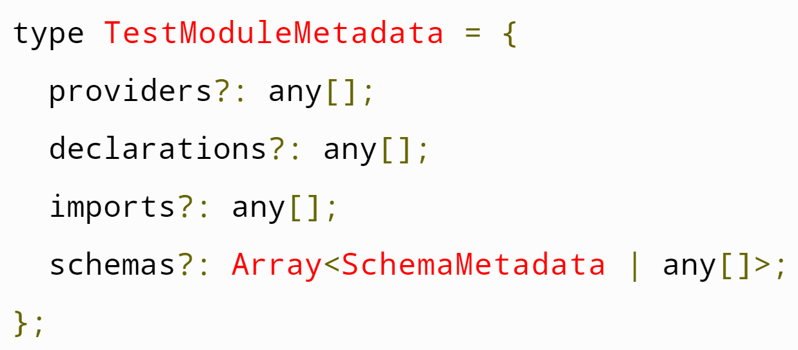
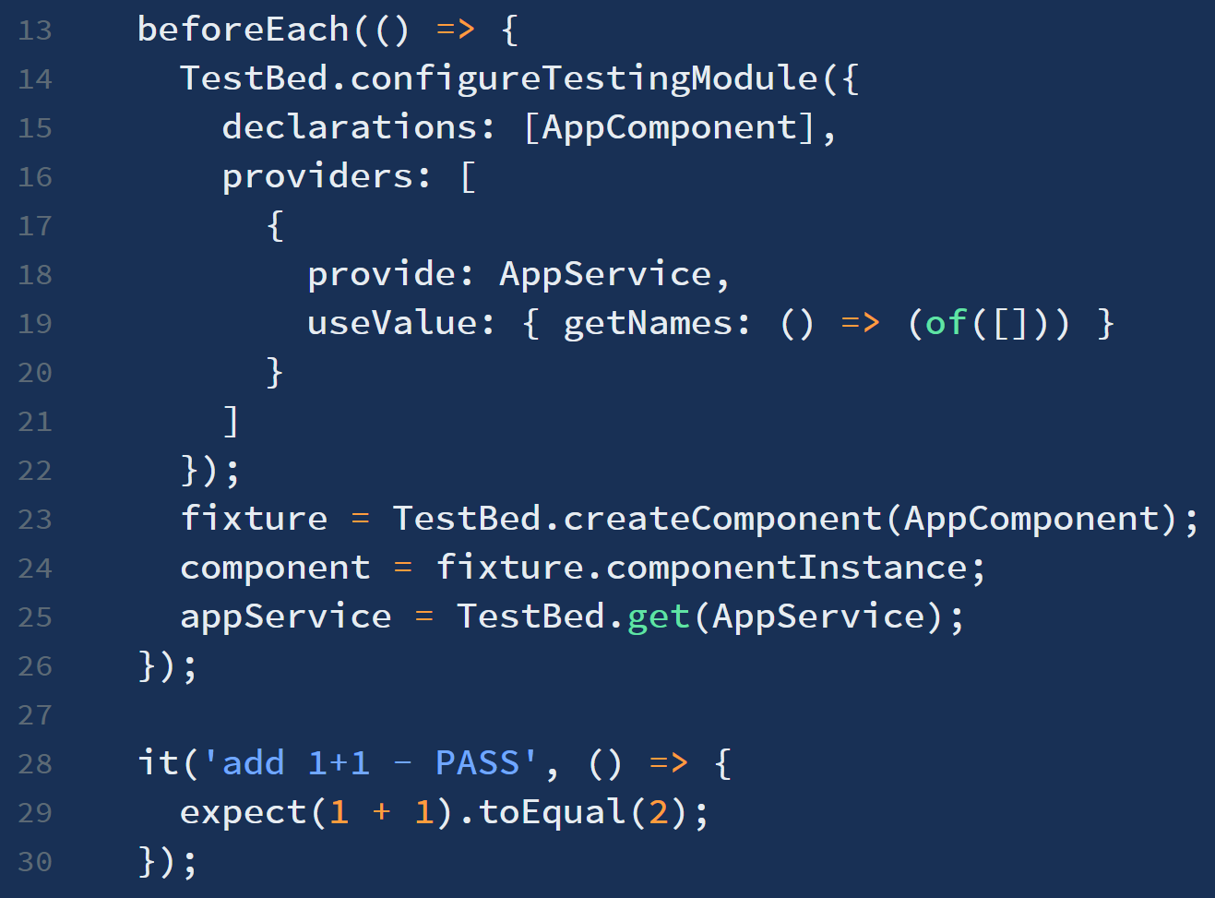
Testing with TestBed https://angular.io/guide/testing-services#testing-services-with-the-testbed https://angular.io/guide/testing-utility-apis#testbed-class-summary https://duncanhunter.gitbook.io/testing-angular/testbed-and-fixtures
TestBed API is an Angular testing utility. TestBed creates a dynamically-constructed Angular module (for testing) that emulates (mocks) a component and its dependencies.
Use TestBed when:
tests require creating the component's host element in the browser DOM and verifying the components interaction with it.
You need to create a component and its dependencies (services) all at once.
.configureTestingModule() takes optional arrays of providers (services), declarations (components), imports, and schemas. It provides static component class methods that either update or reference a global instance of the TestBed.

Slide 13
Mock vs Spy vs Stub https://www.amadousall.com/unit-testing-angular-stubs-vs-spies-vs-mocks/ https://martinfowler.com/bliki/TestDouble.html
Mock | Spy | Stub
Jasmine does not natively have mocking behavior. To mock means to provide an implementation of a function, class, or service as a dependency of the item under test. The SUT will use the mocked implementation instead of its normal dependency. The emphasis with mocks is that the SUT is calling the correct dependencies. The mock has its own verification mechanisms. | A Spy is a special stub that intercepts the call to a dependency function and returns a predefined value. Spies give additional information like how many times the spy was called, what args were sent, etc. The emphasis with spies is to verify that the SUT is calling the correct dependencies. | The mocked instance that replaces the dependency. The stub is used only for the unit test. The emphasis with stubs is verifying that the SUT does the correct things with the data received from its dependencies.

Slide 14
Spies https://jasmine.github.io/api/edge/Spy https://scriptverse.academy/tutorials/jasmine-spyon.html https://www.tutorialspoint.com/jasminejs/jasminejs_spies.htm
If you want to test a function without actually calling its dependency function, Jasmine provides spyOn(). A Spy can stub any function and track calls to it and all its arguments. spyOn() is used to stub a function. spyOn() takes two parameters:
The name of the object to be acted upon.
The name of the method to be spied upon.
spyOn() replaces the spied function with a stub (a stand-in function). It does not execute the real method called. spyOn() can only be called on existing methods.
In this example, we see the original function above and the spec below. The function nextNumber is spied so what is being called when s.getNextNumber is invoked is not the actual function but a temporary stub that returns 10 instead of 3.
function Number() {
this.number = 2;
this.nextNumber = () => {
this.number = this.number + 1;
return this.number;
},
this.getNextNumber = () => {
return this.nextNumber();
}
}; t
describe('spyOn() Number', () => {
it('should be 10', () => {
let s = new Number();
spyOn(s, ‘nextNumber’).and.returnValue(10);
s.getNextNumber();
expect(s.number).toEqual(10);
});
});

Slide 15
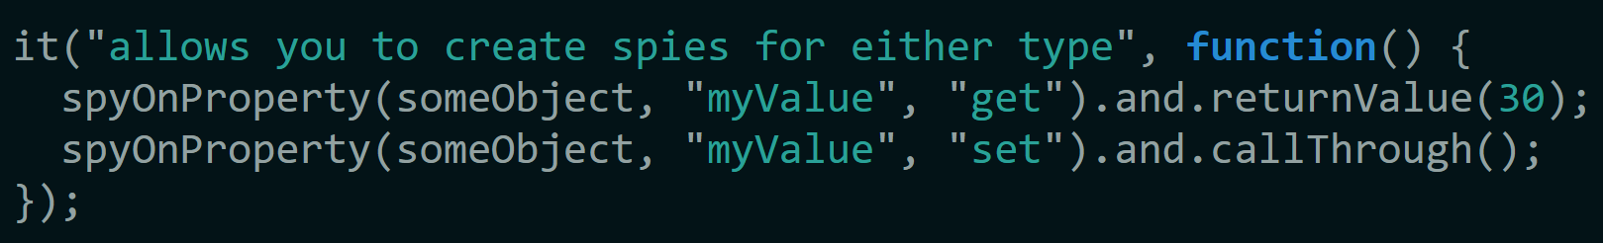
Spying on Properties https://jasmine.github.io/tutorials/spying_on_properties https://jasmine.github.io/api/2.7/global.html#spyOnProperty
In Jasmine, anything a property spy can do, can also be done with a function spy, but potentially with different syntax. Use spyOnProperty() to create a “getter” or a “setter”. spyOnProperty() returns a spy.
spyOnProperty(object, propertyName, accessType?) has three parameters:
an object (the component class) as it’s first parameter.
the name (as a string) of the property.
the type of spy (“get” or “set”) as it’s third.

Slide 16
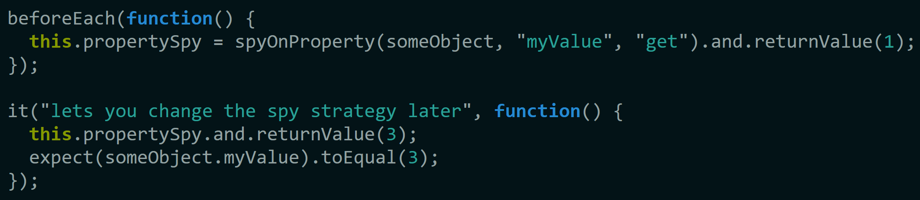
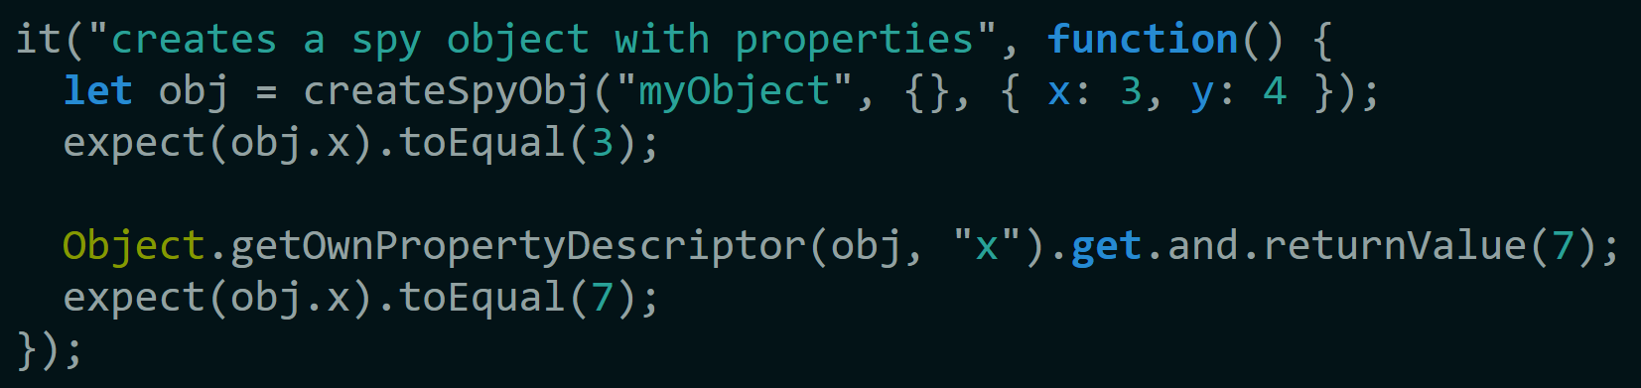
Spying on Properties https://jasmine.github.io/tutorials/spying_on_properties https://jasmine.github.io/api/2.7/global.html#spyOnProperty
You cannot refer to a property without calling its “getter” method. To gain access to the value of an existing spy, save a reference to the spy for later changes.
Create a spy object with several properties by passing an array of properties as a third argument to createSpyObj().
To change the spy property value, use Object.getOwnPropertyDescriptor().

Slide 17
Testing Reactive Forms https://angular.io/guide/forms-overview#testing https://angular.io/guide/forms-overview#testing-reactive-forms https://codecraft.tv/courses/angular/unit-testing/model-driven-forms/
Reactive forms can be tested without rendering the UI because they provide synchronous access to the form models and data models.
In the below spec, status and data are queried and manipulated through the control without interacting with the change detection cycle.
This test verifies the data flow from template to model in a reactive Form.
it('should update the value of the input field', () => {
const input = fixture.nativeElement.querySelector('input’);//Grab "input" element from the form.
const event = createNewEvent('input’); //create an ‘input’ type event.
input.value = 'Red’; //Set value of input element to ‘Red’.
input.dispatchEvent(event); //Fire off the event.
//assert that the value of ‘favoriteColor’ in the model now matches the input.
expect(fixture.componentInstance.favoriteColor.value).toEqual('Red');
});

Slide 18
Testing Template-driven Forms https://angular.io/guide/forms-overview#testing https://angular.io/guide/forms-overview#testing-template-driven-forms https://codecraft.tv/courses/angular/unit-testing/model-driven-forms/
Writing tests with template-driven forms requires a detailed knowledge of the change detection process and an understanding of how directives run on each cycle to ensure that elements are queried, tested, or changed at the correct time.
This test verifies the data flows from view to model and model to view for a template-driven form.
it('should update the favorite color in the component', fakeAsync(() => {
const input = fixture.nativeElement.querySelector('input’); //Grab the "input" element from the form.
const event = createNewEvent('input’); //create an ‘input’ type event.
input.value = 'Red’; //Set the value of the input to ‘Red”.
input.dispatchEvent(event); //Fire off the event.
fixture.detectChanges(); //tell fixture to detect changes
expect(component.favoriteColor).toEqual('Red’);//assert the value in the model now matches the input.
}));

Slide 19
Testing HTTP Services with Spies https://stackblitz.com/angular/mkjgxjnxeak?file=src%2Fapp%2Fmodel%2Fhero.service.spec.ts https://angular.io/guide/testing-services#testing-http-services https://levelup.gitconnected.com/test-angular-components-and-services-with-http-mocks-e143d90fa27d
Services that make HTTP calls to remote servers typically inject and delegate to an Angular HttpClient service. You can test a data service with an injected HttpClient spy as you would test any service with a dependency.
describe ('HeroesService (with spies)', () => {
let httpClientSpy: { get: jasmine.Spy };
let heroService: HeroService;
beforeEach(() => {// TODO: spy on other methods too
httpClientSpy = jasmine.createSpyObj('HttpClient', ['get']);
heroService = new HeroService(httpClientSpy as any);
}); it('should return expected heroes (HttpClient called once)', () => {
const expectedHeroes: Hero[] =
[{ id: 1, name: 'A' }, { id: 2, name: 'B' }]; httpClientSpy.get.and.returnValue(of(expectedHeroes)); heroService.getHeroes().subscribe(
heroes => expect(heroes).toEqual(expectedHeroes, 'expected heroes'),fail
);
expect(httpClientSpy.get.calls.count()).toBe(1, 'one call');
});
});

Slide 20
Mocking AJAX calls https://jasmine.github.io/tutorials/mocking_ajax
describe("mocking ajax", function() {
it("allows use in a single spec", function() {
let doneFn = jasmine.createSpy('success’); //this is the mock response
// .withMock() takes a function that’s called after AJAX has been mocked and is
automatically uninstalled afterwards.
jasmine.Ajax.withMock(function() { //this is normal AJAX setup
let xhr = new XMLHttpRequest(); //but using .withMock()
xhr.onreadystatechange = function(args) {
if (this.readyState == this.DONE) {
doneFn(this.responseText);
}
};
xhr.open("GET", "/reature.com/associates"); //set up the request
xhr.send(); //send the request
expect(doneFn).not.toHaveBeenCalled();
jasmine.Ajax.requests.mostRecent().respondWith({//tell ‘doneFn’ how to respond
"status“ : 200,
"responseText“ : ‘successful mock!'
});
expect(doneFn).toHaveBeenCalledWith('successful mock!’);//assert
}); }) ;});

Slide 21
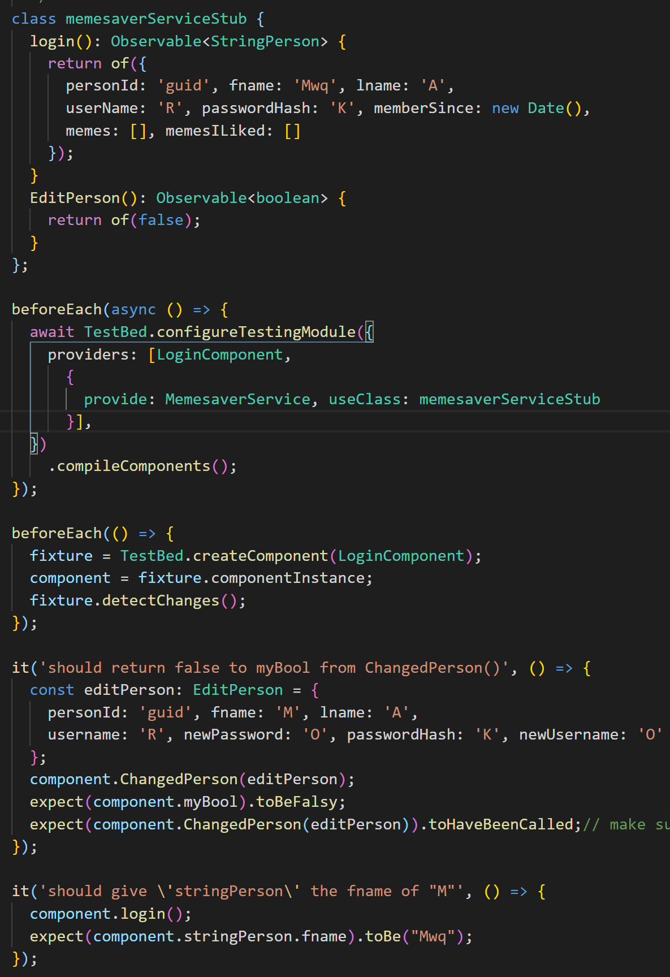
Mock a Service
When a component that consumes a service is under test, any time a function under test that uses the service is called, that service needs to be mocked to properly isolate the function.
In order to mock a service, you must declare a substitute service class that contains the methods expected to be called in the test suites along with a mock implementation.
Then, in TestBed.configureTestingModule(), in the providers[], add an object that states the service name and substitute class. The substitute class will be called instead of the service during the test suite.

Slide 22
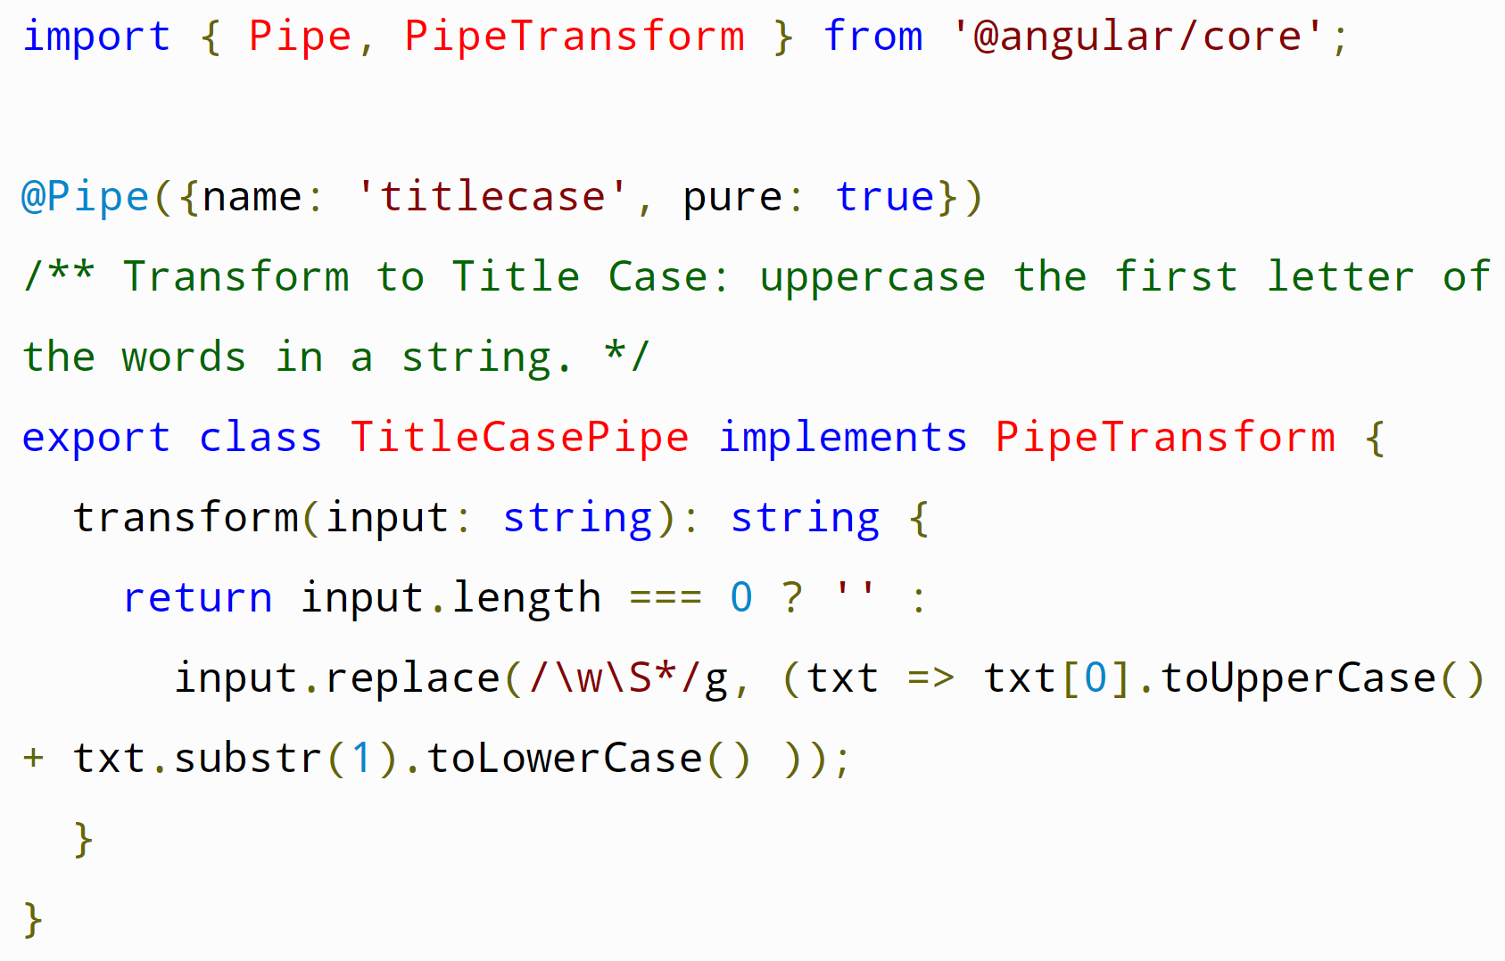
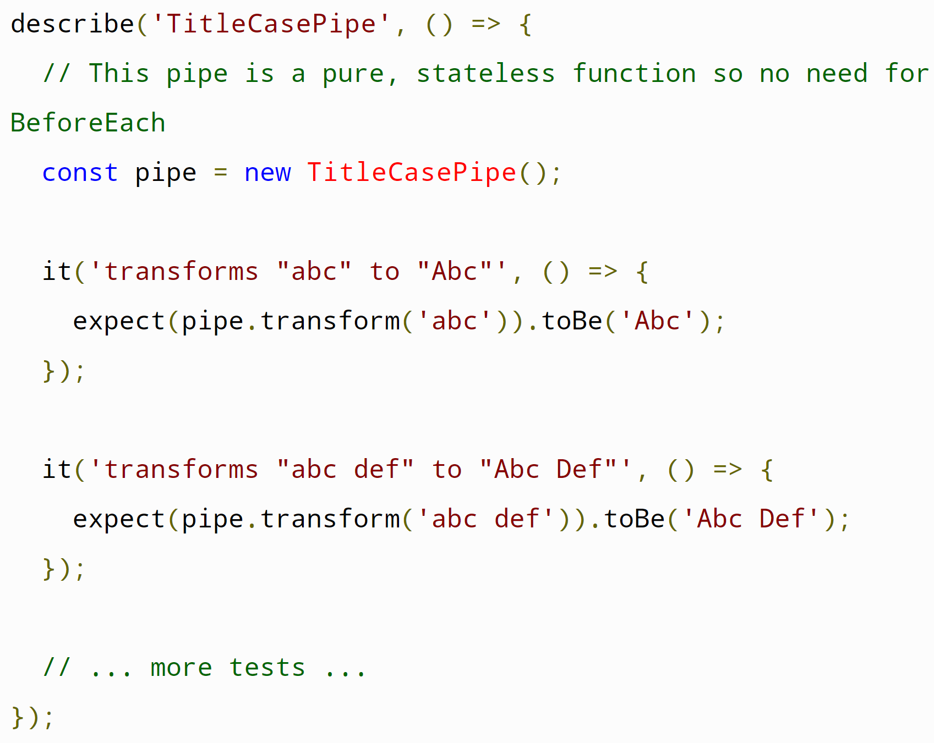
Testing pipe() https://angular.io/guide/testing-pipes
All pipe classes have one method, transform. Transform converts the input value into a transformed output value.
The transform implementation rarely interacts with the DOM and most pipes have no dependence on Angular other than the @Pipe metadata and an interface
Consider a TitleCasePipe that capitalizes the first letter of each word. Here's an implementation with a regular expression.

Slide 23
Control which tests are run
Fail() – manually fail a test
Pending() – just show the test as pending in the readout.
Append x to the front of any function (xbeforeEach(), xit(), xbeforeAll()) to exclude that function from the tests.
Append f to the front of any function (fbeforeEach(), fit(), fbeforeAll()) to only run that function.

