Slide 1

RxJS Operators
.NET

Slide 2
Operators are the essential pieces that allow complex asynchronous code to be easily composed in a declarative manner.
https://rxjs.dev/guide/operators#rxjs-operators

Slide 3
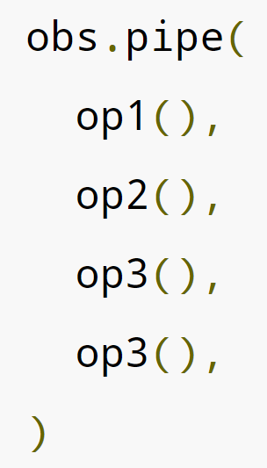
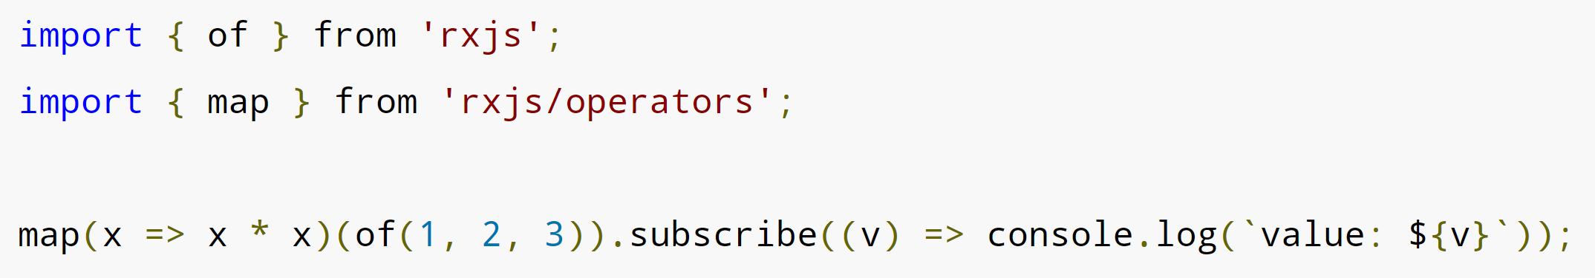
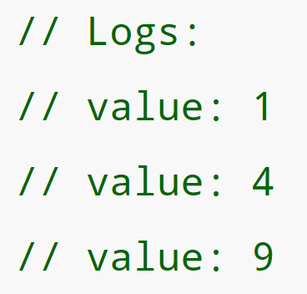
RxJS - Operators https://rxjs-dev.firebaseapp.com/guide/operators https://rxjs-dev.firebaseapp.com/api/index/function/pipe https://angular.io/guide/rx-library#operators
Operators are what make RxJS really useful. Even though the Observable is the foundation of RxJS, operators are the essential functions that allow complex asynchronous code to be easily composed and executed. There are two types of operators.
pipeable operators –take an Observable as input and return another Observable. The original Observable is unmodified. observableInstance.pipe(operator())
creation operators - standalone functions to create a new Observable with some common predefined behavior or by joining other Observables.

Slide 4
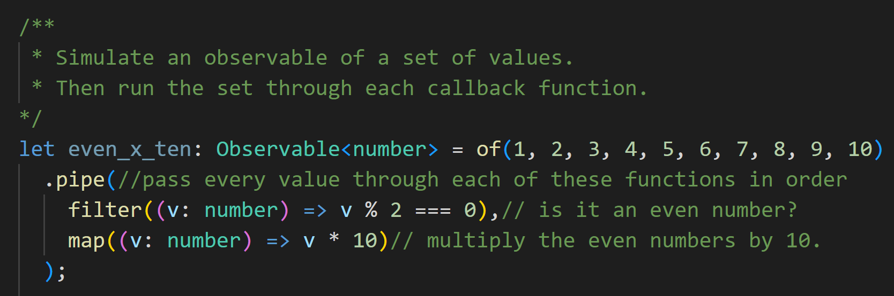
RxJS .pipe() https://rxjs-dev.firebaseapp.com/api/index/function/pipe#pipe https://www.techiediaries.com/observable-pipe-subscribe-map-and-filter-examples
observableInstance.pipe() is a helper function that will take an observable and run up to nine callback functions, in order, on the observable. If the observable is a collection, the callback is called on each element of the collection.
Each callback function must take an observable and return an observable.
The result of each callback is passed to the next callback function in the parameter list.
pipe(fn1: UnaryFunction<T, A>, fn2: UnaryFunction<A, B>): UnaryFunction<T, B>

Slide 5
RxJS – Pipeable Operators https://rxjs.dev/guide/operators https://reactive.how/rxjs
A Pipeable Operator is a regular function and can be called as such. They can only be “Piped” if their parameters and return types are Observables and they return a modified copy of the original observable.
There are many more here.
Name | Description
filter() | Filter items out based on not matching a pattern. .pipe(filter(num => num % 2 === 0));
map() | Applies a predicate to every value of an observable. .pipe(map(x => x*x));
expand() | Merge all values into the output Observable after applying an predicate to it. .pipe(expand(x => of(2 * x));
Distinct() | Remove duplicate values from a collection. .pipe(distinct());
takeWhile() | Emit all values that satisfy a given predicate till one doesn’t. Then return. .pipe(takeWhile(x => x > 200));

Slide 6
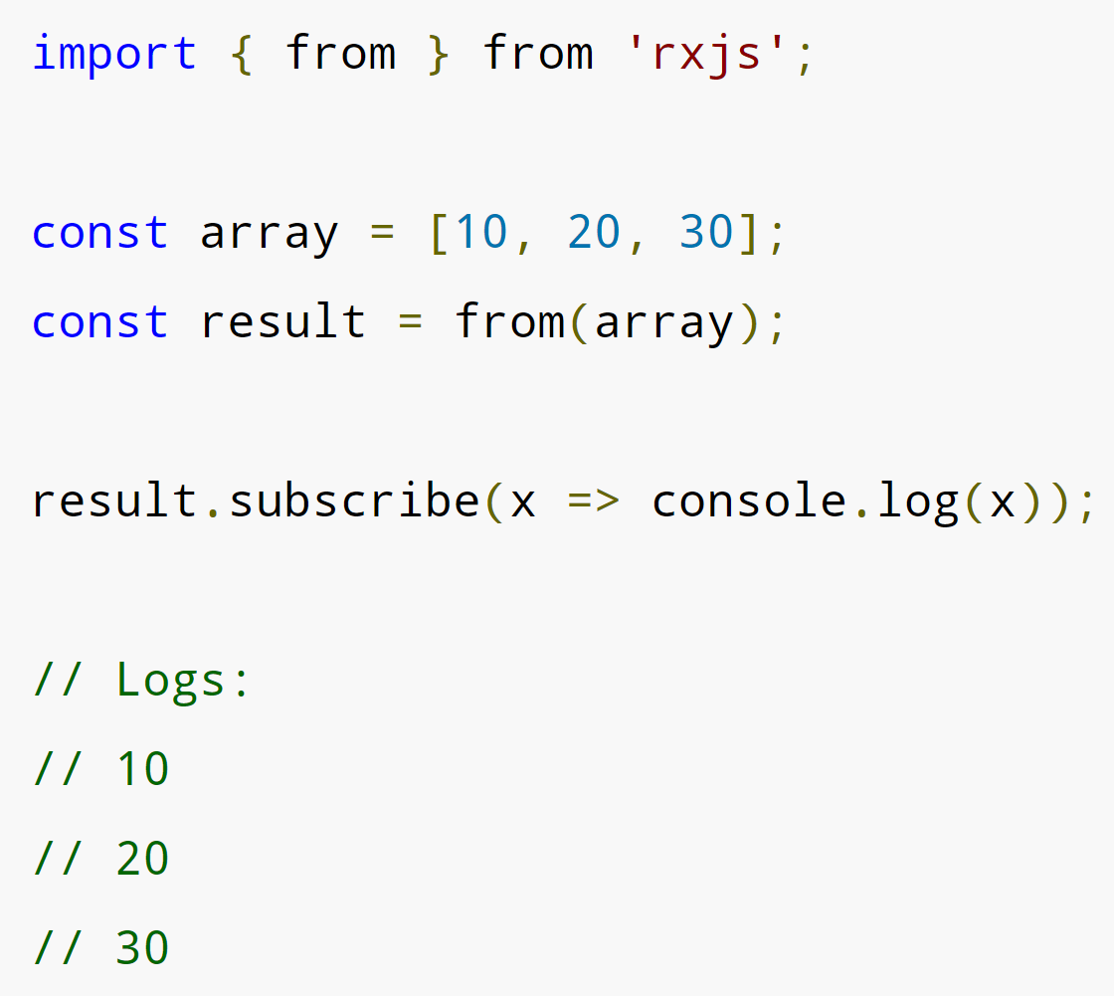
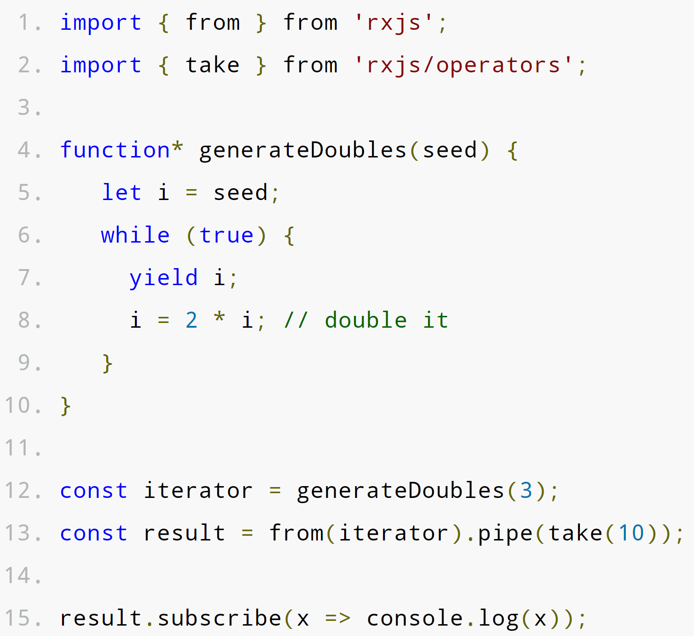
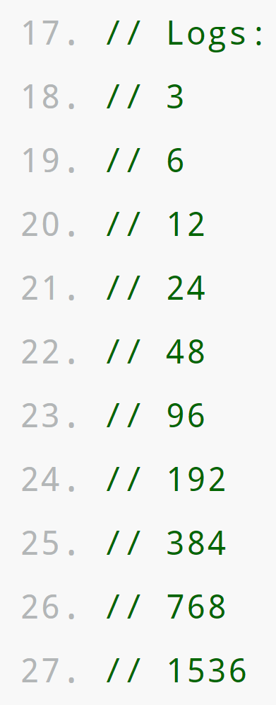
RxJS – Creation Operators https://rxjs-dev.firebaseapp.com/guide/operators https://rxjs-dev.firebaseapp.com/api/index/function/from https://developer.mozilla.org/en-US/docs/Web/JavaScript/Reference/Operators/yield#
interval() takes a number (not an Observable) as its input argument and produces an Observable as output:
import { interval } from 'rxjs’; // you must import the operator
const observable = interval(1000); // number of milliseconds
from() creates an Observable from an Array, an array-like object, a Promise, an iterable object, or an Observable-like object.
take() specifies how many iterations on a given function to make. Here, it is combined with from().

Slide 7
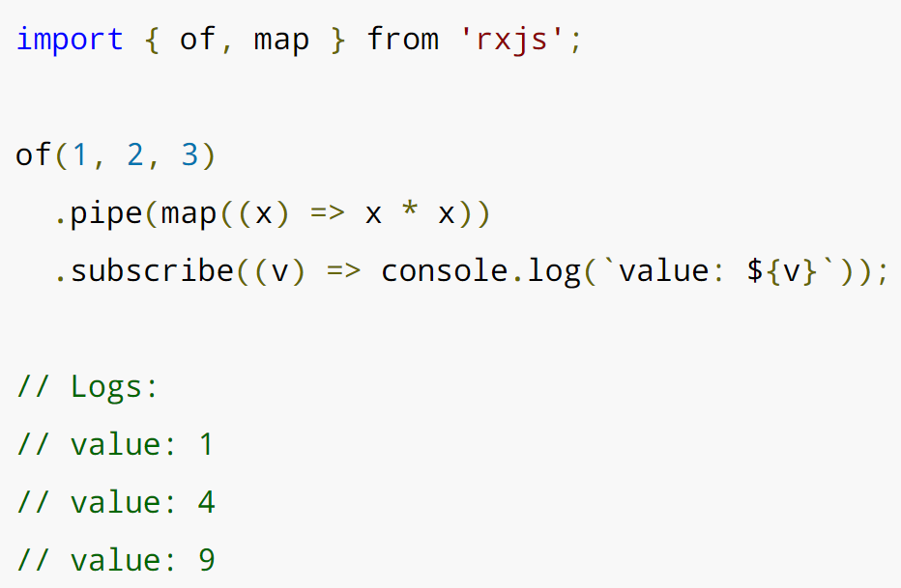
RxJS – Creation Operators https://rxjs.dev/guide/operators
Creation Operators can be called as standalone functions to create a new Observable.
of(1, 2, 3) creates an observable that will emit 1, 2, and 3, one right after another.
Map() is analogous to the Array method of the same name.

Slide 8
Step-by-step - Set-up a sample RxJS Development Environment https://medium.com/codingthesmartway-com-blog/getting-started-with-rxjs
Create a directory for this project and move into it with:
mkdir rxjs-test && cd rxjs-test
Create a NPM package.json to hold configuration settings with: (install Node Package Manager here.)
npm init –y
Install the NPM Webpack, Webpack Web Server, TypeScript, and TypeScript Loader with:
npm install rxjs webpack webpack-dev-server typescript ts-loader
Install the Webpack Command-Line Interface with
npm install webpack-cli --save-dev
In the package.json file, add a new section. This allows you to start the program with npm run start:
"scripts": { "start": "webpack-dev-server --mode development" },

Slide 9
Step-by-step - Set-up a sample RxJS Development Environment https://medium.com/codingthesmartway-com-blog/getting-started-with-rxjs
Set up Webpack. In the command line, create a new file called webpack.config.js in the root directory with:
touch webpack.config.js.
Add this to the file.
const path = require('path');
module.exports = {
entry: './src/index.ts',
devtool: 'inline-source-map',
module: {
rules: [ {
test: /\.tsx?$/,
use: 'ts-loader',
exclude: /node_modules/
}]
},
resolve: { extensions: [ '.tsx', '.ts', '.js' ] },
output: {
filename: 'bundle.js',
path: path.resolve(__dirname, 'dist')
}
};
Set up TypeScript. In the command line, create a new file called tsconfig.json in the root directory with:
Touch tsconfig.json.
Add this to the file (*make sure your “” are the same*):
{ "compilerOptions": { "outDir": "./dist/", "sourceMap": true, "noImplicitAny": true, "module": "es6", "moduleResolution": "node", "target": "es6", "allowJs": true, " lib " : [ "es2017", "dom" ] } }

Slide 10
Step-by-step - Set-up a sample RxJS Development Environment https://medium.com/codingthesmartway-com-blog/getting-started-with-rxjs
Set up your HTML file. In the command line, create a new file called index.html in the root directory with:
Touch index.html.
Add the following to the .html file
<!DOCTYPE html>
<html lang="en">
<head>
<meta charset="UTF-8">
<meta name="viewport" content="width=device-width, initial-scale=1.0">
<meta http-equiv="X-UA-Compatible" content="ie=edge">
<title>RxJS Demo</title>
</head>
<body>
<h1>RxJS Demo</h1>
<div>
<ul id="list"></ul>
</div>
<script src="/bundle.js"></script>
</body>
</html>
In the command line, create a new file called index.ts in the root directory with:
Touch index.ts.
Add this text to the index.ts file.
import { Observable } from 'rxjs';
var observable = Observable.create((observer:any) => {
observer.next('Hello World!');
observer.next('Hello Again!');
observer.complete();
observer.next('Bye');
})
observable.subscribe(
(x:any) => logItem(x),
(error: any) => logItem ('Error: ' + error),
() => logItem('Completed')
);
function logItem(val:any) {
var node = document.createElement("li");
var textnode = document.createTextNode(val);
node.appendChild(textnode);
document.getElementById("list").appendChild(node);
}

Slide 11
Step-by-step - Set-up a sample RxJS Development Environment https://medium.com/codingthesmartway-com-blog/getting-started-with-rxjs
Now you can start the sample app with:
npm run start
.

