Slide 1

RxJS Subscription Subject Schedulers
.NET

Slide 2
Reactive programming is an asynchronous programming paradigm concerned with data streams and the propagation of changes throughout an application.
https://en.wikipedia.org/wiki/Reactive_programming

Slide 3
RxJS – Core Concepts - Overview https://www.learnrxjs.io/ https://angular.io/guide/rx-library#the-rxjs-library
Concept | Definition
Observable | Represents the idea of an invokable collection of future values or events.
Observer | A collection of callbacks that waits for values delivered by the Observable.
Subscription | Represents the execution of an Observable. Primarily useful for cancelling the execution.
Operators | Functions that enable a functional programming style to deal with collections (map(), filter(), concat(), reduce()).
Subject | Equivalent to an EventEmitter. Used to multicast a value or event to multiple Observers.
Schedulers | Centralized dispatchers to control concurrency. Allows coordination when computation happens on setTimeout or requestAnimationFrame.

Slide 4
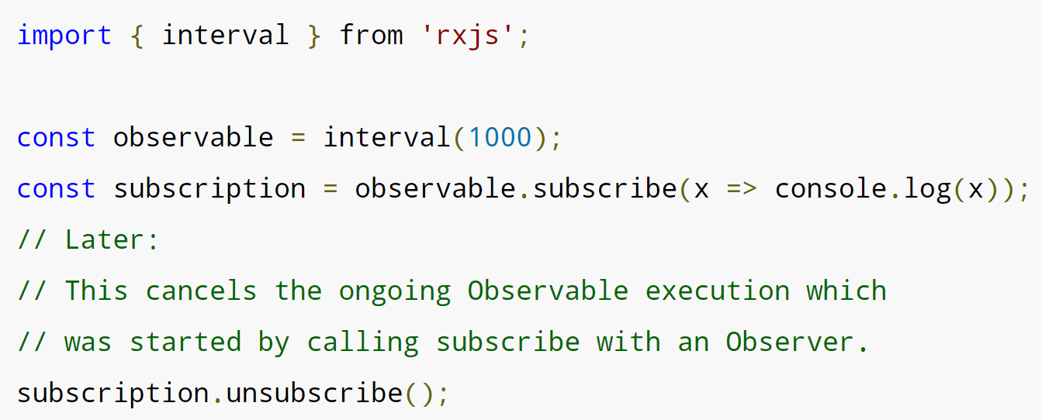
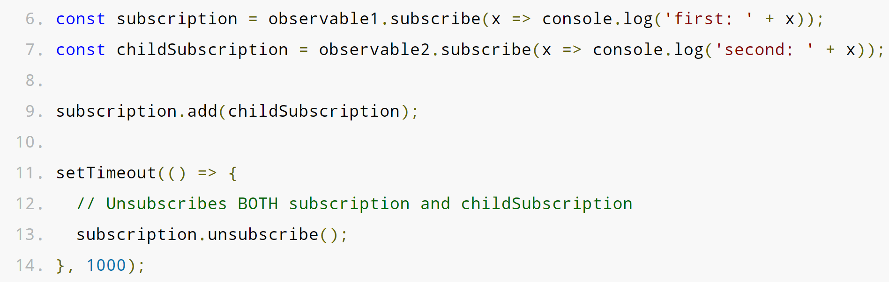
RxJS - Subscription https://rxjs-dev.firebaseapp.com/guide/subscription
A Subscription is an object that represents the execution of an Observable. A Subscription has one method, .unsubscribe(), which takes no argument. It only disposes of the resource held by the subscription.
Subscriptions can also be combined, so that a call to .unsubscribe() of the parent Subscription will unsubscribe .add()‘ed Subscriptions.

Slide 5
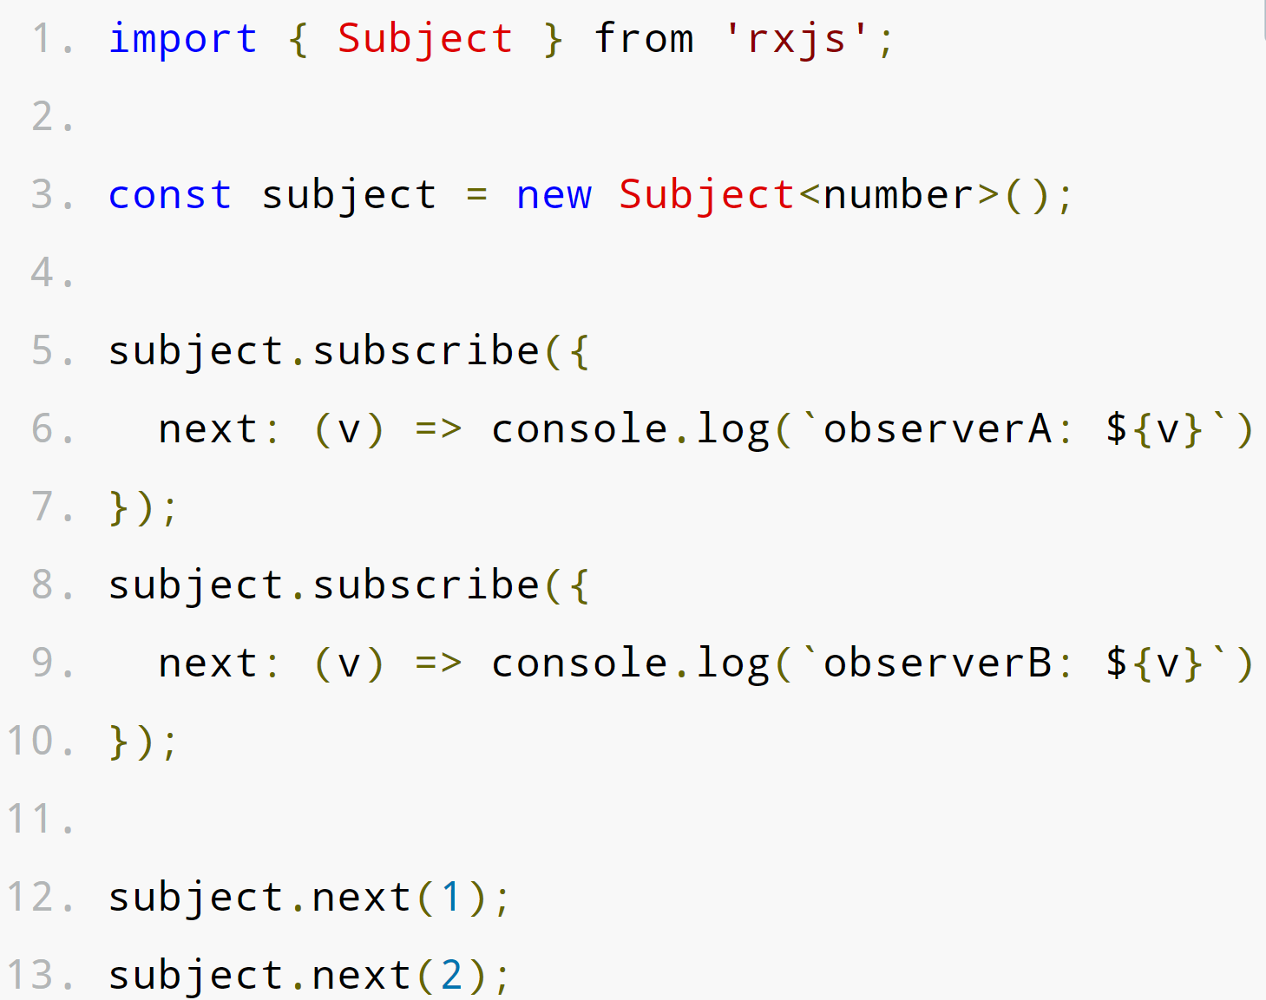
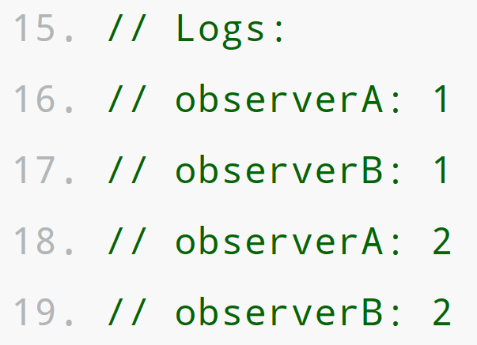
RxJS - Subject https://rxjs-dev.firebaseapp.com/guide/subject
A Subject is used for multicasting. Subjects are like Observables but can multicast to many Observers. Every Subject is an Observable. You can .subscribe() to a Subject by providing an Observer and it will start receiving values normally.
A Subject is also an Observer object with the methods next(v), error(e), and complete().
To feed a new value to the Subject, just call next(theValue), and that value will be multi-casted to the Observers registered to listen to the Subject.

Slide 6
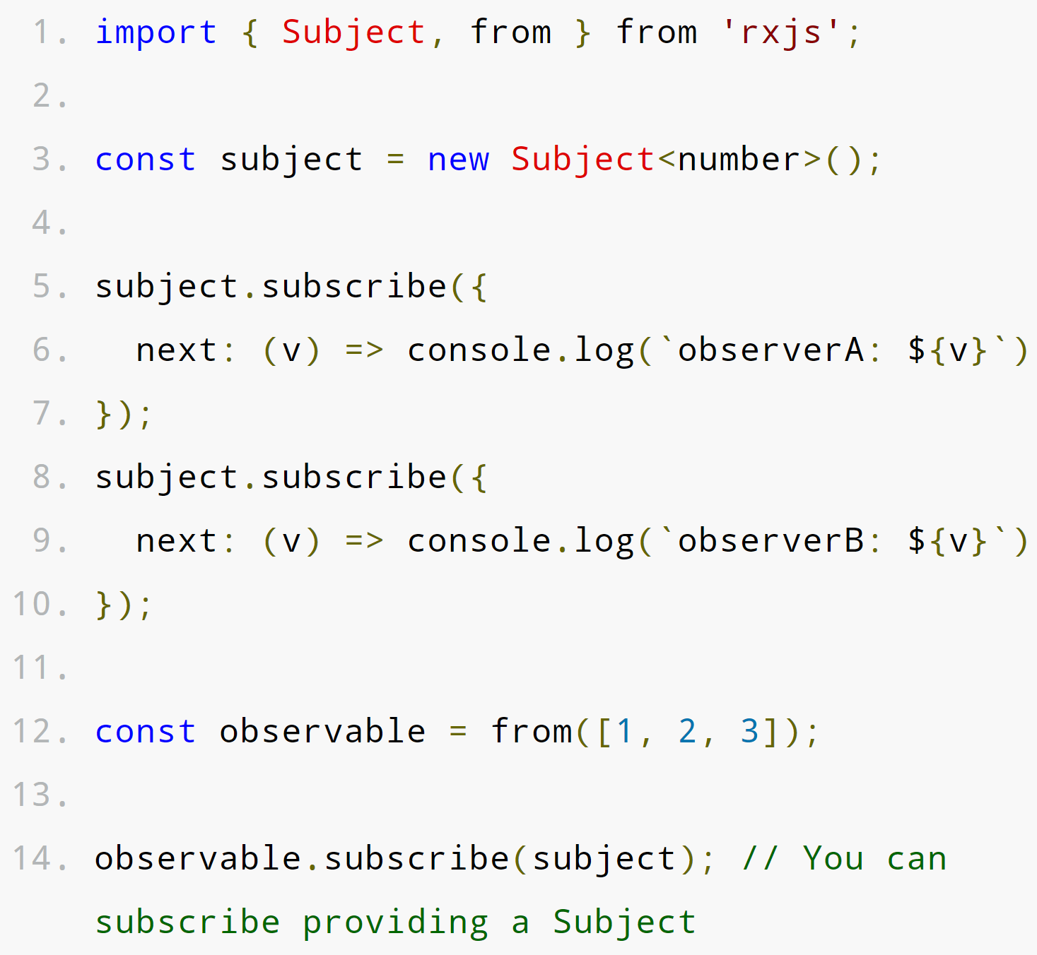
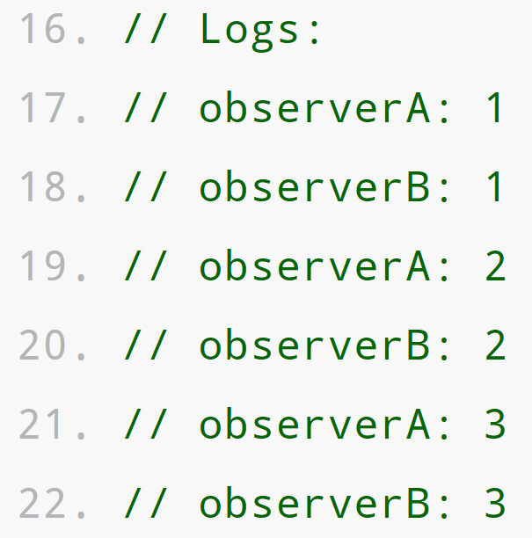
RxJS - Subject https://rxjs-dev.firebaseapp.com/guide/subject
You can also provide a Subject as the argument to the .subscribe() of any Observable. subscribe() will iterate over the Argument Subject and multicast the result to all subscribed Observers.
Subjects are the only way of sharing an Observable execution to multiple Observers.

Slide 7
RxJS - Schedulers https://rxjs-dev.firebaseapp.com/guide/scheduler
A scheduler controls when a subscription starts and when notifications are delivered. It lets you define in what execution context an Observable will deliver notifications to its Observer. It consists of three components.
Data Structure | Execution Context | Clock
A Scheduler knows how to store and queue tasks based on priority (or other criteria). | A Scheduler denotes where and when a task is executed: immediately or in another callback mechanism such as setTimeout or process.nextTick, or the animation frame). | A Schedulers virtual clock provides a notion of "time" by a getter method now(). Tasks being scheduled on a particular scheduler will adhere only to the time denoted by that clock.

Slide 8
RxJS – Scheduler Types https://rxjs-dev.firebaseapp.com/guide/scheduler
When using a Scheduler, you will identify one of the built-in Scheduler Types along with the Scheduler object. Each of these Scheduler Types can be created and returned by using static properties of the Scheduler object.
Scheduler Type | Usage
queueScheduler | Schedules on a queue in the current event frame (trampoline scheduler).
asapScheduler | Schedules on the micro task queue, which is the same queue used for promises. Will run after the current job, but before the next job.
asyncScheduler | Schedules work with setInterval. Use this for time-based operations.
animationFrameScheduler | Used for smooth browser animations. Schedules a task that will happen just before the next browser content ‘repaint’.

Slide 9
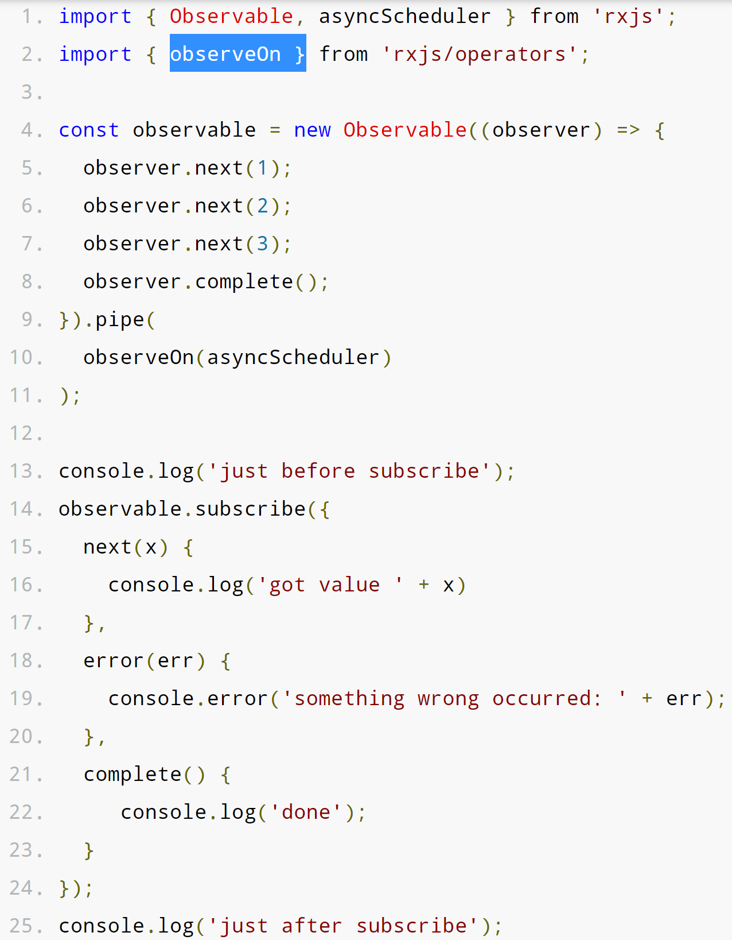
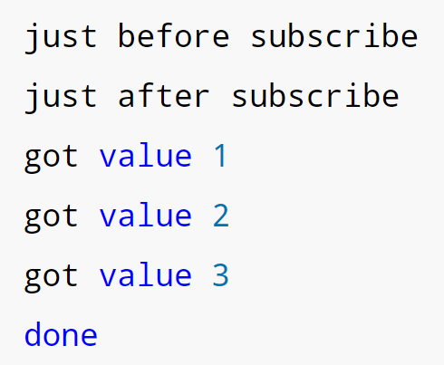
RxJS - Schedulers https://rxjs-dev.firebaseapp.com/guide/scheduler
//Output
The observeOn() Operator is used to attach the Scheduler Type to the Observable.
The Observable is unaffected other than having the new timing layered on top of its current output timing.
observeOn() takes 2 arguments.
A scheduler Type.
An (optional) delay in milliseconds.

Slide 10
Schedulers – Step-by-Step https://rxjs-dev.firebaseapp.com/guide/scheduler
//Output
To implement a Scheduler:
(Ln. 1)Import the Operators and Schedulers you need.
(Ln 4) Create an Observable to hold the values. Normally, you would return an Observable from a service function that you
(Ln 9) pipe() through observeOn() before being returned, and
(Ln 10) add the Scheduler of your choice as the first argument to observeOn().
subscribe() to the Observable and provide (at least) a next() function.

Slide 11
Step-by-step - Set-up a sample RxJS Development Environment https://medium.com/codingthesmartway-com-blog/getting-started-with-rxjs
Create a directory for this project and move into it with:
mkdir rxjs-test && cd rxjs-test
Create a NPM package.json to hold configuration settings with: (install Node Package Manager here.)
npm init –y
Install the NPM Webpack, Webpack Web Server, TypeScript, and TypeScript Loader with:
npm install rxjs webpack webpack-dev-server typescript ts-loader
Install the Webpack Command-Line Interface with
npm install webpack-cli --save-dev
In the package.json file, add a new section. This allows you to start the program with npm run start:
"scripts": { "start": "webpack-dev-server --mode development" },

Slide 12
Step-by-step - Set-up a sample RxJS Development Environment https://medium.com/codingthesmartway-com-blog/getting-started-with-rxjs
Set up Webpack. In the command line, create a new file called webpack.config.js in the root directory with:
touch webpack.config.js.
Add this to the file.
const path = require('path');
module.exports = {
entry: './src/index.ts',
devtool: 'inline-source-map',
module: {
rules: [ {
test: /\.tsx?$/,
use: 'ts-loader',
exclude: /node_modules/
}]
},
resolve: { extensions: [ '.tsx', '.ts', '.js' ] },
output: {
filename: 'bundle.js',
path: path.resolve(__dirname, 'dist')
}
};
Set up TypeScript. In the command line, create a new file called tsconfig.json in the root directory with:
Touch tsconfig.json.
Add this to the file (*make sure your “” are the same*):
{ "compilerOptions": { "outDir": "./dist/", "sourceMap": true, "noImplicitAny": true, "module": "es6", "moduleResolution": "node", "target": "es6", "allowJs": true, " lib " : [ "es2017", "dom" ] } }

Slide 13
Step-by-step - Set-up a sample RxJS Development Environment https://medium.com/codingthesmartway-com-blog/getting-started-with-rxjs
Set up your HTML file. In the command line, create a new file called index.html in the root directory with:
Touch index.html.
Add the following to the .html file
<!DOCTYPE html>
<html lang="en">
<head>
<meta charset="UTF-8">
<meta name="viewport" content="width=device-width, initial-scale=1.0">
<meta http-equiv="X-UA-Compatible" content="ie=edge">
<title>RxJS Demo</title>
</head>
<body>
<h1>RxJS Demo</h1>
<div>
<ul id="list"></ul>
</div>
<script src="/bundle.js"></script>
</body>
</html>
In the command line, create a new file called index.ts in the root directory with:
Touch index.ts.
Add this text to the index.ts file.
import { Observable } from 'rxjs';
var observable = Observable.create((observer:any) => {
observer.next('Hello World!');
observer.next('Hello Again!');
observer.complete();
observer.next('Bye');
})
observable.subscribe(
(x:any) => logItem(x),
(error: any) => logItem ('Error: ' + error),
() => logItem('Completed')
);
function logItem(val:any) {
var node = document.createElement("li");
var textnode = document.createTextNode(val);
node.appendChild(textnode);
document.getElementById("list").appendChild(node);
}

Slide 14
Step-by-step - Set-up a sample RxJS Development Environment https://medium.com/codingthesmartway-com-blog/getting-started-with-rxjs
Now you can start the sample app with:
npm run start
.

