Slide 1

TypeScript Fundamentals
.NET

Slide 2
TypeScript is a static typechecker for JavaScript programs. A static typechecker is a tool run on code before the code itself is run to ensure that the data types will be consistent at runtime.
https://www.typescriptlang.org/docs/handbook/intro.html#about-this-handbook

Slide 3
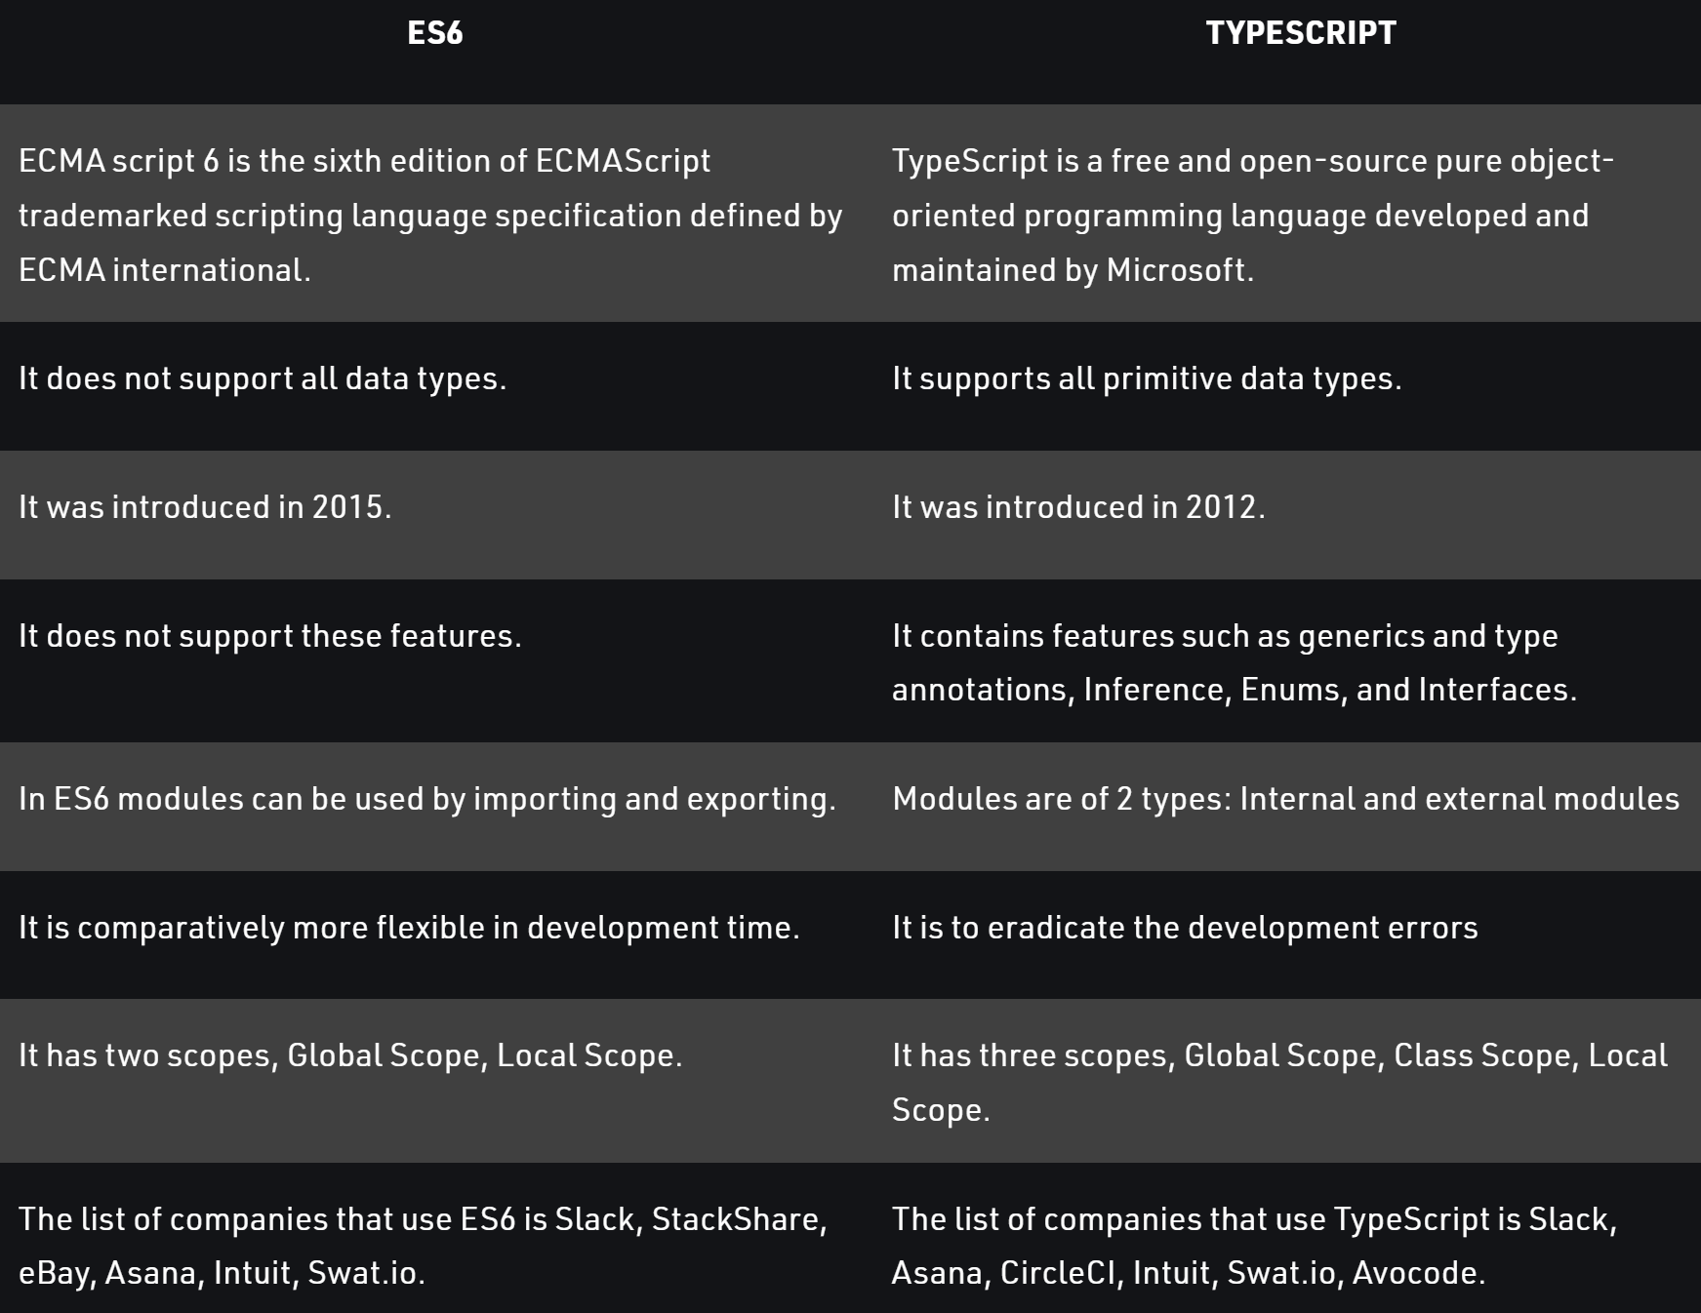
TypeScript vs ES6 https://www.geeksforgeeks.org/difference-between-es6-and-typescript https://www.npmjs.com/package/typescript
ES6 (aka, ECMAScript 2015) is the latest version of JavaScript. It allows developers to instantiate an object using the new operator or an arrow function. Also, the return keyword can be omitted.
TypeScript is an open-source, object-oriented programming language developed and maintained by Microsoft. It was launched and introduced on October 1st, 2012.
TypeScript does not directly run on any browser. It requires a compiler to transpile .ts files into .js files.

Slide 4
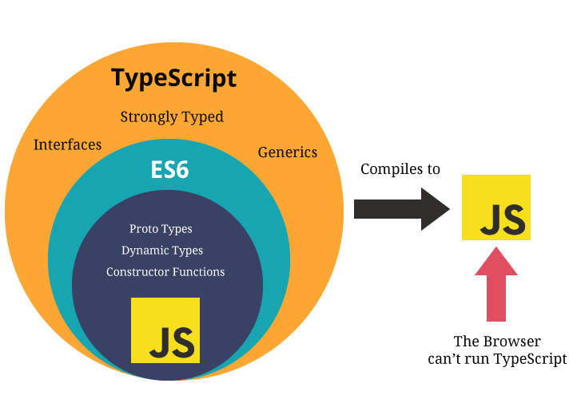
TypeScript https://www.typescriptlang.org/docs/handbook/typescript-from-scratch.html https://angular.io/guide/glossary
The relationship between TypeScript (TS) and JavaScript (JS) is unique among modern programming languages.
TypeScript checks JavaScript programs for errors before execution. It does so based on the kinds (types) of values. TypeScript is a static type checker.
TypeScript is a typed superset of JavaScript. This means that it ‘transpiles’ to plain JavaScript.
TypeScript enforces strict typing along with other rules. It has classes, modules, type checking, and interfaces.
TypeScript must be transpiled into JavaScript code to be run.
Transpiles to

Slide 5
TypeScript – Overview https://www.typescriptlang.org/docs/handbook/typescript-from-scratch.html https://angular.io/guide/glossary
Static Checking* – The process of detecting errors in code without running it.
TypeScript is a Static Type Checking language. It checks a program for errors before it’s run based on the types of the values.
TypeScript is a Superset of JavaScript. All JavaScript syntax is legal within a .ts (TypeScript) file.
You don’t need ‘use strict’.
All JavaScript rules also apply to TypeScript.
There are no browsers that can run TypeScript. It must be ‘transpiled’ to JS.
Transpiles to
*Dynamic Type Checking is when type checking is done at runtime

Slide 6
TypeScript – Compiling vs Transpiling https://www.stevefenton.co.uk/2012/11/compiling-vs-transpiling/ https://code.visualstudio.com/docs/typescript/typescript-compiling https://www.typescriptlang.org/play
“Transpiling” vs. “Compiling”
Compiling is the term for taking source code written in one language and transforming it into another, more basic, language.
Transpiling is a specific term for taking source code written in one language and transforming into another language that has a similar level of abstraction.
Click here to see TS and JS compared.
Transpiles to

Slide 7
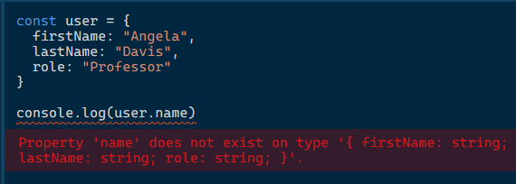
TypeScript – Types https://www.typescriptlang.org/docs/handbook/typescript-from-scratch.html
TypeScript adds rules about how different value types can be used. TypeScript can infer value types and will enforce explicit and inferred types throughout a program.
TypeScript’s type system imposes restrictions that are designed to allow correct programs through, while catching as many common errors as possible.
JS allows division by an empty set while TS will not. The below example in JS will print NaN, but TS will give an error.
If you transpile code from a TypeScript file to a JavaScript file, type errors that are legitimate problems with the code are noted, but it could also be that TypeScript is being overly conservative.

Slide 8
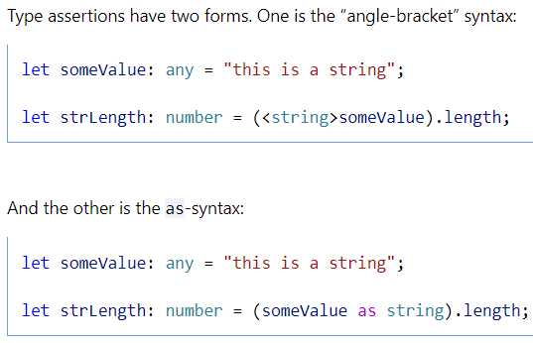

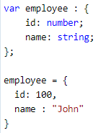

TypeScript Type Annotations https://www.tutorialsteacher.com/typescript/type-annotation https://www.typescriptlang.org/docs/handbook/basic-types.html#type-assertions
One of the primary benefits of TypeScript over JavaScript is that variable types can be explicitly specified. This is done with Type Annotations (Type Assertions).
A Type Annotation is placed after the name of the variable (or parameter, property, etc).
TypeScript has all the primitive types of JavaScript plus adds some new ones.
: void

Slide 9
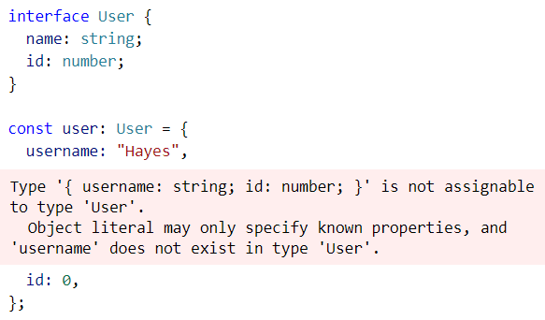
Type Definitions https://www.typescriptlang.org/docs/handbook/typescript-in-5-minutes.html#defining-types
Type Definitions (also known as Type Assertions) are used to define the type for a variable or object.
TypeScript supports classes and OOP.
There are two syntaxes for building types: Interfaces and Types.
TypeScript infers most types, but you can enforce strict typing by using an interface to declare a class. TypeScript will enforce the typing declared in the interface.
Conventionally, interface is used more often.
Use type when specific properties on objects need to be enforced.
The above interface is declared and later an
object is instantiated based on the User interface.
TypeScript will throw an error if a property
called username is inserted.

Slide 10
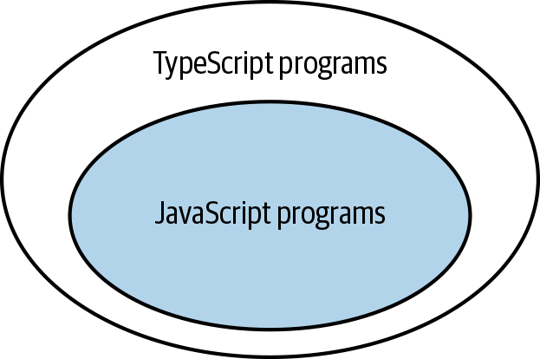
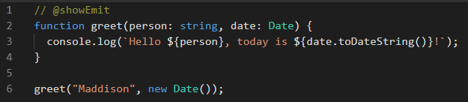
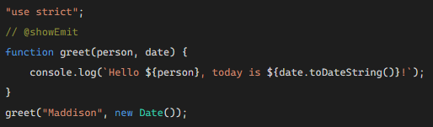
TypeScript – Erased Types https://www.typescriptlang.org/docs/handbook/typescript-from-scratch.html#erased-types
Due to Typescript‘s type annotations there are no browsers that can run TypeScript itself.
TypeScript has its own compiler that strips out (erases) TypeScript-specific code so that it can be run as JavaScript.
After transpilation, no type information in the resulting JS code is left.
TypeScript preserves the runtime behavior of JavaScript.
Typescript never changes the behavior of a program based on the types inferred. This means the type system has no influence on how a program works once it’s running.
Typescript uses JavaScript libraries so there’s no additional Typescript-specific framework to learn.
TypeScript
JavaScript

Slide 11
TypeScript – Primitive Types https://www.typescriptlang.org/docs/handbook/typescript-in-5-minutes.html#defining-types https://www.typescriptlang.org/docs/handbook/basic-types.html
TypeScript uses all JavaScripts data types. TypeScript extends JavaScript types with a few of its own.
Type | Purpose
any | Allow any type
unknown | Ensure someone using the type declares what the type is. Unknown is the type-safe counterpart of any.
never | Represents the type of values that never occur. EX. never is the return type for a function expression that always throws an exception or one that never returns.
void | A function which returns undefined or has no return value

Slide 12

Duck-Typing (Structural Type System) https://www.javatpoint.com/typescript-duck-typing
‘Duck-Typing’ is a method/rule used to check the type compatibility for more complex types.
TypeScript uses ‘duck-typing’ to compare objects. It checks that both objects have the same matching names and types.
If two objects have different properties, functions, or types, the TypeScript compiler will generate a compile-time error.

Slide 13
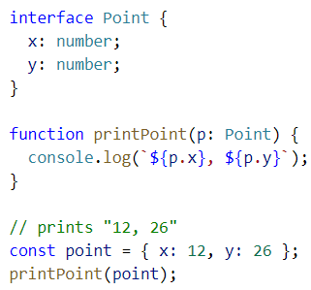
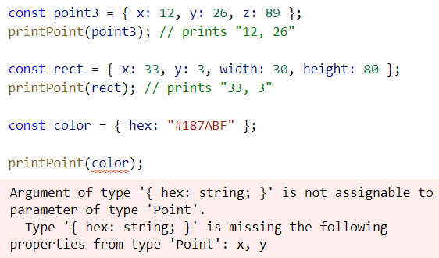
TypeScript – Structural Type System https://www.typescriptlang.org/docs/handbook/typescript-in-5-minutes.html#structural-type-system
A core principle of TypeScript is that type checking focuses on the shape (structure) that objects have. This is called “Structural Typing” (“Duck Typing”). The compiler only checks that (at minimum) the variable names required are present in arguments passed and that they match the types required.
1. Declare an
interface object.
Prints 2 of the 3 parameters
2. Define a function
that takes
that object.
Prints 2 of the 4 parameters
ERROR Result
3. Instantiate the object.
4. Invoke the function.

Slide 14
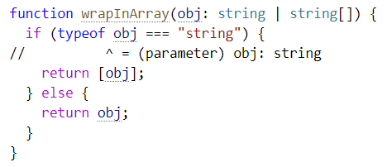
TypeScript – Composing Types https://www.typescriptlang.org/docs/handbook/typescript-in-5-minutes.html#composing-types
Because JavaScript has loose typing, the type of a variable in TypeScript code may need to be verified at runtime so the code can take appropriate action.
A Union allows you to declare what the type could be.
Type | Predicate*
string | typeof myString === “string”
number | typeof myNum === “number”
boolean | typeof myBool === “boolean”
undefined | typeof undef === “undefined”
function | typeof myFunc === “function”
array | Array.isArray(a)
*Often used in a if-else comparison.

Slide 15
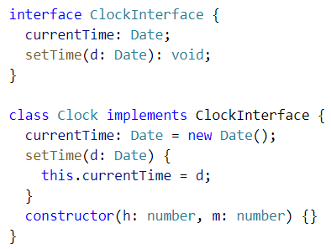
TypeScript Interfaces and Class Types https://www.typescriptlang.org/docs/handbook/interfaces.html#class-types
Interfaces are a great way to explicitly enforce that a class meets a particular contract for properties and functions.
In TypeScript, Interfaces only describe the public properties and fields of a class.

Slide 16
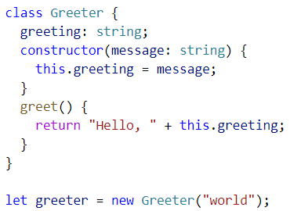
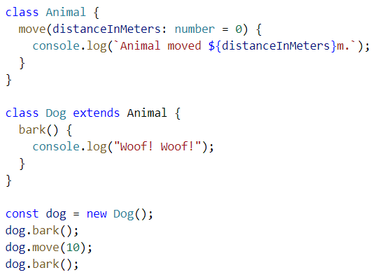
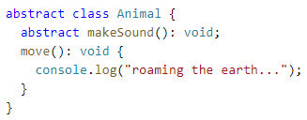
TypeScript Classes and Inheritance https://www.typescriptlang.org/docs/handbook/classes.html
TypeScript developers can use OOP techniques like inheritance.
Abstract classes in TypeScript and JavaScript may only be inherited.

Slide 17
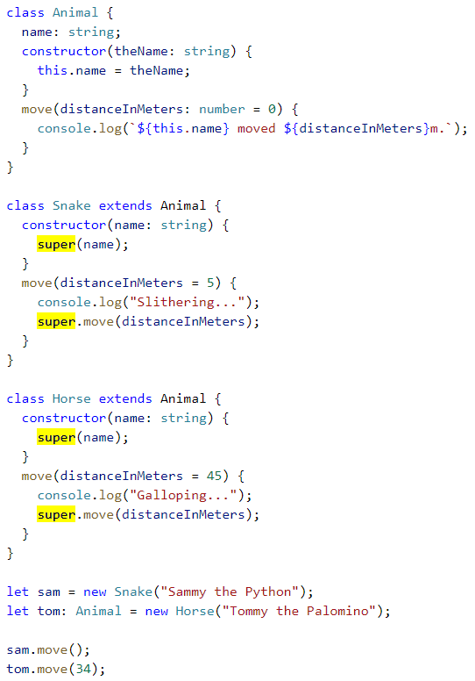
TypeScript Inheritance with this https://www.typescriptlang.org/docs/handbook/classes.html#inheritance
As in JavaScript, each derived class that contains a constructor function must call super() to execute the constructor of the base(parent, super…) class and before any property on this is accessed from within the constructor body.
This is a rule that TypeScript will enforce.

Slide 18
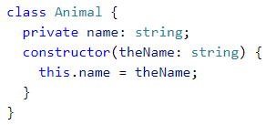

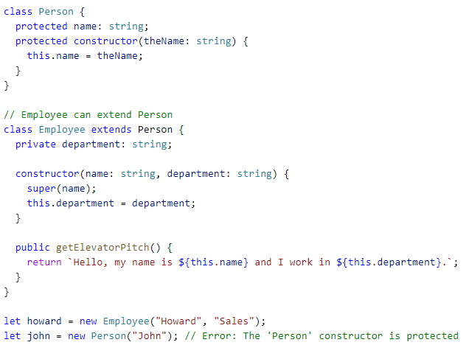
TypeScript – Class Property Modifiers https://www.typescriptlang.org/docs/handbook/classes.html#public-private-and-protected-modifiers
In TypeScript, each class member is public by default.
TypeScript members can be private.
TypeScript supports the new JavaScript syntax for private fields.
Private fields cannot be accessed from outside of their containing classes.
Protected members can be accessed from within their class and deriving classes.
A protected class constructor means that the class cannot be instantiated outside of its containing class but can be extended.
Readonly properties must be initialized at their declaration or in the class constructor.

Slide 19
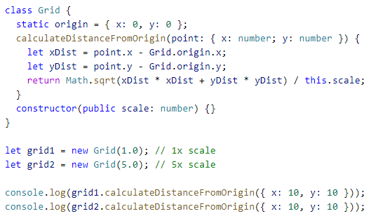
TypeScript – Static Class Properties https://www.typescriptlang.org/docs/handbook/classes.html#static-properties
Static members of a class are only accessible on the class itself. Not on the instances.
Each class instance accesses this shared value through prepending the name of the containing class.

Slide 20
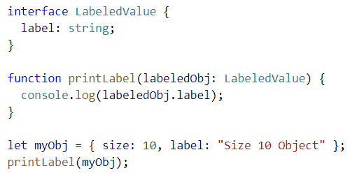
TypeScript Interfaces https://www.typescriptlang.org/docs/handbook/interfaces.html
Here, LabeledValue is an interface with a string property, label.
It is not required to explicitly state that the object passed into a function implements an interface (as in C#).
In TS, only the objects’ shape matters. If the argument passed into the function meets the requirements listed (the shape), it is allowed.
Type checking does not require that properties come in any specific order.
The only requirement is that property names required by the interface must be present* AND have the required type.
*Mark a property optional with ‘?’ at the end of the property name.

Slide 21
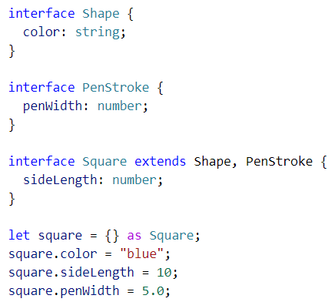
TypeScript – Extending Interfaces https://www.typescriptlang.org/docs/handbook/interfaces.html#extending-interfaces
Classes and Interfaces can extend other Interfaces.
This allows you to copy the members of one interface into another interface or class.

Slide 22
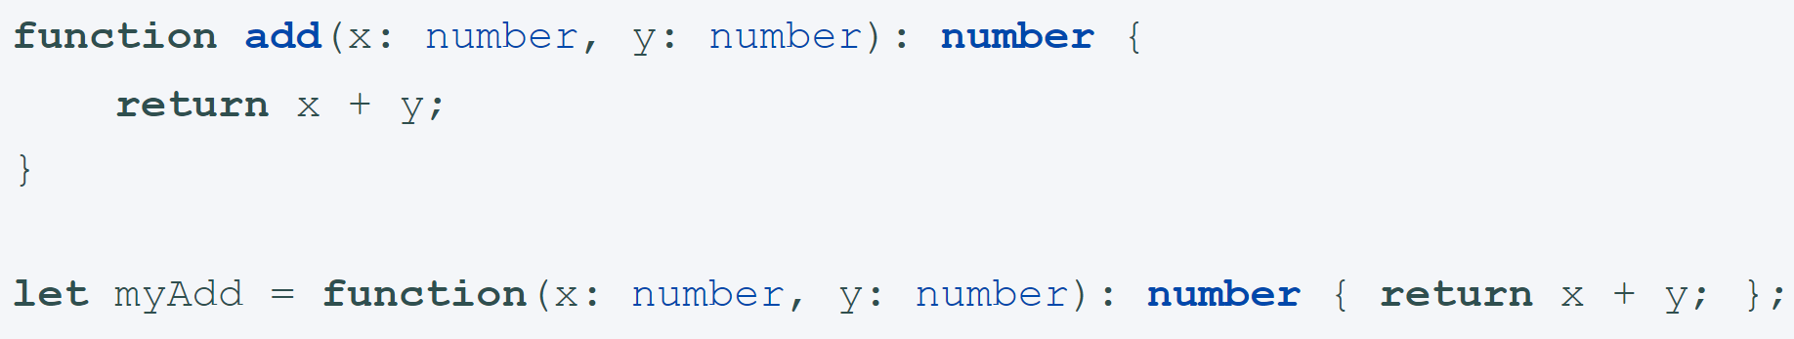
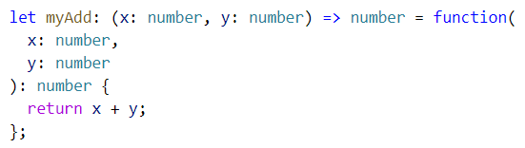
TypeScript Functions https://www.typescriptlang.org/docs/handbook/functions.html
In TypeScript, there are classes, namespaces, and modules. TypeScript adds new capabilities to JS, but functions still play the key role in describing how to complete actions.
TypeScript functions can be named or anonymous. They can also refer to variables outside of the function body, but in scope.
You must explicitly type the parameters of functions.
A function’s type has the same two parts: the type of the arguments and the return type. When writing out the whole function type, both types are required.

Slide 23
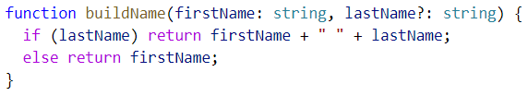


TS Function Parameter Types https://www.typescriptlang.org/docs/handbook/functions.html#optional-and-default-parameters
In TS, every function parameter is assumed to be required by the function.
Make a parameter optional by placing a ‘?’ behind the parameter name.
Optional parameters must be last.
Give parameters default values with ‘paramName = “value”’.
When a default parameter comes last, it is treated as optional.
Rest Parameters (‘…paramName’) in TS are like args parameters in JS.
Rest parameters are treated as optional parameters. The compiler builds an array of the additional arguments passed with the name given after the ellipsis (...).
Optional parameters
Default parameters
Rest parameters

Slide 24
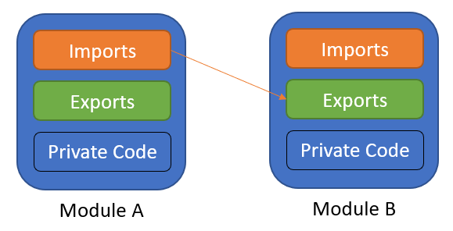
TypeScript Modules https://www.typescriptlang.org/docs/handbook/modules.html
TypeScript shares the JavaScript concept of Modules. Modules in TypeScript have their own scope. A module must be explicitly exported to make its members visible.
To consume a property exported from a different module, it must be imported using an import method.
The relationships between modules are specified in terms of imports and exports at the file level.
In TypeScript, any file containing a top-level import or export is considered a module.
As in JavaScript, a TypeScript file without any top-level import or export declarations is treated as a script whose contents are available in the global scope and in modules as well.

Slide 25

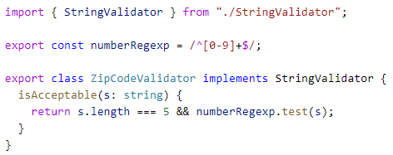
TypeScript - Exporting a Declaration https://www.typescriptlang.org/docs/handbook/modules.html#export
Any declaration (variable, function, class, type alias, or interface) can be exported by adding the export keyword before the type keyword.
Use export to make a class, function, or variable available to other modules.
Use an import statement in a module (component) to gain access to a class, function, or variable what has been exported.

Slide 26
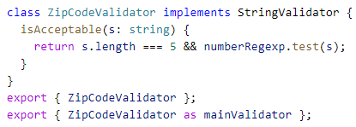


TypeScript - Export https://www.typescriptlang.org/docs/handbook/modules.html#export-statements
export and import statements allow you to rename a module.
Conventionally, import statements are listed at the top of the document while export statements are listed at the bottom.

Slide 27
Create a TS version of GuessingGame (1/2) https://www.valentinog.com/blog/typescript/ https://www.typescriptlang.org/docs/handbook/asp-net-core.html
Create a new folder for this project in your repo.
Make sure you have Node.js with node –v in Command Line. If not, go to nodejs.org to get it.
In Command Line, run npm init –y to create a package.json file.
In Command Line, run npm i typescript --save-dev (dash-dash) to install a TypeScript dev dependency via npm (--save-dev installs for just this program, in dev mode). (why–save-dev?)
In the new package.json file, add to the node script commands a command to compile with tsc. Add “scripts”:{ “tsc”: “tsc”}. “scripts” should already be among the key:value pairs.
Run npm run tsc -- --init (dash-dash, space, dash-dash) in Command Line to create a tsconfig.json file for which the TS compiler (tsc) will look. You should get “message TS6071: Successfully created a tsconfig.json file.” in the Command Line.

Slide 28
Create a TS version of GuessingGame (2/2) https://www.valentinog.com/blog/typescript/ https://www.typescriptlang.org/docs/handbook/asp-net-core.html
Replace all the original content of the tsconfig.json file with:
{ "compilerOptions": { "target": "es5", “module”:”es2015”,"strict": true } }
Why “es2015”?
ES6 is the newest JS release. “strict” enforces the highest level of TypeScript strictness. Visit https://aka.ms/tsconfig.json for info on the tsconfig.json file.
Create a .ts file in the same folder and add .ts code to it. Or complete the Migrating from JavaScript tutorial.
Compile and run with npm run tsc in Command Line. This will transpile the TypeScript code to JavaScript code and create a like-named .js file in the same folder.
Make sure to use <script type=“module” src=“jsFileName.js”> to include the new .js file inside your .html.

