Slide 1

Controller
.NET

Slide 2
Controllers are responsible for responding to requests made against an ASP.NET website. Each browser request is mapped to a particular controller.
https://docs.microsoft.com/en-us/aspnet/mvc/overview/older-versions-1/controllers-and-routing/aspnet-mvc-controllers-overview-cs#understanding-controllers

Slide 3
ASP.NET URL Routing https://docs.microsoft.com/en-us/aspnet/mvc/overview/older-versions-1/controllers-and-routing/asp-net-mvc-routing-overview-cs
The default route in an ASP.NET Core application maps the first addition of a URL to a controller name, the second addition to the controller action, and the third addition to a named parameter. The below URL equates to calling Product.Index(3).
URL
Controller Class
Action Method
Parameter
The routing configuration includes defaults for all three parameters. If a controller is not supplied, the route defaults ‘Home’. If an action is not supplied, the action defaults to ‘Index’. If there’s no id, the id parameter defaults to an empty string.

Slide 4
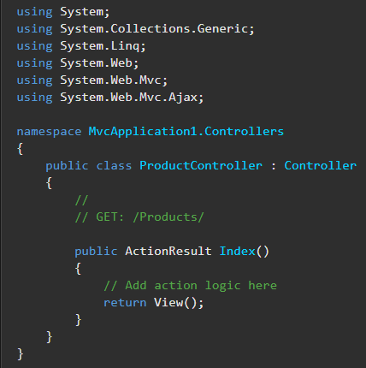
Controllers https://docs.microsoft.com/en-us/aspnet/mvc/overview/older-versions-1/controllers-and-routing/aspnet-mvc-controllers-overview-cs
If the URL, http://localhost/Product/Index/3, is entered into the browser, a controller named ‘ProductController’ is invoked. ProductController is responsible for generating the response to the browser request. Convention (and default) is to route Urls to a named controller.
A controller is a regular C# class that derives from either the base System.Web.Mvc.Controller class for MVC apps or the Microsoft.AspNetCore.Mvc.ControllerBase class for APIs. These base classes provide the controller with valuable functionality.

Slide 5
Controller Actions https://docs.microsoft.com/en-us/aspnet/mvc/overview/older-versions-1/controllers-and-routing/aspnet-mvc-controllers-overview-cs#understanding-controller-actions
An action method is a method in a controller class that gets called when you enter a URL with the action specified. A request is made URL http://localhost/Product/Index/3, will be routed to the Product controller and the Index action with the parameter 3.
URL
Controller Class
Action Method
Parameter
A controller action must be a public method of a controller class. Any public method in a controller class is exposed as a controller action. A method used as a controller action cannot be overloaded.

Slide 6
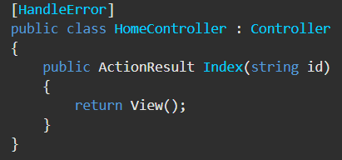
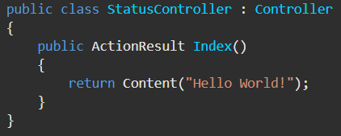
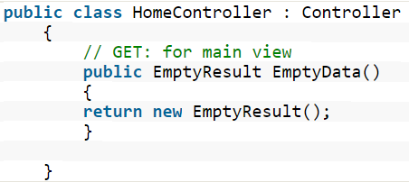
ActionResult<> https://docs.microsoft.com/en-us/aspnet/mvc/overview/older-versions-1/controllers-and-routing/aspnet-mvc-controllers-overview-cs#understanding-action-results
When a browser makes a request, a controller action returns a response in the form of an ActionResult.
ActionResult | Controller Base Class Method | Purpose
ViewResult | Return View(); | Returns a HTML View to the browser
EmptyResult | Return new EmptyResult() | Returns empty (void)
RedirectResult | Return RedirectToAction(Index); | Calls another Action Method.
ContentResult | Content("Hello World!"); | Returns text to the browser

Slide 7
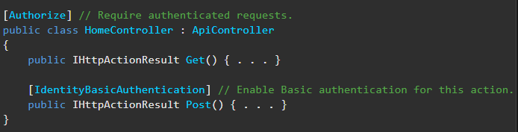
Filter Attributes https://docs.microsoft.com/en-us/aspnet/mvc/overview/older-versions-1/controllers-and-routing/understanding-action-filters-cs#the-different-types-of-filters https://docs.microsoft.com/en-us/aspnet/web-api/overview/security/authentication-filters#setting-an-authentication-filter
The ASP.NET framework supports four different types of filters. Here they are listed in order of execution.
Authorization filters – Implements the IAuthorizationFilter attribute. Always executes first.
Action filters – Implements the IActionFilter attribute.
Result filters – Implements the IResultFilter attribute.
Exception filters – Implements the IExceptionFilter attribute. Always executes last. Can be used for logging.
To implement any filter, create a class that inherits the base Filter class and implements one or more of the IAuthorizationFilter, IActionFilter, IResultFilter, or IExceptionFilter interfaces.

Slide 8
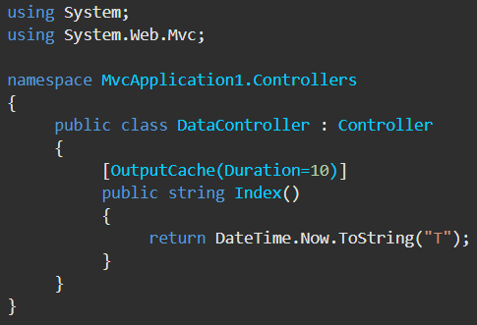
Action Filters https://docs.microsoft.com/en-us/aspnet/mvc/overview/older-versions-1/controllers-and-routing/understanding-action-filters-cs
An action filter is an attribute that you can apply to a controller action or an entire controller. It modifies the way in which the action is executed. The ASP.NET framework includes several action filters:
OutputCache – caches the output of a controller action for a specified amount of time.
HandleError – handles errors raised when a controller action executes.
Authorize – enables you to restrict access to a user or role.
You can also create custom filters.
You can apply more than one action filter at a time.
This OutputCache filter causes the returned value to be cached for 10 seconds. If you repeatedly invoke the Index() action by hitting the Refresh button, you will see the same time for 10 seconds.

Slide 9
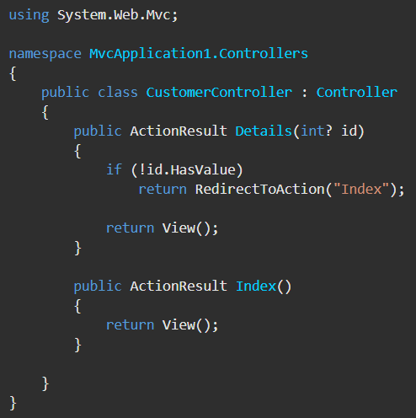
URL Query Parameters https://docs.microsoft.com/en-us/aspnet/mvc/overview/older-versions-1/controllers-and-routing/creating-a-route-constraint-cs
The last part of a Url is the query parameter. This value is passed in the Action Method where it can be acted upon.
To prevent an invalid value from being passed to the Action Method, you can
define constraints when defining routes.
check the value of the parameter and RedirectToAction() to handle the input correctly.

Slide 10
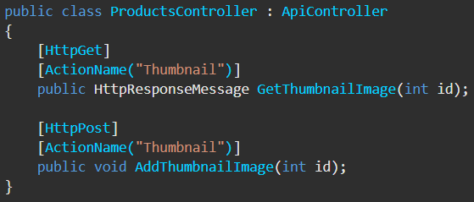
HTTP Verbs in ASP.NET https://docs.microsoft.com/en-us/aspnet/web-api/overview/web-api-routing-and-actions/routing-in-aspnet-web-api
Instead of using the naming convention for HTTP verbs, you can explicitly specify the HTTP verb for an action by decorating the action method with one of the following attributes:
Use attributes to specify the allowed HTTP verbs. You can override the action name given in the URL by using the [ActionName] attribute.
api/products/thumbnail/id maps to both of the below Action Methods.
[HttpGet] | [HttpPut]
[HttpDelete] | [HttpOptions]
[HttpPatch] | [HttpPost]
[HttpHead]

