Slide 1

Data Annotations and Validation
.NET

Slide 2
Data Annotations Attributes enable you to perform validation by adding attributes to a model class property.
https://docs.microsoft.com/en-us/aspnet/mvc/overview/older-versions-1/models-data/validation-with-the-data-annotation-validators-cs

Slide 3

Why Validate User Input?
Client-Side validation gives the user faster error checking. They don’t need to submit a form to see that their input was invalid.
For Client-Side validation, built-in HTML validation attributes can be used. .NET Tag Helpers are designed to work with the jQuery Unobtrusive Validation script. Microsoft jQuery Validation Library, uses jQuery’s Validate Plugin.
Tag Helpers put HTML5 data attributes into form controls, which the Validation Library uses to configure validation logic and display validation messages on the Client-Side. This enables Data Annotations to drive consistent validation on both the Server-Side and the Client-Side (before sending to server).
Custom Client-Side validation is also possible.

Slide 4
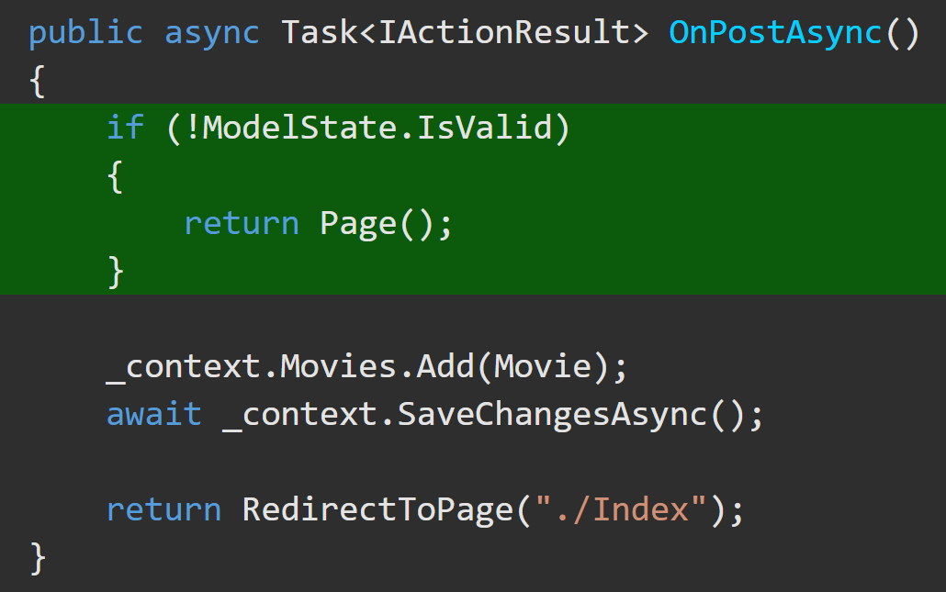
Model State Validation https://docs.microsoft.com/en-us/aspnet/core/mvc/models/validation?view=aspnetcore-5.0#model-state https://docs.microsoft.com/en-us/aspnet/core/web-api/?view=aspnetcore-5.0#automatic-http-400-responses
Both Model Binding and Model Validation occur before the execution of a Controller Action Method. Web apps must manually inspect ModelState.IsValid. If false, redisplay the webpage with an error message.
Web API Controllers using the [ApiController] attribute automatically respond with an HTTP 400 response containing error details.

Slide 5
Model State https://docs.microsoft.com/en-us/aspnet/core/mvc/models/validation?view=aspnetcore-5.0#model-state
Model state comes from the filter pipeline and represents errors that come from two subsystems: Model Binding and Model Validation.
Model Binding errors are generally data conversion errors.
Ex. A string is entered in an integer field.
Model validation occurs after Model Binding and reports errors when data doesn't conform to business rules.
Ex. a 0 is entered in a field that expects a rating between 1 and 5.
A good way to prevent Model Binding errors is to use data annotations on the Model.

Slide 6
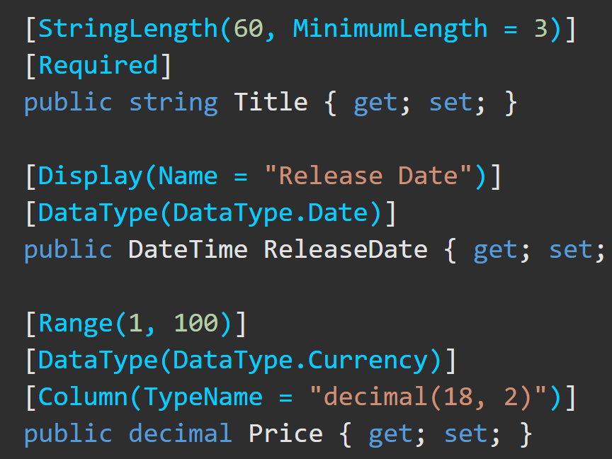
Data Annotations – Overview https://docs.microsoft.com/en-us/aspnet/mvc/overview/older-versions-1/models-data/validation-with-the-data-annotation-validators-cs
The DataAnnotations namespace provides a set of built-in validation attributes that are applied declaratively to a class or property.
DataAnnotations also contains formatting attributes like DataType that help with formatting but don't provide validation.

Slide 7
Validation – Client-Side https://docs.microsoft.com/en-us/aspnet/mvc/overview/getting-started/introduction/adding-validation
Annotation | Explanation
[StringLength] | Validates a string property value doesn't exceed a specified length limit.
[Url] | Validates the property has a URL format.
[Remote] | Validates input on the client by calling an action method on the server.
[MinLength(x)] | Minimum length is x. Also sets DB column size min.
[MaxLength(y, ErrorMessage=“This is required”)] | Maximum length is y and this error message is displayed. Also sets DB column size max.
*Custom createdvalidation is also possible.

Slide 8
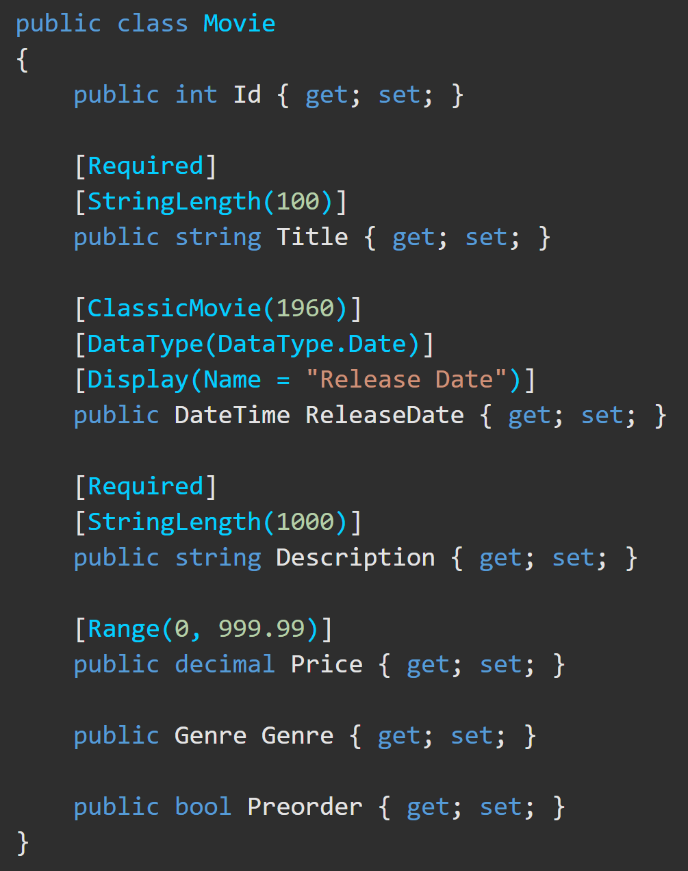
Validation – Client-Side https://docs.microsoft.com/en-us/aspnet/core/mvc/models/validation?view=aspnetcore-5.0#validation-attributes
Attribute | Purpose
[CreditCard] | Validates the property has a credit card format.
[Compare] | Validates two properties in a model match.
[EmailAddress] | Validates the property has an email format.
[Phone] | Validates the property has a telephone number format.
[Range] | Validates the property value falls within a specified range.
[RegularExpression] | Validates the property value matches a specified regular expression.
[Required] | Validates the field is not null.
See a complete list of validation attributes.

Slide 9
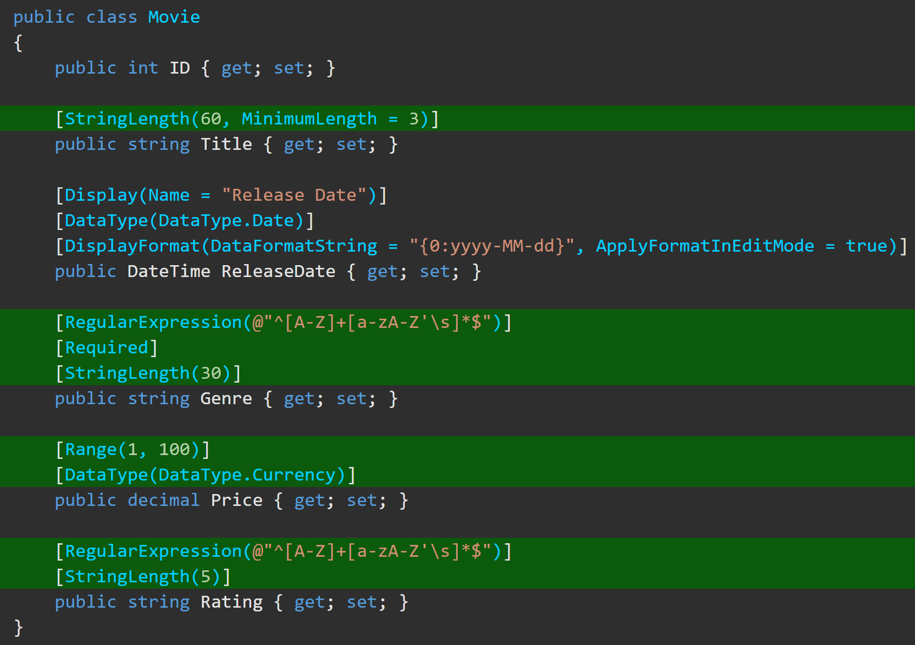
Data Annotations – Examples https://docs.microsoft.com/en-us/aspnet/mvc/overview/getting-started/introduction/adding-validation

Slide 10
Validation – Client-Side Error Messages https://docs.microsoft.com/en-us/aspnet/core/mvc/models/validation?view=aspnetcore-5.0#error-messages
Error messages can be displayed on a web page for the user to see.
When applied to a Name property, the error message created by the preceding code would be "Name length must be between 6 and 8.".

Slide 11
Validation – [Required] Server-Side https://docs.microsoft.com/en-us/aspnet/core/mvc/models/validation?view=aspnetcore-5.0#required-validation-on-the-server
The validation system in .NET Core treats non-nullable parameters or bound properties as if they had a [Required] attribute. Value types such as decimal and int are non-nullable. This behavior can be disabled by configuring the SuppressImplicitRequiredAttributeForNonNullableReferenceTypes property of the options object in Startup.ConfigureServices() to true.
services.AddControllers(options => options.SuppressImplicitRequiredAttributeForNonNullableReferenceTypes = true);

Slide 12
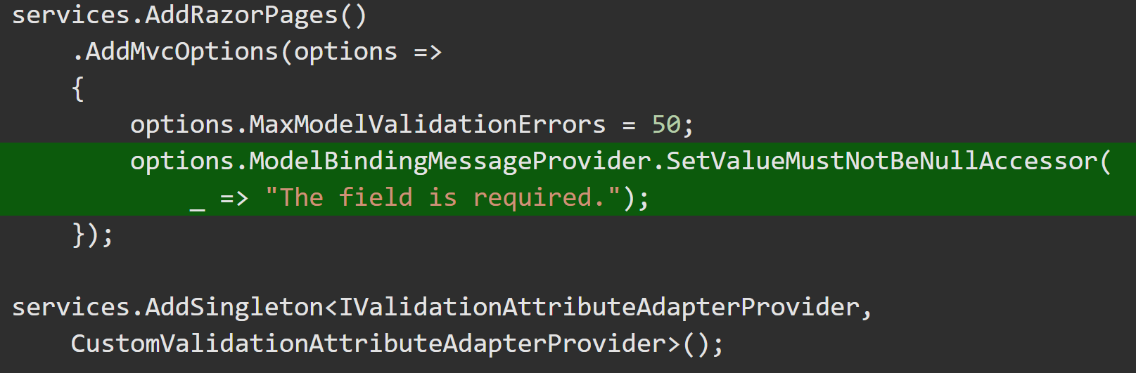
Validation – [Required] Server-Side https://docs.microsoft.com/en-us/aspnet/core/mvc/models/validation?view=aspnetcore-5.0#required-validation-on-the-server
Model Binding for a non-nullable Property can sometimes FAIL. This leaves the value null. On the server, a [Required] value is considered missing if the Property is null, but a non-nullable field (int or decimal) is always counted as valid, server-side. This means the [Required] attribute's error message is never displayed on non-nullable fields when this error occurs.
There are two options to specify a custom error message for server-side validation of non-nullable types.
Make the field nullable (Ex, decimal? instead of decimal).
Specify the default error message to be used by Model Binding. (not recommended)

Slide 13
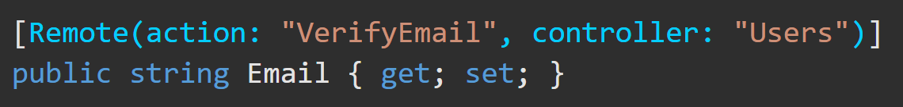
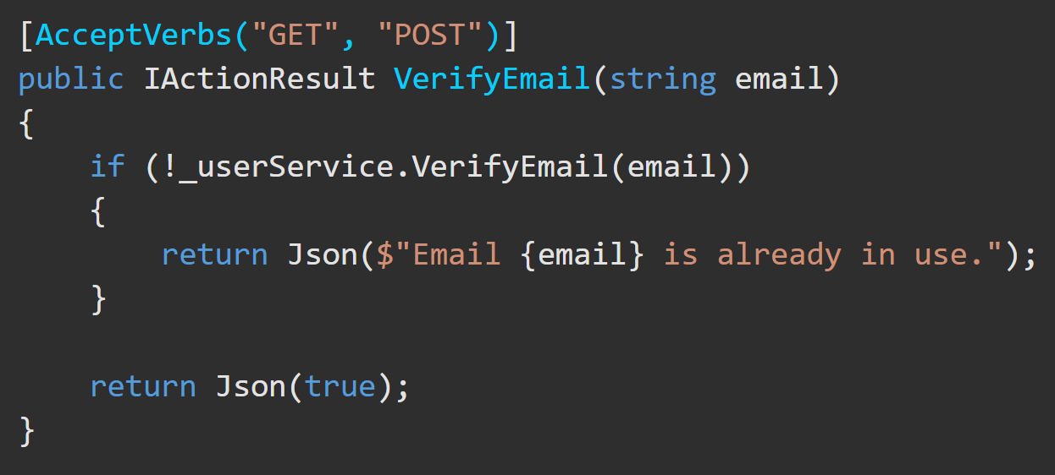
Validation – [Remote] Server-Side https://docs.microsoft.com/en-us/aspnet/core/mvc/models/validation?view=aspnetcore-5.0#remote-attribute
The [Remote] attribute implements client-side validation that requires calling an Action method on the server to determine whether field input is valid. For example, the app may need to verify whether a userName is already in use.
To do this, create an Action method for JavaScript to call. The jQuery Validate remote method expects a JSON response:
true means the input data is valid.
false, undefined, null, or any other string means the input is invalid.
Display the default error message.
Display the string as a custom error message.
*You can also check multiple fields in combination

Slide 14
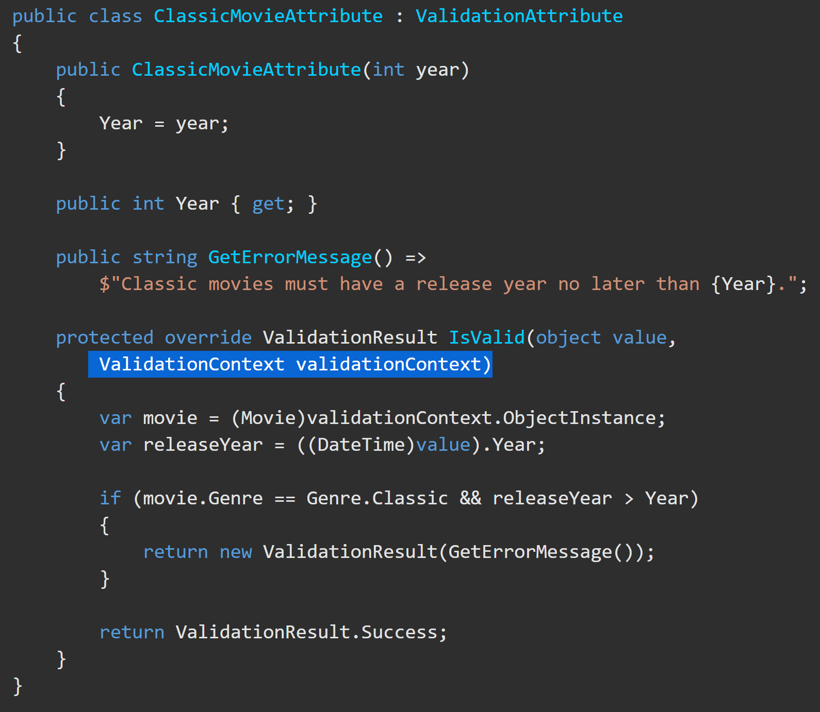
Custom Data Annotations https://docs.microsoft.com/en-us/aspnet/core/mvc/models/validation?view=aspnetcore-5.0#custom-attributes
Create custom validation attributes.
1) Create a class that inherits from ValidationAttribute and contains the data to be validated against as a property.
2) Override IsValid() of ValidationAttribute.
IsValid() accepts an object, which is the input to be validated.
An overload of IsValid() also accepts a ValidationContext object, which provides additional information, like the Model instance created by Model Binding.
This example validates that the release date for a movie in the Classic genre isn’t after a specified year. The [ClassicMovie] attribute is only run on the server.
The Data Annotation syntax on the Model is: [ClassicMovie(1957)]

Slide 15
Validate on leaving a field https://docs.microsoft.com/en-us/aspnet/web-pages/overview/ui-layouts-and-themes/validating-user-input-in-aspnet-web-pages-sites#adding-client-side-validation

Slide 16
EF Code-First Data Annotations https://docs.microsoft.com/en-us/ef/ef6/modeling/code-first/data-annotations#the-model
Data Annotation | Explanation
[Key] | Annotates a property as the Key of the entity .
[Column(order=2)] | Used with [Key] to create a composite column. This will be the 2nd key.
[ForeignKey(“FK_ModelName")] | Marks a certain model as the FK for this model.
[Required] | This property will be required in the Db and client-side.
[NotMapped] | This property will not be mapped to the Db.
[ComplexType] | This annotation is placed on a subtype of a model to alert EF that the property on the model has properties of it own.
[ConcurrencyCheck] | Checks of changes between .SaveChanges() calls.
[Table(“TableName")] | Placed above the Model Class name. Allows you to change the name of the table in the Db.
[Column(“ColumnName”)] | Allows you to name a column other than the property name.
*There are many more available

