Slide 1

.NET Dependency Injection
.NET

Slide 2
A dependency is anything that an object requires in order to function properly. The Dependency injection (DI) design pattern is a technique used to achieve Inversion of Control (IoC) between classes and their dependencies.
https://docs.microsoft.com/en-us/aspnet/core/fundamentals/dependency-injection?view=aspnetcore-5.0

Slide 3
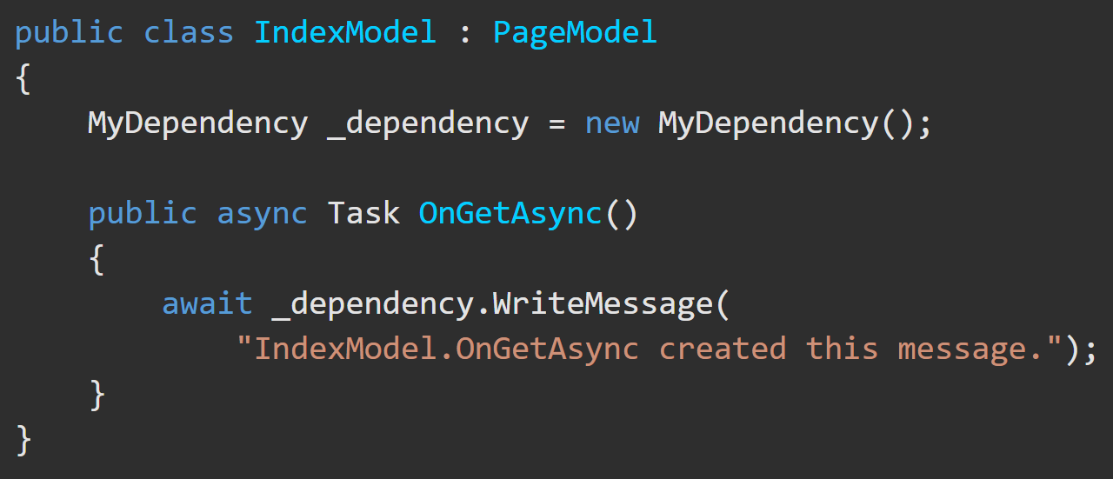
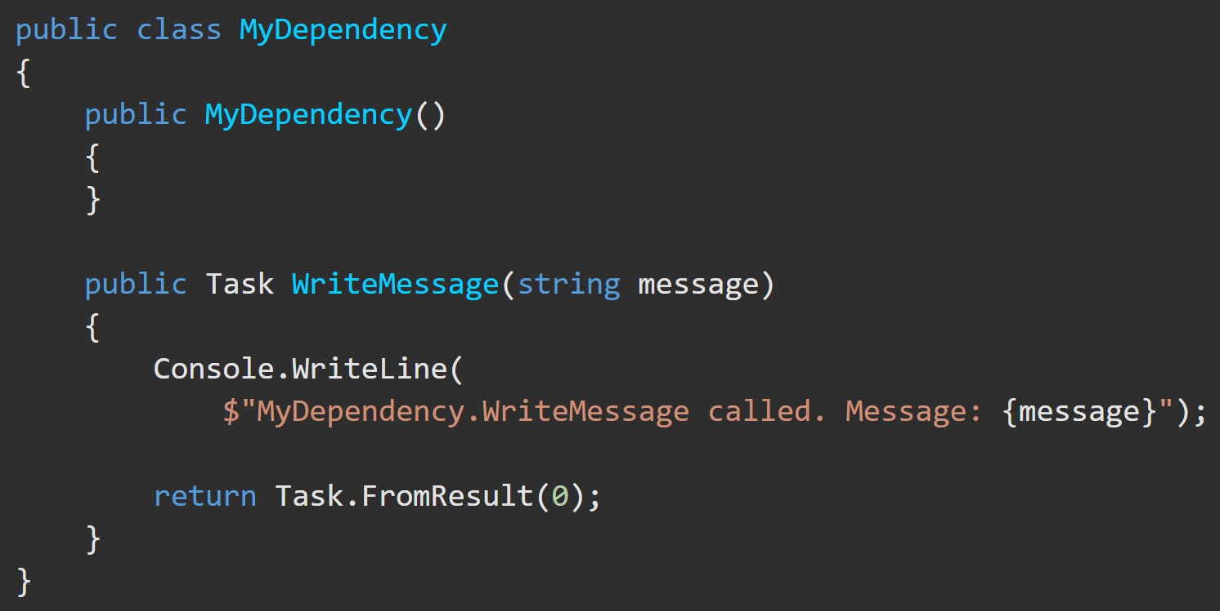
Dependencies Explained https://docs.microsoft.com/en-us/aspnet/core/fundamentals/dependency-injection?view=aspnetcore-5.0
IndexModel class depends on functionality provided by the MyDependency class.
An instance of the MyDependency class can be created in the IndexModel class to make WriteMessage() available to that class.

Slide 4
Dependency Inversion – Overview https://docs.microsoft.com/en-us/aspnet/core/fundamentals/dependency-injection?view=aspnetcore-5.0
Code that is directly dependent on another part of code to function can be problematic and should be avoided.
To replace MyDependency with a different implementation, the class would have to be modified.
If MyDependency has dependencies, they must be configured by the class.
The below implementation is difficult to unit test.

Slide 5
Service Type Lifetimes https://docs.microsoft.com/en-us/aspnet/core/fundamentals/dependency-injection?view=aspnetcore-5.0#transient
Service | Description
Transient | Transient services (AddTransient) are created each time they're requested from the service container. Best for lightweight, stateless services.
Scoped | Scoped lifetime services (AddScoped) are created once per HTTP request (connection).
Singleton | Singleton services (AddSingleton) are created the first time they're requested (or when Startup.ConfigureServices() is run). Every subsequent request uses the same instance.

Slide 6
Dependency Injection – “This is the way” https://docs.microsoft.com/en-us/aspnet/core/fundamentals/dependency-injection?view=aspnetcore-5.0
Dependency injection helps provide services that classes need:
ASP.NET provides a built-in service container called IServiceProvider.
Dependencies are registered in Program.ConfigureServices().
An interface (or base class) is used to abstract the dependency implementation.
Inject the service into the constructor of the class where it's used.
.NET framework takes on the responsibility of creating an instance of the dependency and disposing of it when it's no longer needed.

Slide 7
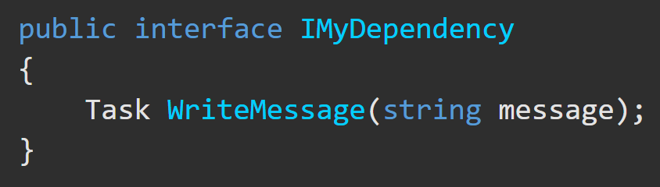
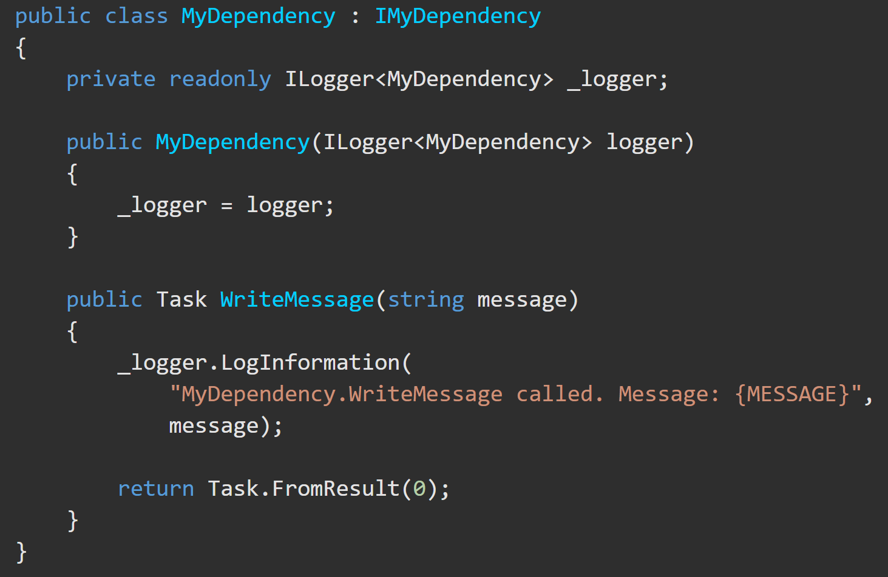
Dependency Injection – Step by Step(1/2) https://docs.microsoft.com/en-us/aspnet/core/fundamentals/dependency-injection?view=aspnetcore-5.0
2)Define the method in a class that implements the Interface.
1) Create an interface where you declare a method that you want to make available through Dependency Injection.

Slide 8
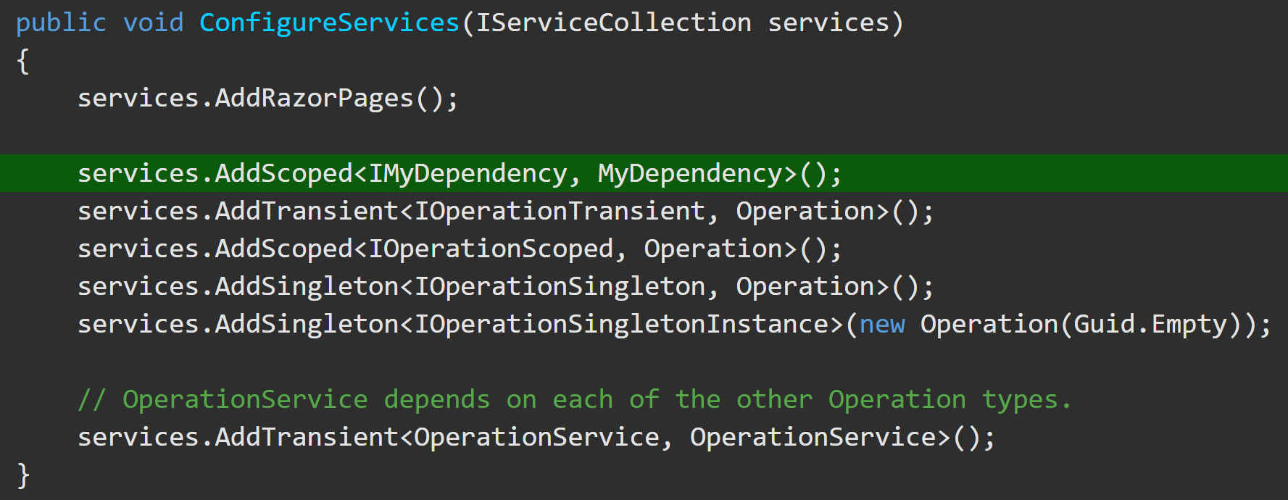
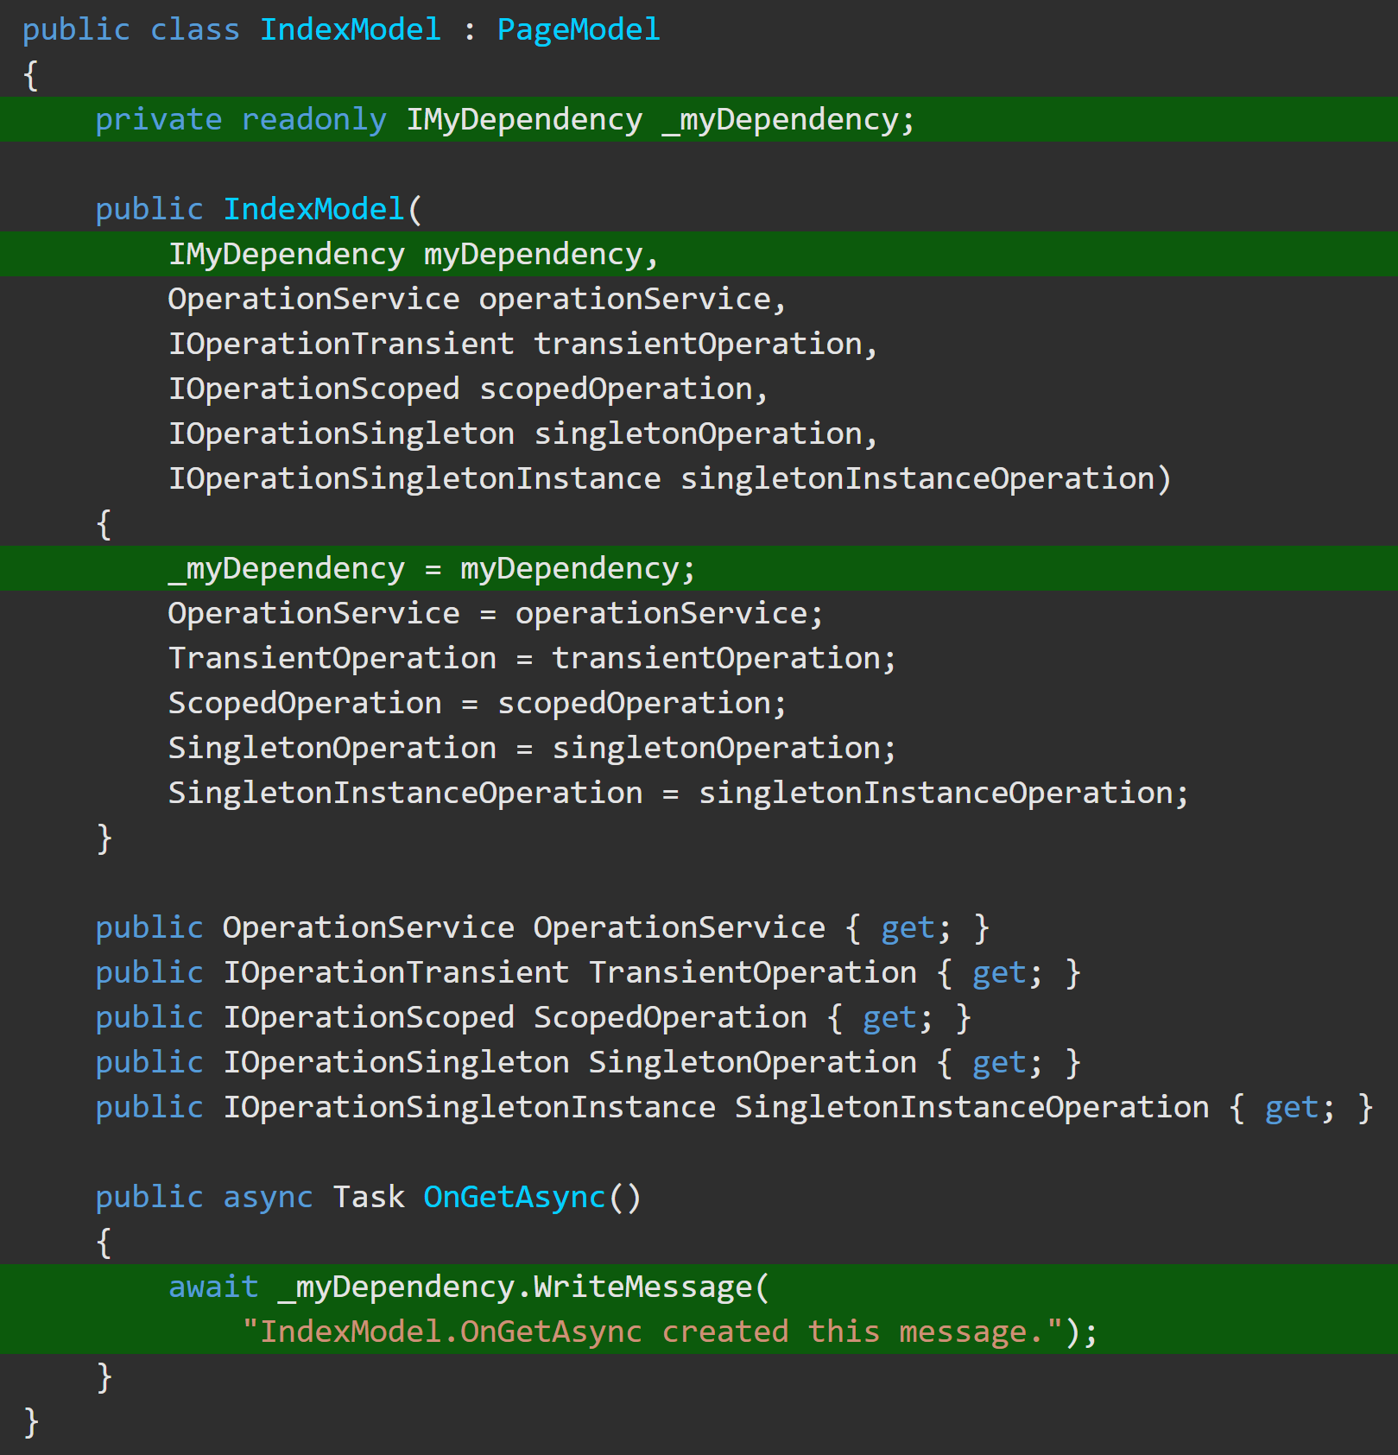
Dependency Injection – Step by Step(2/2) https://docs.microsoft.com/en-us/aspnet/core/fundamentals/dependency-injection?view=aspnetcore-5.0
3)Add the dependency to ConfigureServices() with:
services.[desiredScope]<[interface], [class]>();
4) Inject the dependency into the constructor of the dependent class and assign it to a private variable of the interface type.

Slide 9
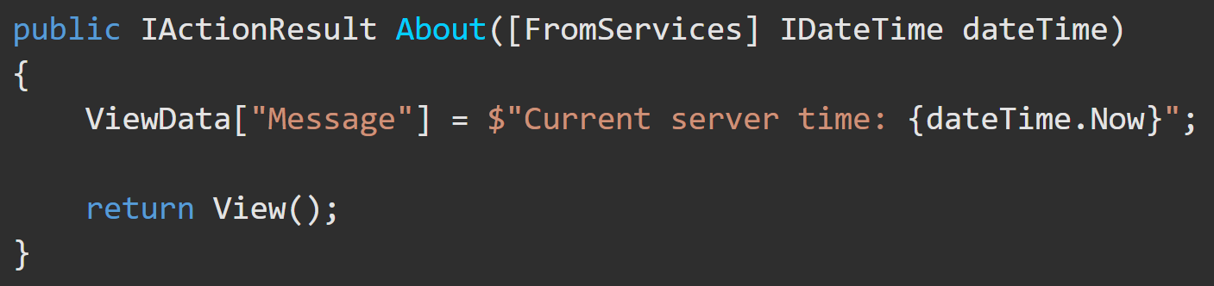
Alternative to Constructor Injection [FromServices] Attribute https://docs.microsoft.com/en-us/aspnet/core/mvc/controllers/dependency-injection?view=aspnetcore-5.0#action-injection-with-fromservices
After registering a service with the service container, the [FromServices] attribute enables injecting the registered service directly into an Action Method without using constructor injection in the Controller.

Slide 10
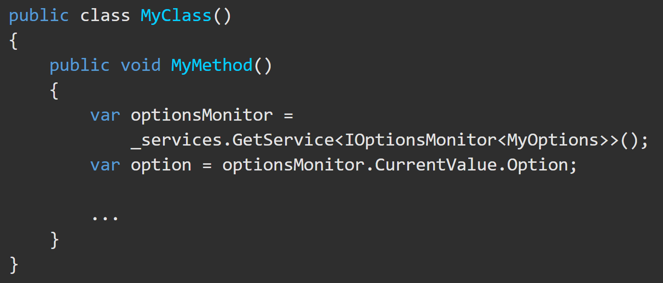
Alternative to Constructor Injection .GetService<>() https://docs.microsoft.com/en-us/aspnet/core/mvc/controllers/dependency-injection?view=aspnetcore-5.0#action-injection-with-fromservices
If you are unable to obtain an instance of a registered service by Dependency Injection, .GetService<> can be used to get a service object.
*Do not invoke GetService to obtain a service instance when you can use DI instead.

Slide 11
Dependency Injection - Examples of Scopes.

Slide 12
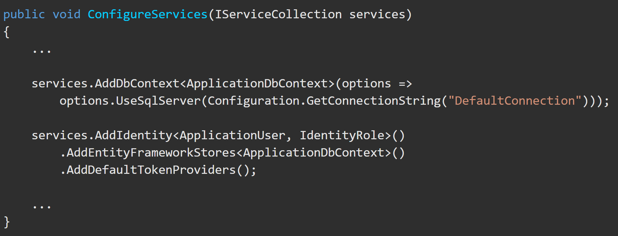
Dependency Injection - .addDbContext https://docs.microsoft.com/en-us/dotnet/api/microsoft.extensions.dependencyinjection.entityframeworkservicecollectionextensions.adddbcontext?view=efcore-5.0 https://docs.microsoft.com/en-us/aspnet/core/fundamentals/dependency-injection?view=aspnetcore-5.0#entity-framework-contexts
The Entity Framework context is usually added to the service container using the scoped lifetime because web app database operations are normally scoped to the client request. The default lifetime is scoped if a lifetime isn't specified by an AddDbContext<TContext>() overload when registering the database context. Services of a given lifetime shouldn't use a database context with a shorter lifetime than the service.

Slide 13
DI – Best Practices (1/2) https://docs.microsoft.com/en-us/aspnet/core/fundamentals/dependency-injection?view=aspnetcore-5.0#design-services-for-dependency-injection
Best design practices are to:
Design services to use dependency injection to obtain their dependencies.
Avoid stateful, static classes and members.
Design apps to use singleton services, which avoid creating global state.
Avoid direct instantiation of dependent classes within services. Direct instantiation couples the code to a particular implementation.
Make classes small, well-factored, and easily tested.
If a class seems to have too many injected dependencies, it’s a sign that the class has too many responsibilities and is violating the Single Responsibility Principle (SOLID).

Slide 14
DI – Best Practices (1/2) https://docs.microsoft.com/en-us/aspnet/core/fundamentals/dependency-injection?view=aspnetcore-5.0#design-services-for-dependency-injection
https://docs.microsoft.com/en-us/aspnet/core/fundamentals/dependency-injection?view=aspnetcore-5.0#recommendations
IServiceProvider requires a public constructor for Dependency Injection.
Dependency Injection is an alternative to static or global object access patterns. You may not be able to realize the benefits of DI if you mix it with static object access.
The IServiceProvider service container is designed to serve the needs of most consumer apps. Use the IServiceProvider container unless you need a specific feature that IServiceProvider doesn't support.

