Slide 1

Model
.NET

Slide 2
The Model in an application represents the state of the application. Business logic should be encapsulated in the model, along with any implementation logic for persisting the state of the application.
https://docs.microsoft.com/en-us/aspnet/core/mvc/overview?view=aspnetcore-5.0#model-binding

Slide 3

Model – Overview https://docs.microsoft.com/en-us/aspnet/core/mvc/overview?view=aspnetcore-5.0#model-responsibilities https://en.wikipedia.org/wiki/Model%E2%80%93view%E2%80%93controller
The model is the central component of the MVC pattern.
It is the application's dynamic data structure. The model receives user input from the view through the controller. The model directly manages the data, logic and rules of the application.

Slide 4
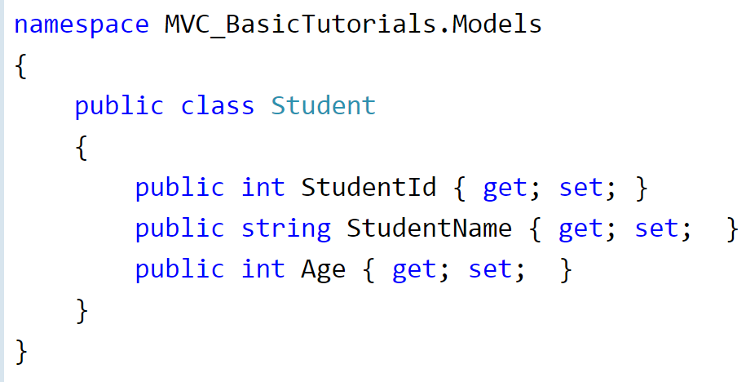
Model – Examples https://www.tutorialsteacher.com/mvc/mvc-model
A Model is a class that holds data in public properties that the program uses as a template for entities in the DB and, through model binding, are connected to user input pages (views), controllers.
Model classes typically reside in the Model folder in MVC folder structure.

Slide 5
What is a DTO?

Slide 6
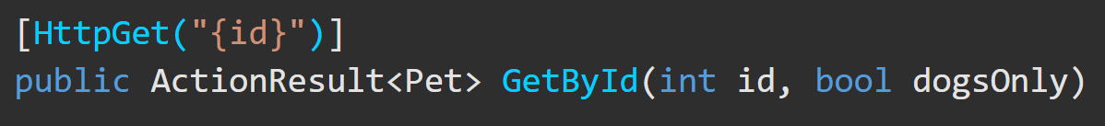
Binding https://docs.microsoft.com/en-us/aspnet/core/mvc/overview?view=aspnetcore-5.0#model-binding https://docs.microsoft.com/en-us/aspnet/core/mvc/models/model-binding?view=aspnetcore-5.0
Controllers work with data that comes from HTTP requests. The HTTP request could provide a record key or data from form fields providing values for the properties of a model. Writing code to retrieve each of these values and convert them from strings to .NET types would be tedious and error-prone. Model binding automates this process.
The model binding system:
Retrieves data from various sources such as route data, form fields, and query strings.
Provides the data to controllers as method parameters and public properties.
Converts string data to .NET types.
Updates properties of complex types.

Slide 7
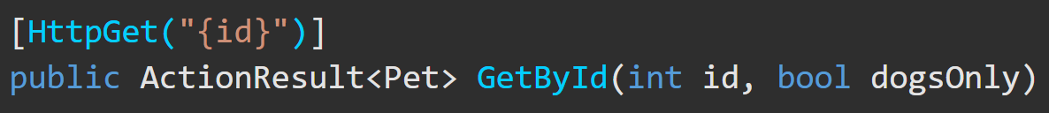
Model Binding – https://docs.microsoft.com/en-us/aspnet/core/mvc/models/model-binding?view=aspnetcore-5.0#example
If your app receives the URL, http://myapp.com/api/GetByID/2?DogsOnly=true, the following steps happen on the action method,
Model binding goes through the following steps after the routing system selects the action method:
Finds the first parameter of GetByID, an integer named id.
Looks through the available sources in the HTTP request and finds id = "2" in route data.
Converts the string "2" into integer 2.
Finds the next parameter of GetByID, a boolean named dogsOnly.
Looks through the sources and finds "DogsOnly=true" in the query string. Name matching is not case-sensitive.
Converts the string "true" into boolean true.
Calls the GetById method, passing in 2 for the id parameter, and true for the dogsOnly parameter.

Slide 8
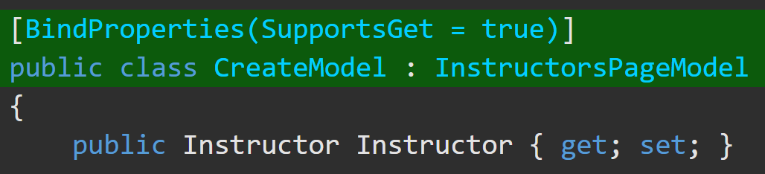
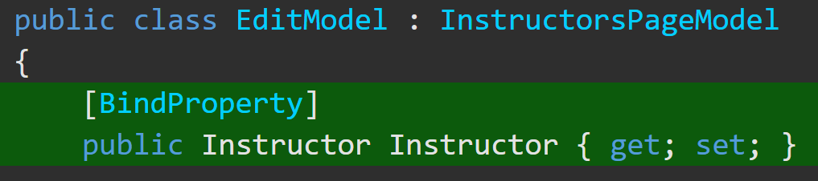
Model Binding Targets https://docs.microsoft.com/en-us/aspnet/core/mvc/models/model-binding?view=aspnetcore-5.0#example
Modelbinding tries to find values for 3 kinds of targets:
Parameters of the controller action method that a request is routed to.
Parameters of the Razor Pages handler method that a request is routed to. (Razor Pages Only)
Public properties of a controller or PageModel class, if specified by attributes.
The [BindProperty] attribute can be applied to a public property of a controller or PageModel class to cause modelbinding to target that property.
Apply [BindProperties] to a controller class to tell model binding to target all public properties of the class.
Apply [BindProperty] to a public property of a controller to cause modelbinding to target that property.

Slide 9
Attributes for Complex Data Types https://docs.microsoft.com/en-us/aspnet/core/mvc/models/model-binding?view=aspnetcore-5.0#attributes-for-complex-type-targets
Add [FromJson]
There are different Annotation attributes for controlling modelbinding of complex types. These attributes affect modelbinding when form data is the source of values.
A complex type must have a public default constructor and public writable properties to bind.
For binding to a parameter, the prefix is the parameter name. Some attributes have a Prefix property that lets you override the default usage of parameter or property name.
Attribute Name | Description
[BindRequired] | Applied only to model properties. Causes modelbinding to add a model state error if binding cannot occur for a model's property.
[BindNever] | Can only be applied to model properties. Prevents model binding from setting a model's property.
[Bind] | Can be applied to a class or a method parameter. Specifies which properties of a model should be included in model binding.

Slide 10
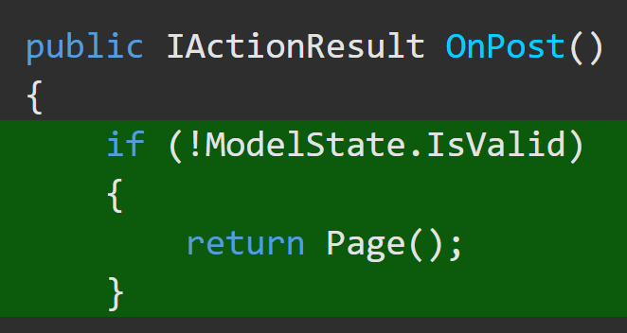
ModelState https://docs.microsoft.com/en-us/aspnet/core/mvc/models/model-binding?view=aspnetcore-5.0#type-conversion-errors https://docs.microsoft.com/en-us/dotnet/api/system.web.mvc.modelstate?view=aspnet-mvc-5.2
The ModelState Class encapsulates the state of modelbinding to a property of an action method argument or to the argument itself.
If a source is found but can't be converted into the target type, model state is flagged as invalid. The target parameter or property is set to null or a default value.
In an API controller that has the [ApiController] attribute, invalid model state results in an automatic HTTP 400 response.
Otherwise, ModelState can be checked manually.

Slide 11
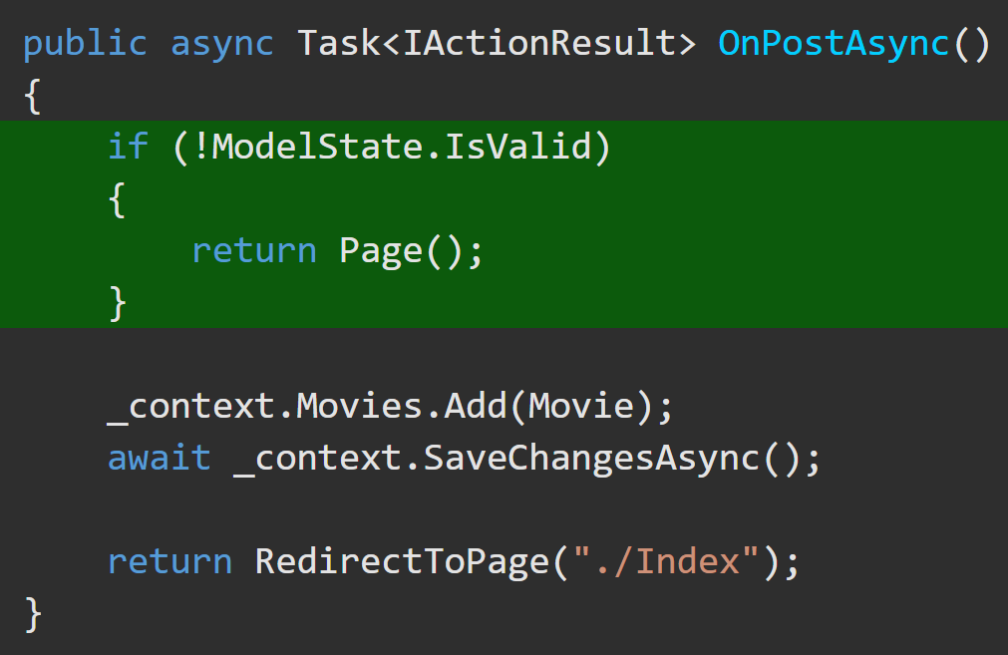
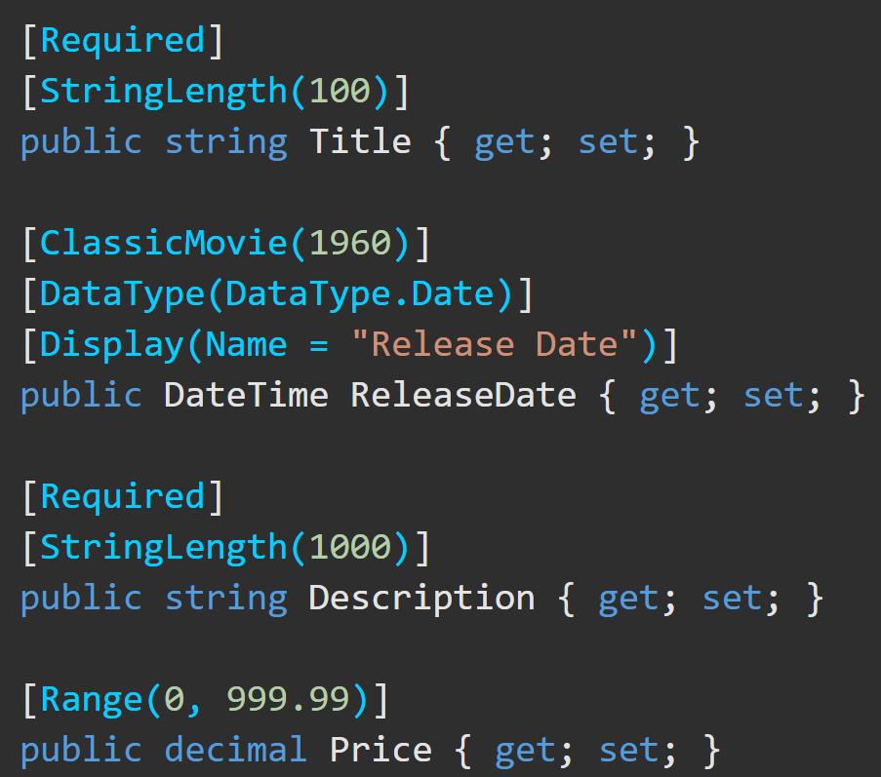
Model Validation https://docs.microsoft.com/en-us/aspnet/core/mvc/models/validation?view=aspnetcore-5.0
Both model binding and model validation occur before the execution of a controller action.
For web apps, if the controller doesn’t have the [ApiController] attribute, it's the app's responsibility to inspect ModelState.IsValid and react appropriately. Web apps typically redisplay the page with an error message.
Validation attributes on the model properties themselves allow you to specify validation rules for model properties.

Slide 12
Available Model Validation Attributes https://docs.microsoft.com/en-us/aspnet/core/mvc/models/validation?view=aspnetcore-5.0#validation-attributes https://docs.microsoft.com/en-us/dotnet/api/system.componentmodel.dataannotations?view=net-5.0
Attribute | Useage
[CreditCard] | Validates that the property has a credit card format.
[Compare] | Validates that two properties in a model match.
[EmailAddress] | Validates that the property has an email format.
[Phone] | Validates that the property has a telephone number format.
[Range] | Validates that the property value falls within a specified range.
[RegularExpression] | Validates that the property value matches a specified regular expression.
[Required] | Validates that the field is not null.
[StringLength] | Validates that a string property value doesn't exceed a specified length limit.
[Url] | Validates that the property has a URL format.
[Remote] | Validates input on the client by calling an action method on the server.
Make sure to check the docs for additional details on these attributes and their usage.

