Slide 1

MVC – Views
.NET

Slide 2
In the Model-View-Controller (MVC) pattern, the view handles the app's data presentation and user interaction. A view is an HTML template with embedded Razor markup.
https://docs.microsoft.com/en-us/aspnet/core/mvc/views/overview?view=aspnetcore-5.0

Slide 3
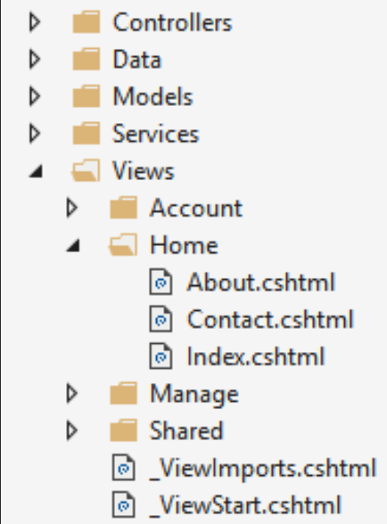
Views – Overview https://docs.microsoft.com/en-us/aspnet/core/mvc/views/overview?view=aspnetcore-5.0
In ASP.NET Core MVC, Views are .cshtml files that use C# in Razor markup. Usually, View files are grouped into folders named for each of an app’s Controllers. The folders are stored in a Views folder at the root of the app
The Home Controller is represented by a Home folder inside the Views folder.
This Home folder contains the Views for the About, Contact, and Index webpages. When a user requests one of these three webpages, Controller Actions in the Home Controller determine which of the three Views is used to Render (build and return) a webpage to the user.

Slide 4

Views – Benefits https://docs.microsoft.com/en-us/aspnet/core/mvc/views/overview?view=aspnetcore-5.0#benefits-of-using-views
Views separate the user interface from other parts of the app.
This helps with Separation of Concerns. The app is easier to maintain because it's better organized.
The parts of the app are loosely coupled. Build and update the app’s Views separate from the business logic and data access components.

Slide 5
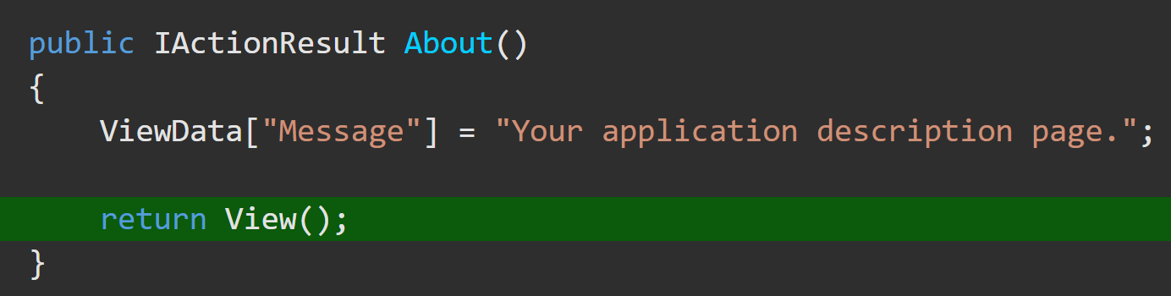
Views – How Controllers Specify Views https://docs.microsoft.com/en-us/aspnet/core/mvc/views/overview?view=aspnetcore-5.0#how-controllers-specify-views
Views are typically returned from actions as a ViewResult, which is a type of ActionResult. Your action method can create and return a ViewResult (not common). Since most controllers inherit from Controller, you simply use the View helper method to return the ViewResult:

Slide 6
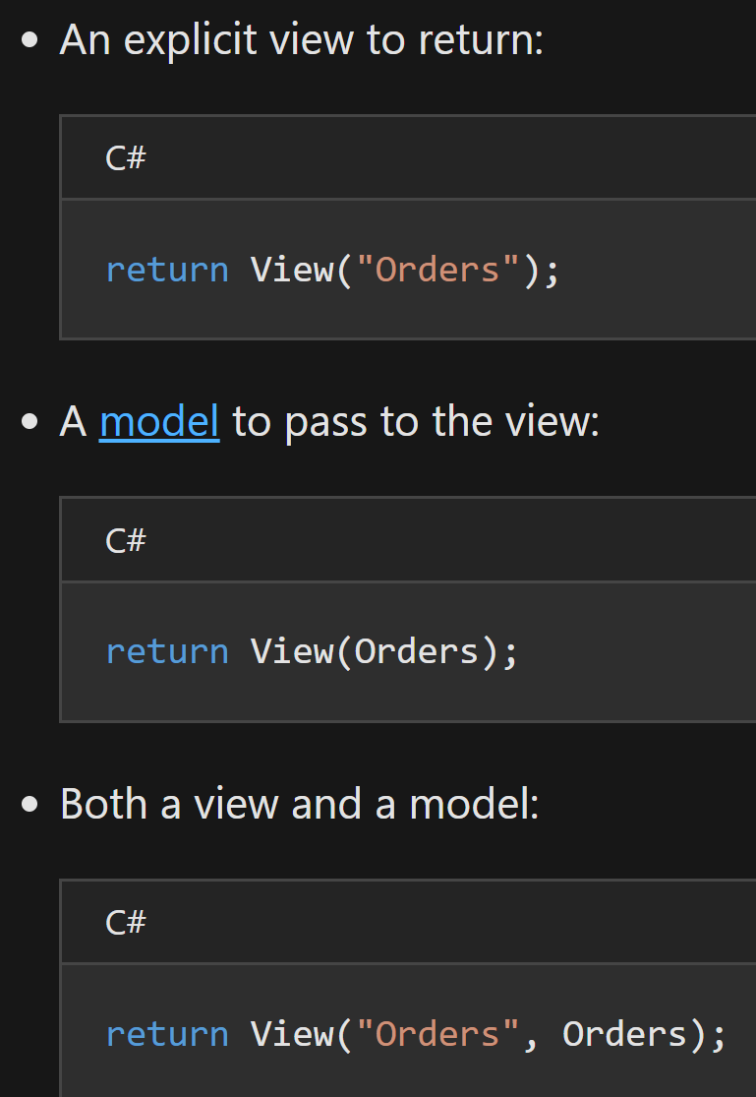
Views – Return Options https://docs.microsoft.com/en-us/aspnet/core/mvc/views/overview?view=aspnetcore-5.0#how-controllers-specify-views
The View helper method has several overloads.

Slide 7

Partial Views https://docs.microsoft.com/en-us/aspnet/core/mvc/views/partial?view=aspnetcore-5.0
A partial view is a Razor markup file (.cshtml) that renders HTML output within another markup file's rendered output. Partial view file names often begin with an underscore (_).
Partial views are an effective way to break up large markup files into smaller components and reduce the duplication of common markup content across markup files.
Partial views shouldn't be used to maintain common layout elements as in _Layout.cshtml, or where complex rendering logic or code execution is required to render the markup.
The Partial Tag Helper renders content asynchronously and uses an HTML-like syntax:

Slide 8
Partial View example

Slide 9
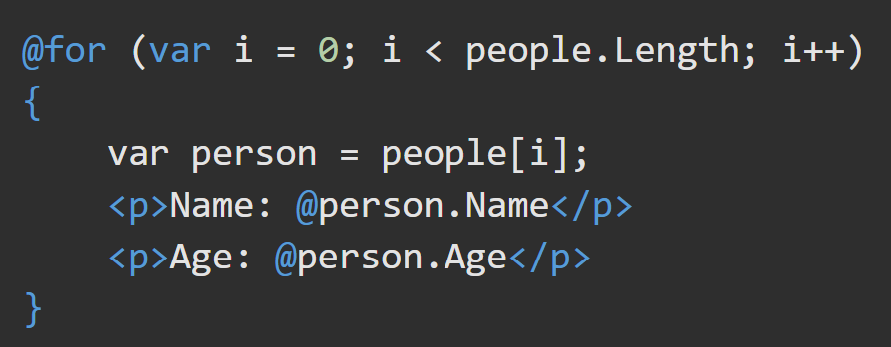
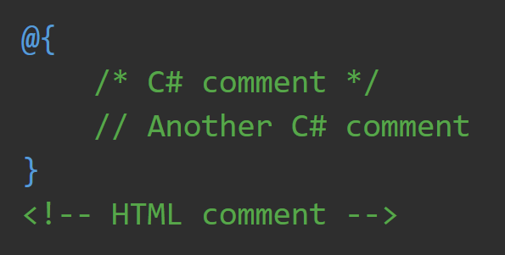
Razor Syntax https://docs.microsoft.com/en-us/aspnet/core/mvc/views/razor https://docs.microsoft.com/en-us/aspnet/core/mvc/views/razor?view=aspnetcore-5.0
Razor is a markup syntax for embedding server-based code into webpages. Razor markup is code that interacts with HTML markup to produce a webpage that's sent to the client. The Razor syntax files end in .cshtml and consist of Razor markup, C#, and HTML.
Razor markup starts with the @ symbol. You can run any C# statement control flow syntax in a Razor markup file by placing C# code within Razor code blocks (marked with curly braces ({ })). You can use C# comment syntax.

Slide 10
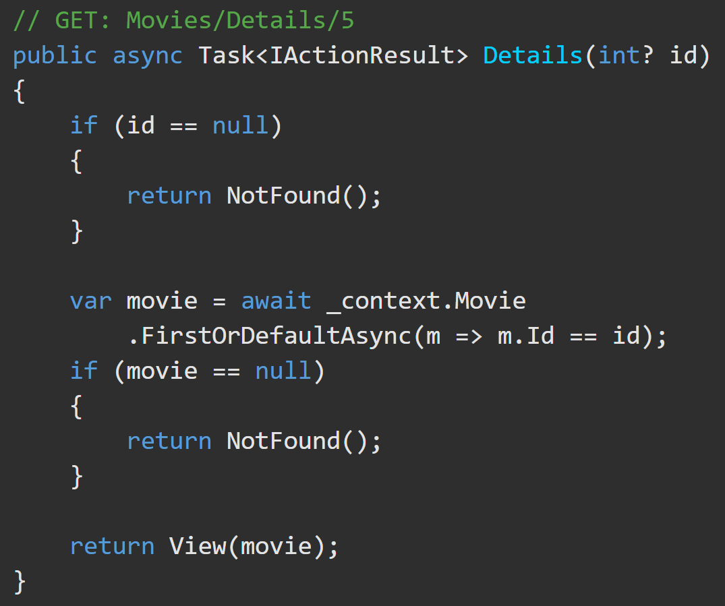
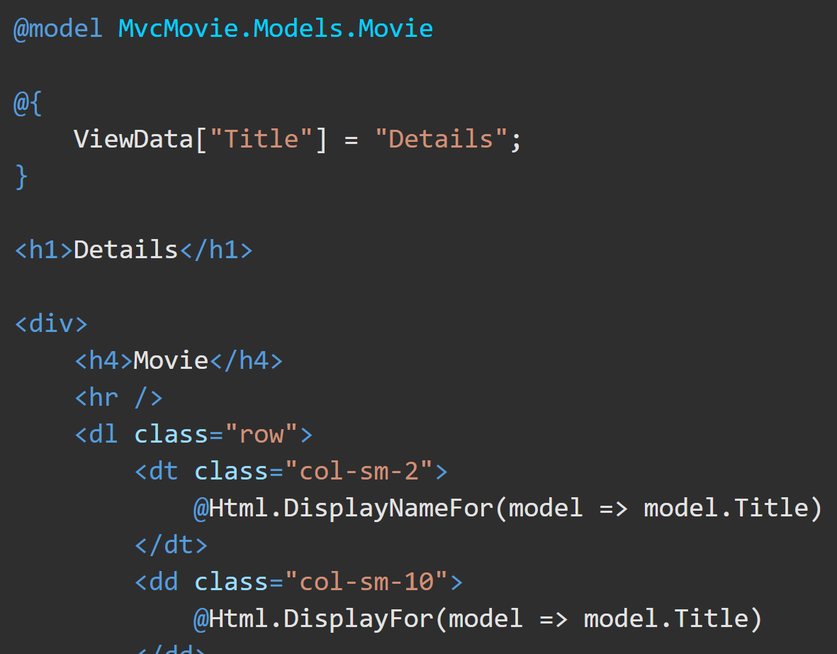
Razor @model directive https://docs.microsoft.com/en-us/aspnet/core/mvc/views/razor?view=aspnetcore-5.0#model https://docs.microsoft.com/en-us/aspnet/core/tutorials/first-mvc-app/adding-model?view=aspnetcore-5.0&tabs=visual-studio#strongly-typed-models-and-the--keyword
MVC provides the ability to pass strongly-typed model objects to a View. This strongly-typed approach enables compile time code checking. The @model directive specifies the type of the model passed to a view.

Slide 11
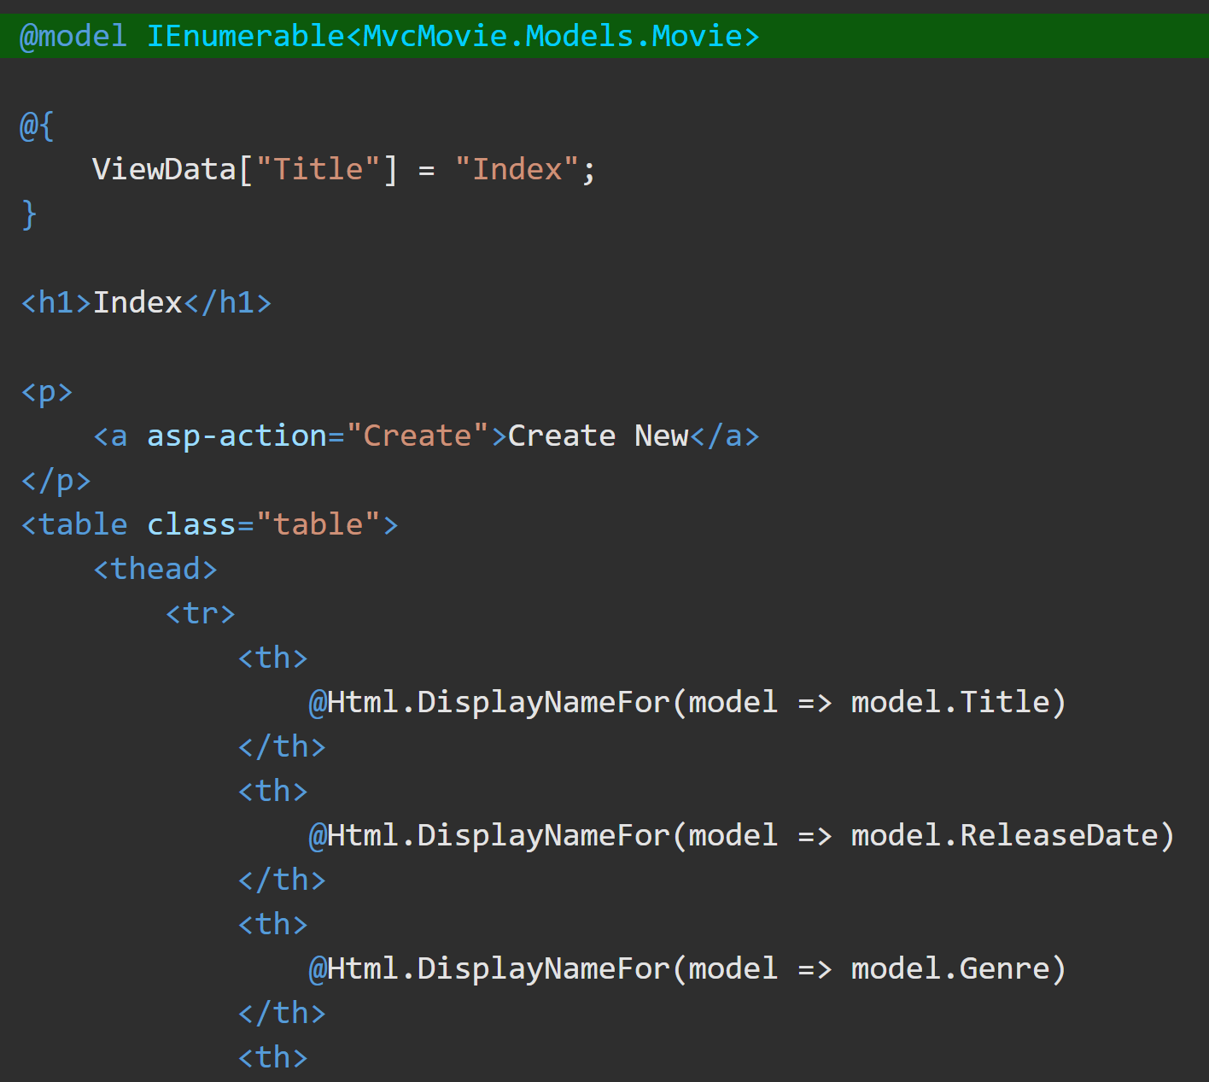
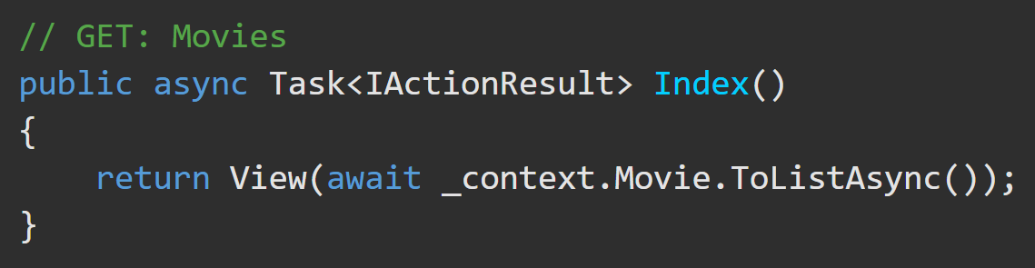
Razor @model directive https://docs.microsoft.com/en-us/aspnet/core/mvc/views/razor?view=aspnetcore-5.0#model https://docs.microsoft.com/en-us/aspnet/core/tutorials/first-mvc-app/adding-model?view=aspnetcore-5.0&tabs=visual-studio#strongly-typed-models-and-the--keyword
The @model directive allows you to access the list of movies that the Controller passed to the view by using a Model object that's strongly typed.
In the Index.cshtml View, the code loops through the movies with a foreach() statement over the strongly-typed Model object.

Slide 12
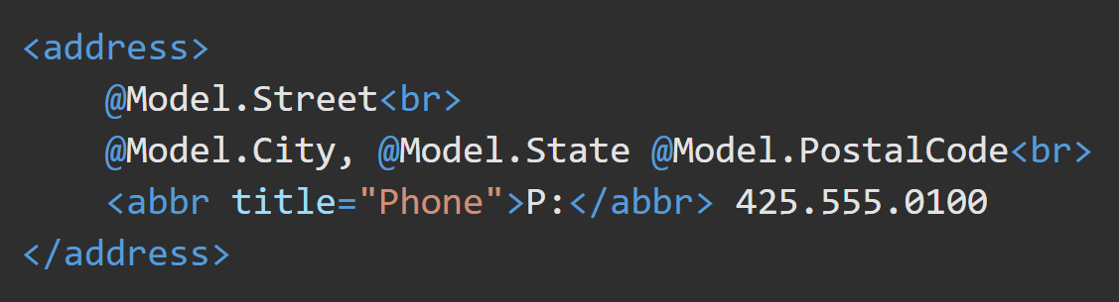
Dynamic Views https://docs.microsoft.com/en-us/aspnet/core/mvc/views/overview?view=aspnetcore-5.0#dynamic-views
Views that don't declare a model type using @model but that have a model instance passed to them (for example, return View(Address);) can reference the instance's properties dynamically. This feature offers flexibility but doesn't offer compilation protection or IntelliSense. If the property doesn't exist, webpage generation fails at runtime.

Slide 13
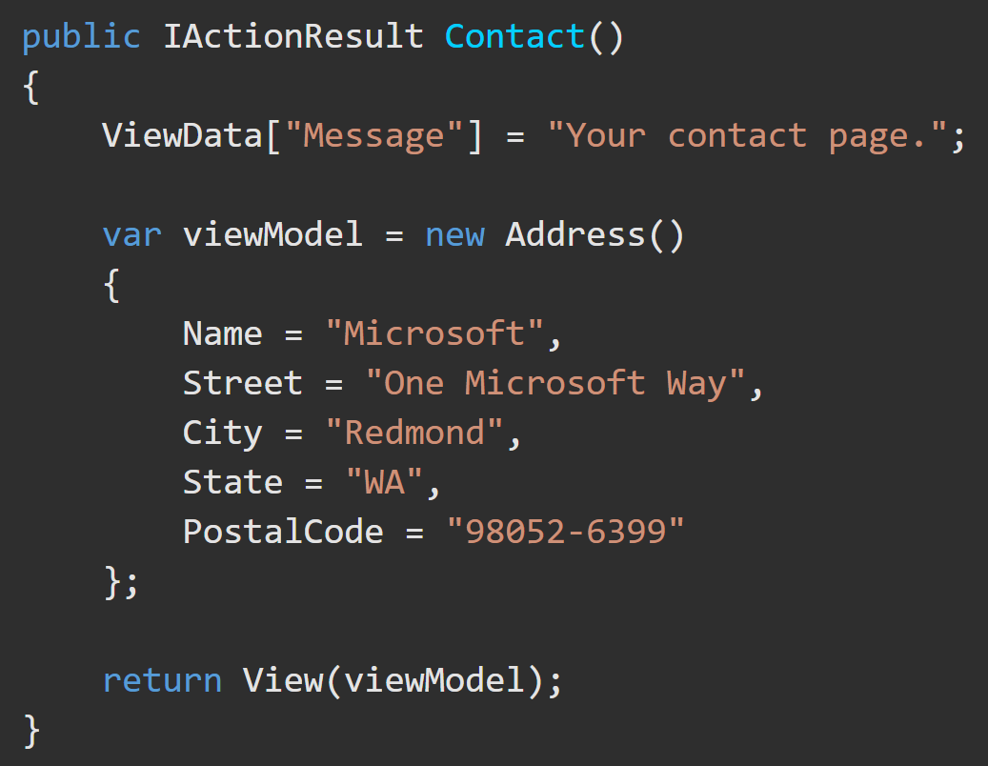
Views – Passing Data https://docs.microsoft.com/en-us/aspnet/core/mvc/views/overview?view=aspnetcore-5.0#passing-data-to-views
You can pass Strongly-Typed data and Weakly-Typed data to views.
Strongly typed – Model or Viewmodel
Specify a model or viewmodel type in the view and pass it from the action method. This allows the view to have strong type-checking(and Intellisense!). Strong typing (or “strongly typed”) means every variable and constant has an explicitly defined type (string, int, DateTime, etc). The validity of types used in a view is checked at compile time.

Slide 14
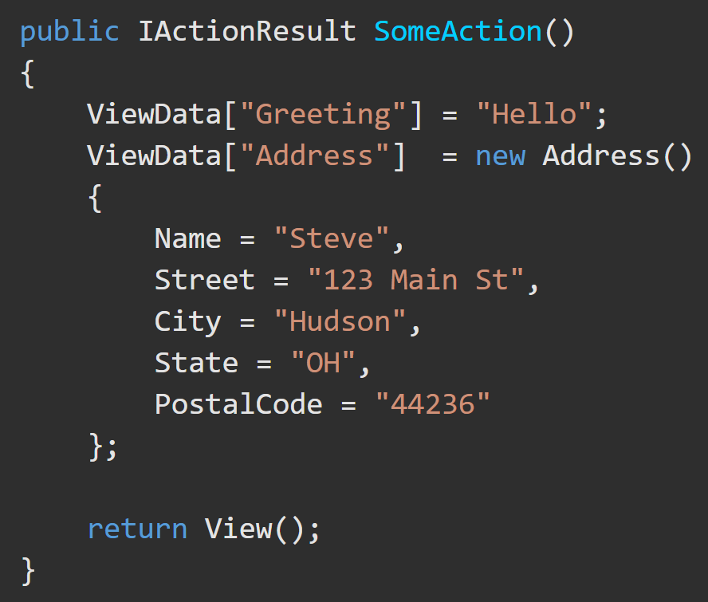
Views – Passing Data https://docs.microsoft.com/en-us/aspnet/core/mvc/views/overview?view=aspnetcore-5.0#weakly-typed-data-viewdata-viewdata-attribute-and-viewbag
Weakly typed ViewData and ViewBag
Weak types (or loose types) means that you don't explicitly declare the type of data you're using. You can use the collection of weakly typed data for passing small amounts of data in and out of controllers and views.

Slide 15
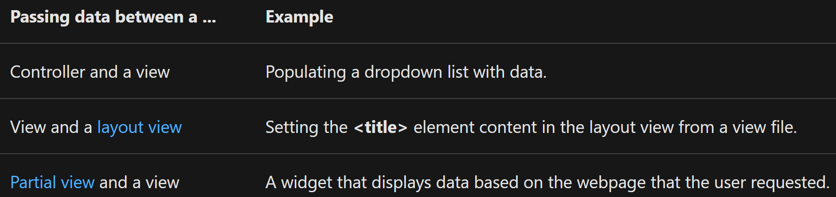
Views – Passing Data https://docs.microsoft.com/en-us/aspnet/core/mvc/views/overview?view=aspnetcore-5.0#weakly-typed-data-viewdata-viewdata-attribute-and-viewbag
ViewData is a Dictionary.
ViewBag is a wrapper around ViewData that provides dynamic properties for the underlying ViewData collection.
Key lookups are case-insensitive for both ViewData and ViewBag.
ViewData and ViewBag don't offer compile-time type checking and are more error-prone than using a viewmodel.
Some developers prefer to minimally or never use ViewData and ViewBag.
Weakly typed – ViewData, ViewDataAttribute, and ViewBag
Weakly typed means that you don't explicitly declare the type of data you're using. You can use the collection of weakly typed data for passing small amounts of data in and out of controllers and views.

Slide 16
ViewData and ViewBag Differences
ViewData() | ViewBag()
Derives from ViewDataDictionary, so it has dictionary properties that can be useful, such as ContainsKey, Add, Remove, and Clear. Keys in the dictionary are strings, so whitespace is allowed. Example: ViewData["Some Key With Whitespace"] Any type other than a string must be cast in the view to use ViewData. | Derives from DynamicViewData, so it allows the creation of dynamic properties using dot notation (@ViewBag.SomeKey = <value or object>), and no casting is required. The syntax of ViewBag makes it quicker to add to controllers and views. Simpler to check for null values. Example: @ViewBag.Person?.Name ViewBag isn't available in the Razor Pages.

Slide 17
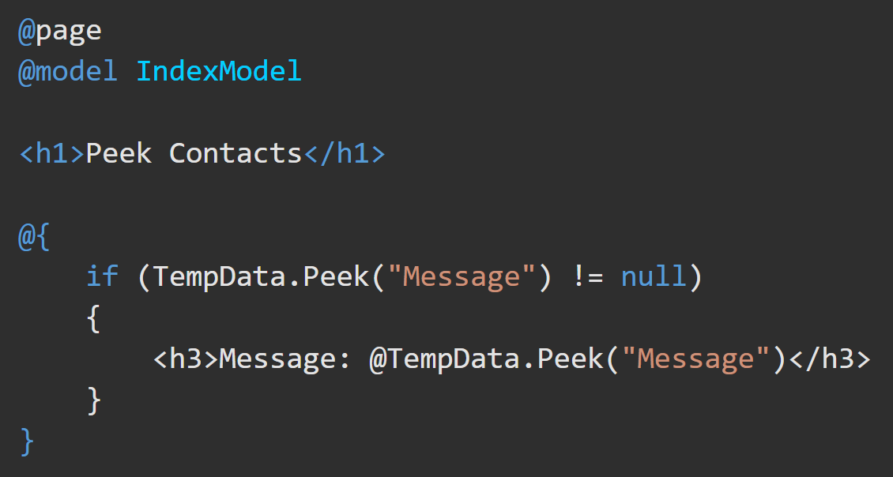
Views – TempData https://docs.microsoft.com/en-us/aspnet/core/fundamentals/app-state?view=aspnetcore-5.0#tempdata
The TempData property stores data until it's read in another request. It is a Dictionary of string to object. Data is removed after the request that reads it.
The Keep(String) and Peek(string) methods can be used to examine the data without deletion at the end of the request. .Keep() marks all items in the dictionary for retention.
TempData is useful for 1) redirection when data is required for more than a single request and 2) when implemented by TempData providers using either cookies or session state.
TempData is:
Useful for redirection when data is required for more than a single request.
Implemented by TempData providers using either cookies or session state.

Slide 18
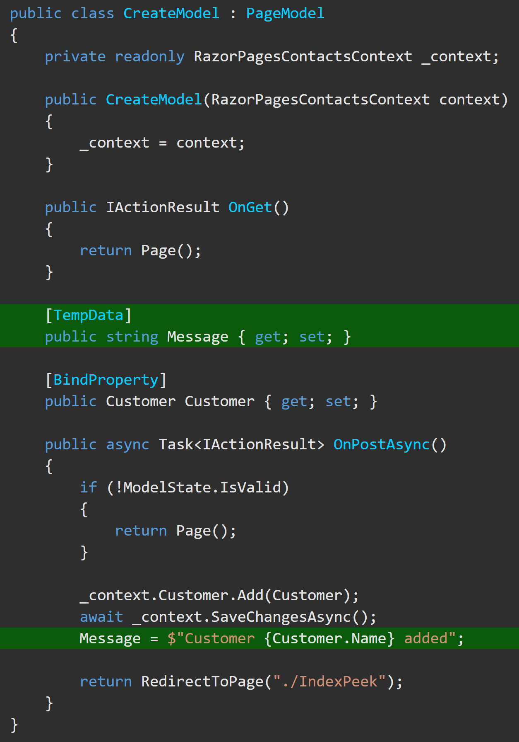
TempData Example https://docs.microsoft.com/en-us/aspnet/core/fundamentals/app-state?view=aspnetcore-5.0#tempdata-samples
In this example, at the end of the request, TempData["Message"] is not deleted because .Peek() is used. Refreshing the webpage displays the contents of TempData["Message"].
The cookie-based TempData provider is enabled and used by default to store TempData in cookies. You can choose another provider and configure it in your ConfigureServices() method.

Slide 19
ASP.NET Core MVC Tutorial
Complete the ASP.NET Core MVC tutorial here

