Slide 1

Dependency Injection
Computer Science Concepts

Slide 2
A dependency is anything that an object requires in order to function properly. The Dependency injection (DI) design pattern is a technique used to achieve Inversion of Control (IoC) between classes and their dependencies.
https://docs.microsoft.com/en-us/aspnet/core/fundamentals/dependency-injection?view=aspnetcore-5.0

Slide 3
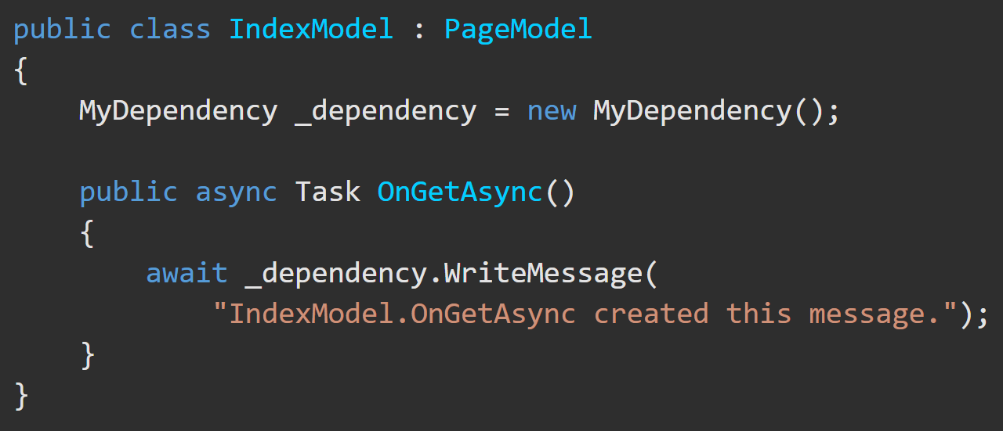
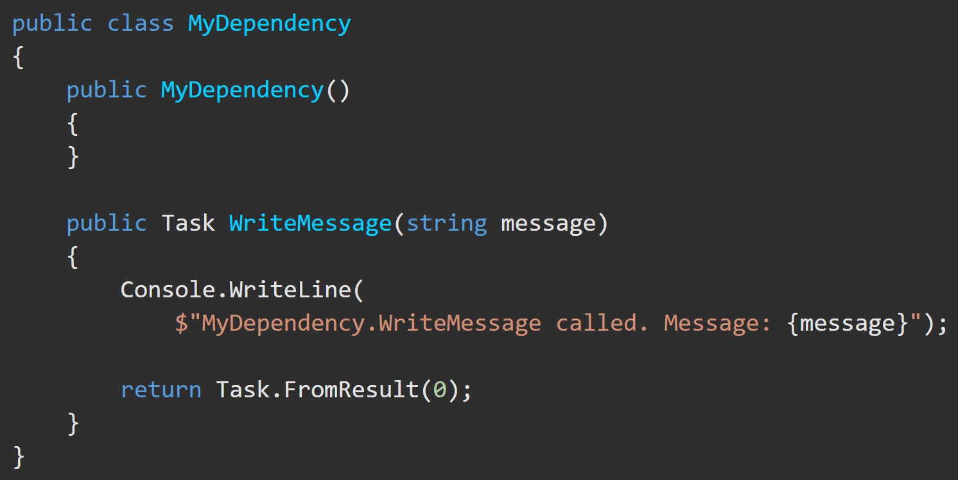
Dependencies Explained https://docs.microsoft.com/en-us/aspnet/core/fundamentals/dependency-injection?view=aspnetcore-5.0
IndexModel class depends on functionality provided by the MyDependency class.
An instance of the MyDependency class can be created in the IndexModel class to make WriteMessage() available to that class.

Slide 4
Dependency Inversion – Overview https://docs.microsoft.com/en-us/aspnet/core/fundamentals/dependency-injection?view=aspnetcore-5.0
Code that is directly dependent on another part of code to function can be problematic and should be avoided.
To replace MyDependency with a different implementation, the class would have to be modified.
If MyDependency has dependencies, they must be configured by the class.
The below implementation is difficult to unit test.

Slide 5
Service Type Lifetimes https://docs.microsoft.com/en-us/aspnet/core/fundamentals/dependency-injection?view=aspnetcore-5.0#transient
Service | Description
Transient | Transient services (AddTransient) are created each time they're requested from the service container. Best for lightweight, stateless services.
Scoped | Scoped lifetime services (AddScoped) are created once per HTTP request (connection).
Singleton | Singleton services (AddSingleton) are created the first time they're requested (or when Startup.ConfigureServices() is run). Every subsequent request uses the same instance.

Slide 6
Dependency Injection – “This is the way” https://docs.microsoft.com/en-us/aspnet/core/fundamentals/dependency-injection?view=aspnetcore-5.0
Dependency injection helps provide services that classes need:
ASP.NET provides a built-in service container called IServiceProvider.
Dependencies are registered in a program at compilation.
An interface (or base class) is used to abstract the dependency implementation.
Inject the service into the constructor of the class where it's used.
.NET framework takes on the responsibility of creating an instance of the dependency and disposing of it when it's no longer needed.

Slide 7
DI – Best Practices (1/2) https://docs.microsoft.com/en-us/aspnet/core/fundamentals/dependency-injection?view=aspnetcore-5.0#design-services-for-dependency-injection
Best design practices are to:
Design services to use dependency injection to obtain their dependencies.
Avoid stateful, static classes and members.
Design apps to use singleton services, which avoid creating global state.
Avoid direct instantiation of dependent classes within services. Direct instantiation couples the code to a particular implementation.
Make classes small, well-factored, and easily tested.
If a class seems to have too many injected dependencies, it’s a sign that the class has too many responsibilities and is violating the Single Responsibility Principle (SOLID).

Slide 8
DI – Best Practices (1/2) https://docs.microsoft.com/en-us/aspnet/core/fundamentals/dependency-injection?view=aspnetcore-5.0#design-services-for-dependency-injection
https://docs.microsoft.com/en-us/aspnet/core/fundamentals/dependency-injection?view=aspnetcore-5.0#recommendations
IServiceProvider requires a public constructor for Dependency Injection.
Dependency Injection is an alternative to static or global object access patterns. You may not be able to realize the benefits of DI if you mix it with static object access.
The IServiceProvider service container is designed to serve the needs of most consumer apps. Use the IServiceProvider container unless you need a specific feature that IServiceProvider doesn't support.

