Slide 1

CLI (Common Language Infrastructure)
.NET

Slide 2
The Common Language Infrastructure (CLI) is an open specification developed by Microsoft and standardized by ISO and ECMA that describes executable code and a runtime environment that allows multiple high-level languages to be used on different computer platforms without being rewritten for specific architectures.
https://en.wikipedia.org/wiki/Common_Language_Infrastructure

Slide 3
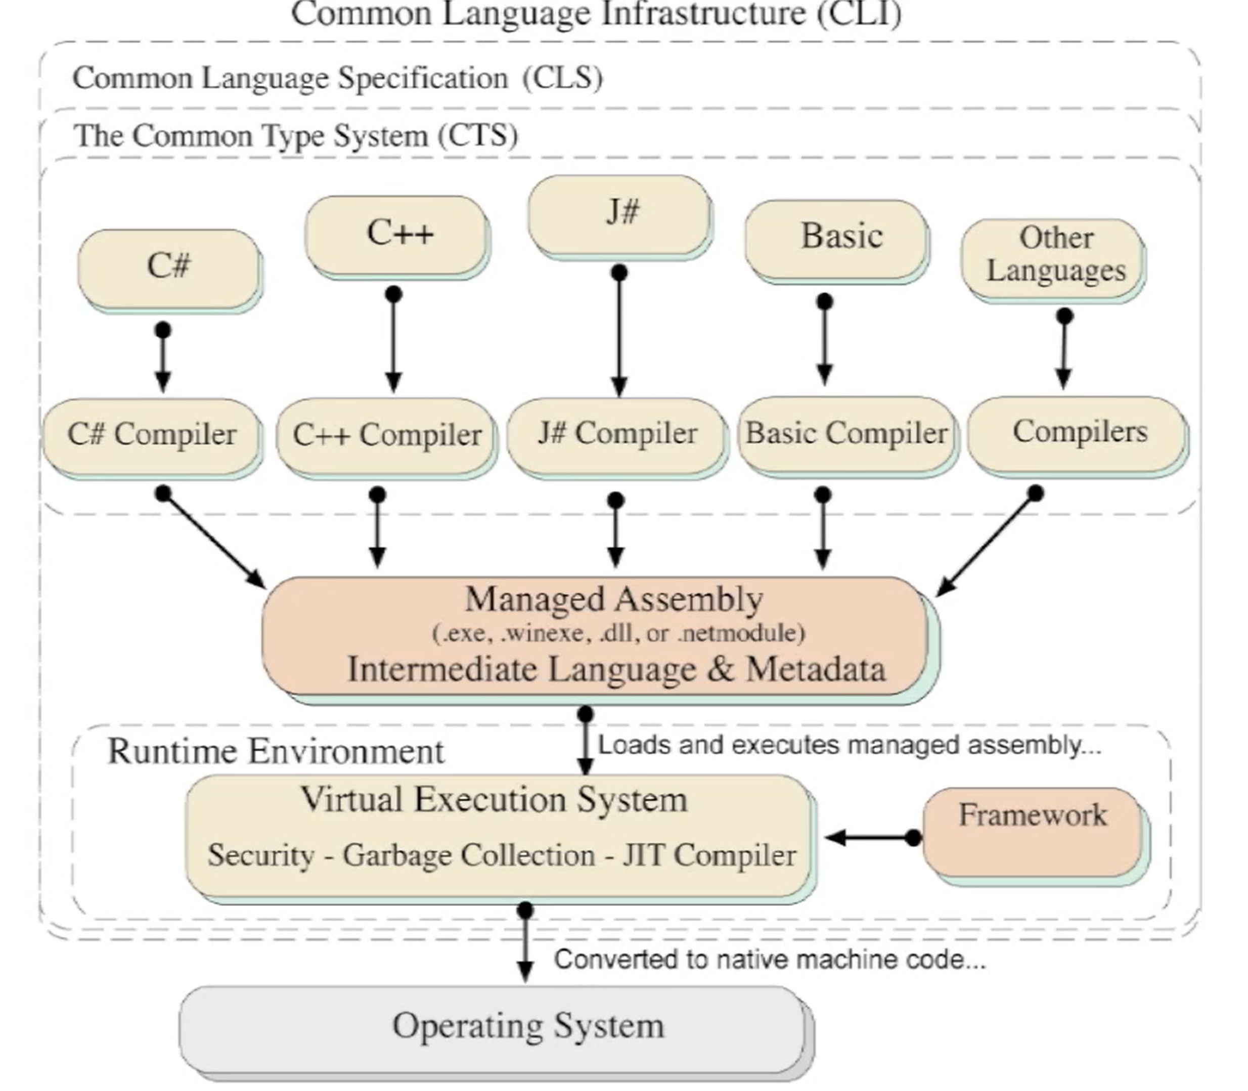
CLI (Common Language Infrastructure) https://searchapparchitecture.techtarget.com/definition/Common-Language-Infrastructure-CLI
Part of Microsoft's .NET strategy, Common Language Infrastructure (CLI) enables an application program written in any programming language to be run on any operating system (OS) using a “common” runtime program rather than a language-specific one.
Common Language Infrastructure provides a virtual execution environment comparable to the one provided by Sun Microsystems for Java programs.

Slide 4
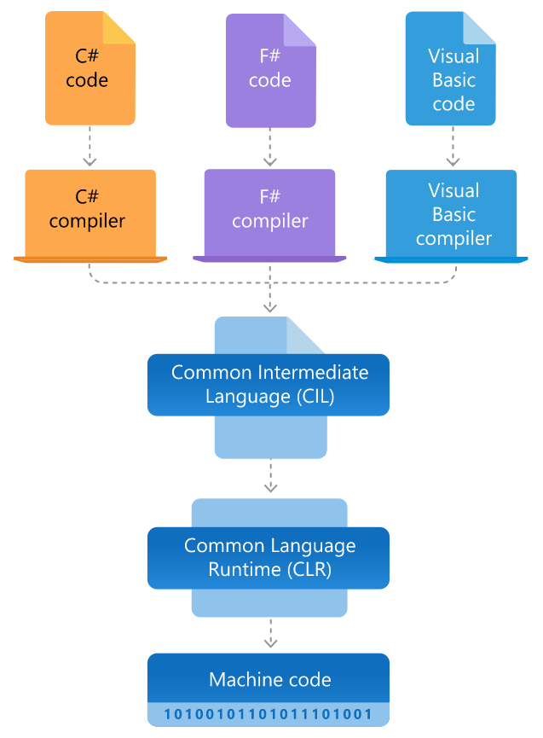
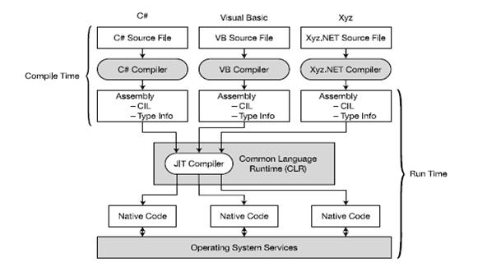
CLI (Common Language Infrastructure) https://docs.microsoft.com/en-us/dotnet/standard/managed-execution-process https://dotnet.microsoft.com/learn/dotnet/what-is-dotnet-framework

Slide 5
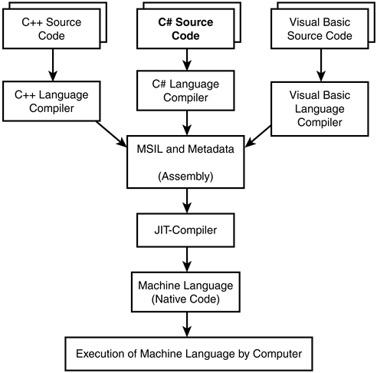
CLI - Two views, one model https://docs.microsoft.com/en-us/dotnet/standard/managed-execution-process

Slide 6
CTS (Common Type System) https://docs.microsoft.com/en-us/dotnet/standard/common-type-system https://docs.microsoft.com/en-us/dotnet/framework/get-started/overview https://www.youtube.com/watch?v=b7L03h7nMwg
The CTS is used by the CLR to enforce strict typing and code verification.
To ensure that all compilers generate managed code that conforms to the CTS, the CTS:
describes all data types and all related constructs which are supported by the CLR
details how they must be represented in the .NET metadata format
specifies how entities can interact with each other
This means that managed code can consume other managed types and instances, while strictly enforcing type fidelity and type safety.

Slide 7
CTS (Common Type System) https://docs.microsoft.com/en-us/dotnet/standard/common-type-system https://www.youtube.com/watch?v=b7L03h7nMwg
The CTS provides a library of the basic primitive data types to be used in application development.
CTS defines the two main types (reference and value types) that should be supported.
CTS defines several categories of types, each with their specific semantics and usage:
CTS defines all other properties of the types (access modifiers, valid type members, how inheritance and overloading works, etc).
Classes | Structs | Enums | Interfaces | Delegates

Slide 8
CLS (Common Language Specification) https://docs.microsoft.com/en-us/dotnet/standard/common-type-system
Since there are numerous different languages, .NET has specified the commonalities required to enable full interoperability between languages into something called the Common Language Specification (CLS).
CLS is a subset of the CTS. This means that all rules of the CTS apply to the CLS also.
CLS defines a set of rules and restrictions that every language must follow which runs under the .NET framework. It provides a sort of recipe for any language that is implemented on top of .NET on what it must support.

Slide 9
CIL (Common Intermediate Language) https://docs.microsoft.com/en-us/dotnet/standard/managed-execution-process#compiling-to-msil
Common Intermediate Language (CIL)* is the intermediate language binary instruction set defined within the Common Language Infrastructure (CLI).
CIL instructions are executed by the Common Language Runtime.
Languages which target the CLI compile to CIL.
Runtimes Just-In-Time(JIT) compile CIL instructions into native code.
*CIL was formerly called Microsoft Intermediate Language (MSIL) or Intermediate Language (IL).

Slide 10
JIT (Just In Time Compiler) https://docs.microsoft.com/en-us/dotnet/standard/managed-execution-process https://docs.microsoft.com/en-us/dotnet/standard/managed-execution-process#compilation-by-the-jit-compiler
Just-In-Time (JIT) compilation involves compilation of a program at run time.
JIT compilation assumes that some code might never be called during execution. Instead of using time and memory to convert all the CIL in a PE (portable executable) file to native code, it converts the CIL as needed during execution and stores the resulting native code in memory so that it is accessible for subsequent calls in the context of that process.

Slide 11
VES (Virtual Execution System) https://en.wikipedia.org/wiki/Virtual_Execution_System
A Virtual Execution System (VES) is a run-time system of the Common Language Infrastructure (CLI) which provides an environment for executing managed code where the Common Intermediate Language (CIL) instruction set can be executed.
The Common Language Runtime (CLR) is the .NET Framework's implementation of a VES. It provides direct support for a set of built-in data types. It defines:
a hypothetical machine with an associated machine model and state,
a set of control flow constructs, and
an exception handling model.

