Slide 1

Common Language Runtime
.neT

Slide 2
Common Language Runtime (CLR) is a managed execution environment that is part of Microsoft's .NET framework. CLR manages the execution of programs written in different supported languages. CLR transforms source code into a form of bytecode known as CIL (Common Intermediate Language).
https://www.techopedia.com/definition/5225/common-language-runtime-clr#:~:text=

Slide 3
CLR (Common Language Runtime) https://docs.microsoft.com/en-us/dotnet/standard/clr https://docs.microsoft.com/en-us/dotnet/framework/get-started/overview
The .NET Framework consists of the Common Language Runtime (CLR) and the .NET Framework base class library.
The CLR is the foundation for .NET Framework. It manages and runs the code and provides services like memory management, remoting, type enforcement (through the CTS), and security.
Benefits of CLR:
cross-language integration | cross-language exception handling | enhanced security
versioning and deployment support | a simplified model for component interaction | debugging and profiling services.

Slide 4
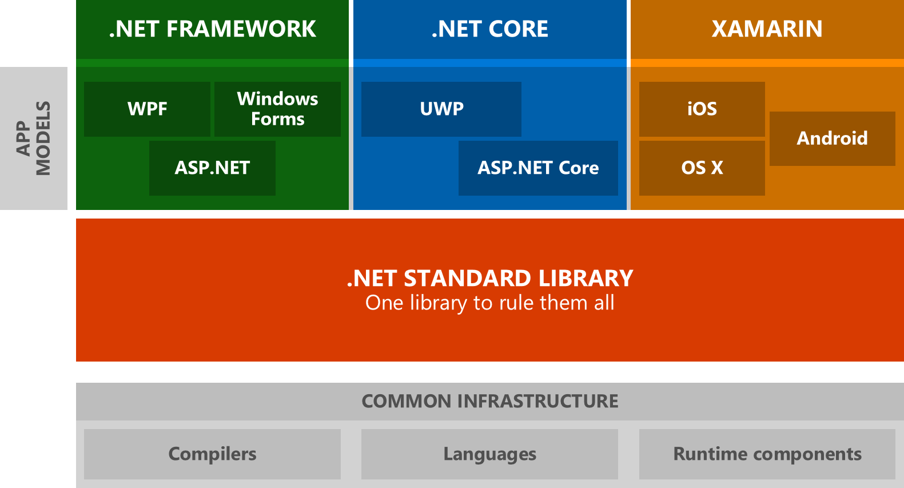

.NET Class Libraries https://docs.microsoft.com/en-us/dotnet/framework/get-started/overview
A class library is an object-oriented collection of reusable types that you can use to develop apps ranging from traditional command-line or graphical user interface (GUI) apps to apps based on the latest innovations provided by ASP.NET, such XML Web services.
Base Class Library here

Slide 5
BCL (Base Class Library) https://docs.microsoft.com/en-us/dotnet/standard/clr
BCL stands for Base Class Library (AKA, Class library (CL)). A .NET Framework library, BCL is the foundation for the C# runtime library and one of the Common Language Infrastructure (CLI) standard libraries.
BCL provides the types that represent built-in CLI data types, basic file access, collections, custom attributes, formatting, security attributes, I/O streams, string manipulation, etc.
Base Class Library here

Slide 6
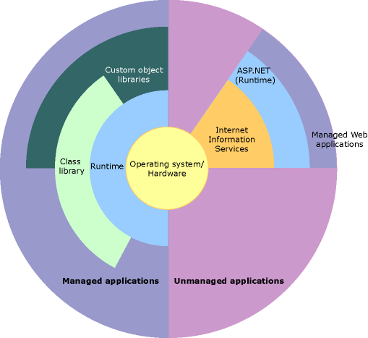
.NET CLR and Class Library Relationship https://docs.microsoft.com/en-us/dotnet/framework/get-started/overview
This illustration shows the relationship of the Common Language Runtime and the class library to your apps and to the overall system.
The illustration also shows how managed code operates within a larger architecture.

Slide 7
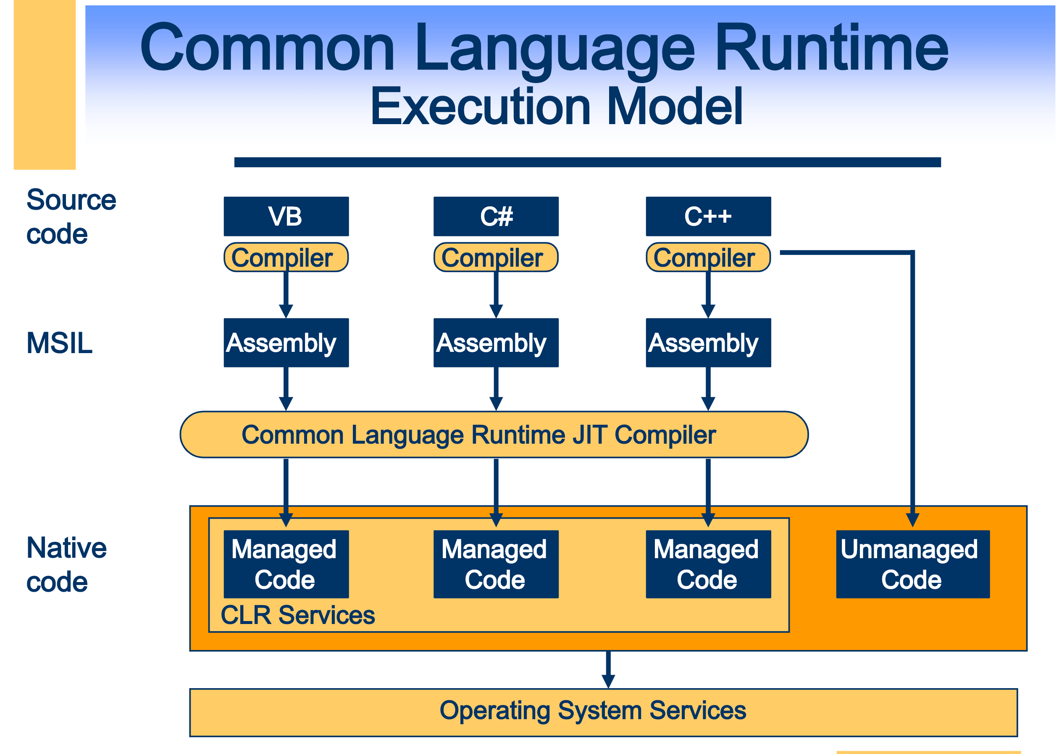
Managed Code https://docs.microsoft.com/en-us/dotnet/standard/managed-code https://docs.microsoft.com/en-us/dotnet/standard/managed-execution-process
Managed code is managed by the Common Language Runtime (CLR) at runtime.
The CLR knows what your code is doing and can manage it.
The CLR provides memory management (GC), security boundaries, type safety, etc.
Managed code is written in a high-level language that can be run on top of .NET.
Code is compiled into Intermediate Language code, which the CLR compiles and executes.
The CLR manages the Just-In-Time compiling of code from IL to machine code that can be run on a CPU.

Slide 8
Unmanaged Code https://docs.microsoft.com/en-us/dotnet/framework/interop/
Code that runs outside the CLR is called Unmanaged Code.
The .NET Framework promotes interaction with COM components, COM+ services, external type libraries, and many operating system services.
Examples of Unmanaged Code:
COM components,
ActiveX interfaces,
Windows API functions.

