Slide 1

Built-in Logging
.net

Slide 2
When things go wrong in production, you must gather information. An effective logging system is essential to ensure that you have some idea of where to look for the cause if an error.
https://visualstudiomagazine.com/articles/2019/03/22/logging-in-net-core.aspx

Slide 3
Logging - Overview https://docs.microsoft.com/en-us/dotnet/core/diagnostics/logging-tracing
‘Logging’ involves an application writing output (to file or console) under certain predetermined situations.
Logging is useful in situations where the debugger falls short or for documenting how an application is used, such as:
Issues occurring over long periods of time.
When analysis is required to understand complex systems after a crash. A debugger tends to modify program behavior.
When attaching a debugger causes timeout failures.
When programs need to always be recording. Logging is designed for low overhead, so they require very little from the system.

Slide 4
Logging – Performance Considerations https://docs.microsoft.com/en-us/dotnet/core/diagnostics/logging-tracing#performance-considerations https://docs.microsoft.com/en-us/aspnet/core/fundamentals/logging/?view=aspnetcore-5.0#no-asynchronous-logger-methods
Logging should be so fast that it isn't worth the performance cost of asynchronous code.
It is recommended that you:
Avoid lots of logging when no one is listening.
Avoid constructing costly logging messages by checking if logging is enabled first.
Only log what's useful.
Defer fancy formatting to the analysis stage.

Slide 5
Logging – .NET Print-Style APIs https://docs.microsoft.com/en-us/dotnet/core/diagnostics/logging-tracing#print-style-apis
The choice of which ‘print-style’ API to use is up to you.
System.Console | System.Diagnostics.Trace | System.Diagnostics.Debug
Always enabled and always writes to the console. Useful for information that your customer may need to see in the release. Because it's the simplest approach, it's often used for ad-hoc temporary debugging. This debug code is often never checked in to source control. | Only enabled when TRACE is defined. Writes to attached Listeners, by default the DefaultTraceListener. Use this API when creating logs that will be enabled in most builds. | Only enabled when DEBUG is defined. Writes to an attached debugger. On *nix writes to stderr if COMPlus_DebugWriteToStdErr is set. Use this API when creating logs that will be enabled only in debug builds.

Slide 6
Logging - Events https://docs.microsoft.com/en-us/dotnet/core/diagnostics/logging-tracing#print-style-apis
Rather than logging simple strings these APIs log event objects.
They can be utilized with using System.Diagnostics.*
.Tracing.EventSource | .DiagnosticSource | .Activity | .EventLog
EventSource is the primary root .NET Core tracing API. Available in all .NET Standard versions. Only allows tracing serializable objects. Writes to the attached event listeners. .NET Core provides listeners for: .NET Core's EventPipe on all platforms Event Tracing for Windows (ETW) LTTng tracing framework for Linux | Included in .NET Core and as a NuGet package for .NET Framework. Allows in-process tracing of non-serializable objects. Includes a bridge to allow selected fields of logged objects to be written to an EventSource. | Provides a definitive way to identify log messages resulting from a specific activity or transaction. This object can be used to correlate logs across different services. | Windows only. Writes messages to the Windows Event Log. System administrators expect fatal application error messages to appear in the Windows Event Log.

Slide 7
ILogger https://docs.microsoft.com/en-us/aspnet/core/fundamentals/logging/?view=aspnetcore-5.0#built-in-logging-providers https://www.blinkingcaret.com/2018/02/14/net-core-console-logging/ https://docs.microsoft.com/en-us/aspnet/core/fundamentals/host/generic-host?view=aspnetcore-5.0
.NET Core has a built-in logging API (ILogger) that works with a variety of built-in and third-party logging providers.
ILogger can be used with HostBuilder.
ILogger provides multiple ways to display or store logs. Logs can be sent to multiple destinations by adding multiple providers.
Logging code for apps without Generic Host differs in the way providers are added and loggers are created.

Slide 8
ILogger Built-in Providers https://docs.microsoft.com/en-us/aspnet/core/fundamentals/logging/?view=aspnetcore-5.0#built-in-logging-providers
Provider | Description
Console | The Microsoft.Extensions.Logging.Console package sends log output to the console.
Debug | The Microsoft.Extensions.Logging.Debug package writes log output by using the System.Diagnostics.Debug class.
Event Source | The Microsoft.Extensions.Logging.EventSource package writes to an Event Source cross-platform with the name Microsoft-Extensions-Logging. .EventSource is added automatically when CreateDefaultBuilder is called to build the host.
Windows EventLog | The Microsoft.Extensions.Logging.EventLog package sends log output to the Windows Event Log.
TraceSource | The Microsoft.Extensions.Logging.TraceSource provider package uses the TraceSource libraries and providers.
Azure App Service | The Microsoft.Extensions.Logging.AzureAppServices provider package writes logs to text files in an Azure App Service app's file system and to blob storage in an Azure Storage account.
Azure Application Insights trace logging | The Microsoft.Extensions.Logging.ApplicationInsights package writes logs to Azure Application Insights.

Slide 9
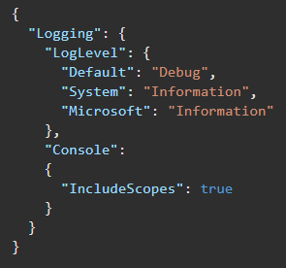
ILogger Configuration https://docs.microsoft.com/en-us/aspnet/core/fundamentals/logging/?view=aspnetcore-5.0#configuration
Logging configuration can be done in various files and in various languages..
File formats (JSON/XML).
Command-line arguments.
Environment variables.
In-memory .NET objects.
The unencrypted Secret Manager storage.
An encrypted user store, such as Azure Key Vault.
Custom providers (installed or created).
Most commonly, appsettings.json is used to configure built-in logging

Slide 10
ILogger - Log Levels https://docs.microsoft.com/en-us/aspnet/core/fundamentals/logging/?view=aspnetcore-5.0#log-level
The Logging property in appsettings.json can have LogLevel and log provider properties.
The LogLevel property under Logging specifies the minimum level to log for selected categories.
(Optional) LogLevel under a provider specifies levels to log for that provider.
levels specified in Logging.{providername}.LogLevel override anything set in Logging.LogLevel.

Slide 11
ILogger – Log Levels https://docs.microsoft.com/en-us/aspnet/core/fundamentals/logging/?view=aspnetcore-5.0#log-level
Log Level | Description
Trace = 0 | For information that's valuable only for debugging. These messages may contain sensitive application data and so shouldn't be enabled in a production environment. Disabled by default.
Debug = 1 | For information that may be useful in development and debugging. Enable Debug level logs in production only when troubleshooting, due to the high volume of logs.
Information = 2 | For tracking the general flow of the app. These logs typically have some long-term value.
Warning = 3 | For abnormal or unexpected events in the app flow. These may include errors or other conditions that don't cause the app to stop but might need to be investigated. Handled exceptions are a common place to use the Warning log level.
Error = 4 | For errors and exceptions that cannot be handled. These messages indicate a failure in the current activity or operation (such as the current HTTP request), not an app-wide failure.
Critical = 5 | For failures that require immediate attention. Examples: data loss scenarios, out of disk space.

Slide 12
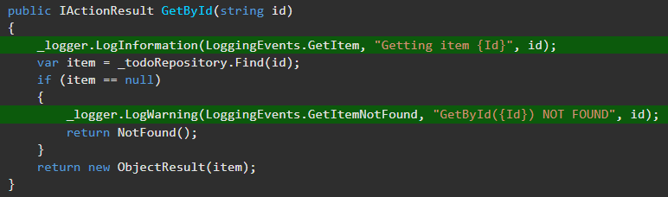
ILogger – Log Levels https://docs.microsoft.com/en-us/aspnet/core/fundamentals/logging/?view=aspnetcore-5.0#log-level
Use the log level to control how much log output is written to your logging destination.
Logging Rules of thumb.
In production - Logging at the Trace through Information levels produces a high-volume of detailed log messages. Log Trace through Information level messages to a high-volume, low-cost data store.
Logging at Warning through Critical levels typically produces fewer, smaller log messages. Therefore, costs and storage limits usually aren't a concern, which results in greater flexibility of data store choice.
During development - Log Warning through Critical messages to the console. Add Trace through Information messages when troubleshooting.

Slide 13
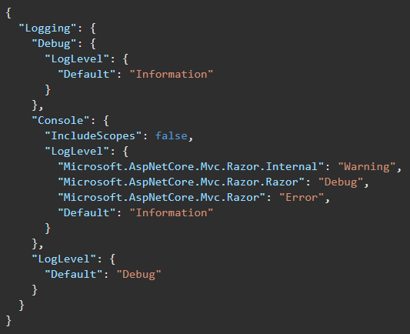
ILogger – Log Filtering https://docs.microsoft.com/en-us/aspnet/core/fundamentals/logging/?view=aspnetcore-5.0#log-filtering
Specify a minimum log level for a provider and category or for all providers or all categories.
Any logs below the minimum level aren't passed to that provider, so they don't get displayed. If the default value is Information, Trace and Debug logs are ignored.
Each provider defines an alias that can be used during configuration. For built-in providers, use the following aliases:
Console, Debug, EventSource, EventLog, TraceSource, AzureAppServicesFile, AzureAppServicesBlob, ApplicationInsights

Slide 14
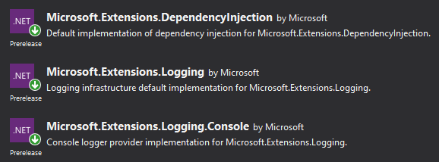
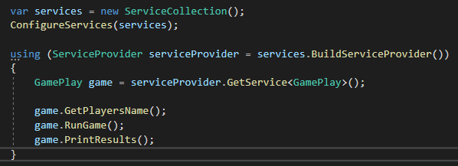
Logging in a Console App Step-by-Step https://www.blinkingcaret.com/2018/02/14/net-core-console-logging/
1. Add three Nuget Packages.
2. Add Logging Service in Program.cs and configure logging.

Slide 15
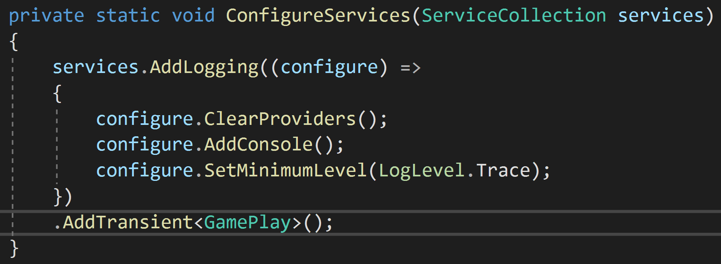
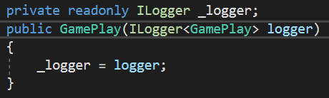
Logging in a Console App Step-by-Step https://www.blinkingcaret.com/2018/02/14/net-core-console-logging/
3. Add ConfigureServices() below Main(), but inside the Program Class.
4. Inject the Logging Service into the constructor of the class you want to log in.

Slide 16
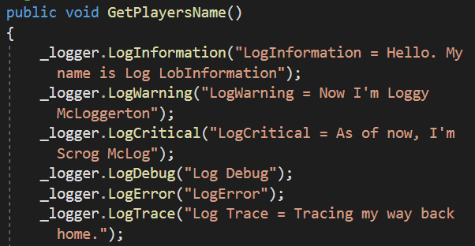
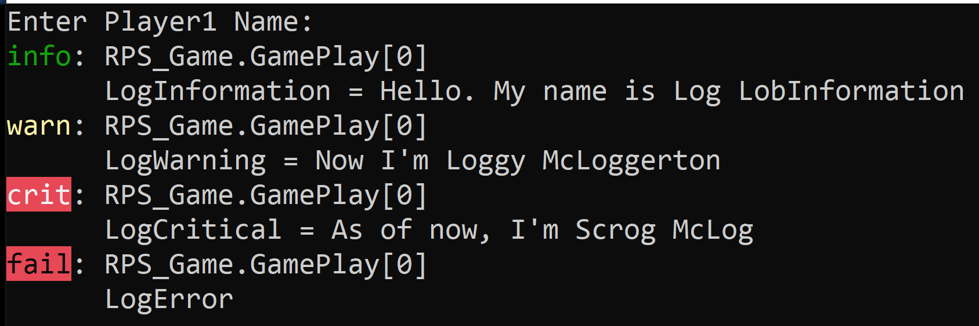
Logging in a Console App Step-by-Step https://www.blinkingcaret.com/2018/02/14/net-core-console-logging/
5. Use the _logger to log wherever you want to log inside the class.
6. View the logging levels shown to the console. .logDebug() and .logTrace() are not printed to console by default

Slide 17
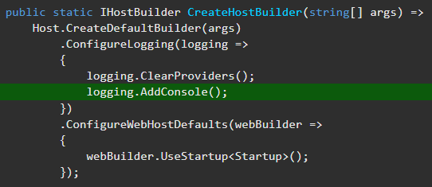
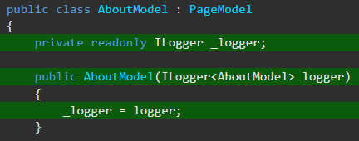
ILogger in a Web API - Step-by-Step https://docs.microsoft.com/en-us/aspnet/core/fundamentals/logging/?view=aspnetcore-5.0 https://www.youtube.com/watch?v=oXNslgIXIbQ
To add a provider in an app that uses Generic Host,
Add Microsoft.Extensions.Logging NuGet Package
add using Microsoft.Extensions.Logging at the top of your Program.cs.
Under Host.CreateDefaultBuilder(args), clear out default logging settings with logging.ClearProviders();.
Call the logging.Add{provider name} extension method in Program.cs. (Ex. logging.AddConsole();, logging.AddDebug();, etc.)
Add using Microsoft.Extensions.Logging; to any class where you will be logging.
Use Dependency Injection to inject an instance of an ILogger<ContainingClassName> object into each class where you will use logging.
Use the different logging levels to note different events in your applications processes.

Slide 18
Logging in a Console App Step-by-Step https://www.blinkingcaret.com/2018/02/14/net-core-console-logging/
A good source on Dependency Injection - https://andrewlock.net/using-dependency-injection-in-a-net-core-console-application/
Good source to talk about App Configuration - https://docs.microsoft.com/en-us/aspnet/core/fundamentals/configuration talks about how appsettings.json is called. Then userSecrets.json.
https://docs.microsoft.com/en-us/aspnet/core/security/app-secrets?view=aspnetcore-3.1&tabs=windows#enable-secret-storag

