Slide 1

Machine and Environment Setup
.NET

Slide 2


Slide 3
Contents
Chat Platform – Slack. This is where we will communicate, organize, and where I will post important information for you.
Code Editor – Visual Studio Code and Visual Studio. This is where we will create and test code.
SDK (Software Development Kit) – This is the suite of programs that we download that enables us to create, edit, test, and compile code.
Version Control – GitHub. This is where we will store our documents and code, record changes, and control which version of our code we use.

Slide 4
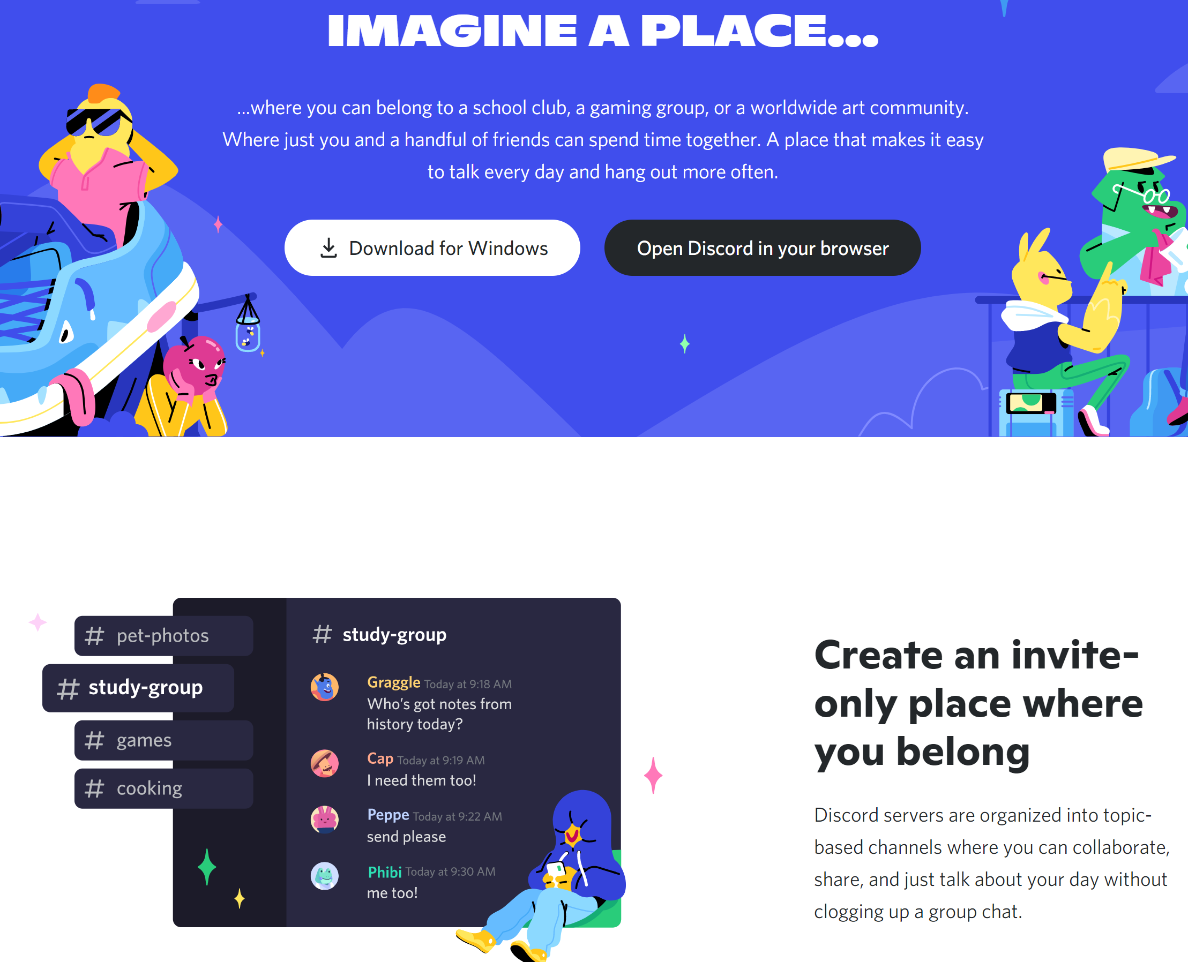
Chat Platform – Discord https://discord.com/brand-new
Download Discord to your PC/Mac and phone
Each associate is responsible for maintaining contact and being up to date on messages on Discord. Especially during 9-5 (CST) hours.

Slide 5
Chat Platform – Slack https://discord.com/brand-new
Create steps for Slack.

Slide 6

gitBash https://gitforwindows.org/
Git for Windows focuses on offering a lightweight, native set of tools that bring the full feature set of the Git SCM to Windows while providing appropriate user interfaces for experienced Git users and novices alike.
Go to https://gitforwindows.org/
Notes:
They should already have this.

Slide 7

Version Control – github.com https://gitforwindows.org/
Open Command Line (Terminal). Run ‘git –version’.
Accept your invite to the class repo.
On the class repo, create a personal Repo of the format ‘MooreMark’.
Clone your remote repo from your local gitBash.
Create a text doc in your cloned repo folder.
Push a simple text doc.
git add .
git commit –m “message to self”
git push
Create new upstream branch, if necessary.
Verify it worked by looking at your account online.

Slide 8
Basic Git Life Cycle https://education.github.com/git-cheat-sheet-education.pdf
git clone [url] or git pull from master branch.
git checkout –b [branchName] (Create a new “feature” branch and switch to it.)
Make changes to add a feature.
git add . (Add all changes made to tracking)
git commit –m “This message tells what the changes are” (Add to staging)
git pull (to be 100% sure no changes were made to the master branch while you were working)
git push
Go online and make a pull request (PR) to master.
Return to Local main branch and git pull.
Notes:
Draw this out.

Slide 9
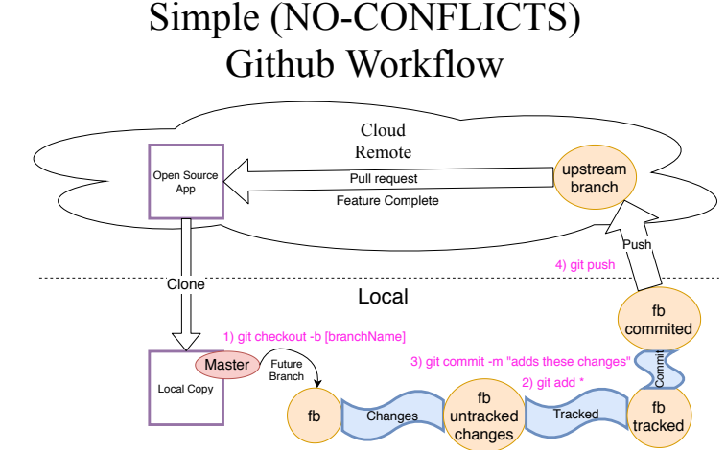

Slide 10
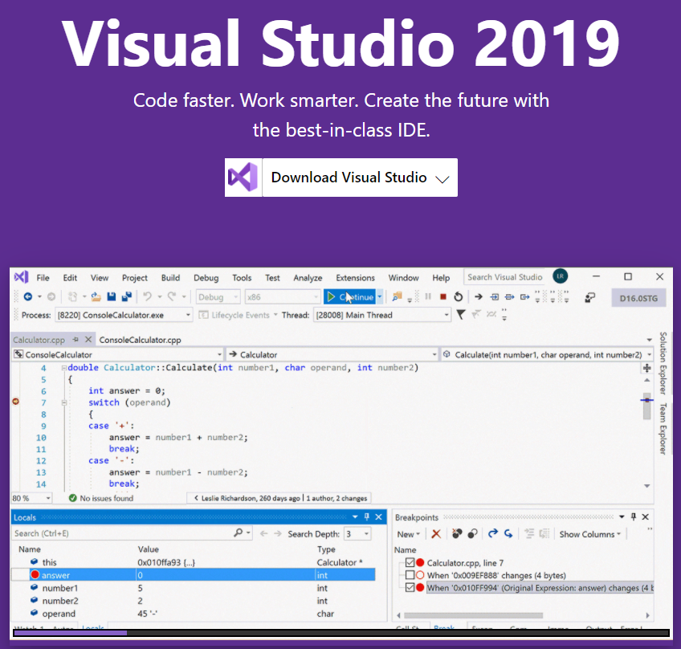
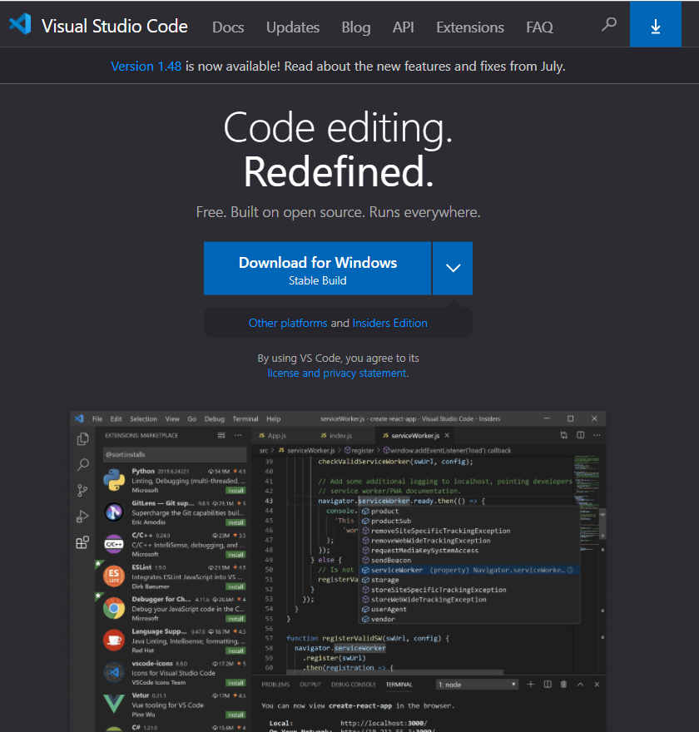
Code Editor – Visual Studio https://visualstudio.microsoft.com/vs/ https://dotnet.microsoft.com/download https://code.visualstudio.com/
Visual Studio VS Code

Slide 11
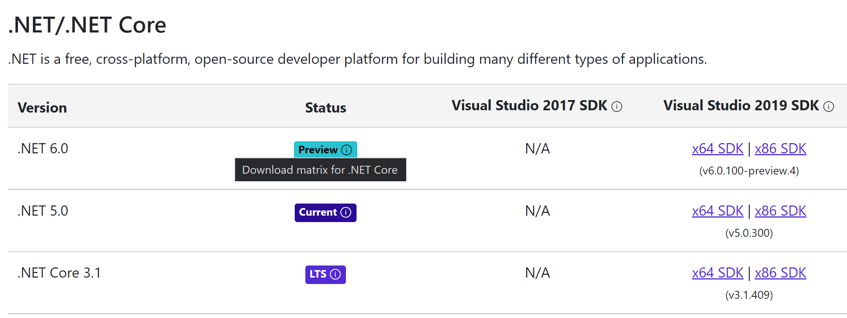
SDK (Software Development Kit) https://en.wikipedia.org/wiki/Software_development_kit#:~:text= https://dotnet.microsoft.com/download/visual-studio-sdks
A Software Development Kit (SDK) is a collection of software development tools in one installable package. They have compiler, debugger and perhaps a software framework. They are normally specific to a hardware platform and operating system combination.
An SDK is required for developing a platform-specific app.
The development of an Android app on Java platform requires a Java Development Kit.
For iOS applications (apps) the iOS SDK is required.
For Universal Windows Platform (UWP) the .NET Framework SDK is used.
Some SDKs add additional features and can be installed in apps to provide analytics, data about application activity, and monetization options.

Slide 12
Log into Git from Command Line https://kbroman.org/github_tutorial/pages/first_time.html https://docs.github.com/en/github/getting-started-with-github/quickstart/set-up-git
You need to log into github.com from the command line and may have to change some settings.

