Slide 1

Access Modifiers
.net

Slide 2
Access Modifiers are keywords used to specify which parts of the program structure can access the data of a member or type.
https://docs.microsoft.com/en-us/dotnet/csharp/language-reference/keywords/access-modifiers

Slide 3
Access Modifiers - Class Accessibility https://docs.microsoft.com/en-us/dotnet/csharp/programming-guide/classes-and-structs/access-modifiers
Classes and structs declared directly within a namespace (not nested within other classes or structs) can only be either public or internal.
Internal is the default.
Derived classes can't have greater accessibility than their base classes.

Slide 4
Access Modifiers - Class Member Accessibility https://docs.microsoft.com/en-us/dotnet/csharp/tour-of-csharp/classes-and-objects#accessibility
Access Modifiers placed on members of a class control which regions of the program can access that member.
public - Access is not limited to the member.
private – default level for members.
internal - Current assembly (.exe, .dll).
protected – This class and derived classes.
protected internal - Derived classes or any class in the same assembly.
private protected - This class and derived classes if they are in the same assembly.

Slide 5
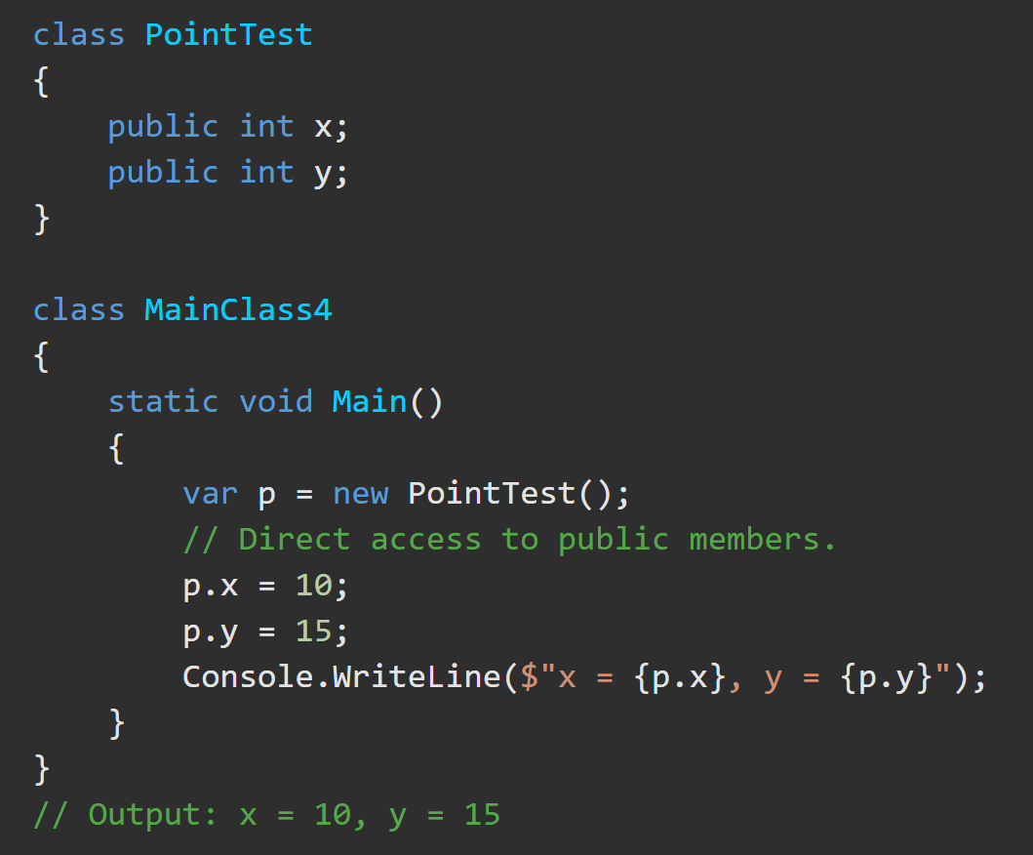
Access Modifiers – Public https://docs.microsoft.com/en-us/dotnet/csharp/language-reference/keywords/public
The public keyword is an access modifier for:
types and
type members.
There are no restrictions on accessing public members.

Slide 6
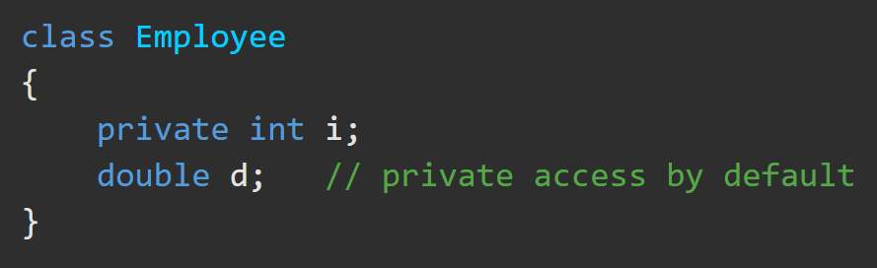
Access Modifiers – Private https://docs.microsoft.com/en-us/dotnet/csharp/language-reference/keywords/private
Private access is the least permissive access level.
Private members are accessible only within the body of the class or the struct in which they are declared.
Nested types in the same body can access private members.
Derived classes do inherit private members but the private member cannot be accessed directly. Reflection must be used to access them.

Slide 7
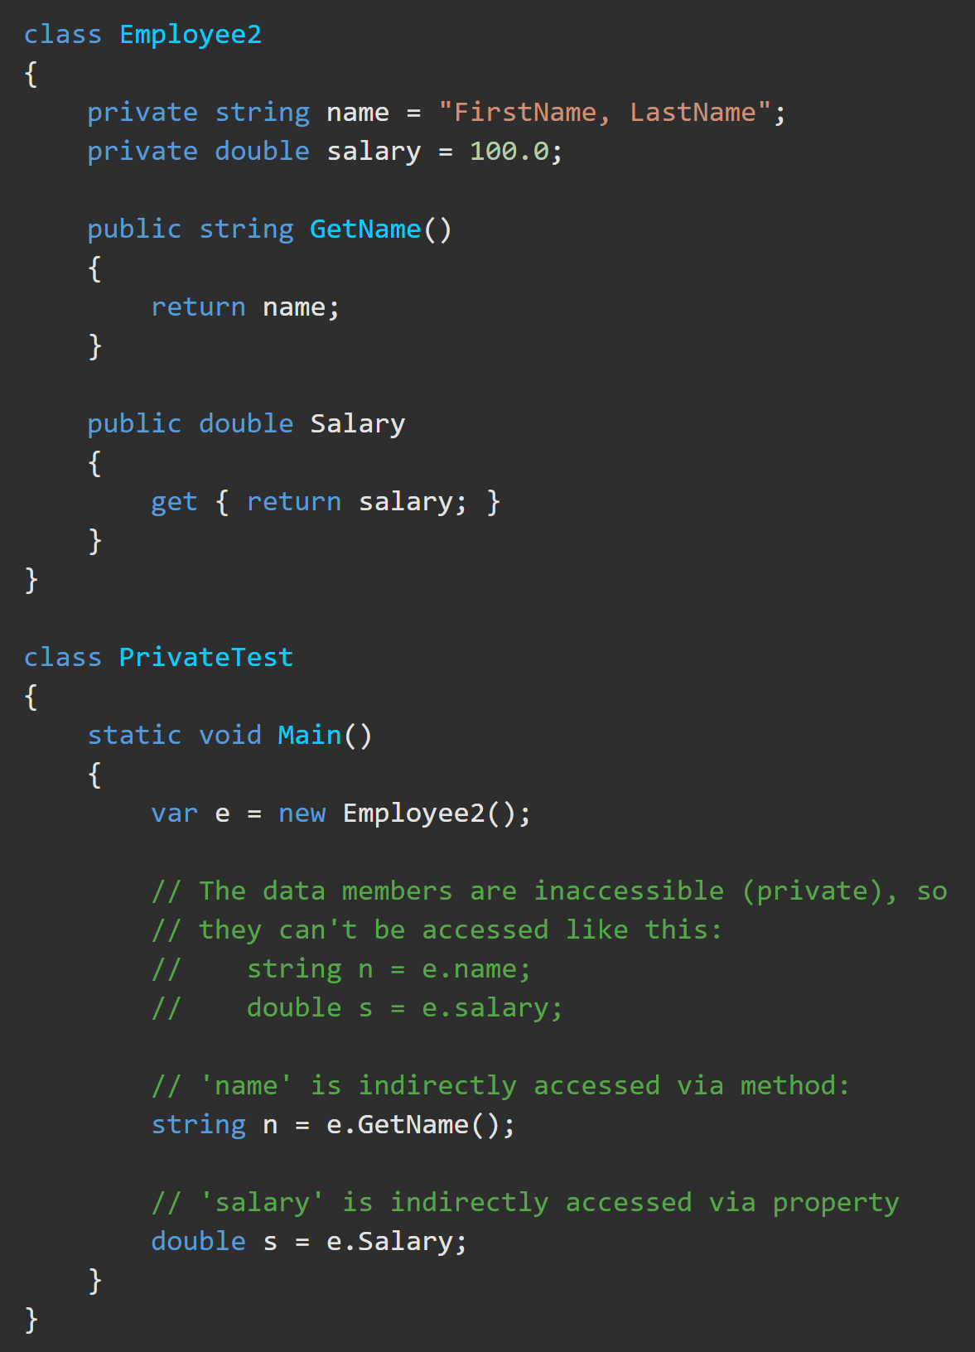
Access Modifiers – Private Example https://docs.microsoft.com/en-us/dotnet/csharp/language-reference/keywords/private
This Employee class contains two private data members. As private members, they can only be accessed by member methods.
Public methods, GetName() and Salary(), are added to allow controlled access to the private members.

Slide 8
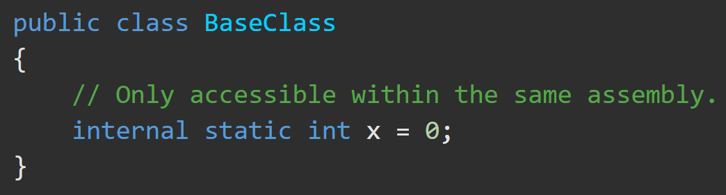
Access Modifiers – Internal https://docs.microsoft.com/en-us/dotnet/csharp/language-reference/keywords/internal
Internal types and members are accessible only within files in the same assembly.
A common use of internal access is in layered development because it enables a group of components to cooperate in a private manner without being exposed to the rest of the application code.

Slide 9
Access Modifiers – Protected Internal https://docs.microsoft.com/en-us/dotnet/csharp/language-reference/keywords/protected-internal
A protected internal member of a base class is accessible from any type within its containing assembly.
It is also accessible in a derived class located in another assembly only if the access occurs through a variable of the derived class type.
Struct members cannot be protected internal because structs cannot be inherited.

Slide 10
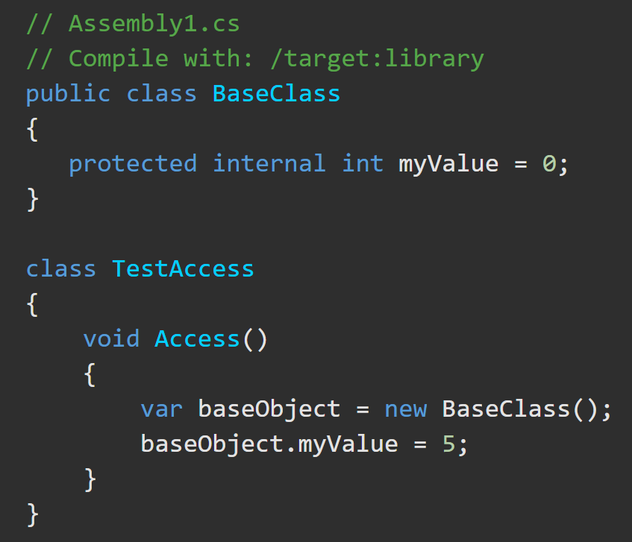
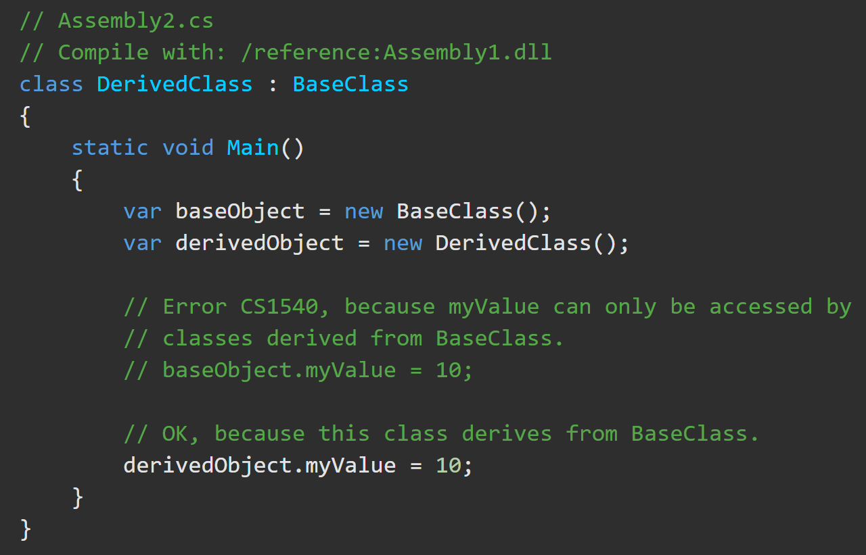
Access Modifiers – Protected Internal https://docs.microsoft.com/en-us/dotnet/csharp/language-reference/keywords/protected-internal
BaseClass and TestAccess are in the same assembly. TestAccess can access myValue. In the second file, an attempt to access myValue through an instance of BaseClass will produce an error, while an access to this member through DerivedClass succeeds.

Slide 11
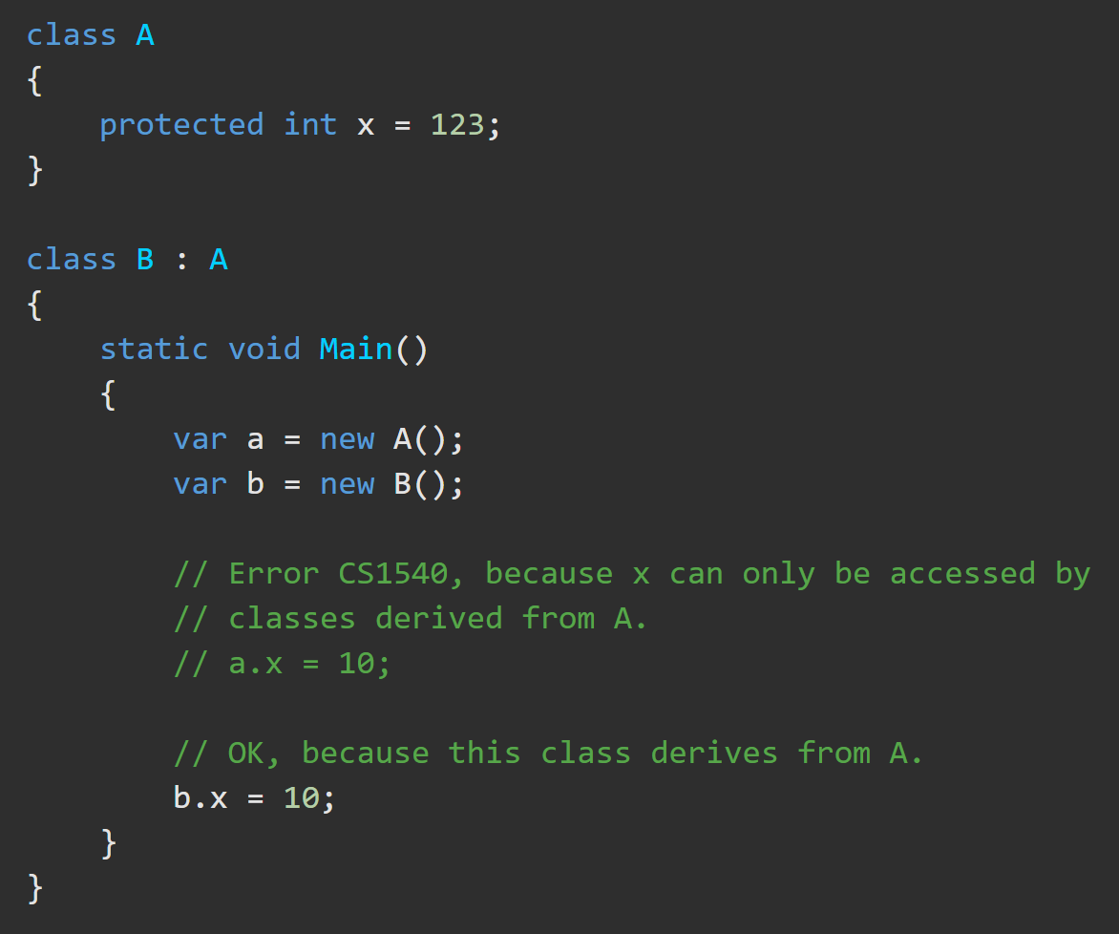
Access Modifiers – Protected https://docs.microsoft.com/en-us/dotnet/csharp/language-reference/keywords/protected
A protected member is accessible within its class and by derived class instances.

Slide 12
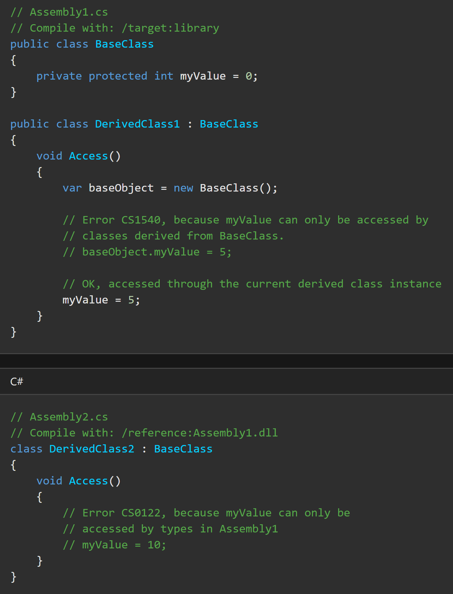
Access Modifiers – Private Protected https://docs.microsoft.com/en-us/dotnet/csharp/language-reference/keywords/private-protected
A private protected member is accessible by types derived from the containing class, but only within its containing assembly.
Assembly1.cs contains public BaseClass, and derived DerivedClass1.
BaseClass owns private protected myValue, which DerivedClass1 tries to access in two ways.
Accessing myValue through an instance of BaseClass will produce an error.
Using it as an inherited member in DerivedClass1 succeeds.
In Assembly2.cs, accessing myValue as an inherited member of DerivedClass2 produces an error, because it’s in a different assembly.

Slide 13
Access Modifiers – Private Protected https://docs.microsoft.com/en-us/dotnet/csharp/language-reference/keywords/private-protected
Private Protected members are inherited in all derived classes.
BUT only those derived classes within the base class’ assembly can access those (their own) members.

