Slide 1

async / await
.net

Slide 2
Asynchronous programming enables code that reads like a sequence of statements but executes in a much more complicated order based on external resource allocation and when tasks complete.
https://docs.microsoft.com/en-us/dotnet/csharp/programming-guide/concepts/async/

Slide 3
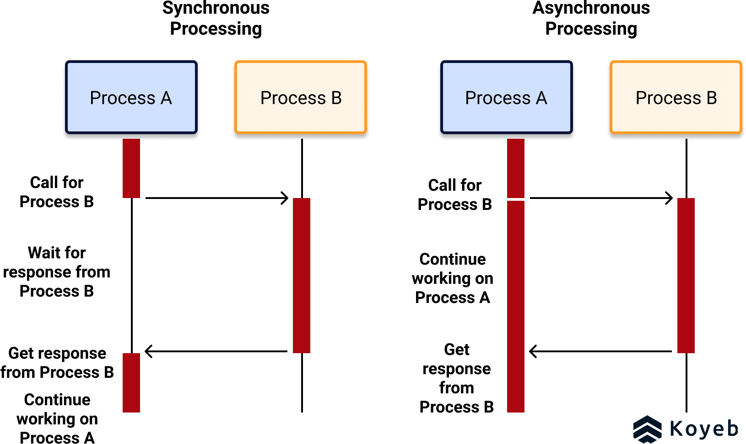
When should you use async/await? https://www.koyeb.com/blog/introduction-to-synchronous-and-asynchronous-processing
Any programming code that accesses the Web, communicates with a database, or works with files or images should be written asynchronously.
Asynchronous code enables a program to continue with non-dependent actions while waiting for the result of the prior asynchronous action.

Slide 4
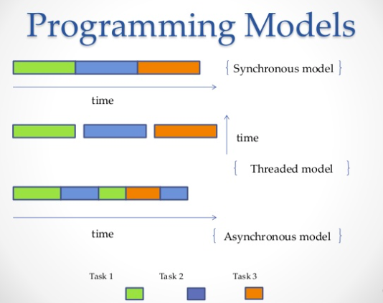
The asynchronous programming model https://docs.microsoft.com/en-us/dotnet/csharp/programming-guide/concepts/async/task-asynchronous-programming-model https://medium.com/velotio-perspectives/an-introduction-to-asynchronous-programming-in-python-af0189a88bbb
Asynchronous programming is used to avoid performance bottlenecks and enhance the overall responsiveness of an application. C# 5 introduced async programming.
The compiler does most of the syntactical work so that the code can retain a synchronous-like structure.
Asynchrony is essential for potentially blocking code. If an activity is blocked in a synchronous process, the entire application must wait.
In an asynchronous process, the application can continue with other work until the blocking task finishes.

Slide 5
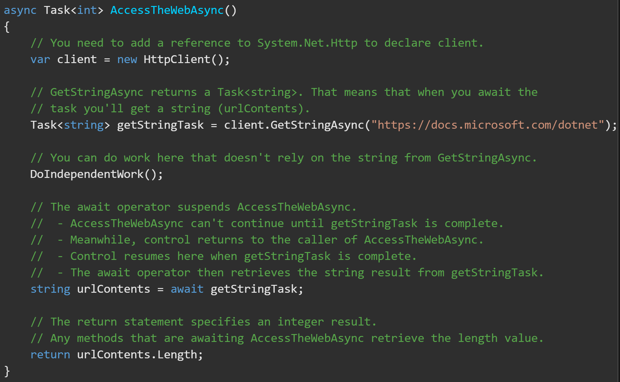
async/await https://docs.microsoft.com/en-us/dotnet/csharp/programming-guide/concepts/async/task-asynchronous-programming-model#BKMK_HowtoWriteanAsyncMethod
By using the keywords async and await, you can use resources in .NET Framework to create an asynchronous method.
The method signature includes the async modifier.
The return type is Task<int> or Task.
Conventionally, the method name ends in …Async.
GetStringAsync returns a Task<string>.
When you await the task, you'll get a string (urlContents).
Before awaiting the task, you can do work that doesn't rely on the string from GetStringAsync.

Slide 6
async Modifier https://docs.microsoft.com/en-us/dotnet/csharp/language-reference/keywords/async https://www.codeproject.com/Articles/1054993/async-await-What-You-Should-Know-Updated
Use the async modifier to specify that a method is asynchronous.
An async method uses the await operator to continue doing work without blocking the caller’s thread.
An async method runs synchronously until it reaches its first await expression, at which point it is suspended until the awaited task is complete. In the meantime, control returns to the caller of the async method.
The async keyword is contextual in that it's a keyword only when it modifies a method. In all other contexts, it's interpreted as an identifier.
An async method can't declare any in, ref, or out parameters, nor can it have a reference return type.
The async method can call methods that have in, ref, or out parameters.

Slide 7
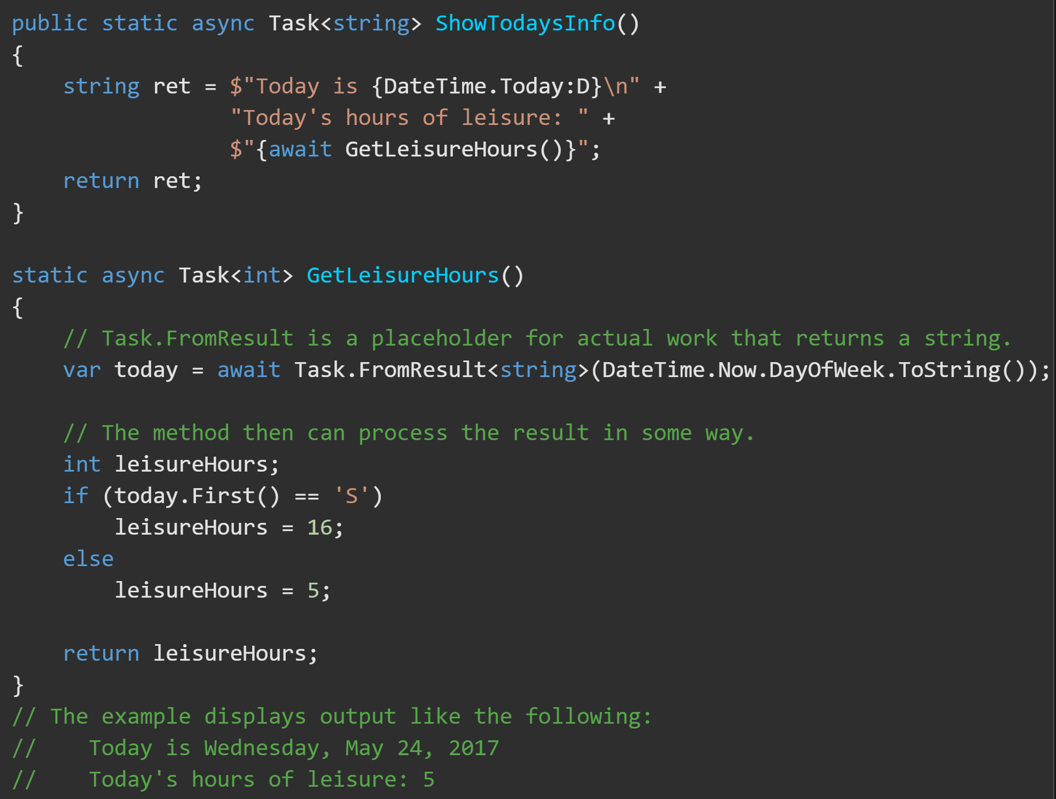
async Methods https://docs.microsoft.com/en-us/dotnet/csharp/language-reference/keywords/async
An async method can have only the return types Task or Task<TResult>
An async method can't declare any in, ref or out parameters, nor can it return a reference value, but it can call methods that have such parameters.
Only async methods can call other async methods.
By convention, async methods have and await statement in them.

Slide 8
Async vs parallelism.
Array of 1 billion Ints (10 minutes processing time)
Parallelism splits the actions among multiple processors
My Async Code
1
2 async
3
4
5
Await 2
6 – requires the results of step2
7
Sideways API

