Slide 1

Boxing, and Unboxing
.neT

Slide 2
Subtyping between more complex types relates to subtyping between their components. If type Cat is a subtype of Mammal, then an instance of type Cat should be substitutable wherever an instance of type Mammal is used.
https://docs.microsoft.com/en-us/dotnet/csharp/programming-guide/types/boxing-and-unboxing

Slide 3
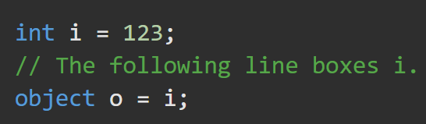
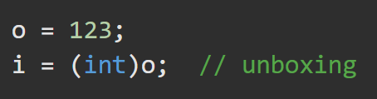
Boxing Unboxing https://docs.microsoft.com/en-us/dotnet/csharp/programming-guide/types/boxing-and-unboxing#boxing https://docs.microsoft.com/en-us/dotnet/csharp/programming-guide/types/boxing-and-unboxing#unboxing
The concept of boxing and unboxing underlies the C# Unified Type System in which a value of any type can be treated as an object.
https://docs.microsoft.com/en-us/dotnet/csharp/programming-guide/types/boxing-and-unboxing
Boxing happens when any value type is cast to an object type. The value is wrapped to give it reference type behavior.
BOXING is implicit
Unboxing extracts the value type from the object.
UNBOXING is explicit

Slide 4
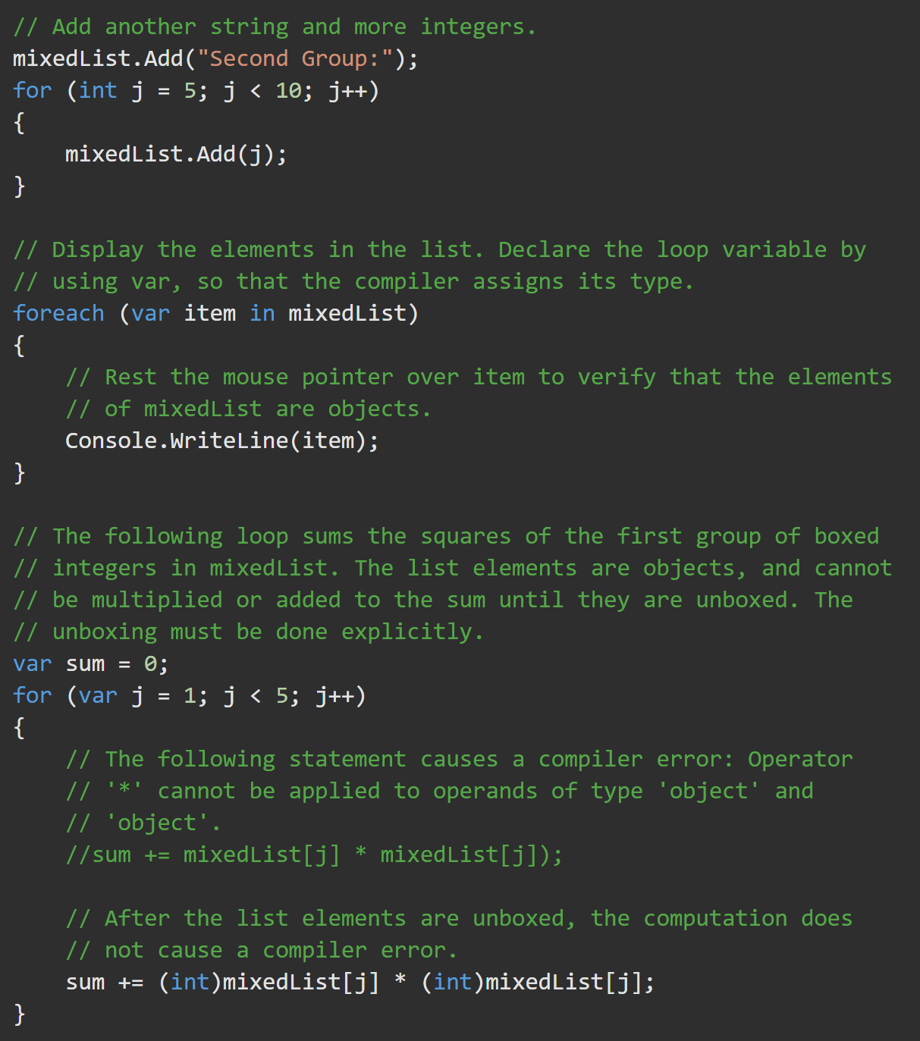
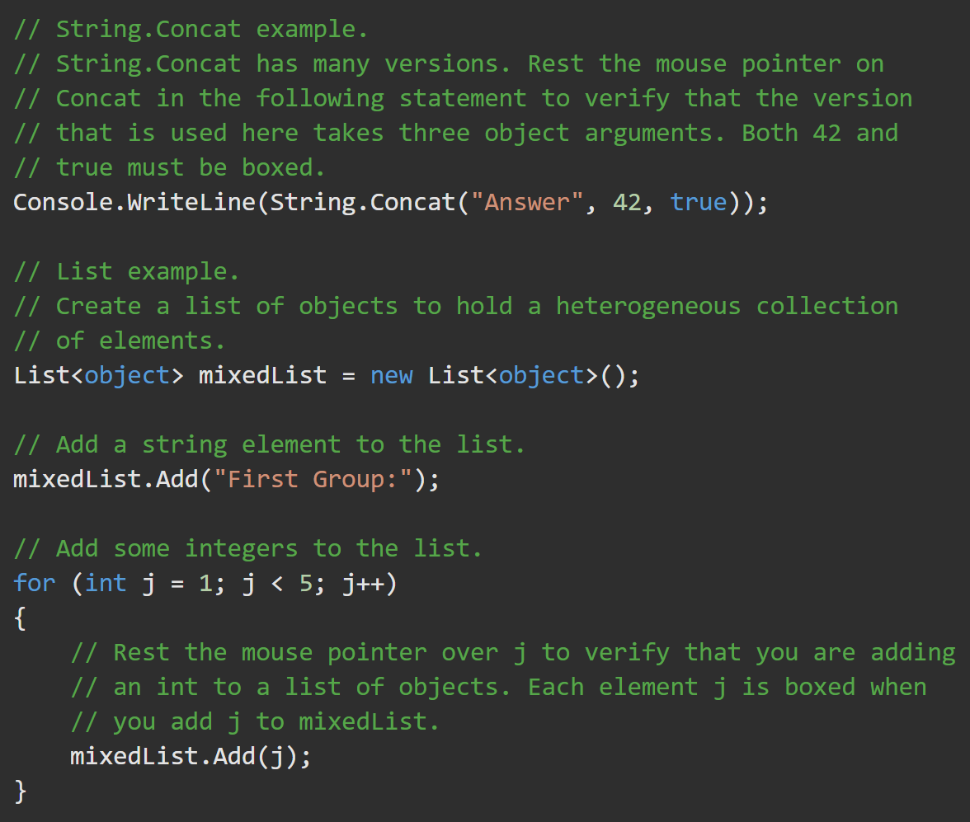
Boxing to the object type allows different types to inhabit the same array.
https://docs.microsoft.com/en-us/dotnet/csharp/programming-guide/types/boxing-and-unboxing

Slide 5
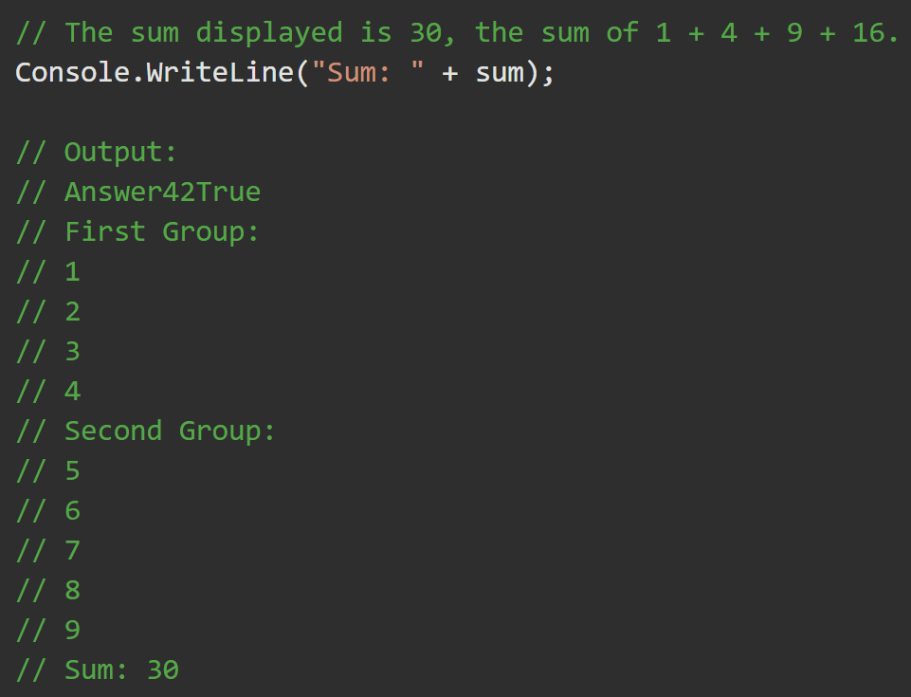
Output

Slide 6
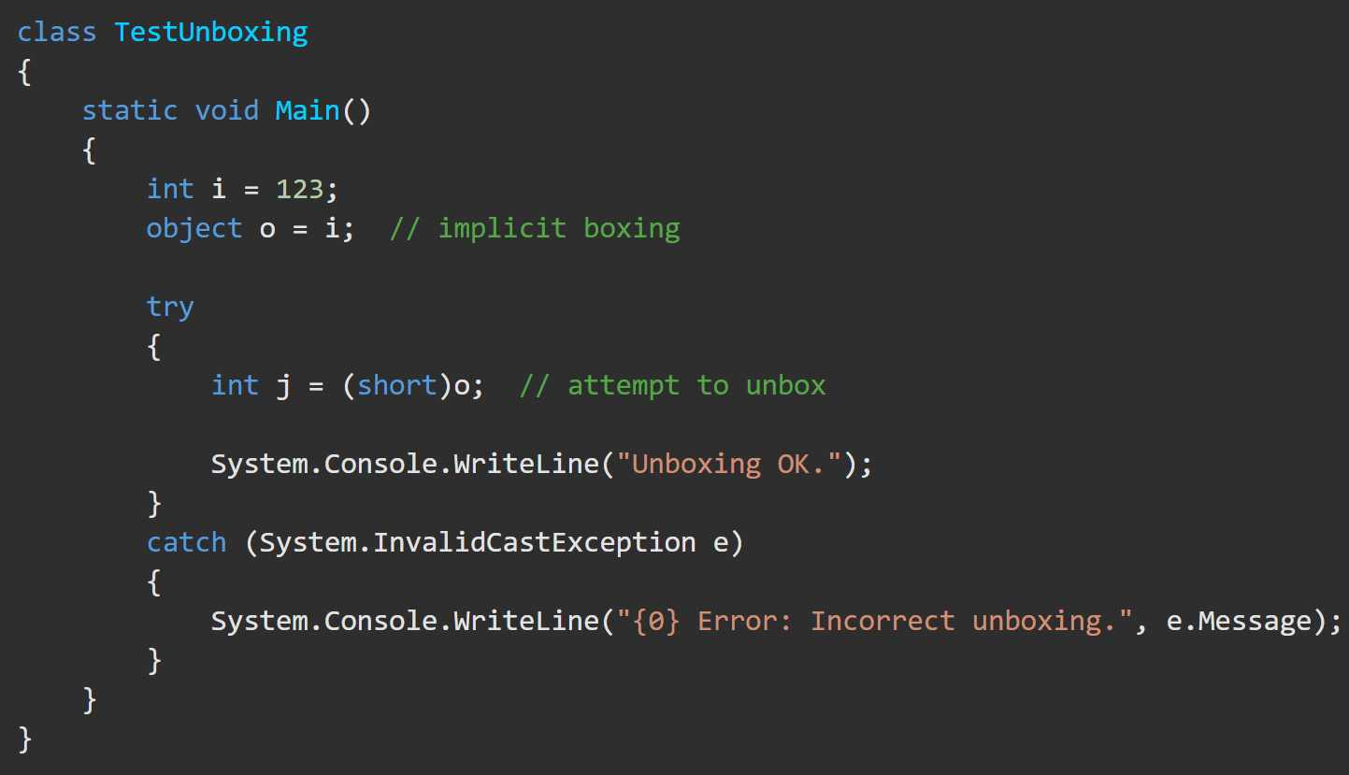
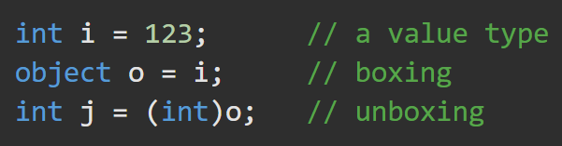
Unboxing https://docs.microsoft.com/en-us/dotnet/csharp/programming-guide/types/boxing-and-unboxing#unboxing
Unboxing is an explicit conversion from the type object to a value type or from an interface type to a value type that implements the interface. An unboxing operation consists of:
Checking the object instance to make sure that it is a boxed value of the given value type.
Copying the value from the instance into the value-type variable.

