Slide 1

Casting and Type Conversion
.net

Slide 2
C# is statically typed at compile time.
After a variable is declared, it cannot be declared again or assigned a value of another type unless that type is implicitly convertible to the variable's type. Converting one type to another implicitely is called type conversion.
https://docs.microsoft.com/en-us/dotnet/csharp/programming-guide/types/casting-and-type-conversions

Slide 3
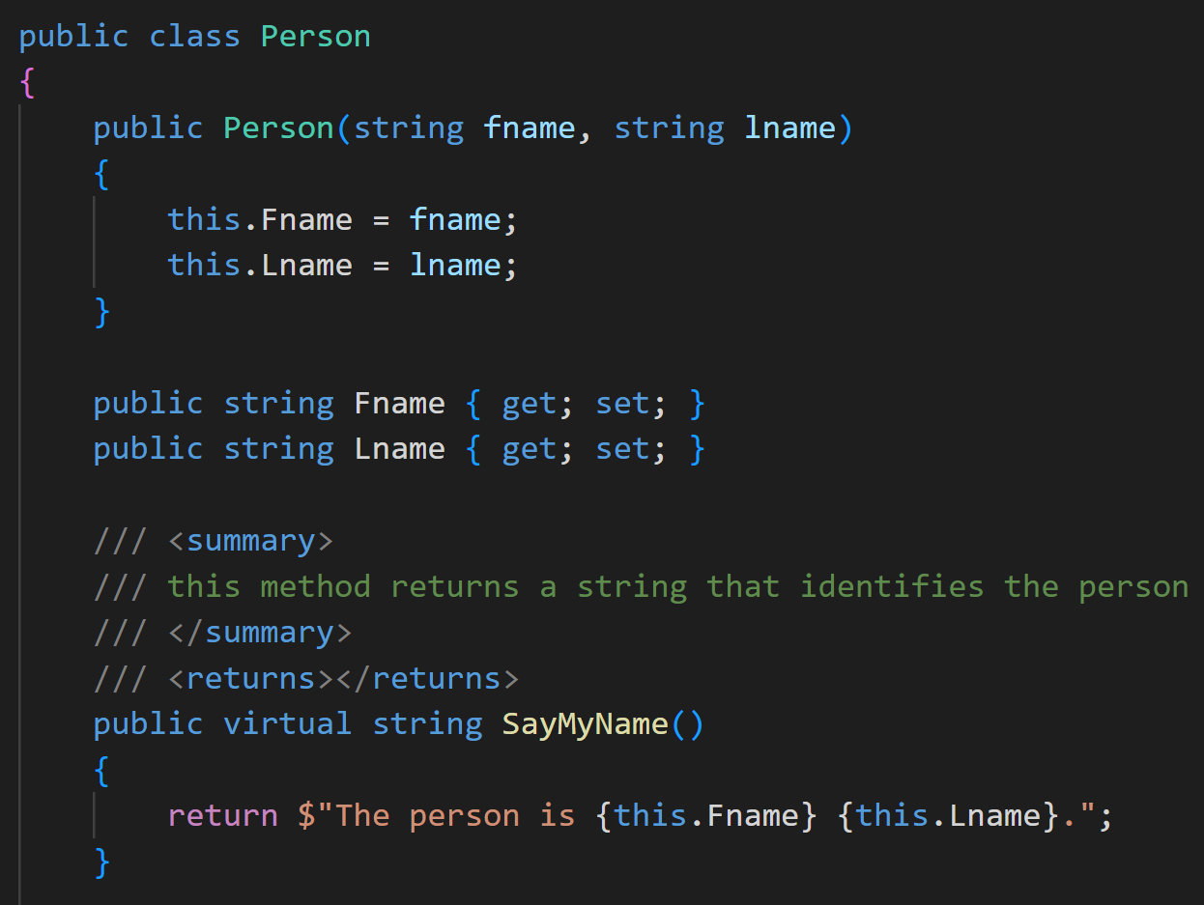
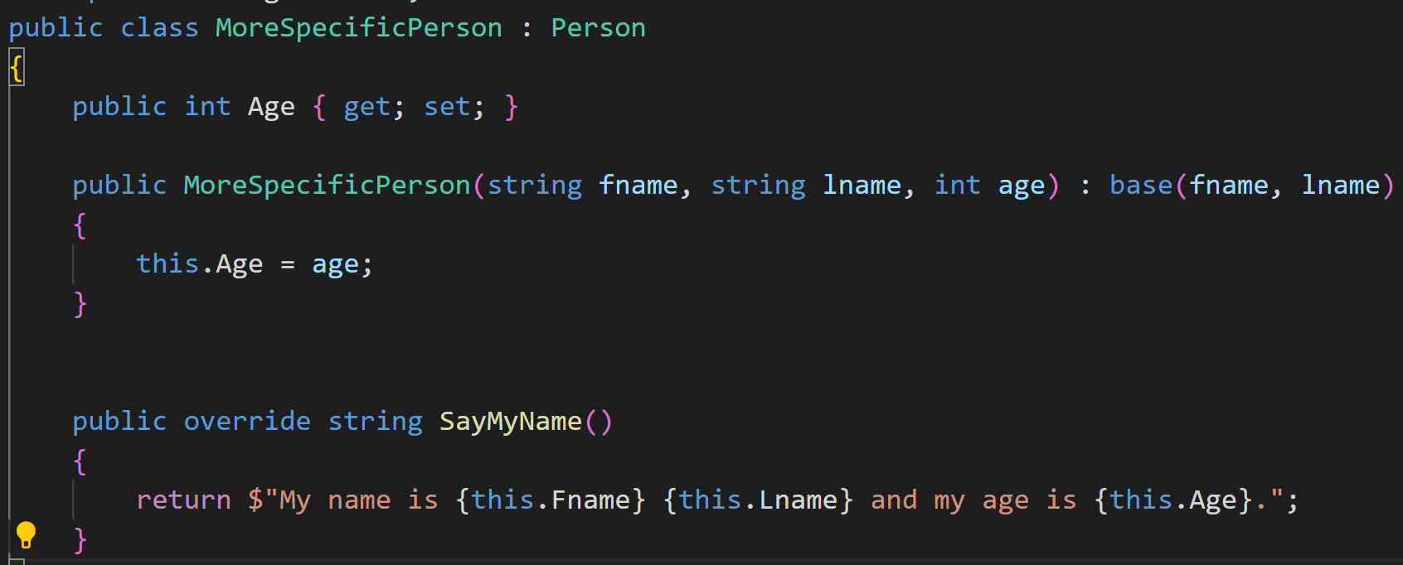
Type Casting vs Type Conversion https://docs.microsoft.com/en-us/dotnet/csharp/programming-guide/types/casting-and-type-conversions

Slide 4
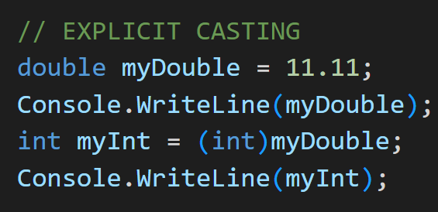
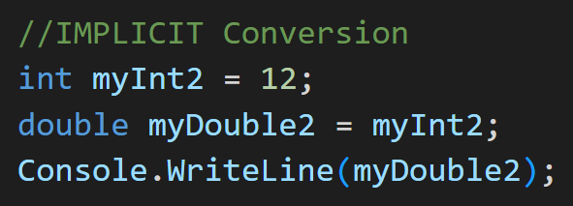
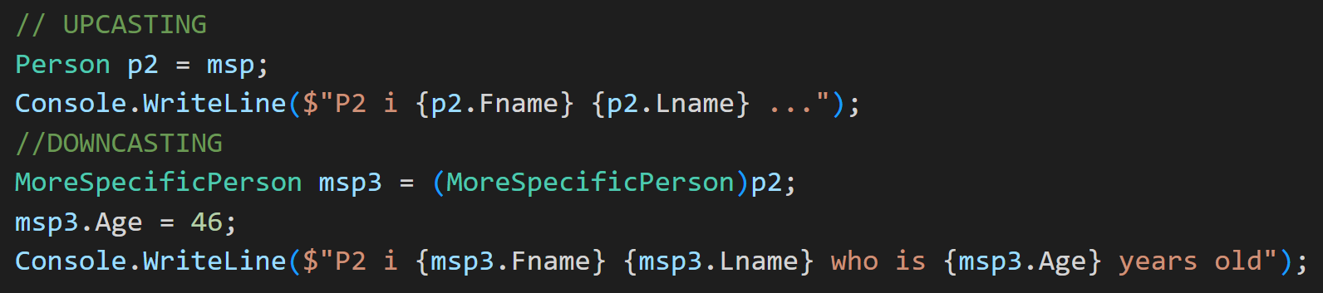
Type Casting vs Type Conversion https://docs.microsoft.com/en-us/dotnet/csharp/programming-guide/types/casting-and-type-conversions
There are 2 types of datatype conversions in C#
Type Conversion (implicit): | Type Casting (explicit):
This is done by the compiler. No special syntax is required. Type safe. No data loss. | Requires use of the cast operator, (). A cast is required when data might be lost in the conversion, or When failure could occur.

Slide 5
Casting and Type Conversion https://docs.microsoft.com/en-us/dotnet/csharp/programming-guide/types/casting-and-type-conversions
There are 2 types of conversions in C#:
Implicit conversions: No special syntax. Type safe. No data loss.
Explicit conversions (casts): Explicit conversions require the cast operator, (). A cast is required when data might be lost in the conversion, or when failure could occur.

Slide 6
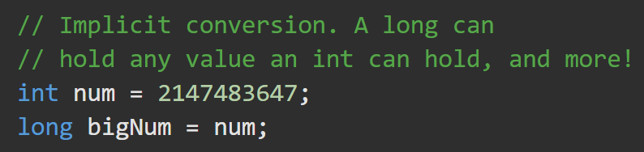

Implicit Conversion https://docs.microsoft.com/en-us/dotnet/csharp/programming-guide/types/casting-and-type-conversions#implicit-conversions
Implicit conversion is possible in:
numeric types when the value to be stored can fit into the variable memory without being truncated.
integral types when the range of the source type is at least as big as the target type.
Implicit conversion is always possible in reference types.
When a class is converted to any one of its direct or indirect base classes or interfaces.
No special syntax is necessary.
Derived classes always contain all the members of the base class.

Slide 7
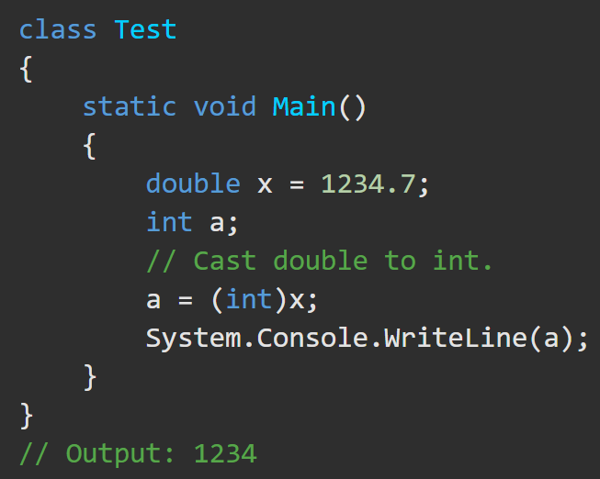
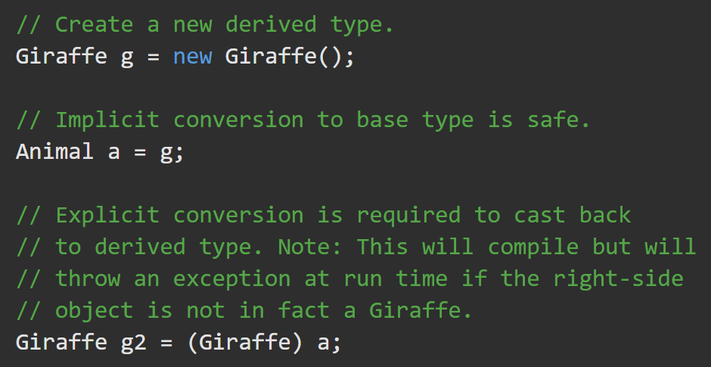
Explicit Conversion (Casting) https://docs.microsoft.com/en-us/dotnet/csharp/programming-guide/types/casting-and-type-conversions#explicit-conversions
If there is a risk of losing information, you must perform a cast.
Specify the target type in ( ) in front of the value or variable to be converted.
*This doesn’t prevent the loss of data.
An explicit cast is required if you need to convert from a base type to a derived type.

Slide 8
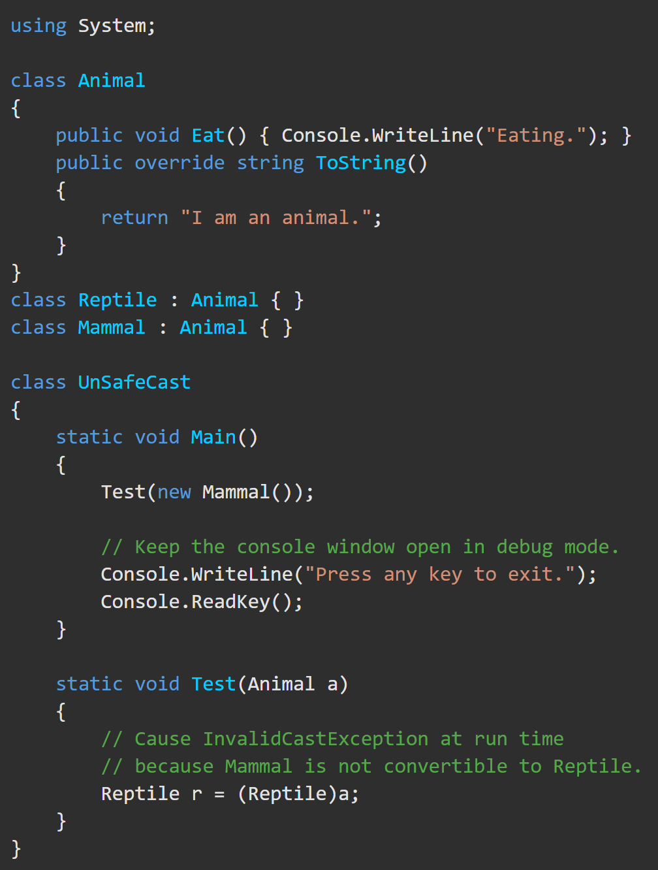
Type conversion run time exceptions https://docs.microsoft.com/en-us/dotnet/csharp/programming-guide/types/casting-and-type-conversions#type-conversion-exceptions-at-run-time
In some reference type conversions, It is possible for a cast operation that compiles correctly to fail at run time.
A type cast that fails at run time will cause an InvalidCastException to be thrown.

