Slide 1

Class and Interface
.net

Slide 2
A Class is a blueprint for a Class Object. The Class is the most fundamental of C#’s types. It is a data structure that combines state (fields) and functionality (methods) into a single unit. Classes support inheritance and polymorphism.
https://docs.microsoft.com/en-us/dotnet/csharp/tour-of-csharp/classes-and-objects

Slide 3
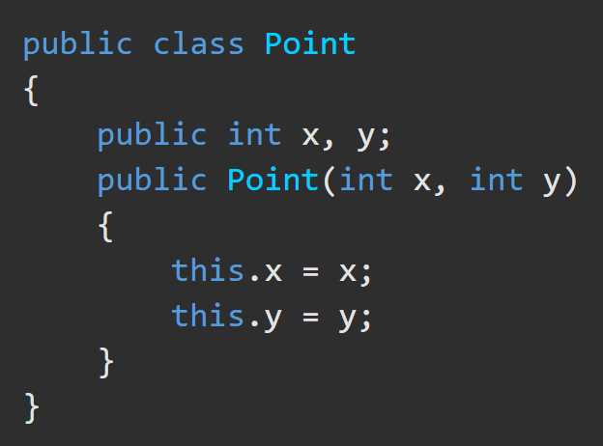
Class https://docs.microsoft.com/en-us/dotnet/csharp/tour-of-csharp/classes-and-objects
Classes are defined using class declarations.
A class declaration starts with a header that specifies
the attributes and modifiers of the class,
the name of the class,
the base class (if given), and
the interfaces implemented by the class.
The header is followed by the class body, which consists of a list of member declarations written between curleyBrackets { }.
Header
Body

Slide 4
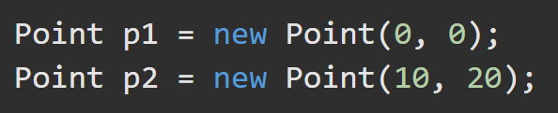
Class – Instance Instantiation https://docs.microsoft.com/en-us/dotnet/csharp/tour-of-csharp/classes-and-objects
Instances of classes are created using the new operator, which
allocates heap memory for an instance of the class,
invokes the class constructor to initialize the instance, and
returns a reference to the instance.
The memory occupied by an object is automatically reclaimed by the Garbage Collector after the object is out of scope.

Slide 5
Class - Members https://docs.microsoft.com/en-us/dotnet/csharp/tour-of-csharp/classes-and-objects
Members of a class are:
Constructors - To initialize instances of the class
Constants - Constant values
Fields – Variables
Methods – Computations/actions that can be performed
Properties – Fields combined with the actions associated with reading/writing them
Types - Nested types declared by the class
Class members can be:
static - belong to classes. Envoked with: ClassName.MethodName();
instance - belong to instances of classes. Envoked with: InstanceName.MethodName();

Slide 6
Accessibility of Classes https://docs.microsoft.com/en-us/dotnet/csharp/programming-guide/classes-and-structs/access-modifiers
Classes and structs declared directly in a namespace (not nested in another class or struct) can be either public or internal.
Internal is the default access level if no other is specified.
Derived classes can not have greater accessibility than their base class.

Slide 7
Class – Member Accessibility https://docs.microsoft.com/en-us/dotnet/csharp/tour-of-csharp/types#classes-and-objects https://docs.microsoft.com/en-us/dotnet/csharp/programming-guide/classes-and-structs/access-modifiers
Access Modifiers control which regions of a program can access a member.
private - This class only.
protected - accessed by code in the same class, or in a derived class.
private protected - accessed by the same class or derived classes only when in the same assembly.
internal – accessed by any code in the same assembly (.exe, .dll).
protected internal - accessed by any code in the same assembly and from a derived class that is in a different assembly.
public - Access isn't limited.

Slide 8
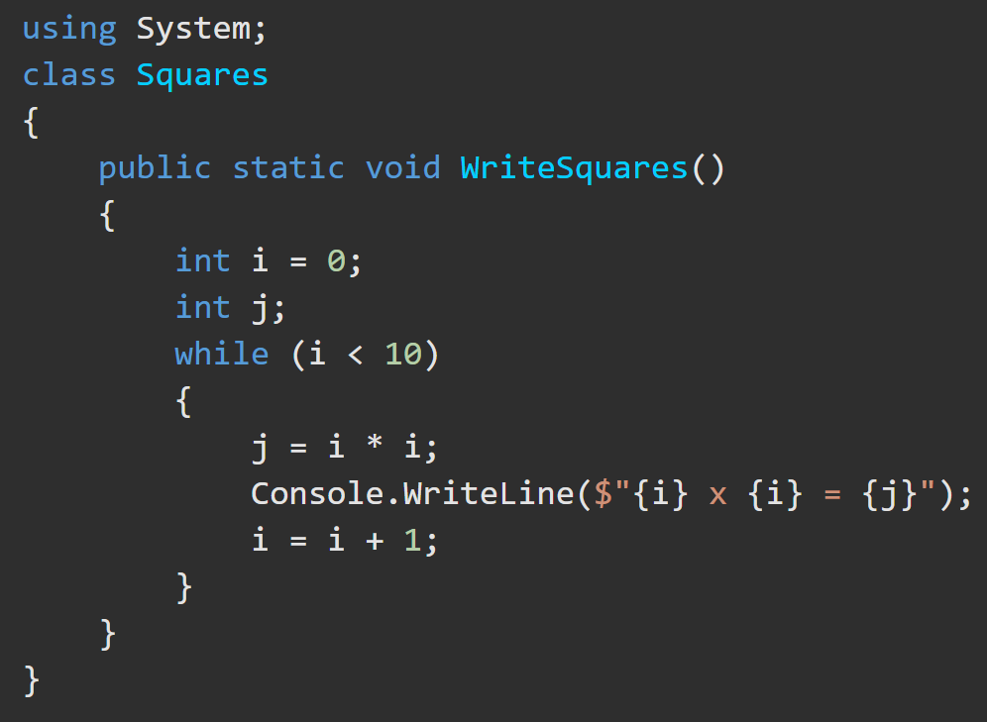
Class – Local Variables https://docs.microsoft.com/en-us/dotnet/csharp/tour-of-csharp/classes-and-objects#method-body-and-local-variables
Local variables are declared inside the body of a method. They must have a type name and a variable name. All variables must be given a default value.
int == 0;
string == “”;

Slide 9
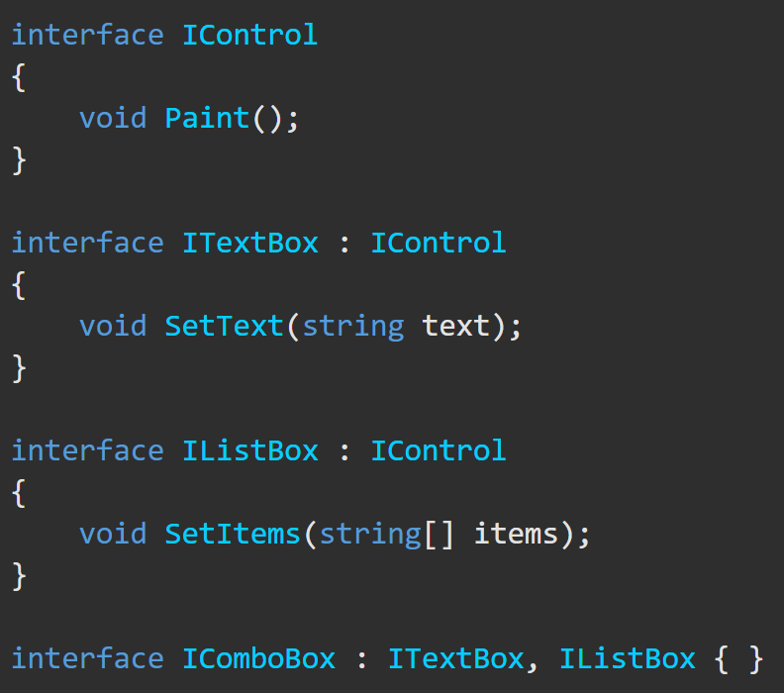
Interface https://docs.microsoft.com/en-us/dotnet/csharp/tour-of-csharp/interfaces https://docs.microsoft.com/en-us/dotnet/csharp/language-reference/keywords/interface
An interface defines a contract that must be implemented by classes and structs that use the interface.
It can contain methods, properties, events.
It specifies members that must be implemented by classes or structs that implement the interface.
Interface implementation is NOT inheritance.
An Interface is intended to express a "can do" relationship between an interface and its implementing class.
Interfaces are used to simulate multiple inheritance.
An interface CAN have default interface methods. These methods have implementations and are not required to be implemented by the implementing class. They are useful for when methods are added to an interface after other classes have implemented it already.

Slide 10
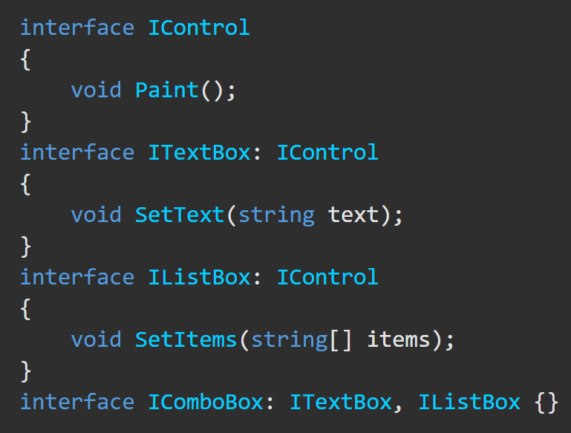
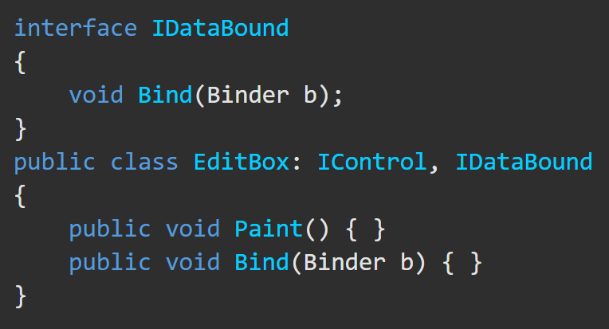
Interface https://docs.microsoft.com/en-us/dotnet/csharp/tour-of-csharp/interfaces
Interfaces may employ multiple inheritance.
Classes and structs can implement multiple interfaces.
Are Paint() and Bind() defined?

Slide 11
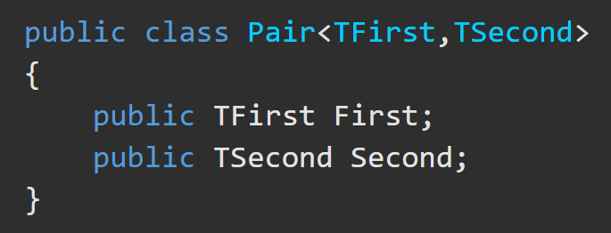
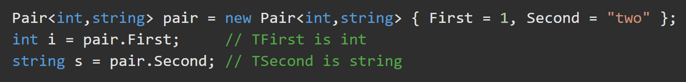
Class – Type Parameters https://docs.microsoft.com/en-us/dotnet/csharp/tour-of-csharp/classes-and-objects#type-parameters
Class Type Parameters:
are used to define a generic class type,
follow the class name and are inside < >,
are used to define the types that the members of the class act upon.

Slide 12
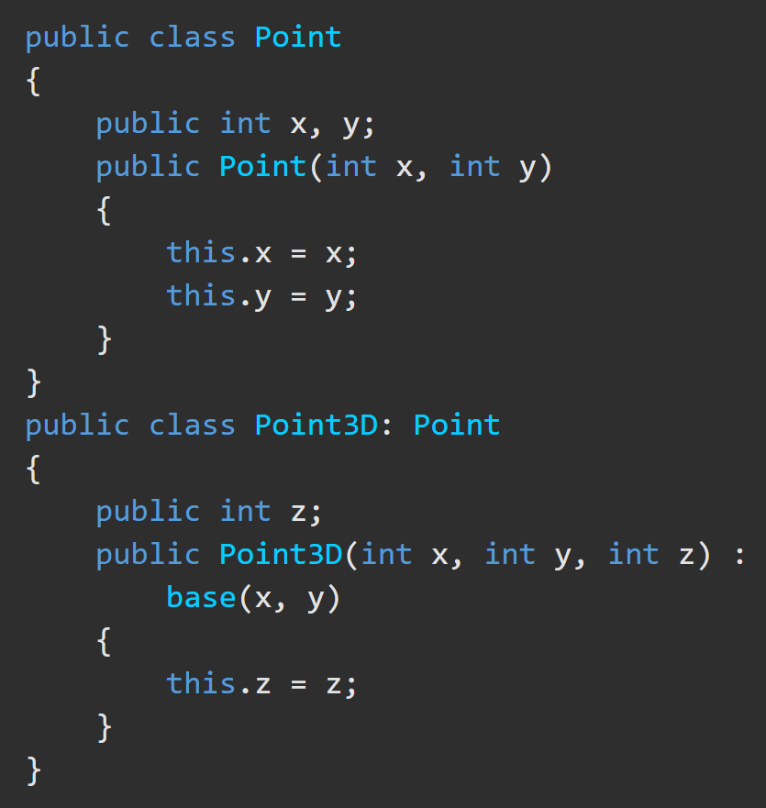
Class – Base (inherited) Classes https://docs.microsoft.com/en-us/dotnet/csharp/tour-of-csharp/classes-and-objects#base-classes
A class declaration specifies inheritance of a base class by following the class name with the name of the base class. Use the syntax to the right.

Slide 13
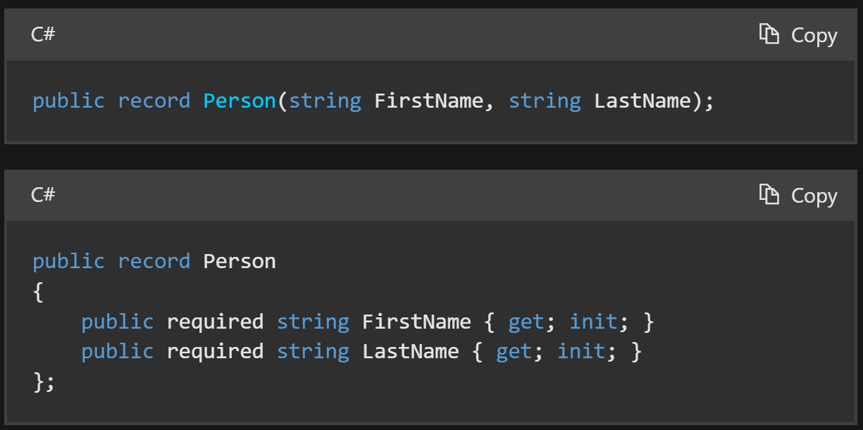
Record https://docs.microsoft.com/en-us/dotnet/csharp/language-reference/builtin-types/record
The record modifier defines a reference type that has built-in functionality for encapsulating data. Use record class syntax to clarify a reference type, and record struct to define a value type.
When you declare a primary constructor on a record, the compiler generates public properties for the primary constructor parameters.
The constructor parameters are referred to as positional parameters. The compiler creates positional properties that mirror the primary constructor or positional parameters.
You type this.
The compiler creates this.

