Slide 1

Collections
.net

Slide 2
Collections are ready-made classes that provide a more flexible way to work with groups of objects. The group of objects can grow and shrink dynamically as the needs of the application change.
https://docs.microsoft.com/en-us/dotnet/csharp/programming-guide/concepts/collections

Slide 3

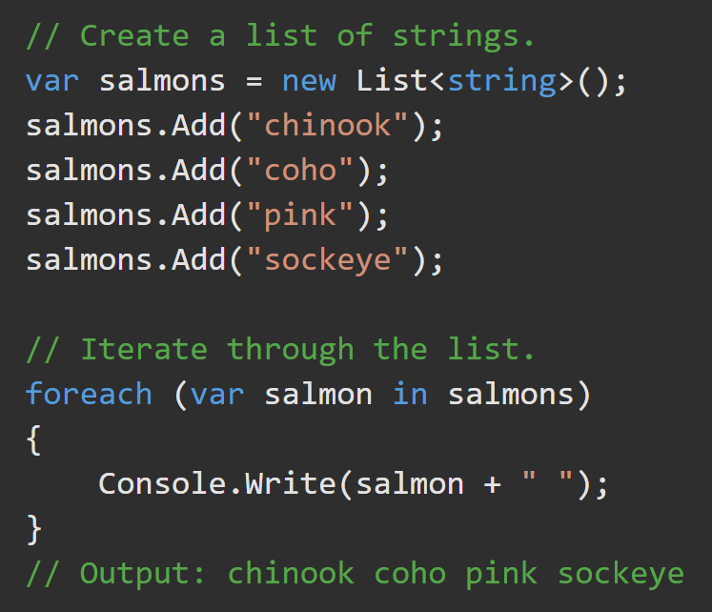
Collections https://docs.microsoft.com/en-us/dotnet/csharp/programming-guide/concepts/collections
There are two ways to group similar objects in C#:
arrays of objects, and
collections of objects.
Collections provide a more flexible way to work with groups of objects. The group of objects can grow and shrink dynamically.
A collection is a class, so an instance of the class must be created before elements can be added to that collection.
If the collection contains elements of only one data type, the System.Collections.Generic namespace ca be used. A generic collection enforces type safety so that no other data type can be added to it.

Slide 4
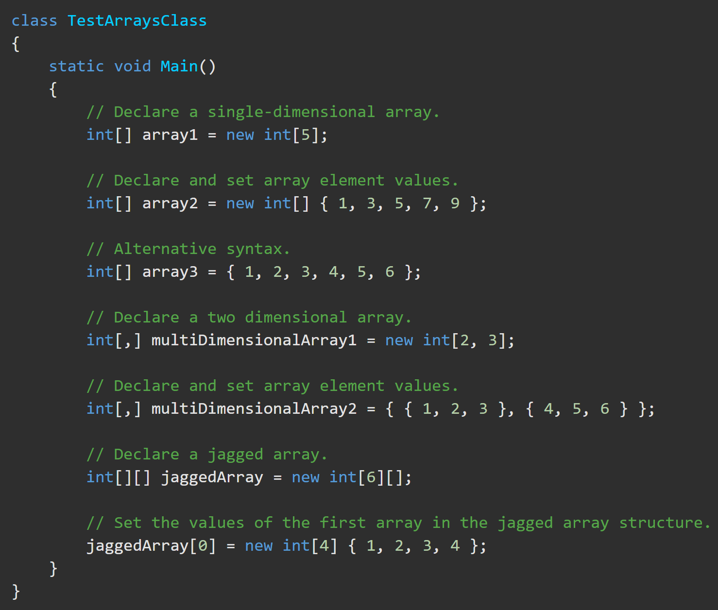
C# Array Class https://docs.microsoft.com/en-us/dotnet/csharp/programming-guide/arrays/ https://docs.microsoft.com/en-us/dotnet/standard/generics/?view=net5.0
The Array class is considered a collection because it is based on the IList interface.
It has methods for creating, manipulating, searching, and sorting arrays,
length, and data type are set when the array instance is created and cannot be changed.
An array can be Single-Dimensional, Multidimensional or Jagged.
Numeric default values are zero (0).
Reference default values are ‘null’.
Arrays are ‘zero indexed’ (They start at 0).

Slide 5
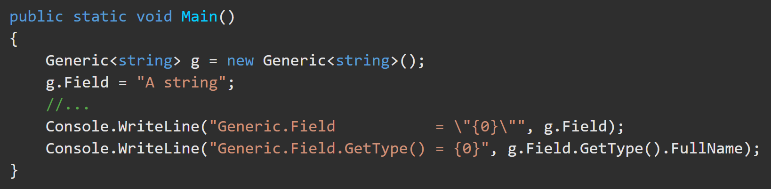

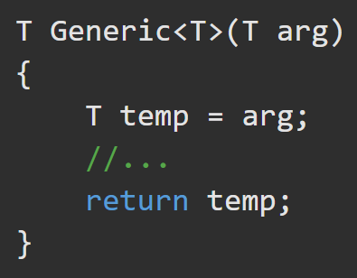
Generics https://docs.microsoft.com/en-us/dotnet/standard/generics/?view=net5.0
Generics let you tailor a method, class, structure, or interface to the precise data type it acts upon.
When you create an instance of a generic class, you specify the types to substitute for the type parameters.
This establishes a new generic class, referred to as a constructed generic class, with your chosen types substituted everywhere that the type parameters appear. The result is a type-safe class that is tailored to your choice of types.

Slide 6
Generic Collections (1/2) https://docs.microsoft.com/en-us/dotnet/csharp/programming-guide/generics/ https://docs.microsoft.com/en-us/dotnet/csharp/programming-guide/concepts/collections#systemcollectionsgeneric-classes
The .NET class library provides a number of strongly-typed generic collection classes in the System.Collections.Generic and System.Collections.ObjectModel namespaces.
Many generic collection types are direct analogs of non-generic types.
Dictionary<TKey,TValue> | Hashtable | Creates a Dictionary of any datatype key and value.
List<T> | ArrayList | Creates a list of any object type you need.
Queue<T> and Stack<T> | Queue and Stack | Creates a Queue or Stack of any object type.
SortedList<TKey,TValue> | SortedList | Both versions are hybrids of a dictionary and a list.

Slide 7
Generic Collections (2/2) https://docs.microsoft.com/en-us/dotnet/api/system.collections.generic.sorteddictionary-2?view=net-5.0 https://docs.microsoft.com/en-us/dotnet/api/system.collections.generic.linkedlist-1?view=net-5.0
The .NET class library provides a number of strongly-typed generic collection classes in the System.Collections.Generic and System.Collections.ObjectModel namespaces.
Generic Structures Unique to .NET
SortedDictionary<TKey,TValue> | This is a pure dictionary of key/value pairs sorted based on the value of the key.
LinkedList<T> | A linked list of any object type.

Slide 8
Generics - Terminology https://docs.microsoft.com/en-us/dotnet/standard/generics/?view=net5.0
generic type definition - a class, structure, or interface declaration that functions as a template with placeholders for its types.
generic type parameters - type parameters. Placeholders in a generic type or method definition. Conventionally named <T>.
constructed generic type - constructed type. The result of specifying types for the generic type parameters of a generic type definition.
generic type argument - any type that is substituted for a generic type parameter.
generic type - constructed types and generic type definitions.
constraints - limits placed on generic type parameters. Arguments that do not satisfy the constraints cannot be used.
generic method definition - a method with two parameter lists: a list of generic type parameters and a list of formal parameters. Type parameters can appear as the return type or as the types of the formal parameters.

Slide 9
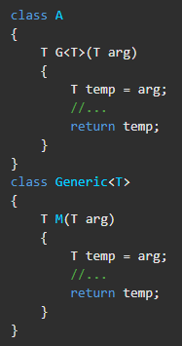
Generic Methods https://docs.microsoft.com/en-us/dotnet/standard/generics/?view=net5.0
A method is generic only if it has its own list of type parameters.
Generic methods can appear on generic or nongeneric types.
A method is not generic just because it belongs to a generic type, or even because it has formal parameters whose types are the generic parameters of the enclosing type.
In the following code, only method G is generic.

Slide 10

Generics - Instantiation https://docs.microsoft.com/en-us/dotnet/csharp/programming-guide/generics/ https://docs.microsoft.com/en-us/dotnet/standard/generics/?view=net5.0
On instantiation of a generic class, specify the actual types to substitute for the type parameters. This establishes a ‘constructed generic class’, with your chosen types substituted everywhere that the type parameters appear. The result is a type-safe class that is tailored to your choice of types.

Slide 11
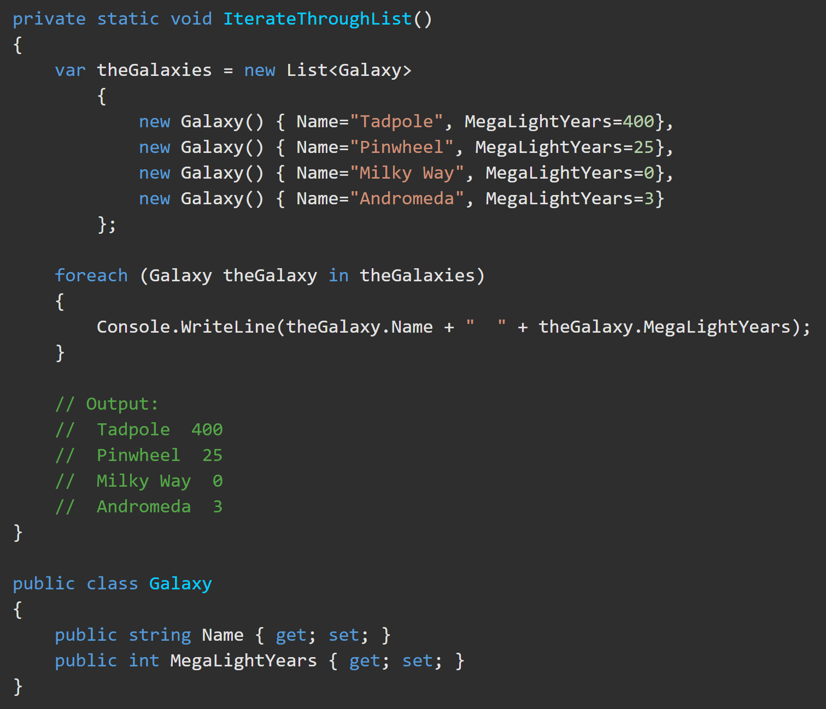
List<T> https://docs.microsoft.com/en-us/dotnet/csharp/programming-guide/concepts/collections https://docs.microsoft.com/en-us/dotnet/api/system.collections.generic.list-1?view=net-5.0
List<T> represents a strongly typed list of objects
Elements can be accessed by (zero-based) index[].
Provides methods to search, sort, and manipulate lists.
The List<T> class is the generic equivalent of the (Deprecated) ArrayList class.
It implements the IList<T> generic interface by using an array whose size is dynamically increased as required.
The List<T> is not guaranteed to be sorted.

Slide 12
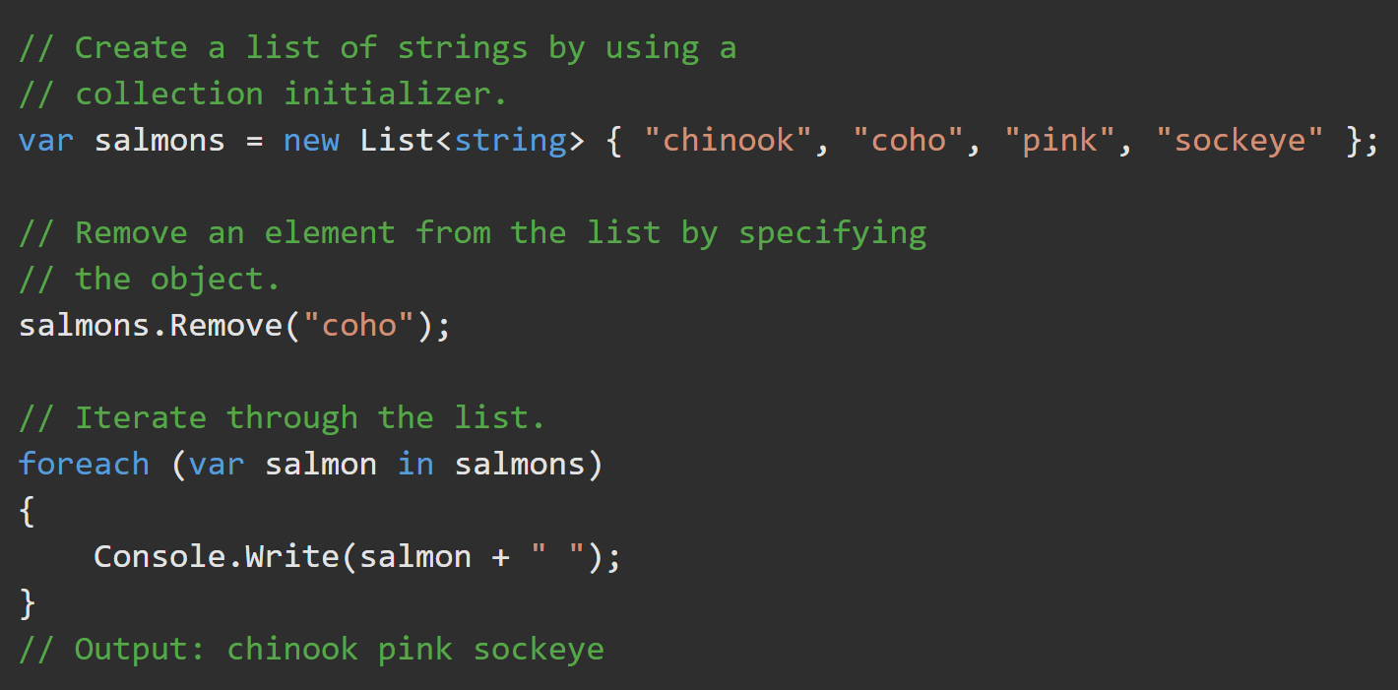

List<T> https://docs.microsoft.com/en-us/dotnet/csharp/programming-guide/concepts/collections https://docs.microsoft.com/en-us/dotnet/api/system.collections.generic.list-1?view=net-5.0
Add content using .Add().
Use foreach() loop to iterate through the List.
Use a ‘collection initializer’ to add content of the specified type.
Use a foreach() loop to iterate through the List.

Slide 13
Dictionary<TKey,TValue> https://docs.microsoft.com/en-us/dotnet/api/system.collections.generic.dictionary-2?view=netcore-5.0
Represents a collection of key/value pairs.
The Dictionary<TKey,TValue> generic class provides a mapping from a set of keys to a set of values. A key and its value must be added at the same time.
A key cannot be null, but a value can be, if its type TValue is a reference type.
As elements are added to a Dictionary<TKey,TValue>, the capacity is automatically increased as required by reallocating the internal array.

Slide 14
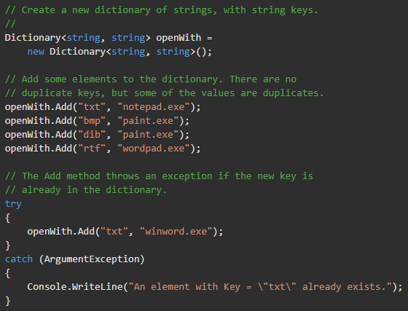
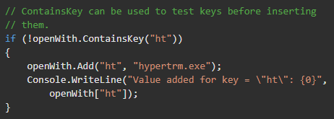
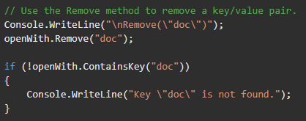
Dictionary<TKey,TValue> – Usage https://docs.microsoft.com/en-us/dotnet/api/system.collections.generic.dictionary-2?view=netcore-5.0

Slide 15

Dictionary<TKey,TValue> https://docs.microsoft.com/en-us/dotnet/api/system.collections.generic.dictionary-2?view=netcore-5.0
The foreach statement returns an object representing the key/value pair in the collection. Since the Dictionary<TKey,TValue> is a collection of keys and values, the element type is not the type of the key or the type of the value. Instead, the element type is a KeyValuePair<TKey,TValue> of the key type and the value type. The foreach statement is a wrapper around the enumerator, which allows only reading from the collection, not writing to it.

Slide 16
SortedList<TKey,TValue> https://docs.microsoft.com/en-us/dotnet/api/system.collections.generic.sortedset-1?view=net-5.0
Represents a collection of key/value pairs that are sorted by key based on the associated IComparer<T> implementation.
SortedList<TKey,TValue> is implemented as an array of key/value pairs, sorted by the key.
SortedList<TKey, TValue> is similar to the SortedDictionary<TKey,TValue> generic class
SortedList<TKey,TValue> uses less memory than SortedDictionary<TKey,TValue>.
SortedDictionary<TKey,TValue> has faster insertion and removal operations for unsorted data.
If the list is populated all at once from sorted data, SortedList<TKey,TValue> is faster than SortedDictionary<TKey,TValue>.
SortedList<TKey,TValue> supports efficient indexed retrieval of keys and values
The capacity can be decreased by calling .TrimExcess() or by setting the Capacity property explicitly.
The foreach() statement is a wrapper around the enumerator and is readonly.

Slide 17
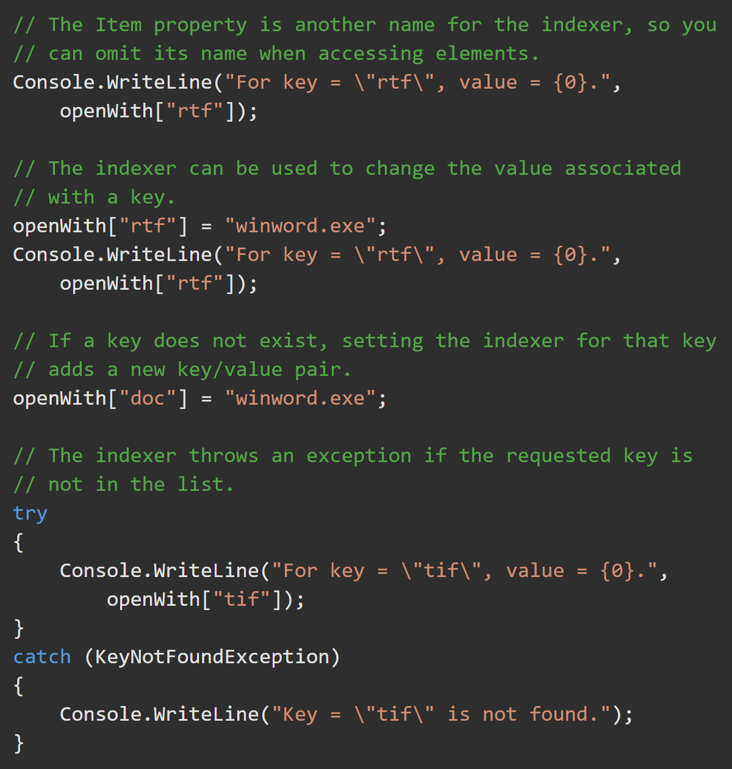
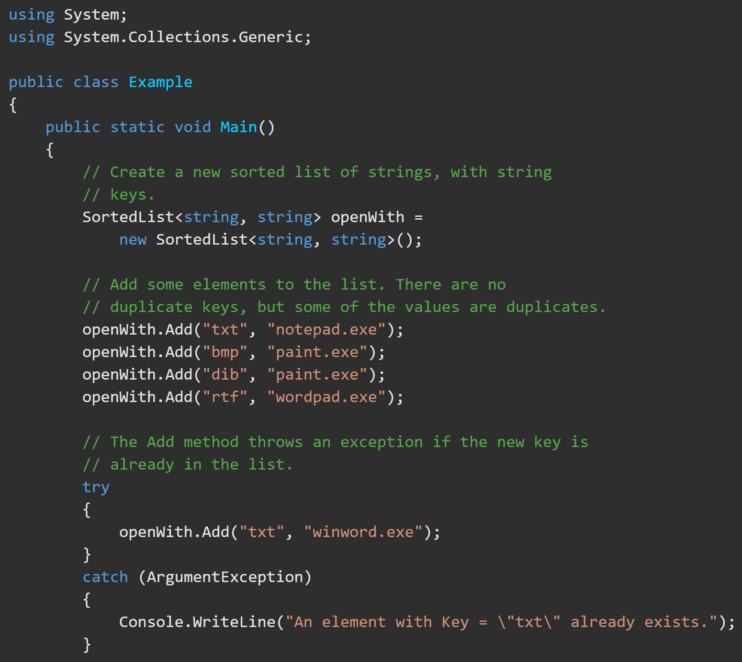
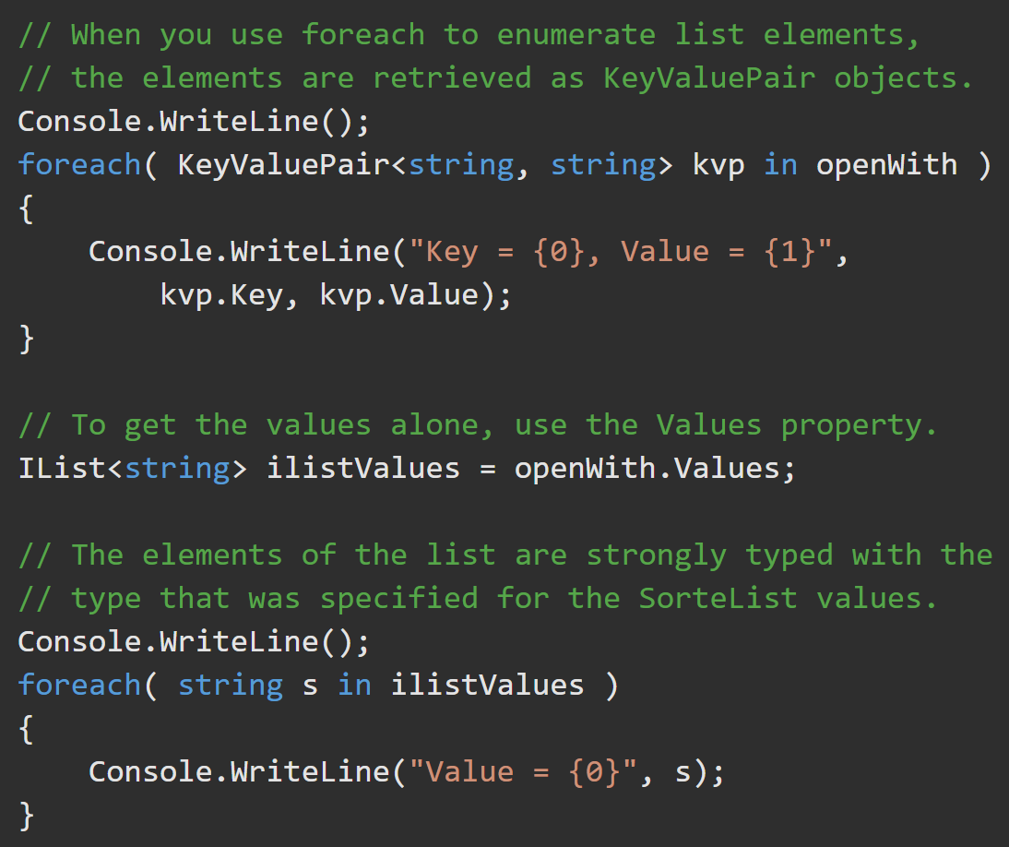
SortedList<TKey,TValue> https://docs.microsoft.com/en-us/dotnet/api/system.collections.generic.sortedlist-2?view=net-5.0

Slide 18
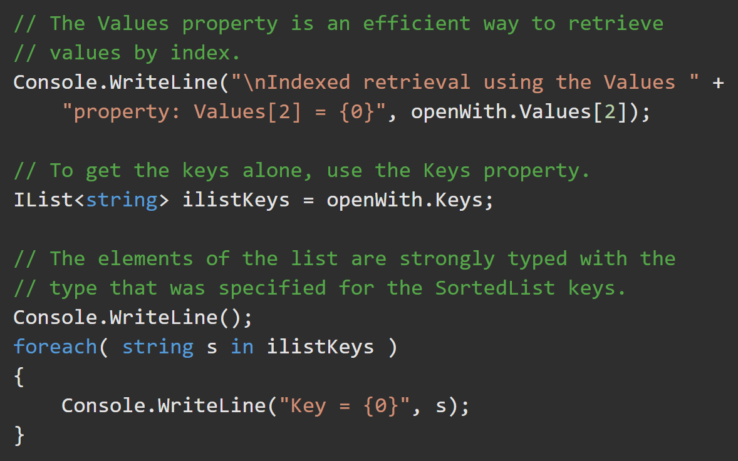
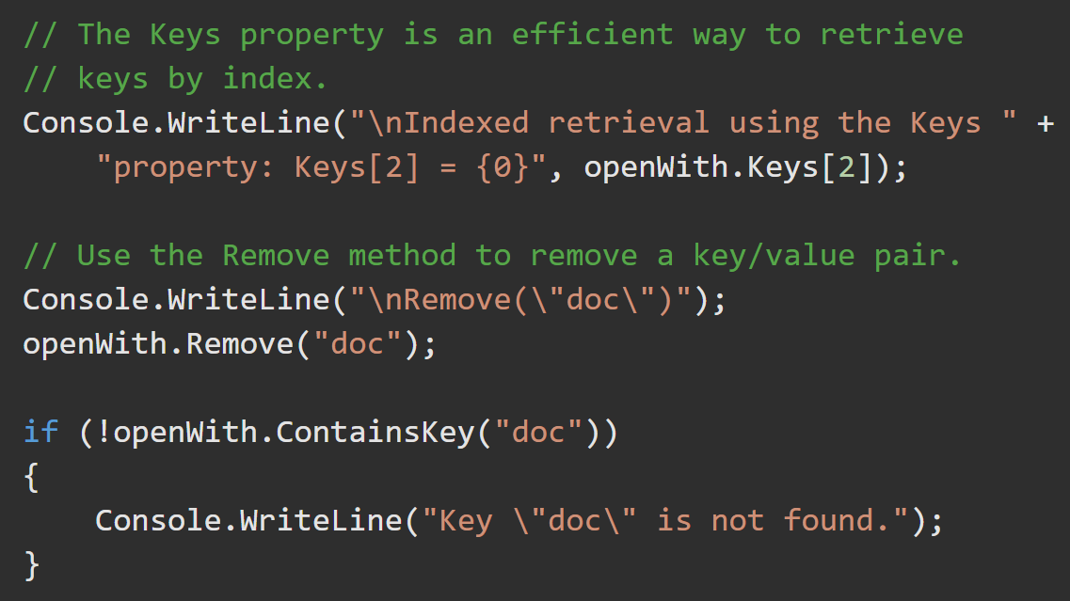
SortedList<TKey,TValue> https://docs.microsoft.com/en-us/dotnet/api/system.collections.generic.sortedlist-2?view=net-5.0

Slide 19
Queue<T> (rarely used) https://docs.microsoft.com/en-us/dotnet/api/system.collections.generic.queue-1?view=net-5.0
FIFO - Objects stored in a Queue<T> are inserted at one end and removed from the other.
Use Queue<T> if you need to access the information in the same order that it is stored in the collection.
Use ConcurrentQueue<T> if you need to access the collection from multiple threads concurrently.
Queue<T> accepts null as a valid value for reference types and allows duplicate elements.
Queues and stacks are useful when you need temporary storage for information
Three main operations can be performed on a Queue<T> and its elements:
Enqueue() adds an element to the end of the Queue<T>.
Dequeue() removes the oldest element from the start of the Queue<T>.
Peek() returns the oldest element that is at the start of the Queue<T> but does not remove it from the Queue<T>.

Slide 20
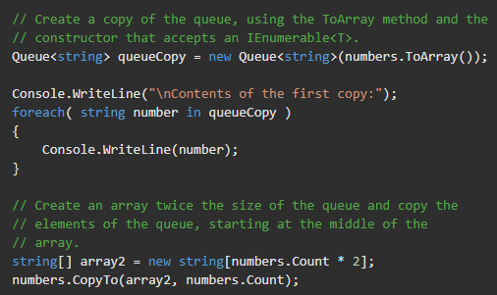
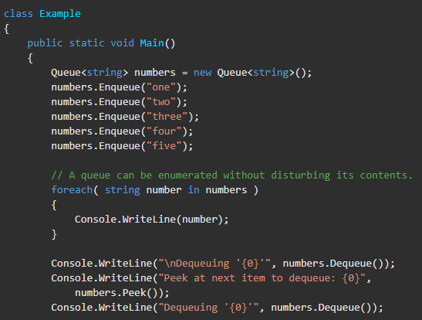
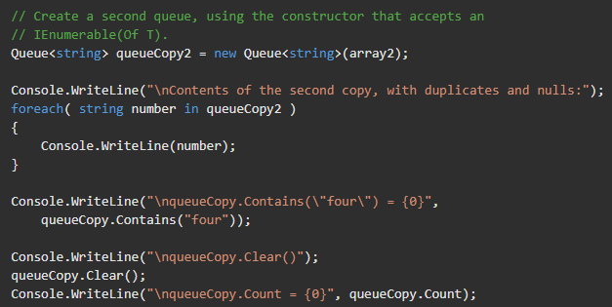
Queue<T> (rarely used) https://docs.microsoft.com/en-us/dotnet/api/system.collections.generic.queue-1?view=net-5.0

Slide 21
Stack<T> (rarely used) https://docs.microsoft.com/en-us/dotnet/api/system.collections.generic.stack-1.push?view=net-5.0
A (LIFO) collection of instances of the same specified type.
Stack<T> is implemented as an array.
Stacks (and Queues) are useful when you need temporary storage for information
Use Stack<T> if you need to access the information in reverse order.
Use System.Collections.Concurrent.ConcurrentQueue<T> when access is needed from multiple threads concurrently.
System.Collections.Generic.Stack<T> preserves variable states during calls to other procedures.
The capacity can be decreased by calling .TrimExcess().
Stack<T> accepts null as a valid value for reference types and allows duplicate elements.
Three main operations can be performed on a System.Collections.Generic.Stack<T> and its elements:
.Push() inserts an element at the top of the Stack<T>.
.Pop() removes an element from the top of the Stack<T>.
.Peek() returns an element that is at the top of the Stack<T> but does not remove it from the Stack<T>.

Slide 22
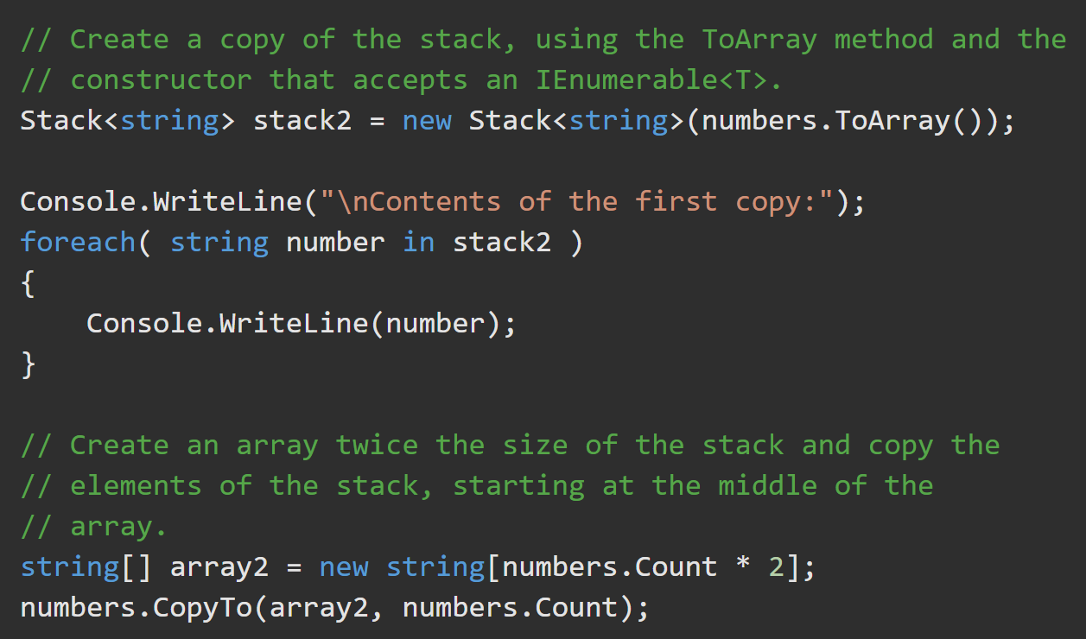
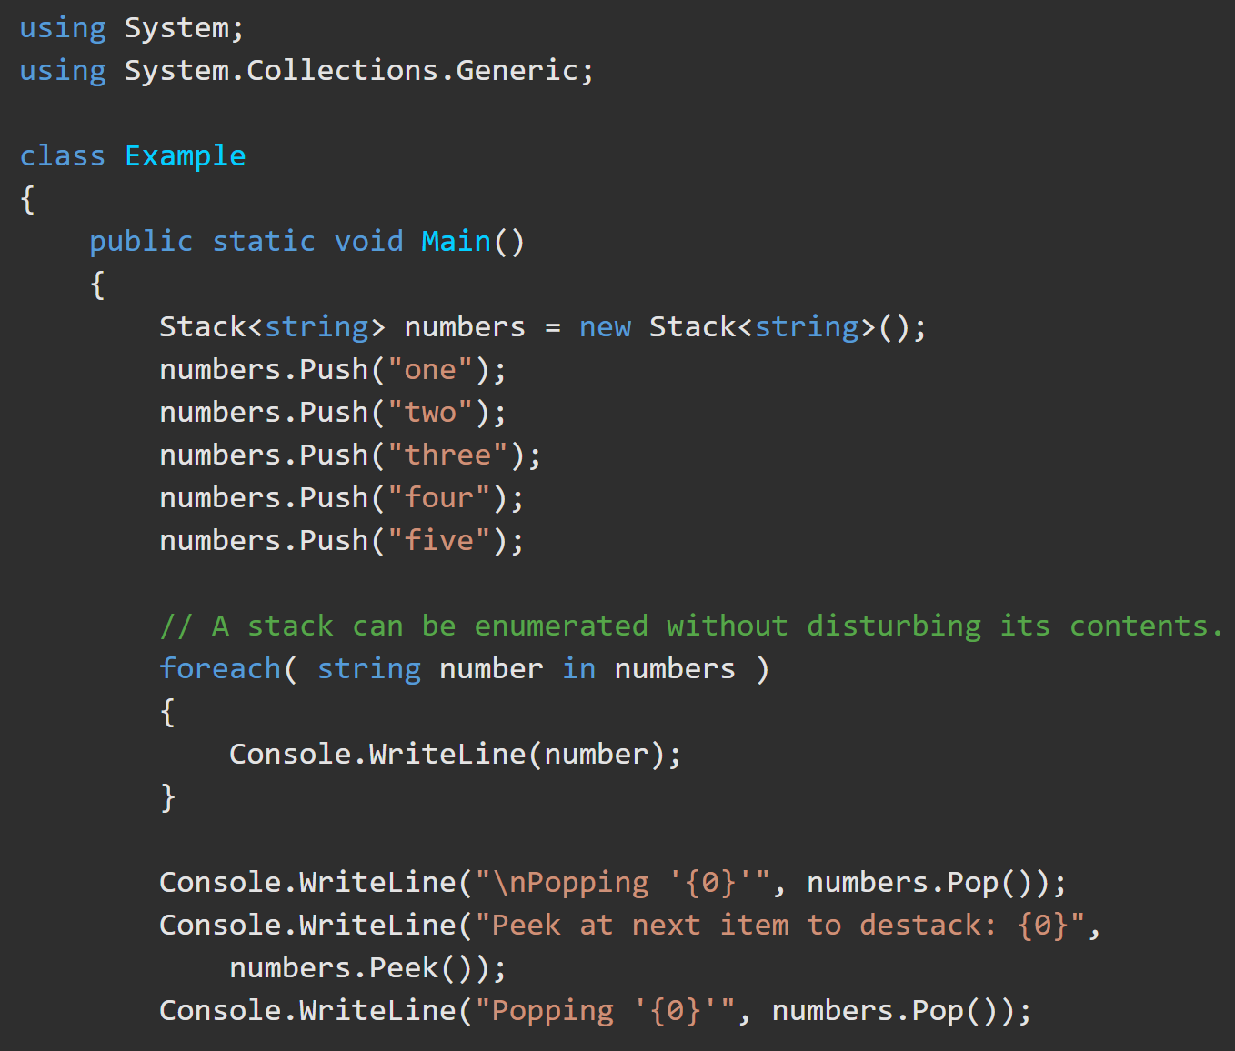
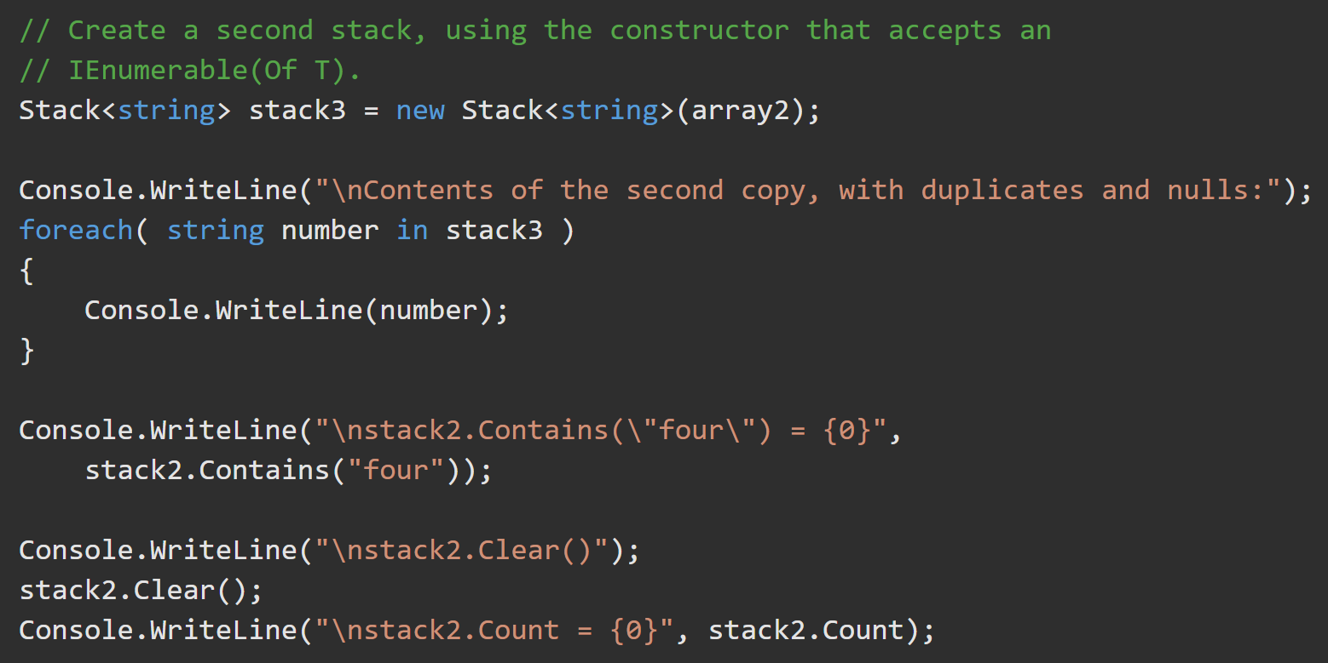
Stack<T> (rarely used) https://docs.microsoft.com/en-us/dotnet/api/system.collections.generic.stack-1.push?view=net-5.0

Slide 23
Task
Create a List<>.
Create an object, Person, that contains a persons name, age, and telephone number.
add 5 Person objects to the List<>.
Sort the list by the age of the people.
Print the Name and Age of the sorted list.

