Slide 1

HttpClient
.net

Slide 2
The HttpClient class provides the ability to send HTTP requests and receive HTTP responses from a resource identified by a URI.
https://learn.microsoft.com/en-us/dotnet/fundamentals/networking/http/http-overview

Slide 3
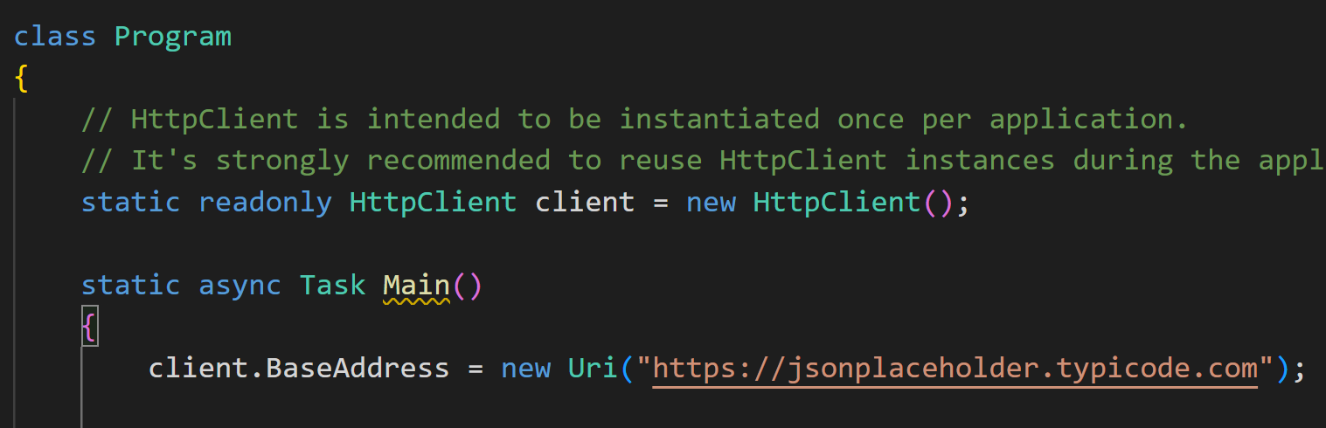
HttpClient Overview https://learn.microsoft.com/en-us/dotnet/fundamentals/networking/http/httpclient https://learn.microsoft.com/en-us/dotnet/api/system.net.http.httpclient.defaultrequestversion?view=net-6.0#system-net-http-httpclient-defaultrequestversion
HttpClient is .NET’s Class for internet communication. An HttpClient instance is a collection of settings that's applied to all requests executed by that instance. You can make any type of HTTP request using HttpClient.
An HttpClient instance contains useful fields and methods that help you configure defaults your requests, such as:
DefaultRequestHeaders – set the default headers for your requests.
DefaultRequestVersion – Gets or sets the default HTTP Version.
HttpContent – Used to represent an HTTP request body and headers needed for the request.
HTTP endpoints usually return Serialized JSON data.
For convenience, System.Net.Http.Json (NuGet package) provides several extension methods for HttpClient that perform automatic serialization and deserialization using System.Text.Json.

Slide 4
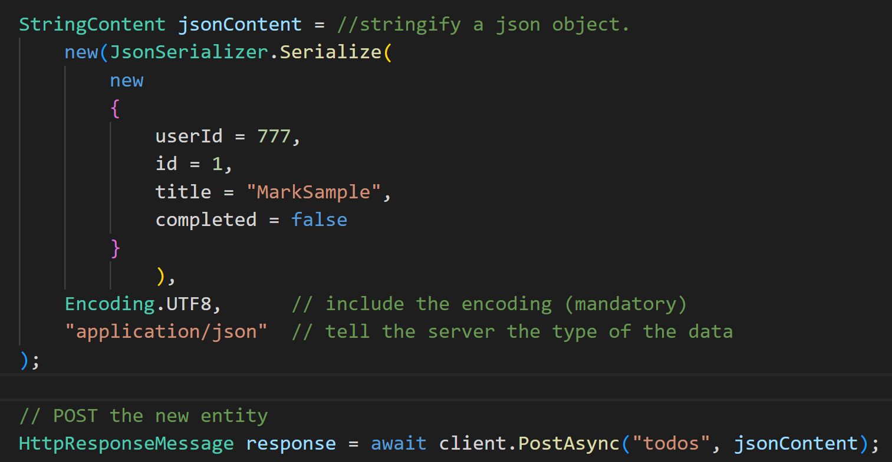
HttpContent https://learn.microsoft.com/en-us/dotnet/fundamentals/networking/http/httpclient#http-content
The HttpContent class is used to hold the HTTP request body and the request content headers.
The HttpContent class is also used as the response body of the HttpResponseMessage., which holds the content return ed from the server.
It is accessible on the property, HttpResponseMessage.Content.

Slide 5
HttpContent https://learn.microsoft.com/en-us/dotnet/fundamentals/networking/http/httpclient#http-content
Although most returns are JSON formatted, subclasses exist in HttpClient for different content types. These types are known as Multipurpose Internet Mail Extensions (MIME).
Class/Type Name | Purpose
FormUrlEncodedContent | HTTP content for name/value tuples encoded using "application/x-www-form-urlencoded" MIME type.
ByteArrayContent | HTTP content based on a byte array.
JsonContent | HTTP content ba sed on JSON.
MultipartContent | A collection of HttpContent objects that get serialized using the "multipart/*" MIME type specification.
MultipartFormDataContent | A container for content encoded using "multipart/form-data" MIME type.
ReadOnlyMemoryContent | HTTP content based on a ReadOnlyMemory<T>.
StreamContent | HTTP content based on a stream.
StringContent | HTTP content based on a string.

Slide 6
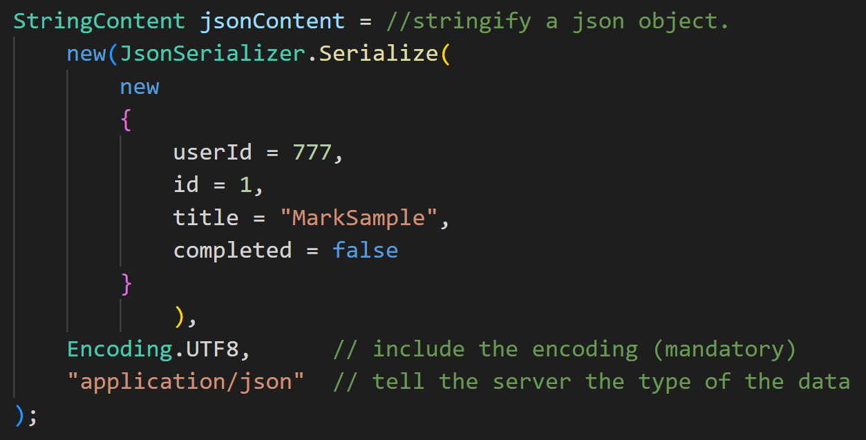
HttpClient Post Step-by-step (1/2) https://docs.microsoft.com/en-us/dotnet/csharp/programming-guide/concepts/collections
Create a HttpClient Object with:
(optional) Set the base URL for your queries with:
Create a StringContent Object leveraging the System.Text.Json.JsonSerializer Class with:

Slide 7
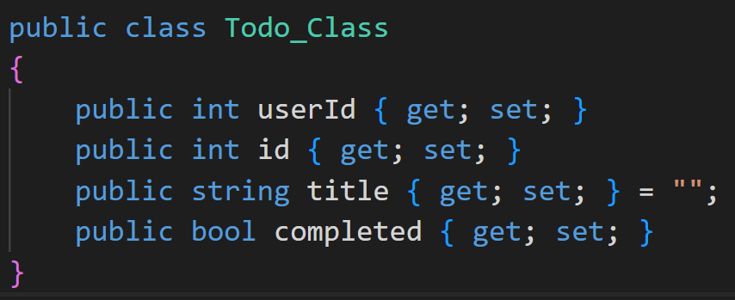
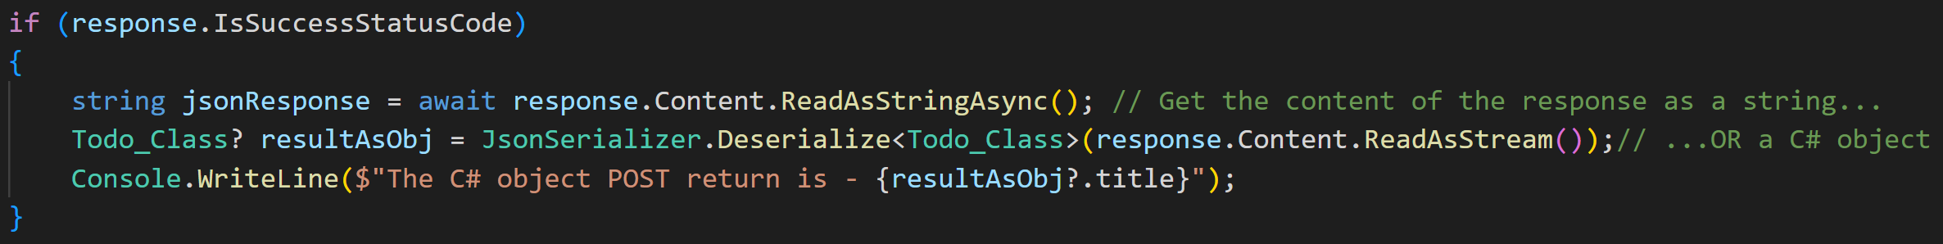
HttpClient Post Step-by-step (2/2) https://docs.microsoft.com/en-us/dotnet/csharp/programming-guide/concepts/collections
POST the new data to the external API with:
Create a model to hold the result of the POST request.
Verify that the Status Code result of the POST was 201 and access the content of the response message with:

Slide 8
HttpClient Status Codes https://learn.microsoft.com/en-us/dotnet/fundamentals/networking/http/http-overview
This page lists all the available and supported status codes on the .NET HttpClient

Slide 9
HttpClient https://docs.microsoft.com/en-us/dotnet/csharp/programming-guide/concepts/collections
https://jsonplaceholder.typicode.com/guide/
This is where the MS Tutorial sends requests.

