Slide 1

LINQ (Language-Integrated Query)
.net

Slide 2
Language-Integrated Query (LINQ) is the name for a set of Libraries and classes based on the integration of query capabilities directly into the C# language.
https://docs.microsoft.com/en-us/dotnet/csharp/linq/

Slide 3
LINQ - Overview https://docs.microsoft.com/en-us/dotnet/csharp/linq/ https://docs.microsoft.com/en-us/dotnet/csharp/programming-guide/concepts/linq/
Traditionally, queries against data (in a DB or file) have been expressed as simple strings without type-checking at compile time or IntelliSense.
You’d have to learn a different query language for each type of data source:
SQL databases,
XML documents,
various Web services, etc.
With LINQ, a query is a language construct, just like classes, methods, events.
Query expressions are written in a “declarative” query syntax.
Perform filtering, ordering, and grouping operations on data sources with minimal code.
Use the same basic query expression patterns to query and transform data in SQL databases, ADO.NET Datasets, XML documents and streams, and .NET collections.

Slide 4
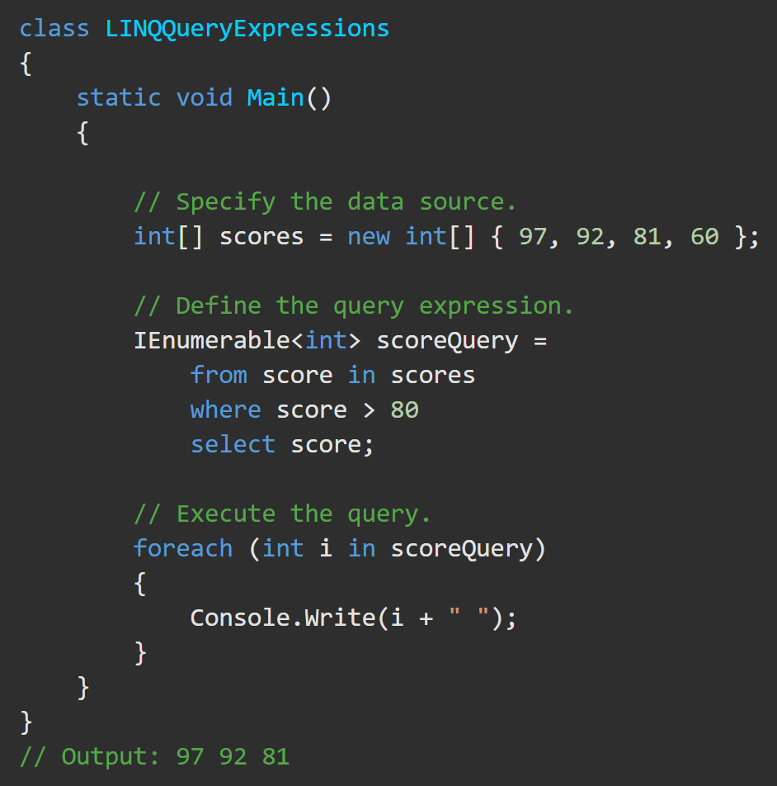
LINQ - Overview https://docs.microsoft.com/en-us/dotnet/csharp/linq/
A complete LINQ query operation includes:
creating a data source,
defining the query expression, and
executing the query in a foreach statement.
There are two Query Expression syntaxes:
Query Syntax
Method-Based Syntax (Lambda Expression)

Slide 5
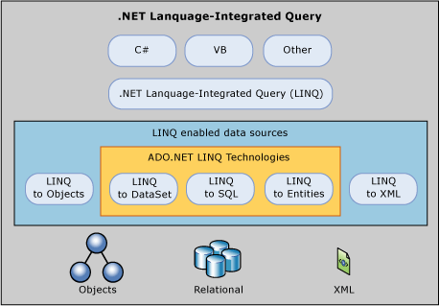
LINQ and ADO.NET (FYI only) https://docs.microsoft.com/en-us/dotnet/framework/data/adonet/linq-and-ado-net
Transferring data from SQL tables into objects in memory is often tedious and error-prone. The LINQ provider implemented by LINQ to DataSet and LINQ to SQL converts the source data into IEnumerable-based object collections. The programmer always views the data as an IEnumerable collection, both when you query and when you update. Full IntelliSense support is provided for writing queries against those collections.
There are three separate ADO.NET Language-Integrated Query (LINQ) technologies:
LINQ to DataSet - provides richer, optimized querying over the DataSet.
LINQ to SQL - LINQ to SQL enables you to directly query SQL Server database schemas
LINQ to Entities - LINQ to Entities allows you to query an Entity Data Model.

Slide 6
LINQ – Query Expression Basics
A query is a set of instructions that describes what data to retrieve from a given data source (or sources) and what type and organization the returned data should have. A query expression is a query expressed in query syntax.
The source data is organized logically as a sequence of elements of the same kind. For example:
a SQL database table contains a sequence of rows.
In an XML file, there is a "sequence" of XML elements
An ‘in-memory’ collection contains a sequence of objects.
A query expression must begin with a from clause and must end with a select or group clause. Between the first from clause and the last select or group clause, it can contain one or more of: where, orderby, join, let and even more from clauses. You can also use the into keyword to enable the result of a join or group clause to serve as the source for additional query clauses in the same query expression.
From an application's viewpoint, the specific type and structure of the original source data is not important.
The application always sees the source data as an IEnumerable<T> or IQueryable<T> collection.

Slide 7
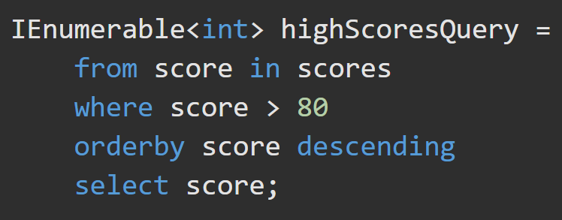
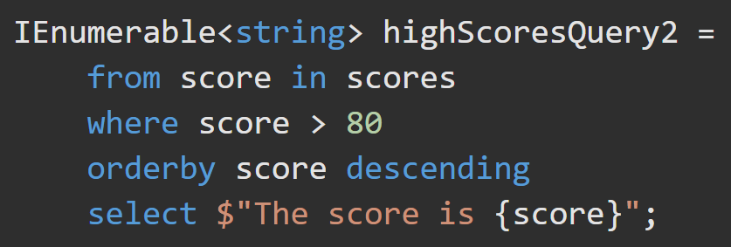
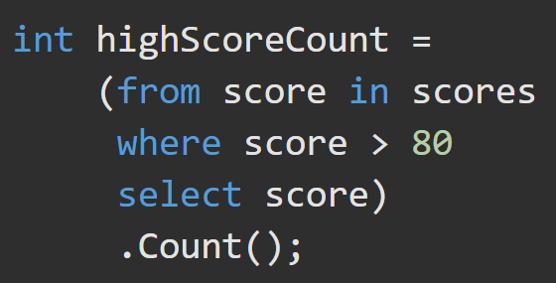
LINQ – Query Expression Examples https://docs.microsoft.com/en-us/dotnet/csharp/linq/query-expression-basics https://docs.microsoft.com/en-us/dotnet/csharp/linq/query-expression-basics#what-is-a-query-expression
A query can:
Retrieve a subset of the elements to produce a new sequence without modifying the individual elements. The query may then sort or group the returned sequence in various ways
Retrieve a sequence of elements but transform them to a new type of object.
Retrieve a singleton value about the source data, such as:
The number of elements that match a certain condition.
The element that has the greatest or least value.
The first element that matches a condition, or the sum of particular values in a specified set of elements.

Slide 8
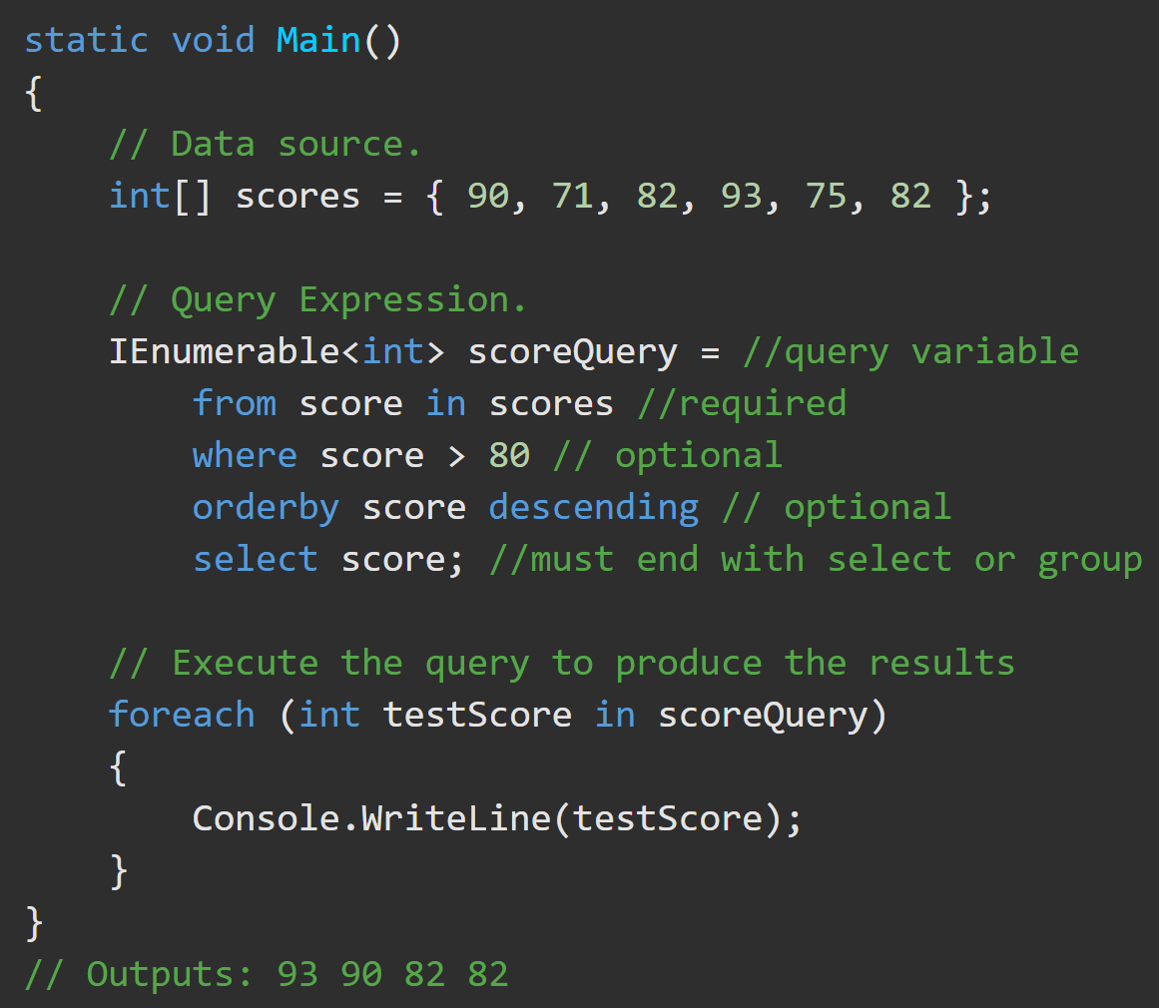
LINQ – Query Variables https://docs.microsoft.com/en-us/dotnet/csharp/linq/query-expression-basics#query-variable
A query variable is any variable that stores a query instead of the result of a query.
A query variable is always an enumerable type that will produce a sequence of elements when it is iterated over in a foreach statement or a direct call to its IEnumerator.MoveNext method.

Slide 9
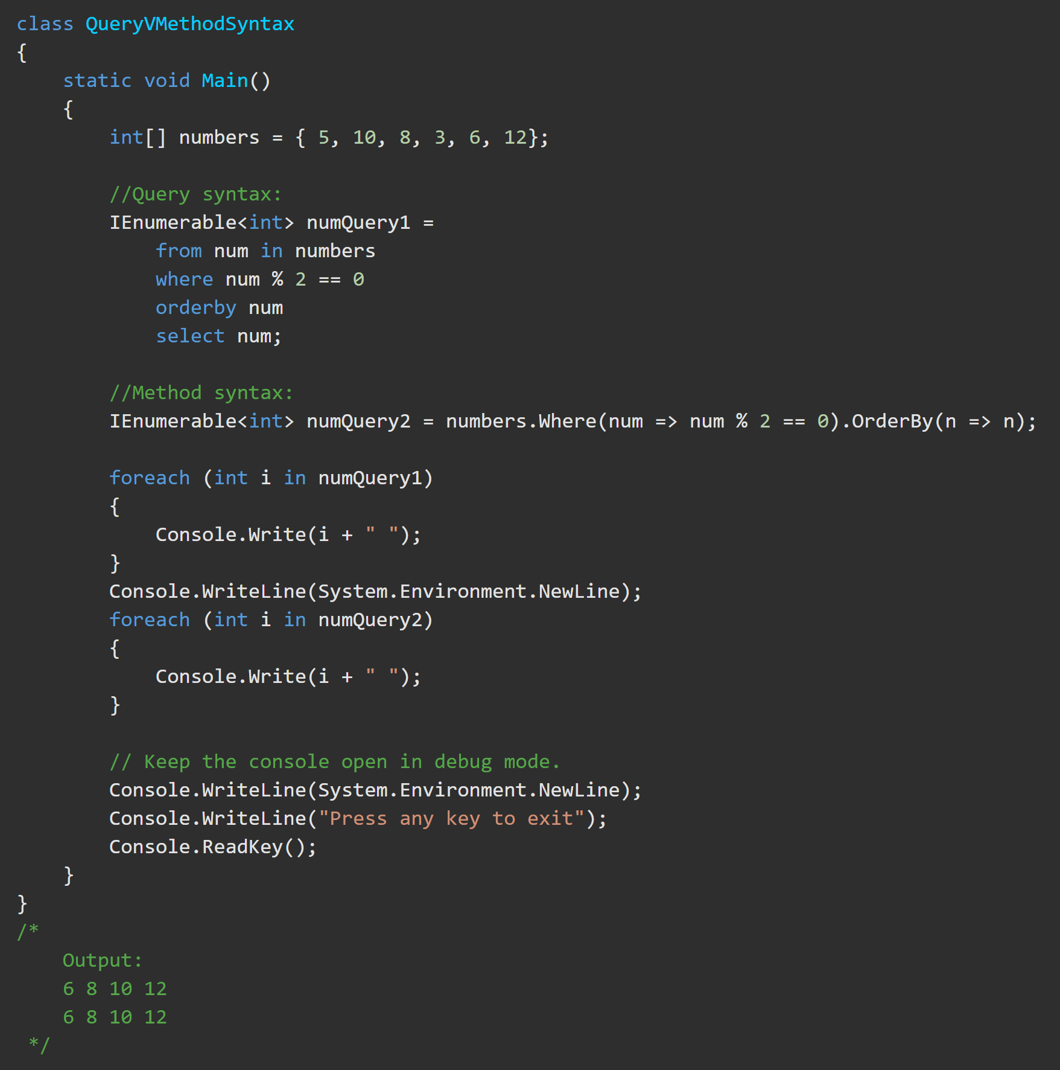
LINQ – Method Expressions https://docs.microsoft.com/en-us/dotnet/csharp/programming-guide/concepts/linq/query-syntax-and-method-syntax-in-linq
As a rule, when you write LINQ queries, it is recommended to use query syntax whenever possible and method syntax whenever necessary.
Some queries must be expressed as method calls. Such as:
to retrieve the number of elements that match a specified condition.
to retrieve the element that has the maximum value in a source sequence.

Slide 10
LINQ – Activity https://docs.microsoft.com/en-us/dotnet/csharp/tutorials/working-with-linq
Complete the tutorial at the above link.
Then change all queries in Method Syntax.

Slide 11
LINQ – Additional Practice
Starting a query expression Ending a query expression
select clause Continuations with "into“
Filtering, ordering, and joining where clause
orderby clause join clause
let clause Subqueries in a query expression

