Slide 1

Lambda Expressions
.net

Slide 2
Lambda expressions are anonymous functions that contain expressions or a sequence of operators. It uses the lambda operator. The left side of the lambda operator specifies the input parameters, and the right side holds an expression or a code block that works with the input parameters.
https://www.c-sharpcorner.com/UploadFile/bd6c67/lambda-expressions-in-C-Sharp/

Slide 3

Lambda Expression https://docs.microsoft.com/en-us/dotnet/csharp/programming-guide/statements-expressions-operators/lambda-expressions
There are two Lambda expression forms.
Expression Lambda -
Statement Lambda -
Specify input parameters to the left of the => and an expression or statement block to the right.

Slide 4
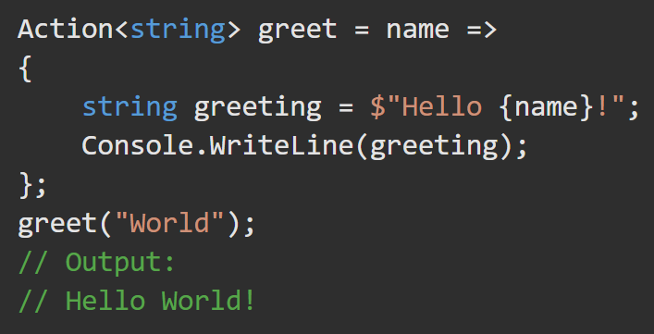
Lambda Statement Form https://docs.microsoft.com/en-us/dotnet/csharp/programming-guide/statements-expressions-operators/lambda-expressions#stateme0nt-lambdas
The body of a statement lambda can consist of any number of statements.
Statement lambdas cannot be used to create expression trees.

Slide 5
Lambda Expression Form https://docs.microsoft.com/en-us/dotnet/csharp/programming-guide/statements-expressions-operators/lambda-expressions#expression-lambdas
Expression lambdas are used extensively in the construction of expression trees. An expression lambda returns the result of the expression.
Zero parameters have empty ( ).
>2 parameters are separated by commas enclosed in ( ).
You can optionally specify the types explicitly.
Parameter types must be all explicit or all implicit.

Slide 6
Lambda Conversion to Delegate https://docs.microsoft.com/en-us/dotnet/csharp/programming-guide/statements-expressions-operators/lambda-expressions
Any lambda expression can be converted to a delegate type.
The delegate type to which a lambda expression can be converted is defined by the types of its parameters and return value.
If a lambda expression doesn't return a value,
It can be converted to one of the Action<> delegate types.
EX. A lambda expression that has two parameters and returns void can be converted to an Action<T1,T2> delegate.
If a lambda expression returns a value,
It can be converted to a Func<> delegate type.
A lambda expression that has one parameter and returns a value can be converted to a Func<T,TResult> delegate.

Slide 7
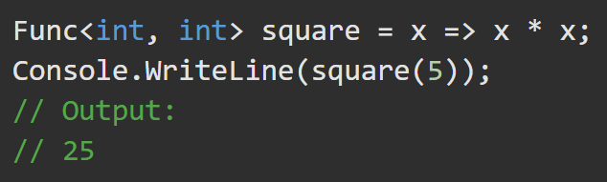
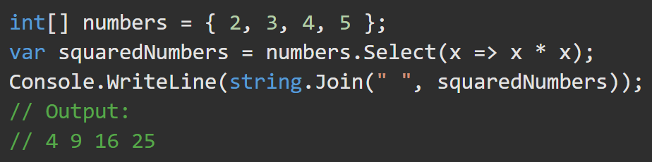
Lambda Conversions - Examples https://docs.microsoft.com/en-us/dotnet/csharp/programming-guide/statements-expressions-operators/lambda-expressions
You can use lambda expressions with the LINQ library.
The lambda expression
x => x * x specifies a parameter x and returns x*x. It is assigned to a variable of a delegate type.

Slide 8
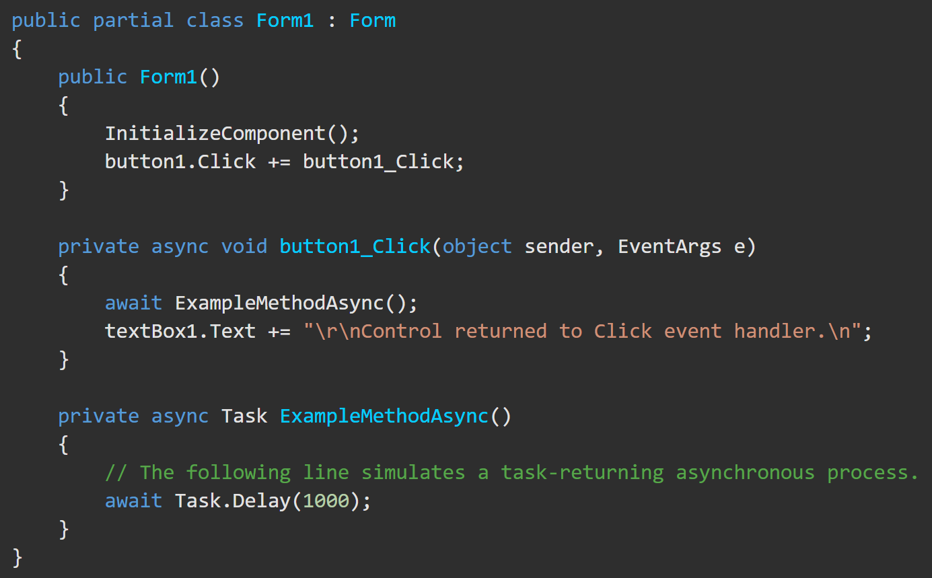
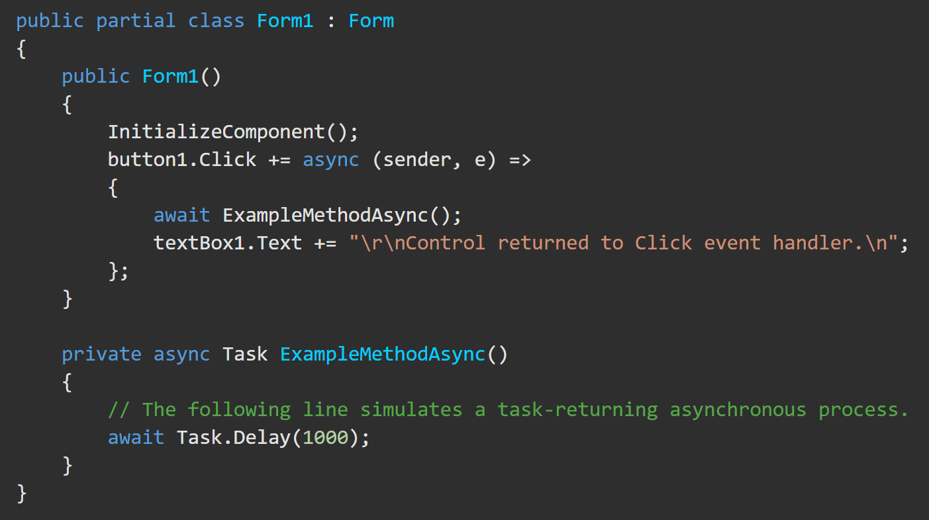
Lambda Async/Await https://docs.microsoft.com/en-us/dotnet/csharp/programming-guide/statements-expressions-operators/lambda-expressions#async-lambdas
Create lambda expressions and statements that incorporate asynchronous processing by using the async and await keywords.

Slide 9
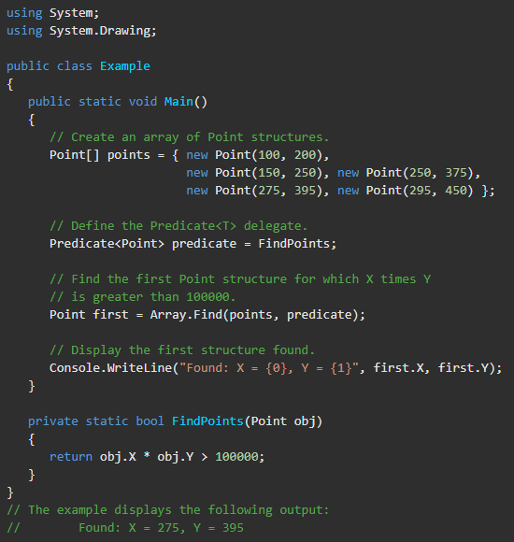
Predicate<T> Delegate https://docs.microsoft.com/en-us/dotnet/api/system.predicate-1?view=net-5.0
A Predicate <T> variable type represents a method that defines a set of criteria and iterates over a set to determine whether a specified object in that set meets those criteria.
The Predicate returns Boolean true if the obj meets the criteria defined within the method represented by this delegate; otherwise returns, false.

Slide 10
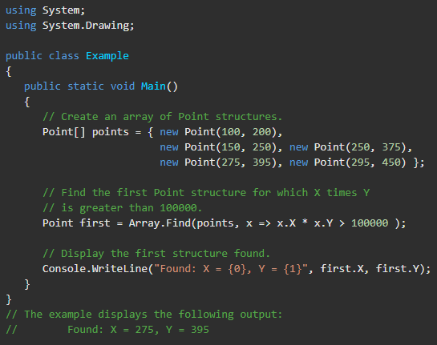
Predicate<T> Delegate https://docs.microsoft.com/en-us/dotnet/api/system.predicate-1?view=net-5.0
It’s customary to use a lambda expression rather than to explicitly define a delegate of type Predicate<T>.
Each element of the Points array is passed to the lambda expression until the expression finds an element that meets the search criteria. The .Find() method invokes the lambda expression which returns true if the product of the x and y fields is greater than 100,000.

