Slide 1

Methods
.net

Slide 2
In C#, every action is performed within a method. A method is a code block that contains a series of statements. A program calls the method, specifying any required method arguments.
https://learn.microsoft.com/en-us/dotnet/csharp/methods

Slide 3
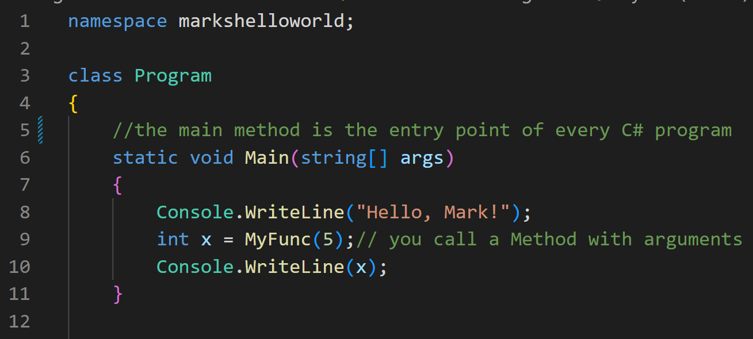
Methods overview https://learn.microsoft.com/en-us/dotnet/csharp/methods
The Main method is the entry point for every C# application. Methods are called by the common language runtime (CLR) when the program is started.
Methods are declared in a class, record, or struct and have unique signatures. They are invoked by other parts of the application that have access to the method.

Slide 4
Class Members Overview https://docs.microsoft.com/en-us/dotnet/csharp/tour-of-csharp/classes-and-objects
Members of a class are:
Constructors - To initialize instances of the class
Constants - Constant values
Fields – Variables
Methods – Computations/actions that can be performed
Properties – Fields combined with the actions associated with reading/writing them
Types - Nested types declared by the class
Class members can be:
static - belong to classes. Envoked with: ClassName.MethodName();
instance - belong to instances of classes. Envoked with: InstanceName.MethodName();

Slide 5
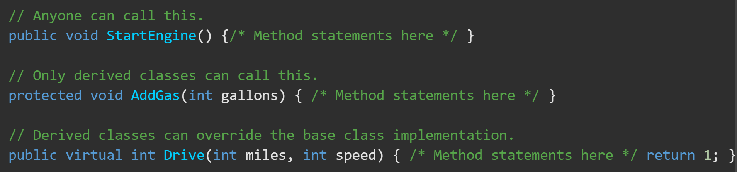
Methods https://docs.microsoft.com/en-us/dotnet/csharp/methods
A method (procedure, function) is a code block that contains a series of statements. A program calls the method and includes any required arguments. Every C# command is executed within a method.
Methods are declared in a class or struct by specifying a method signature that contains:
(optional) access level
(optional) modifiers
Return value
Method name
Method parameters

Slide 6
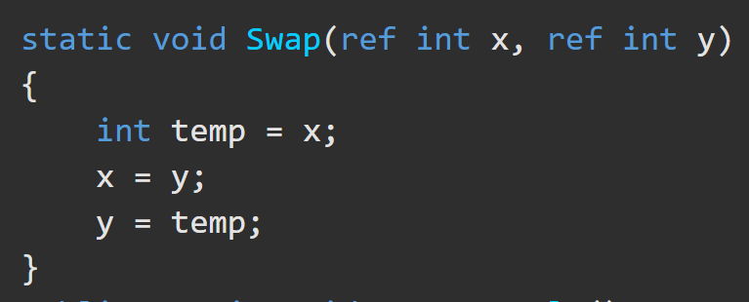
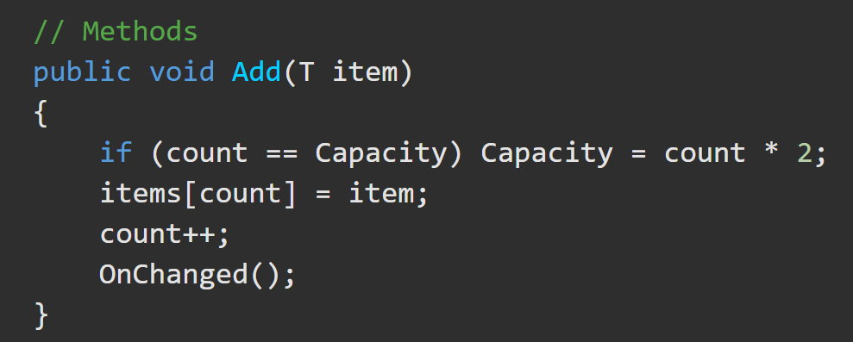
Methods https://docs.microsoft.com/en-us/dotnet/csharp/tour-of-csharp/classes-and-objects#methods
There are two categories of methods:
Static – accessed directly through the class
Instance – accessed though instances of a class.
Methods have a Method Signature which consists of:
The name of the method,
The type parameters (if needed),
Parameter names.
*The signature of a method doesn't include the return type.

Slide 7
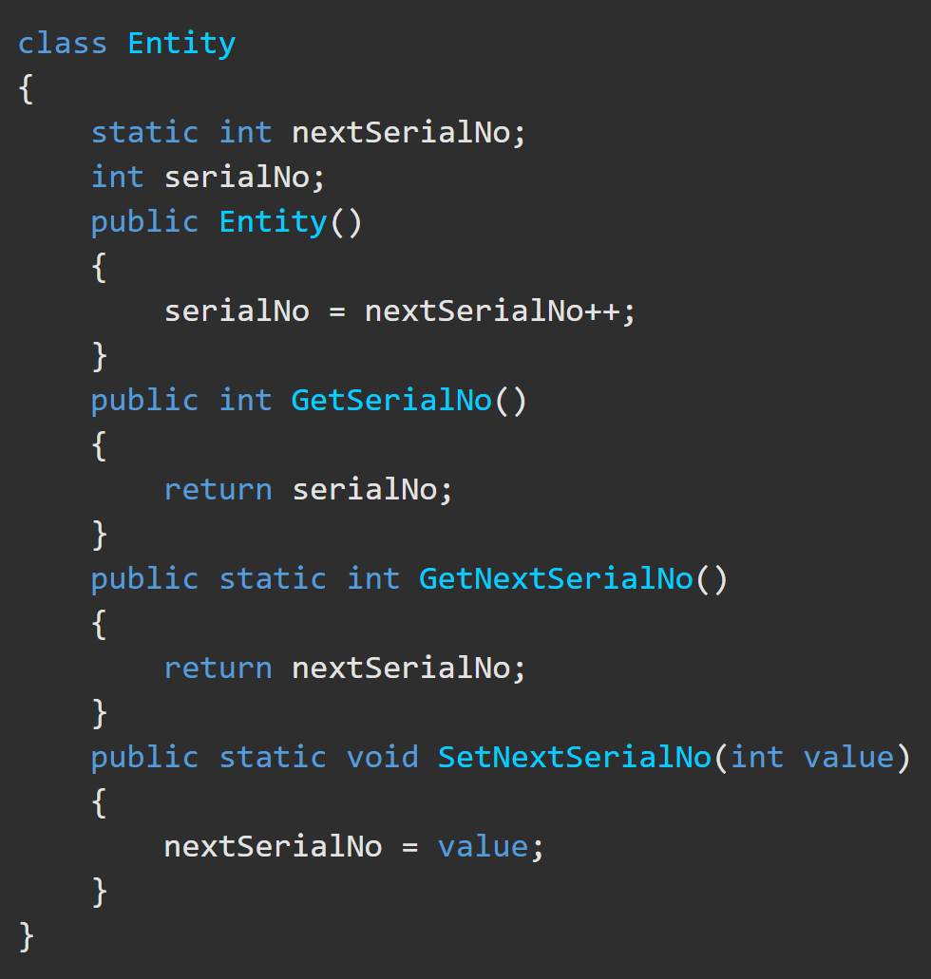
Static and Instance Methods https://docs.microsoft.com/en-us/dotnet/csharp/tour-of-csharp/classes-and-objects#static-and-instance-methods
static method –
declared with a static modifier.
doesn't operate on a specific class instance.
Only accessed through the class name. (Ex. MyClassName.MyStaticMethod())
Cannot use this.
instance method –
declared with any modifier other than static.
operates on a specific class instance only.
can access both static and instance members.
Can use this.

Slide 8
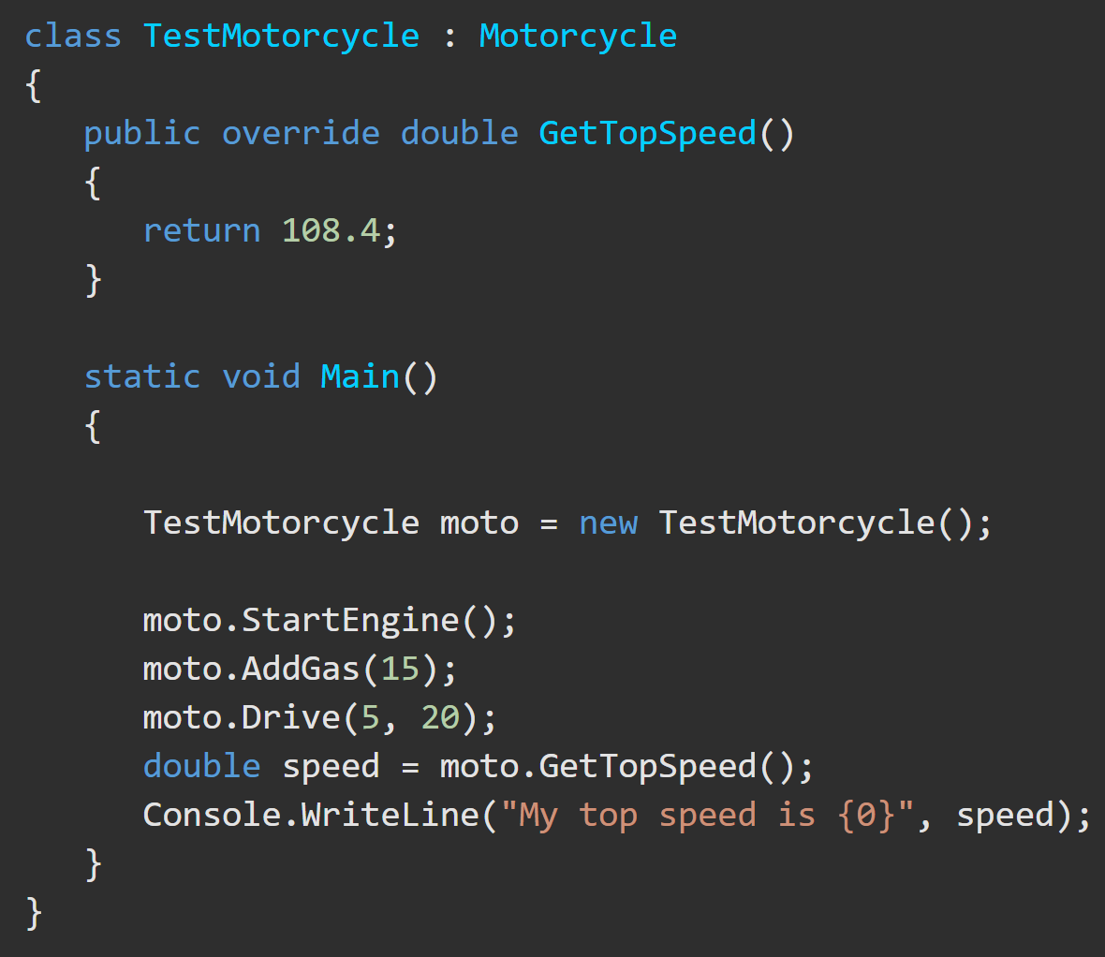
Method Invocation https://docs.microsoft.com/en-us/dotnet/csharp/methods#method-invocation
There are two types of methods:
Instance and Static
Instance methods
Require an object be instantiated to be called – myClassInstance.doWork();

Slide 9
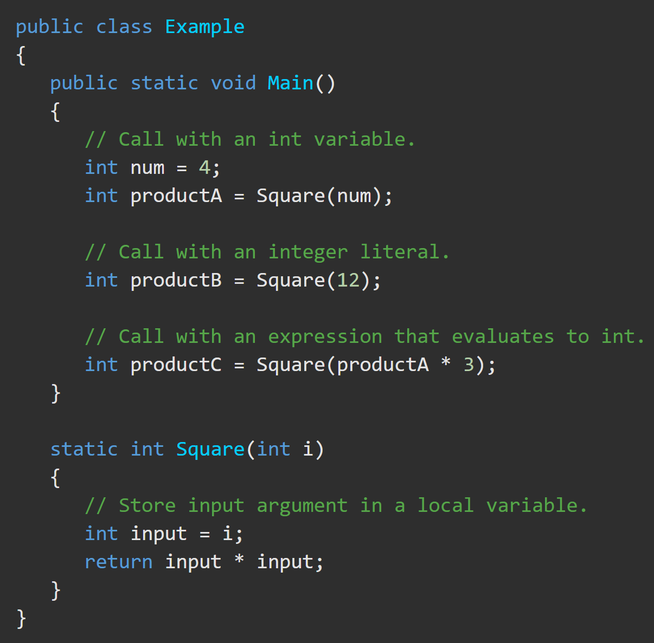
Method Invocation https://docs.microsoft.com/en-us/dotnet/csharp/methods#method-invocation
There are two types of methods:
Instance and Static
Static methods
Can be called without instantiating an object – myClassName.doWork();

Slide 10
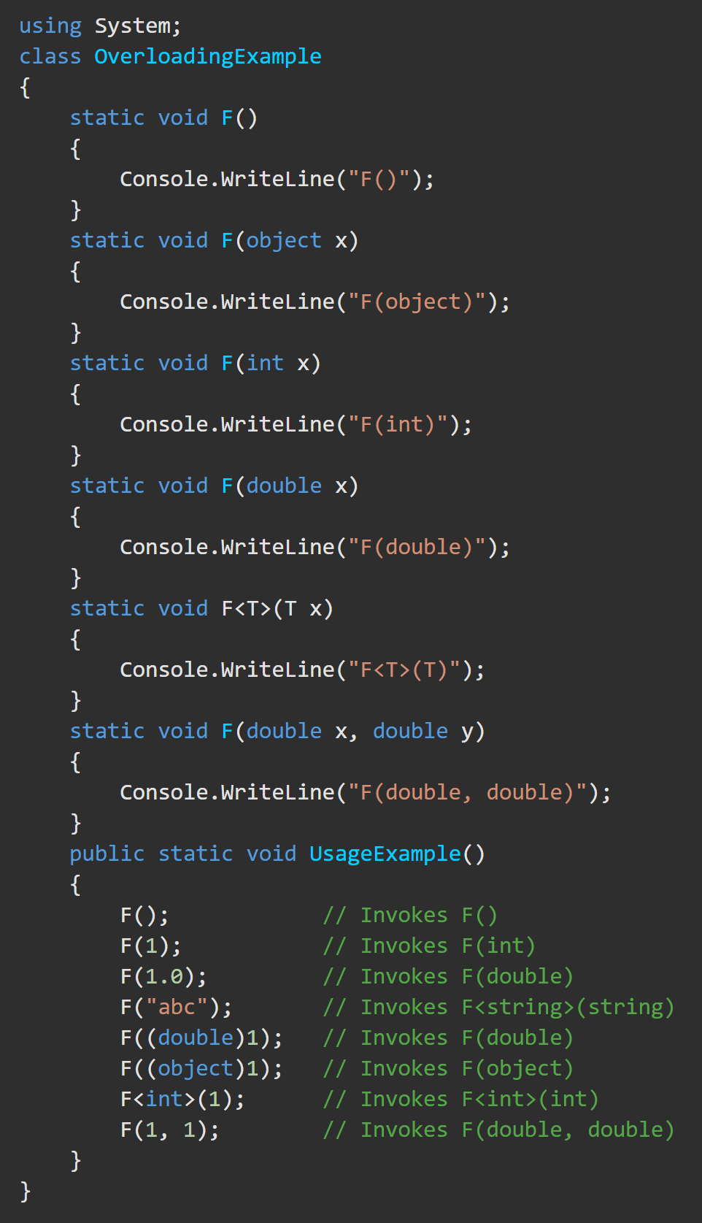
Method Overloading https://docs.microsoft.com/en-us/dotnet/csharp/tour-of-csharp/classes-and-objects#method-overloading
Method overloading
permits multiple methods in the same class to have the same name
Methods must each have unique parameter lists.
The compiler uses ‘overload resolution’ to determine the specific method to invoke.
‘Overload resolution’ finds the one method that best matches the arguments or reports an error if none is found.
A method can be selected by explicitly casting the arguments to the exact parameter types.

Slide 11
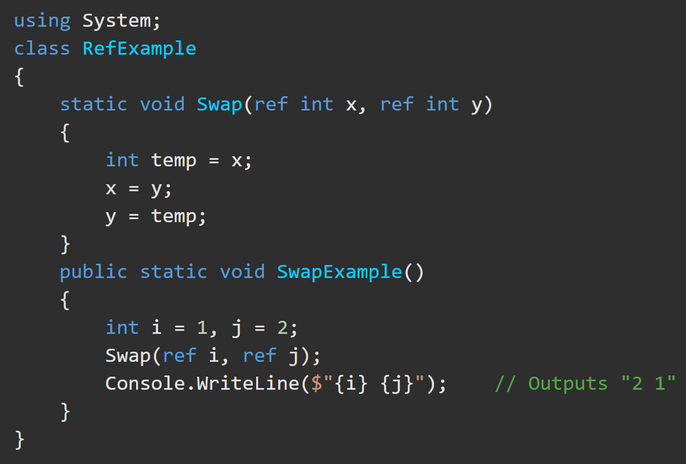
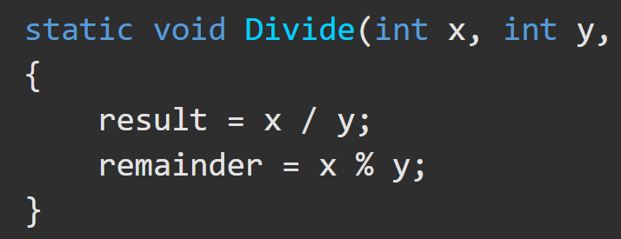
Value and reference Parameters https://docs.microsoft.com/en-us/dotnet/csharp/language-reference/keywords/ref
Parameters are used to receive variables from method calls.
There are five types of method parameters:
1. value parameter
a copy of the argument passed. Changes don’t affect the original argument. Can be options by specifying a default value.
2. reference parameter
declared with the ‘ref’ modifier. Used for passing value arguments by reference. The argument must be a variable with a definite value. Changes take place on the original value.

Slide 12
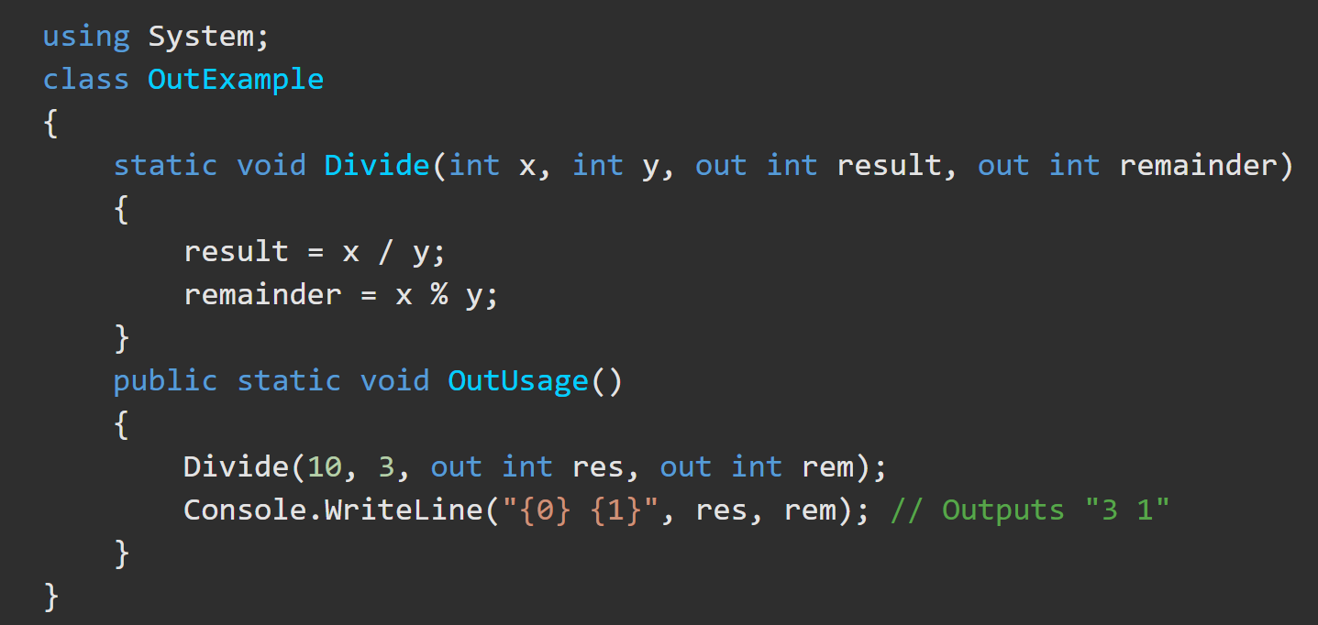
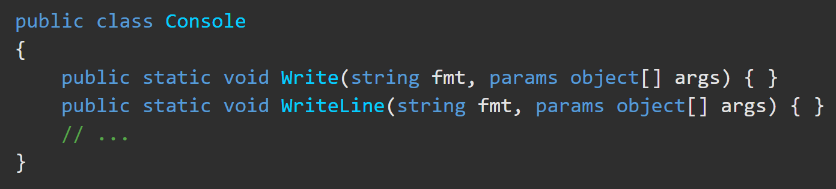
out and params parameters https://docs.microsoft.com/en-us/dotnet/csharp/language-reference/keywords/out-parameter-modifier https://docs.microsoft.com/en-us/dotnet/csharp/language-reference/keywords/params
3. output parameter –
declared with the out modifier.
Used for passing arguments by reference.
An explicitly assigned value is not allowed before the method call.
4. parameter array –
permits an ‘N’ number of arguments to be passed to a method.
Declared with the params modifier.
Must be the last parameter and be a 1-D array.
Write() and WriteLine() methods use parameter arrays.

Slide 13
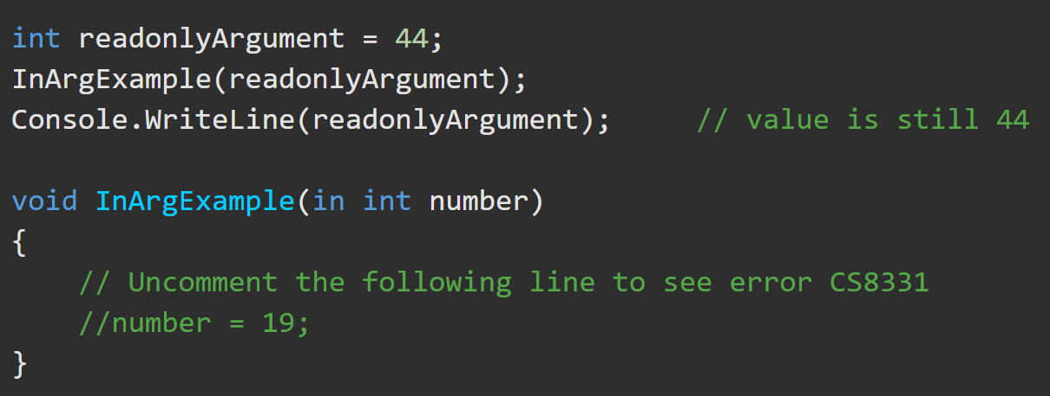
in parameter https://docs.microsoft.com/en-us/dotnet/csharp/language-reference/keywords/in-parameter-modifier
The in keyword causes arguments to be passed by reference but ensures the argument is not modified. It makes the formal parameter an alias for the argument, which must be a variable.
It is like the ref or out keywords, except that in arguments cannot be modified by the called method. Whereas ref arguments may be modified, out arguments must be modified by the called method, and those modifications are observable in the calling context.

Slide 14
Optional Params and Default Values https://docs.microsoft.com/en-us/dotnet/csharp/programming-guide/classes-and-structs
A parameter can be optional. Any call must provide arguments for all required parameters but can omit arguments for optional parameters.
Each optional parameter has a default value as part of its definition. If no argument is sent for that parameter, the default value is used.
Optional parameters are at the end of the parameter list after all required parameters. The caller must provide arguments for all required parameters before any optional parameters.

