Slide 1

Operators
.net

Slide 2
C# provides a number of operators that allow you to perform evaluation and manipulate the data of variables.
https://learn.microsoft.com/en-us/dotnet/csharp/language-reference/operators/

Slide 3
https://learn.microsoft.com/en-us/dotnet/csharp/language-reference/operators/
Above is the docs for operators.

Slide 4
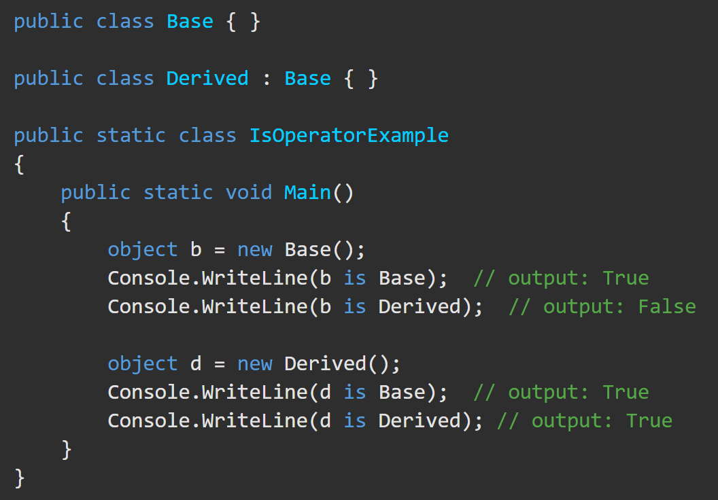

Type-testing and cast operators – ‘is’ operator https://docs.microsoft.com/en-us/dotnet/csharp/language-reference/operators/type-testing-and-cast#typeof-operator
The is operator checks if the runtime type of an expression result is compatible with a given type.
returns true if E is non-null and can be converted to type T by a reference, a boxing, or an unboxing conversion.

Slide 5
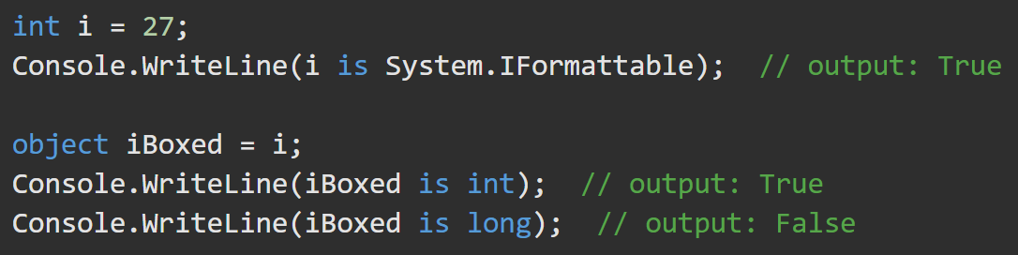
Type-testing and cast operators – ‘is’ operator https://docs.microsoft.com/en-us/dotnet/csharp/language-reference/operators/type-testing-and-cast#typeof-operator
The is operator takes into account boxing and unboxing conversions but doesn't consider numeric conversions.

Slide 6


Type-testing and cast operators – ‘as’ operator https://docs.microsoft.com/en-us/dotnet/csharp/language-reference/operators/type-testing-and-cast#as-operator
The as operator explicitly converts the result of an expression to a given reference or nullable value type. If the conversion is not possible, the as operator returns null. Unlike the cast operator (), the as operator never throws an exception.
produces the same result as
The as operator considers only reference, nullable, boxing, and unboxing conversions.
You cannot use the as operator to perform a user-defined conversion. To do that, use the cast operator ().

Slide 7
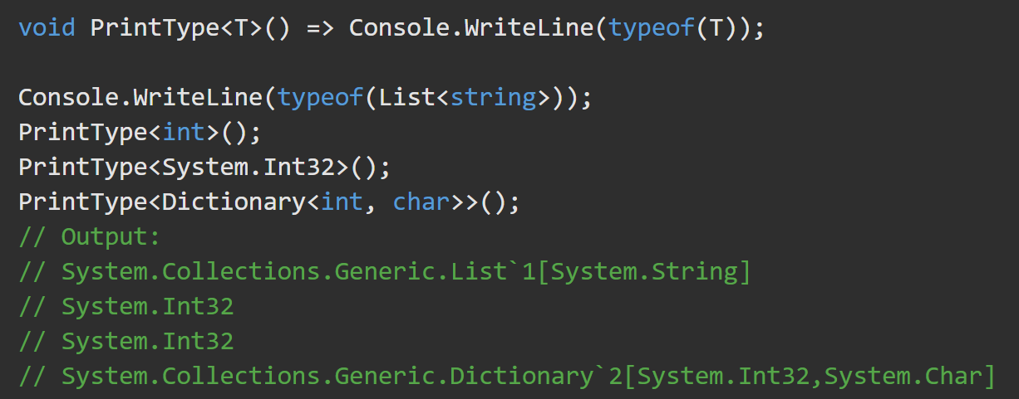
typeof https://docs.microsoft.com/en-us/dotnet/csharp/language-reference/operators/type-testing-and-cast#typeof-operator
The typeof operator obtains the System.Type instance type. The argument to the typeof operator must be the name of a type or a type parameter.

Slide 8
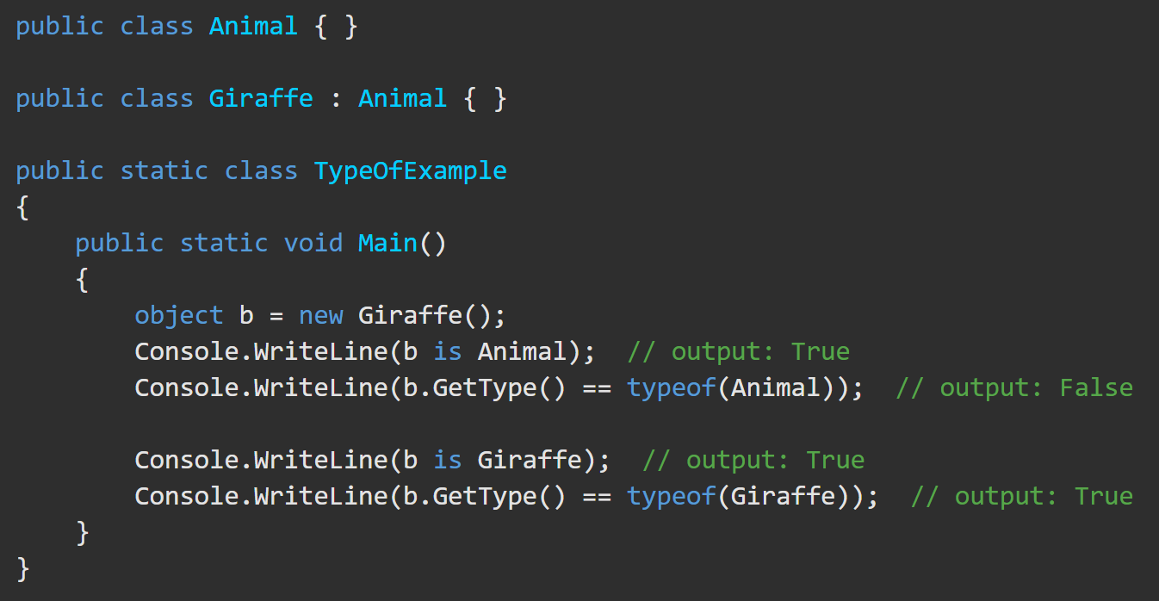
typeof Operator https://docs.microsoft.com/en-us/dotnet/csharp/language-reference/operators/type-testing-and-cast#typeof-operator
An expression cannot be an argument of the typeof operator. To get the System.Type instance for the runtime type of an expression result, use Object.GetType().
Use the typeof operator to check if the runtime type of the expression result exactly matches a given type.
This example demonstrates the difference between type checking performed with the typeof operator and the is operator.

Slide 9
?? and ??= - the null-coalescing operators https://learn.microsoft.com/en-us/dotnet/csharp/language-reference/operators/null-coalescing-operator
The null-coalescing operator ?? returns the value of its left-hand operand if it isn't null; otherwise, it evaluates the right-hand operand and returns its result. The ?? operator doesn't evaluate its right-hand operand if the left-hand operand evaluates to non-null.
The null-coalescing assignment operator ??= assigns the value of its right-hand operand to its left-hand operand only if the left-hand operand evaluates to null. The ??= operator doesn't evaluate its right-hand operand if the left-hand operand evaluates to non-null.
??= is a perfect replacement for:
if(myVar == null) {// do domething}

