Slide 1

Reflection
.NET

Slide 2
Reflection assists languages to operate in networks by providing libraries for serialization, bundling, and varying data formats. Reflection is a language more suited to network-oriented code.
https://en.wikipedia.org/wiki/Reflective_programming

Slide 3

A History of Reflection.
The earliest computers were inherently reflective. Their architectures were programmed by defining instructions as data and using self-modifying code.
As programming moved to compiled languages (C,C++) this reflective ability largely disappeared until new programming languages with built-in reflection appeared.
In 1982, Brian Smith proposed computational reflection in procedural programming languages and the notion of the meta-circular interpreter as a component of 3-Lisp.

Slide 4
What is Reflection? https://en.wikipedia.org/wiki/Reflective_programming
Reflection can be used for observing and modifying program execution during runtime based on the state of different program elements. A reflection-oriented program component can monitor the execution of code and then modify itself according to predefined goals.
In OOP languages, reflection:
allows inspection of assemblies, classes, interfaces, fields, and methods at runtime without knowing the names of the interfaces, fields, methods at compile time.
allows instantiation of new objects and invocation of methods.
is used as part of testing for mocking objects and bringing otherwise unreachable, and thereby untestable, code into scope.
In some languages (like C#), reflection can be used to bypass member accessibility rules. It is also possible to find non-public class methods and manually invoke them.

Slide 5
Reflection in .NET https://docs.microsoft.com/en-us/dotnet/csharp/programming-guide/concepts/reflection
Reflection provides type Type objects that describe assemblies, modules, and types.
You can use reflection to:
dynamically create an instance of a type,
bind the type to an existing object, or
get the type from an existing object and invoke its methods or access its fields and properties.
// Using GetType() to obtain type information:
int myInt = 42;
Type type = myInt.GetType();
Console.WriteLine(type);
// prints System.Int32

Slide 6
When to use Reflection https://docs.microsoft.com/en-us/dotnet/csharp/programming-guide/concepts/reflection#reflection-overview https://docs.microsoft.com/en-us/dotnet/framework/reflection-and-codedom/reflection
Reflection is useful in the following situations:
When you need to access attributes in your program's metadata.
Retrieving Information Stored in Attributes.
For examining and instantiating Types in an assembly.
Use System.Reflection.Emit for building new types at run time.
For performing late binding, accessing methods on types created at run time.
See Dynamically Loading and Using Types.
// Without reflection
Foo foo = new Foo();
foo.PrintHello();
// With reflection
Object foo = Activator.CreateInstance("complete.classpath.and.Foo");
MethodInfo method =
foo.GetType().GetMethod("PrintHello");
method.Invoke(foo, null);

Slide 7
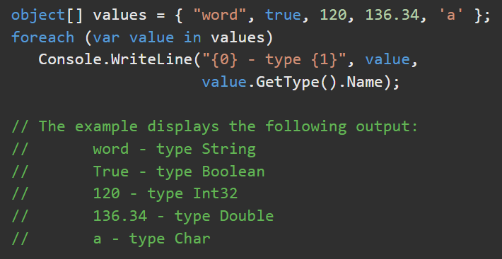
Type Class: A Reflections datatype https://docs.microsoft.com/en-us/dotnet/api/system.type?view=net-6.0
Type Class – Represents all class types (interface, array, value, enum, generic, type parameters).
Type is the root of System.Reflection and is the primary way to access metadata. Use the members and extension methods of Type to get information about any type, about the members of the type (class constructors, methods, fields, properties, events), and the module and assembly of the class.
Type access requires no special permissions. A derived class can access protected members of the calling code's base classes. Access is allowed to members of the calling code's assembly.
In the code at right, .GetType().Name gets the official name of the type.

Slide 8

MemberInfo https://learn.microsoft.com/en-us/dotnet/api/system.reflection.memberinfo?view=net-6.0
MemberInfo contains information about the attributes of a class member and provides access to member metadata. Use Type.GetMembers() to get an array of the members of a type.
Some important MemberInfo Properties and extension methods are:
Method/Property | Usage
.MemberType | Contains a MemberTypes object (method, constructor, event, etc).
.Name | Contains the member's official name.
.GetType() | Gets the Type of the current instance.

Slide 9
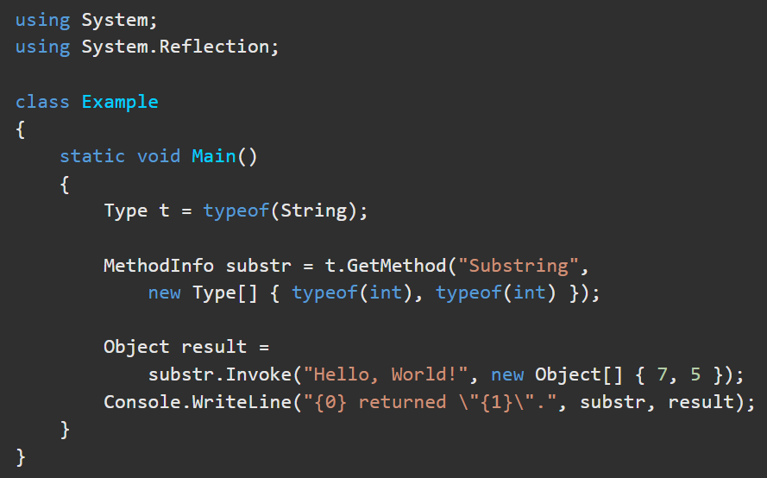
MethodInfo https://learn.microsoft.com/en-us/dotnet/api/system.reflection.methodinfo?view=net-6.0
The MethodInfo Class contains the attributes of a method and provides access to method metadata. Use Type.GetMethods() to get references to the methods in that Type object.
Some important MethodInfo Properties and extension methods are:
Method/Property | Usage
.Name | Contains the Method Name.
.ReturnParameter | A ParameterInfo object representing the return type of the method.
.GetMethodBody() | Returns a MethodBody object.
.GetParameters() | Returns the methods parameters.
.Invoke() | Invokes the method and returns an object representing the return.

Slide 10
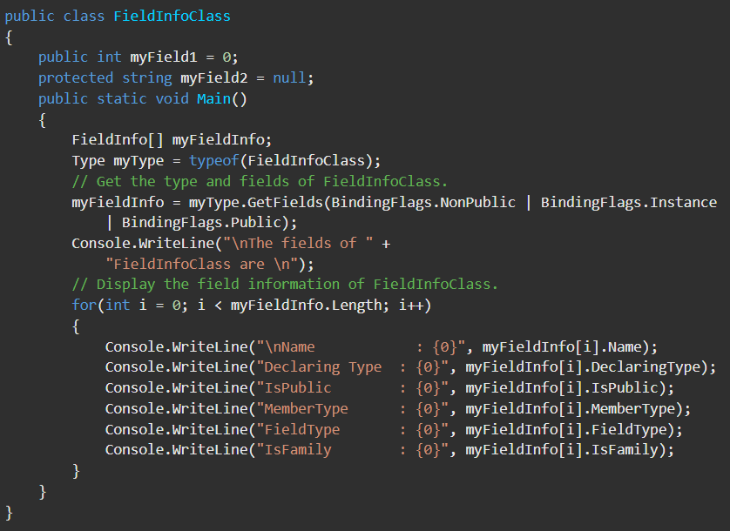
FieldInfo https://learn.microsoft.com/en-us/dotnet/api/system.reflection.fieldinfo?view=net-6.0
Fields are variables defined in a class. FieldInfo provides access to the metadata for a class’s fields. Use TypeVar.GetFields() to get references to the fields of a type object. The class is not loaded into memory until .invoke() or get() is called on the object.
Some important FieldInfo Properties and extension methods are:
Method/Property | Usage
.Attributes | Get the attributes associated with the field.
.FieldType | Gets the type of this field object.
.Name | Gets the official name of the field.
.GetValue(Obj) | Gets the value of the field.
.SetValue(Obj, Obj) | Sets the value of the field.

Slide 11
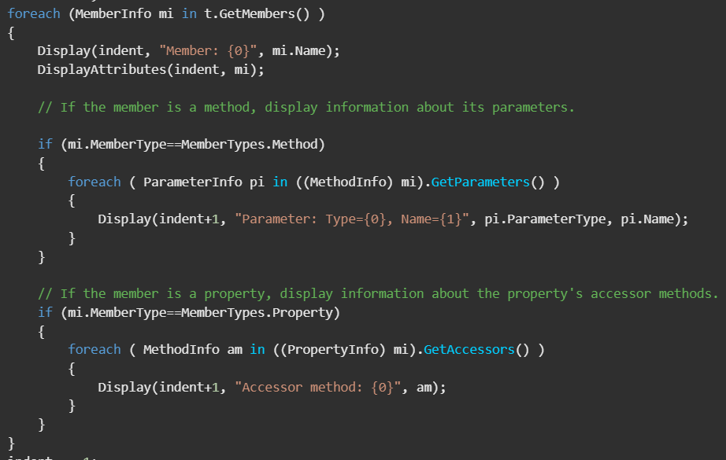
PropertyInfo https://learn.microsoft.com/en-us/dotnet/api/system.reflection.propertyinfo?view=net-6.0
The PropertyInfo Class provides access to property metadata. A property’s value is typically accessible through get and set accessors. Properties may be read-only, so a set may not be supported. Use Type.GetProperties() to get references to the properties in that Type object.
Some important PropertyInfo Properties and extension methods are:
Method/Property | Usage
.Name | Gets the official name of the field.
.GetMethod() | Gets the get accessor for this property.
.PropertyType | Gets the type of this property.
.GetValue(Obj) | Gets the value of the property.
.SetValue(Obj, Obj) | Sets the value of the property.

