Slide 1

Design Patterns
.net

Slide 2
A repository layer holds methods that can perform actions on a Database. Repositories support the purpose of separating, clearly and in one direction, the dependencies between the work domain and the data allocation and/or mapping domains.
https://docs.microsoft.com/en-us/dotnet/architecture/microservices/microservice-ddd-cqrs-patterns/infrastructure-persistence-layer-design

Slide 3
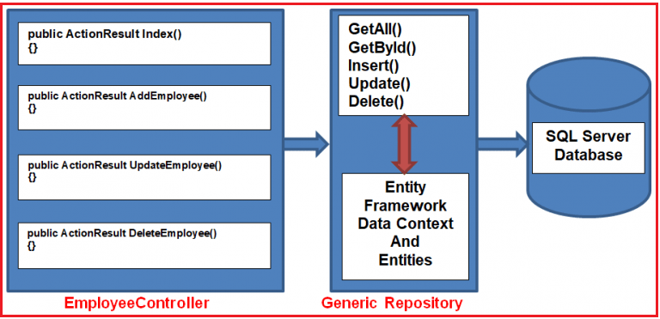
Repository Pattern https://docs.microsoft.com/en-us/dotnet/architecture/microservices/microservice-ddd-cqrs-patterns/infrastructure-persistence-layer-design#the-repository-pattern https://docs.microsoft.com/en-us/previous-versions/msp-n-p/ff649690(v=pandp.10)?redirectedfrom=MSDN
Repositories are classes that encapsulate the logic required to access a data source.
They provide better maintainability and decouple the code and technology used to access databases from the domain model layer.
ADO.NET

Slide 4
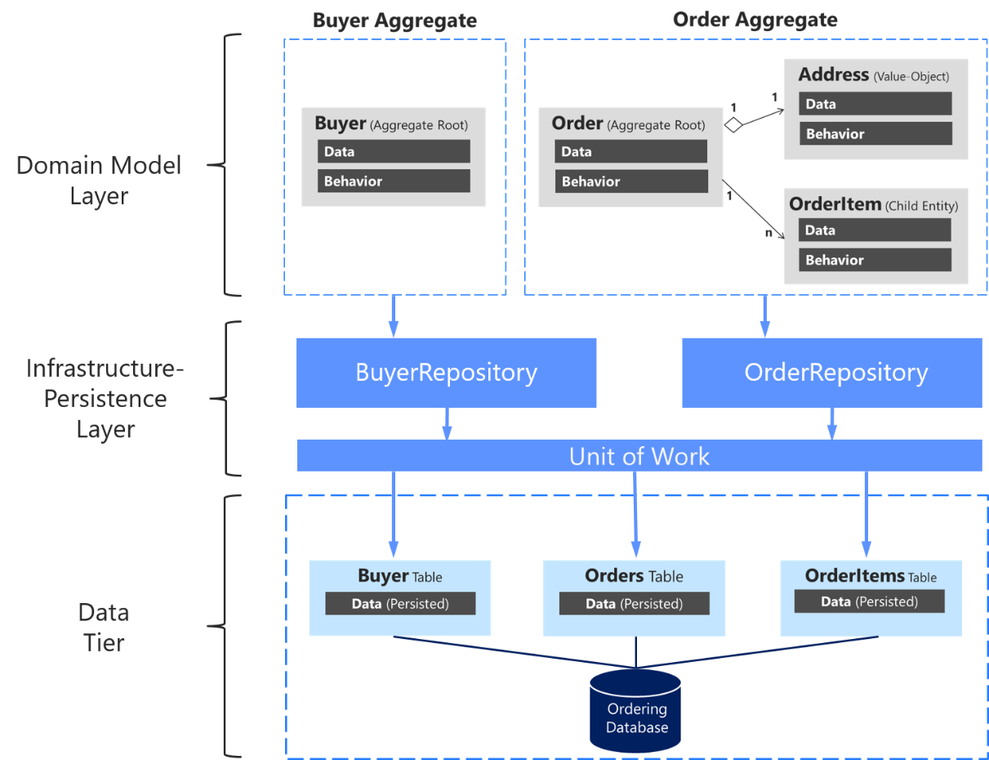
Repository Pattern Best Practices https://docs.microsoft.com/en-us/dotnet/architecture/microservices/microservice-ddd-cqrs-patterns/infrastructure-persistence-layer-design#define-one-repository-per-aggregate
For each API in a system, you should create one repository class.
This is referred to as Domain-Driven Design (DDD).
The only layer you should use to update the database should be the repository layer.
The transactional area (updates) must always be controlled by the repositories.
It’s considered acceptable to SELECT (not INSERT) data from the database through channels other than the repository because queries don't change the state of the database.

Slide 5
Repository Pattern Best Practices https://docs.microsoft.com/en-us/dotnet/architecture/microservices/microservice-ddd-cqrs-patterns/infrastructure-persistence-layer-design#define-one-repository-per-aggregate
A repository allows you retrieve data from the database and store it in local C# class models while you work with the data.
Changed data can then be persisted back to the database.
Never create a repository for each table in the database. Only define one repository layer for each whole database to maintain transactional consistency between all the tables within it.
Entity Framework Core forces the use of the Repository Pattern.

Slide 6
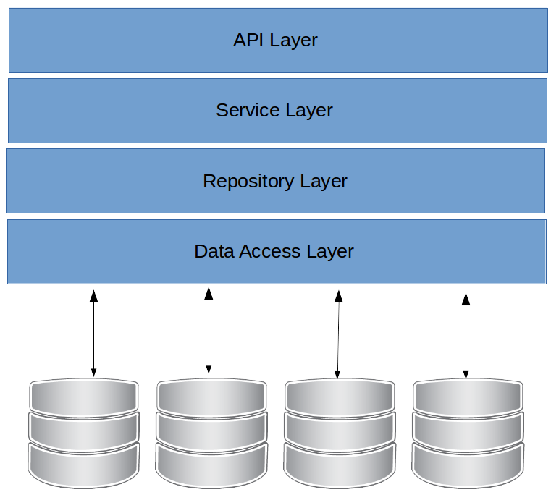
Repository Pattern Benefits https://docs.microsoft.com/en-us/dotnet/architecture/microservices/microservice-ddd-cqrs-patterns/infrastructure-persistence-layer-design#the-repository-pattern-makes-it-easier-to-test-your-application-logic
When repository layer interfaces are defined and placed in the business/model layer, the application layer (API service), won’t depend directly on the repository layer.
Repository layers make it easier to implement unit tests because it forces Single Responsibility Principle.
Dependency Injection in the controller of a Web API allows mock repositories to return mocked (staged) data instead of data from the database.

Slide 7
Repository Pattern Structure https://garywoodfine.com/generic-repository-pattern-net-core/
HTTP Call
Controllers/Actions
Business Class
Repository Class
Entity Framework
ADO.NET
Database

Slide 8
Unit of Work Design Pattern https://docs.microsoft.com/en-us/aspnet/mvc/overview/older-versions/getting-started-with-ef-5-using-mvc-4/implementing-the-repository-and-unit-of-work-patterns-in-an-asp-net-mvc-application
The Unit-of-Work Design Pattern helps to minimize redundant code and ensures that all repositories use the same database context. The Unit-of-Work Design Pattern uses a Unit-of-Work class along with a generic repository. The Unit-of-Work class instantiates the generic repository multiple times with different entities to perform the actions needed in one work action (unit of work).
The Unit-of-Work class coordinates the work of multiple repositories by first creating a single database context class. Then it instantiates the repository class shared by all of them.
HTTP Call
Controller Class
Unit-of-Work Class
DataBase Context Class
Player Class
Game Class
Round Class

Slide 9
Unit of Work Design Pattern https://docs.microsoft.com/en-us/aspnet/mvc/overview/older-versions/getting-started-with-ef-5-using-mvc-4/implementing-the-repository-and-unit-of-work-patterns-in-an-asp-net-mvc-application
The unit of work class serves one purpose: to make sure that all repositories share a single database context. When a unit of work (a single action) is complete, call .SaveChanges() on the Db context instance so all related changes are persisted simultaneously.
The Unit-of-Work class needs a Save() method and a property representing an instance of each repository. Each repository property is a repository instance that has been instantiated using the same database context instance as the other repository instances.
HTTP Call
Controller Class
Unit-of-Work Class
DataBase Context Class
Player Class
Game Class
Round Class

Slide 10
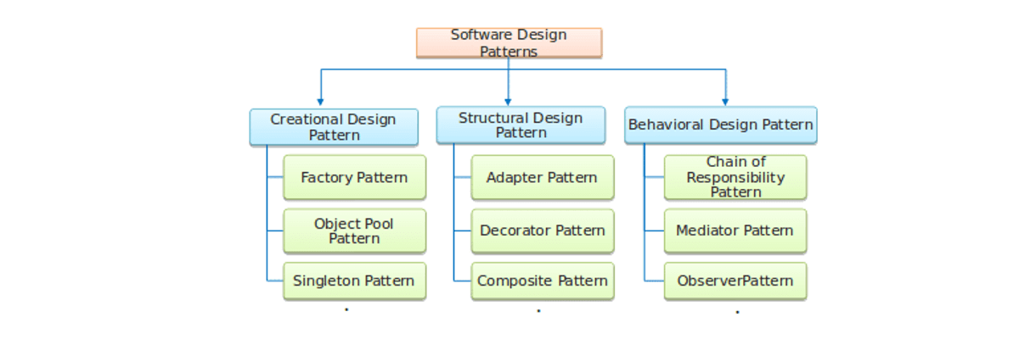
Repository vs Unit-of-Work Patterns https://docs.microsoft.com/en-us/aspnet/mvc/overview/older-versions/getting-started-with-ef-5-using-mvc-4/implementing-the-repository-and-unit-of-work-patterns-in-an-asp-net-mvc-application
There are many ways to implement the Repository and Unit-of-Work patterns.
You can use repository classes with or without a Unit-of-Work class.
You can implement a single repository for each entity type.
When implementing one entity class for each type, you can use 1) separate classes, 2) a generic base class with derived classes, or 3) an abstract base class and derived classes.
You can include business logic in your repository or restrict it to data access logic.
You can build an abstraction layer into your database context class by using IDbSet interfaces there instead of DbSet types for your entity sets.
Every approach to implementing an abstraction layer is just one consideration when creating an application. Choose which pattern is right for your project.

Slide 11
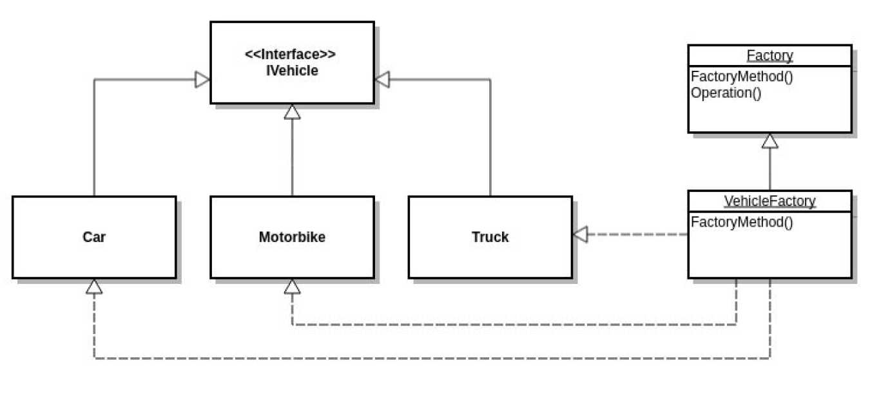
Factory Design Pattern
In Factory pattern, objects are created without exposing the creation logic to the client. The client uses the same interface (UI) to create each new type of object.
The idea is to use a static member-function (static factory method) that creates & returns instances, hiding the details of class modules from the user.
A factory pattern is one of the core design principles to create an object, allowing clients to create objects of a library(explained below) in a way such that it doesn’t have tight coupling with the class hierarchy of the library.

Slide 12
Factory Design Pattern
This class should not have logic to create the object.
The static FactoryMethod() exists to take responsibility away from the client.

Slide 13
Singleton Design Pattern https://en.wikipedia.org/wiki/Singleton_pattern
The Singleton pattern restricts the instantiation of a class to one single instance.
This is useful when exactly one object is needed to coordinate actions across the system.
The singleton design pattern solves problems by allowing it to:
Ensure that a class only has one instance
Easily access the sole instance of a class
Control its instantiation
Restrict the number of instances
Access a global variable
Rock-Paper-Scissors Game
Program.cs
Gameplay Class
Game Class
Rock Class
Paper Class
Scissors Class

