Slide 1

S.O.L.I.D.
.net

Slide 2
In Object-Oriented Programming, S.O.L.I.D. is an acronym for five design principles intended to help make software more understandable, flexible, and maintainable.
https://en.wikipedia.org/wiki/SOLID

Slide 3
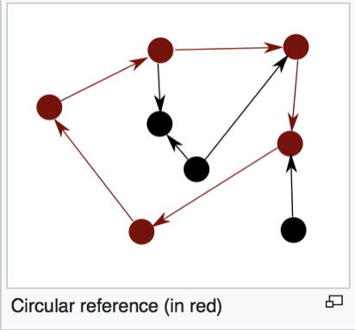
S.O.L.I.D. – Overview https://medium.com/better-programming/solid-principles-simple-and-easy-explanation-f57d86c47a7f https://www.c-sharpcorner.com/UploadFile/damubetha/solid-principles-in-C-Sharp/ https://medium.com/better-programming/what-is-bad-code-f963ca51c47a
SOLID is a coding standard that helps developers avoid problematic design in software development.
When applied properly, SOLID principles make code easier to refactor, easier to debug, and easier to read.
Badly designed software is inflexible and brittle. Small changes can result in a cascade of problems that break various parts of the code.

Slide 4
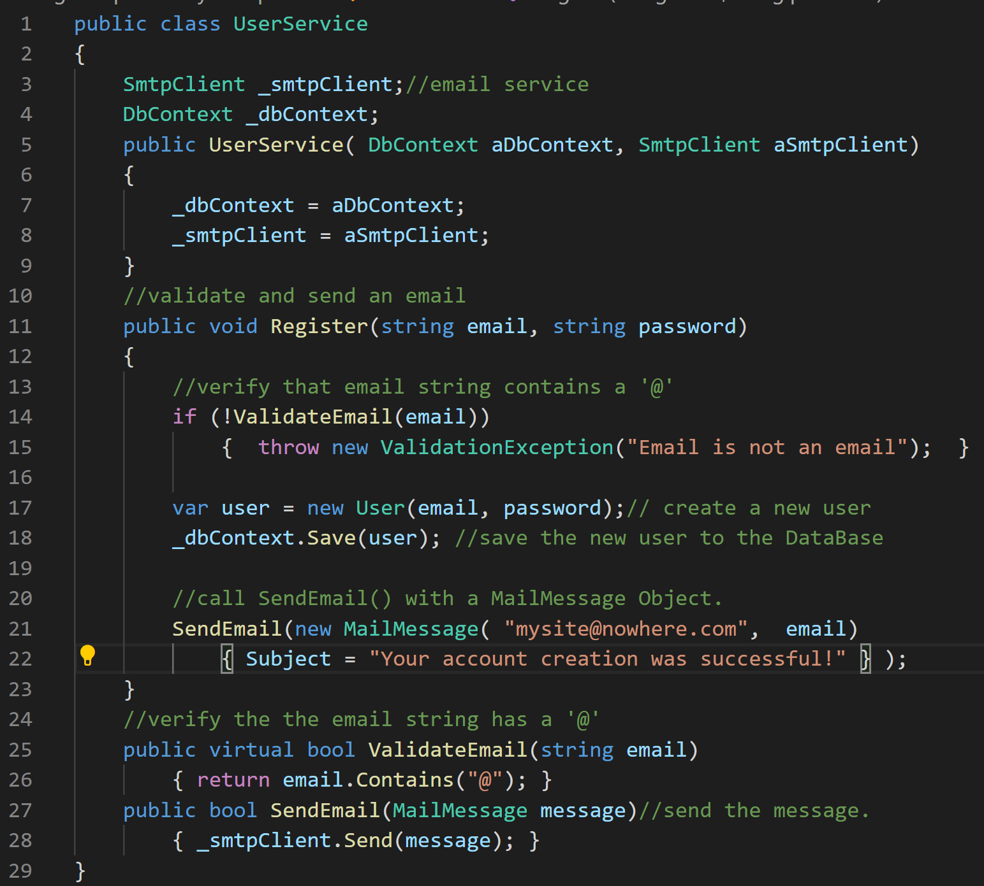
Single Responsibility Principle https://www.c-sharpcorner.com/UploadFile/damubetha/solid-principles-in-C-Sharp/
A class should only have one responsibility. When classes have single responsibilities, changes to software should only affect one class at a time.
In this example, SendEmail() and ValidateEmail() serve a logically different purpose from the UserService class, which registers a new user.
The UserService class should not contain logic to be sending and validating emails.
Sending and validating emails should be done by a Service classes.

Slide 5
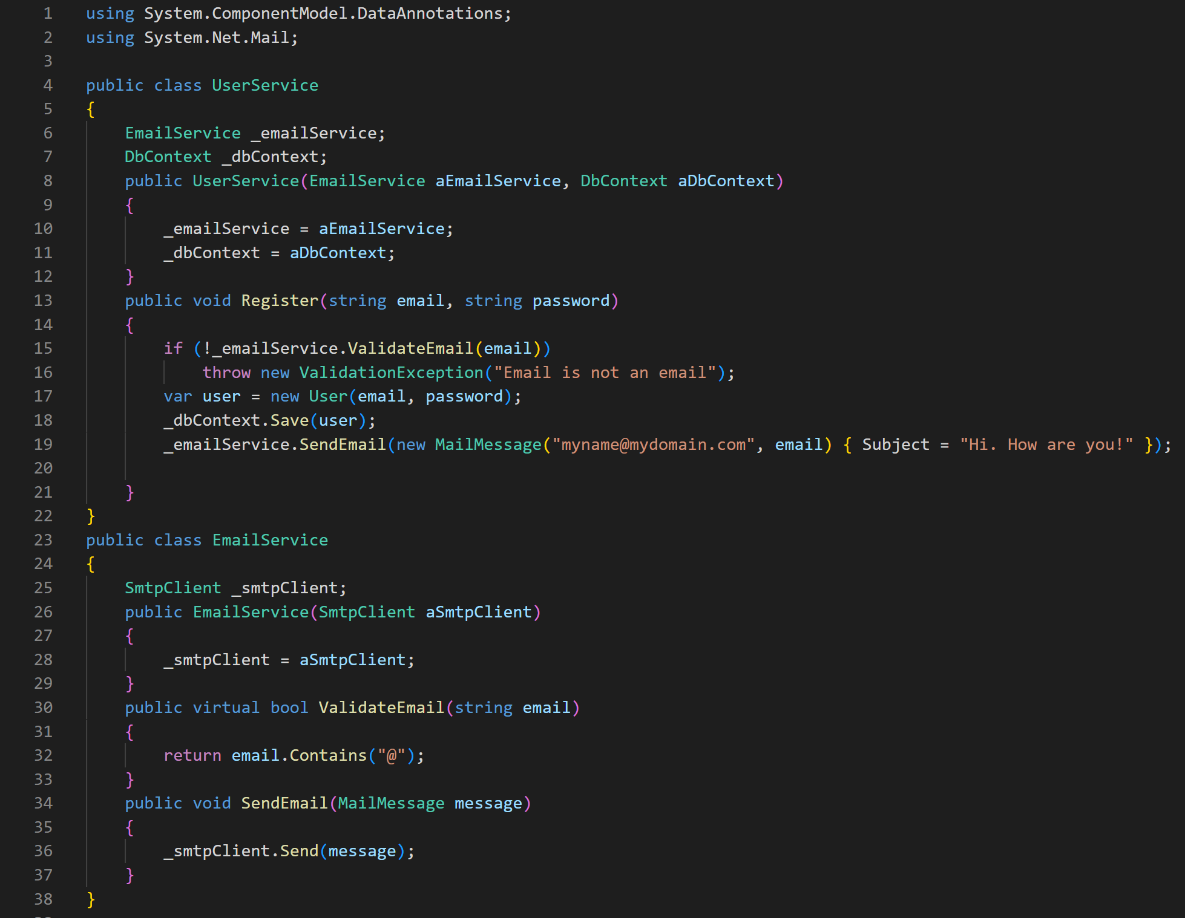
Single Responsibility Principle https://www.c-sharpcorner.com/UploadFile/damubetha/solid-principles-in-C-Sharp/
To fulfill the Single Responsibility Principal, now UserService only creates a new user. It leverages EmailService for anything email related.
EmailService is a service class that is injected into any other class that needs to handle emails. It is very basic. It only verifies the email address and sends the email.
You can add as much related functionality as needed to each service class.

Slide 6
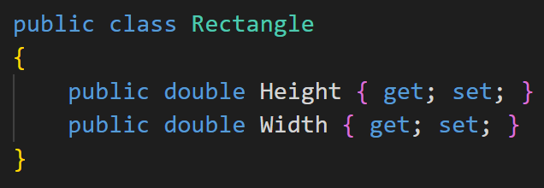
Open-Closed Principle https://www.c-sharpcorner.com/UploadFile/damubetha/solid-principles-in-C-Sharp/
“A class should be open for extension but closed to modification”.
Modules and classes must be designed in such a way that new functionality can be added when new requirements are generated. We implement interfaces and use inheritance to do this.
The Rectangle class needs to be able to calculate the total area of a collection of Rectangles. The Single Responsibility Principle dictates that we should not put the total area calculation code inside the Rectangle class.
How can this problem be solved?

Slide 7
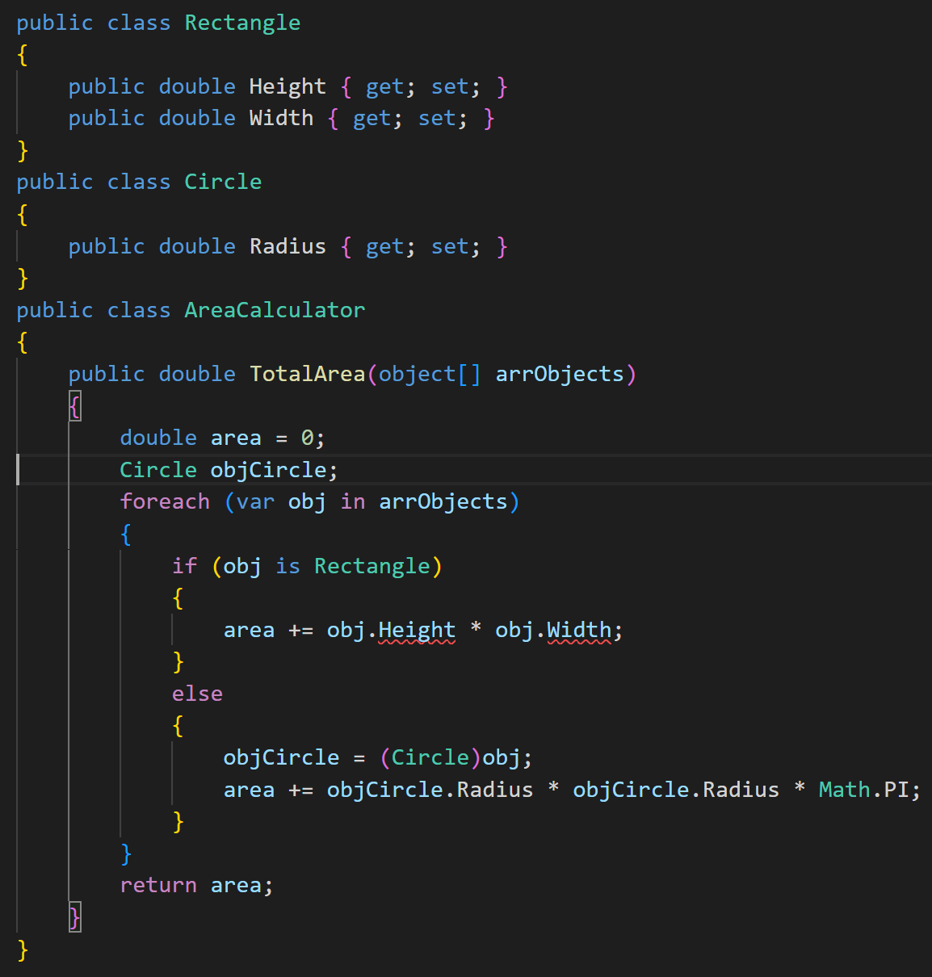
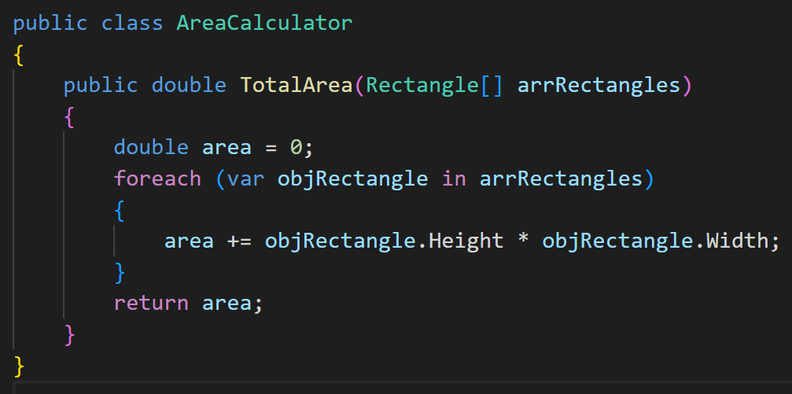
Open-Closed Principle https://www.c-sharpcorner.com/UploadFile/damubetha/solid-principles-in-C-Sharp/
We create a class specifically to calculate the area of objects.
EVEN BETTER. Create one class for the calculation of the area of ANY shape. →→→→→→→→→→→

Slide 8
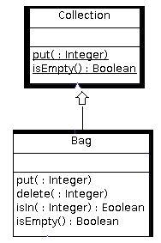
Liskov Substitution Principle https://medium.com/better-programming/solid-principles-simple-and-easy-explanation-f57d86c47a7f https://www.c-sharpcorner.com/UploadFile/damubetha/solid-principles-in-C-Sharp/
Derived classes must implement all the methods and fields of their parent.
After implementing the methods and fields of the parent, you will be able to use any derived class instead of a parent class and it will behave in the same manner.
This ensures that a derived class does not affect the behavior of the parent class.
A derived class must be substitutable for its base (parent/super) class.
Interfaces help us implement this principle by defining methods but leaving the implementation to the developer. This allows you to abstract away dependencies of the class when testing.
: Collection

Slide 9
How Liskov Substitution Principle Works IRL.
// Bag inherits from Collection
Bag myBag = new Bag();//This Bag TYPE inherits (derives from) from Collections TYPE
myBag.BagMethod();// BagMethod is a new method on Bag only
myBag.CollectionMethod();//CollecitonsMethod is a Collection class method inherited by Bag
//myBags’ actual value is the memory location on the heap of the Bag object.
Collection myCollection = myBag;//assign the memory location to the collection TYPE variable.
myCollection.BagMethod();// a Collection TYPE variable cannot access a Bag TYPE method.
myCollection.CollectionMethod();// This still works.

Slide 10
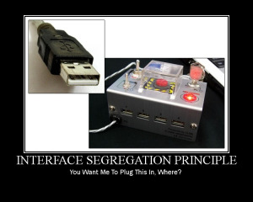
Interface Segregation Principle https://www.c-sharpcorner.com/UploadFile/damubetha/solid-principles-in-C-Sharp/
Each interface should have a specific purpose or responsibility.
Large interfaces are more likely to include methods that not all classes can implement.
Client classes should not be forced to depend on interfaces with methods they will never use.

Slide 11
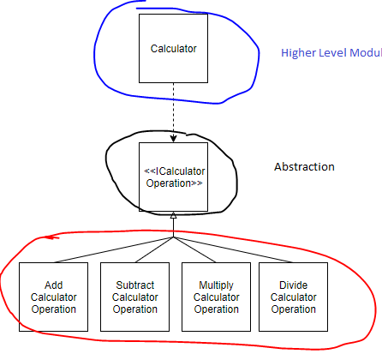
Dependency Inversion Principle https://www.c-sharpcorner.com/UploadFile/damubetha/solid-principles-in-C-Sharp/
“High-level modules should not depend on low-level modules. Both should depend upon abstractions.”
Higher-level modules/classes implement business rules or logic in a system.
Lower-level modules/classes deal with more detailed operations like writing data to databases.
When a class is directly dependent on another class, changes to the dependency class might break the dependent class. We should keep these high-level and low-level classes as loosely coupled as possible.
To do that, make both classes dependent on interfaces instead of on each other.

