Slide 1
Typography in the future
Jihae Choe

Slide 2
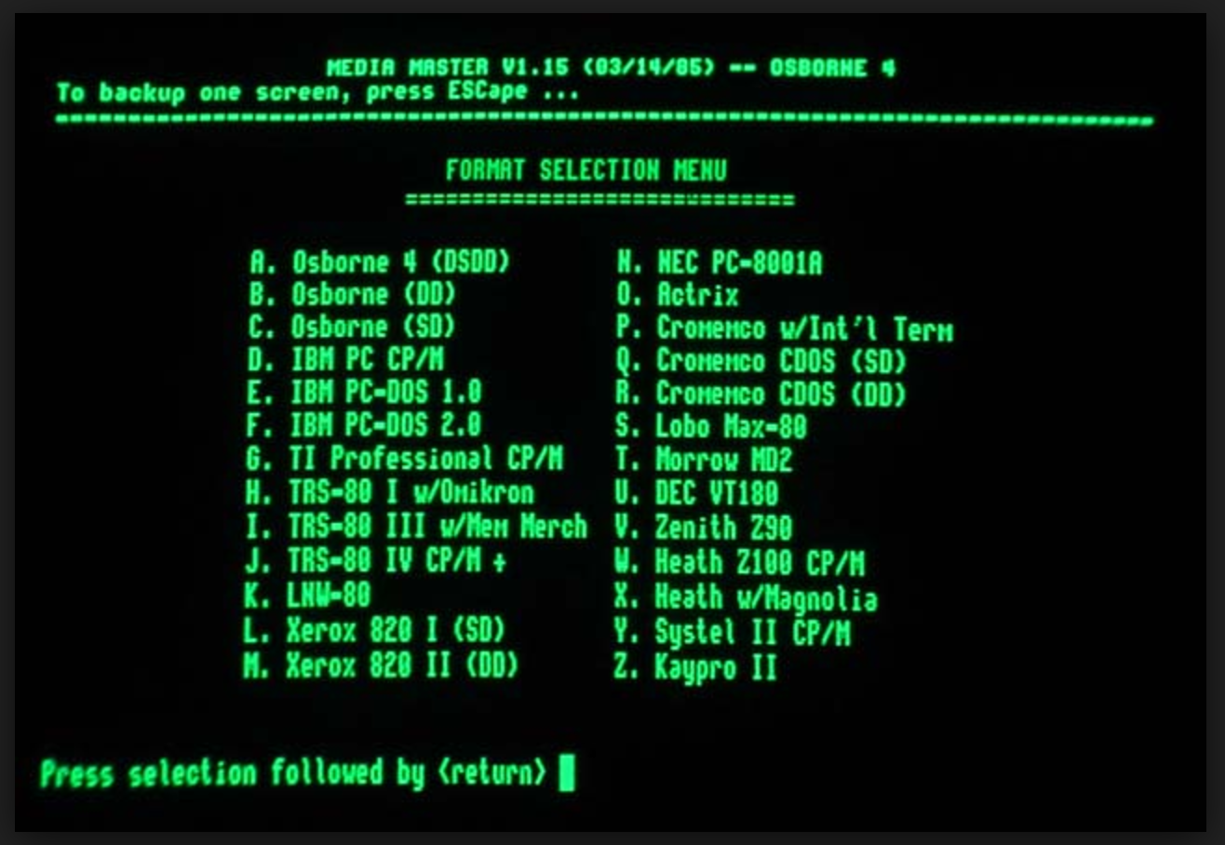
SCREEN IN 1980s

Slide 3
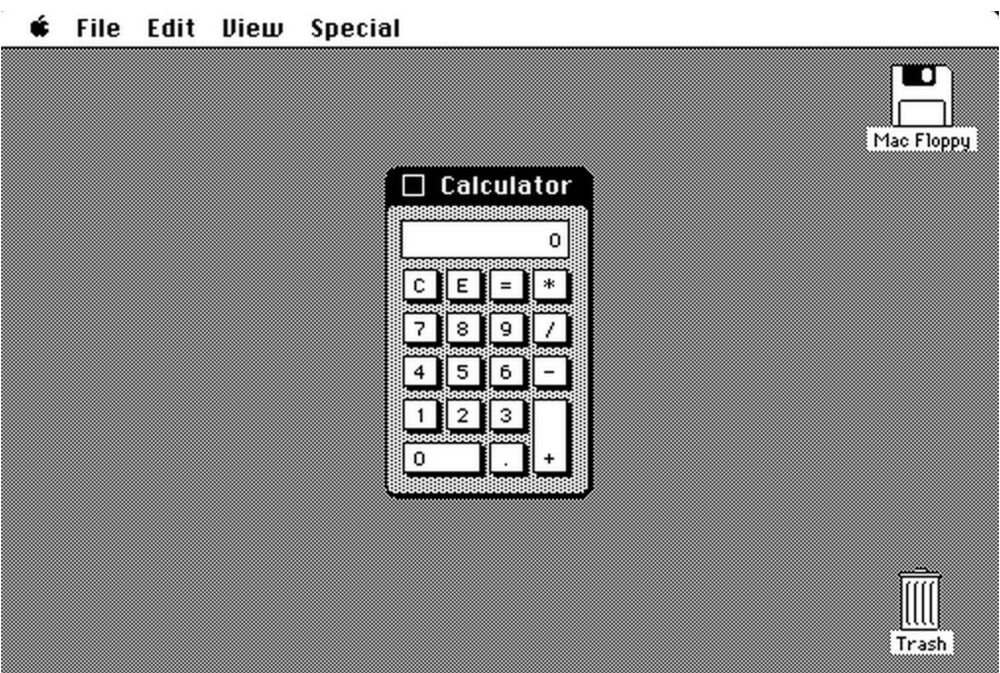
STEVE JOB’S ICON

Slide 4

LAMBADA VISUAL IDENDITY
INSPIRATIONAL SOURCE
Pedro Neiko and Herbert Loureiro treated the word Lambada like an image.

Slide 5
Pictorial language
Jihae Choe

