Slide 1
DTAI H3013
Object Oriented
Analysis and Design
Mark Deegan

Slide 2
Assessment
Practical/Skills Evaluation

Slide 3
Assessment
Practical Skills Evaluation | A series of tasks that will help develop OO Analysis & Design Skills | 25% | Development of various C++/Java exercises I pursuit of better understanding OOAaD
Case Study | ACM/IEEE Code of Ethics | 10% | Essay on the implications for software developers of the Code of Ethics
Journal |  | 15% | GitHub readme and wiki contributions
Project | Individual Work | 20% | Development of examples that illustrate understanding of core OOAaD concepts
Project | Team Work | 30%

Slide 4
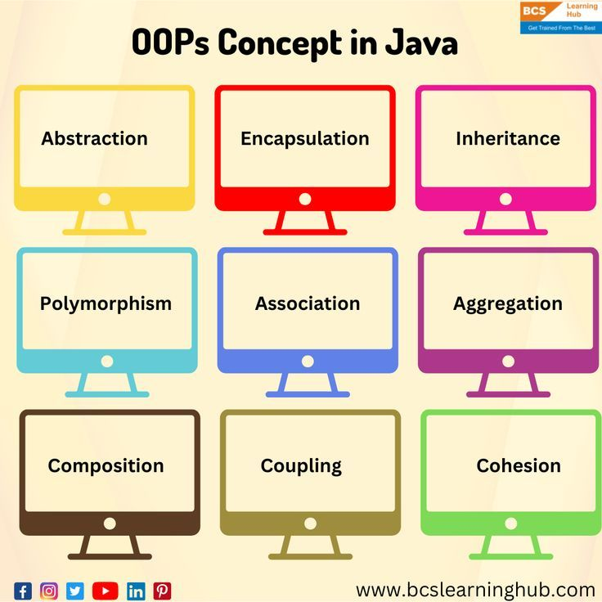
OOPs Conepts in Java

Slide 5
OOAaD Concepts
Abstraction
Encapsulation
Inheritance
Polymorphism
Association
Aggregation
Composition
Coupling
Cohesion

Slide 6
Abstraction
Handle complexity by hiding unnecessary details from the user
That enables the user to implement more complex logic on top of the provided abstraction without understanding or even thinking about all the hidden complexity.

Slide 7
Encapsulation
Combining data and the methods that operate on it into one unit, usually a class.
Encapsulation protects data from accidental modification, enhances code organization, and streamlines interaction between program components

Slide 8
Inheritance
A mechanism where you can to derive one class from another class and construct a hierarchy of classes that share a set of attributes and methods
  Vehicle etc.

Slide 9
Polymprphism
Something which occurs in several different forms.
The concept that you can access objects of different types through the same interface
  A collection of Vehicles can contain Mopeds and Helicopters and Cars
Each type can provide its own independent implementation of this interface.

Slide 10
Association
Relationships between classes play a crucial role in defining how objects interact with each other.
Java provides mechanisms to model these relationships through association, aggregation, and composition.
Aggregation, association, and composition in Java describe how instances of classes relate to each other.
An association can be considered a generic term to indicate the relationship between two independent classes;
  the relationship may be one-to-one, one-to-many, or many-to-many, but it need not indicate ownership.

Slide 11
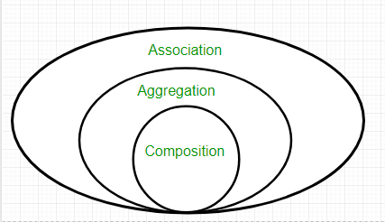
Association Aggregation and Composition

Slide 12
Aggregation
Aggregation is a specific form of association in which one class, the whole, contains a collection of other classes, the parts;
  here, however, the lifecycle of the parts does not depend upon the whole
  For example, a library and books show aggregation, since books may exist somewhere apart from the library.

Slide 13
Composition
Composition is a stronger form of aggregation that means ownership and lifecycle dependence; if the whole gets destroyed, then the parts no longer exist.
For composition, a good example would be a house and its different rooms; a room cannot exist without a house

Slide 14
More on Association
Association describes the relationship between two independent classes.
Association can be viewed as describing a “uses-a” relationship where an object uses, or in any way interacts with, another object.
Association may be either unidirectional or bidirectional and may exist in several forms, such as one-to-one, one-to-many, many-to-one, and many-to-many, similar to database relationships

Slide 15
More on Association
Unidirectional Association is the one in which one class is aware and associated with another class;
  the reverse is not true.
  For example, the Student class can be associated with the LibraryCard class, for the association where the student has a library card;
  a LibraryCard does not need to ‘know about’ a Student.

Slide 16
More on Association
In Bidirectional Association the classes are aware of each other and interact with one another.
For example, a Teacher class and a Classroom class may be associated bidirectionally;
  there would be a teacher assigned to a classroom, and a classroom would know to which teacher it is assigned.

Slide 17
More on Aggregation
Classifying an instance of a class as “has a.”
It’s a form of association with weaker relationship strength, whereby the lifetime of the contained object (part) is not controlled based on the lifetime of the container object (whole).
Concepts of aggregation are quite important for developing modular and reusable software components.

Slide 18
More on Aggregation…
Aggregation is a type of association that represents a relationship where one class is a collection or container of another class.
It depicts a “has-a” relationship, where the container object can exist independently of its contents, and the contained objects can exist independently of the container.

Slide 19
More On Aggregation
A special form of Association where:
  It represents Has-A’s relationship
  It is a unidirectional association i.e. a one-way relationship.
    For example, a department can have students but vice versa is not possible and thus unidirectional in nature.
  In Aggregation, both entries can survive individually which means ending one entity will not affect the other entity.

Slide 20
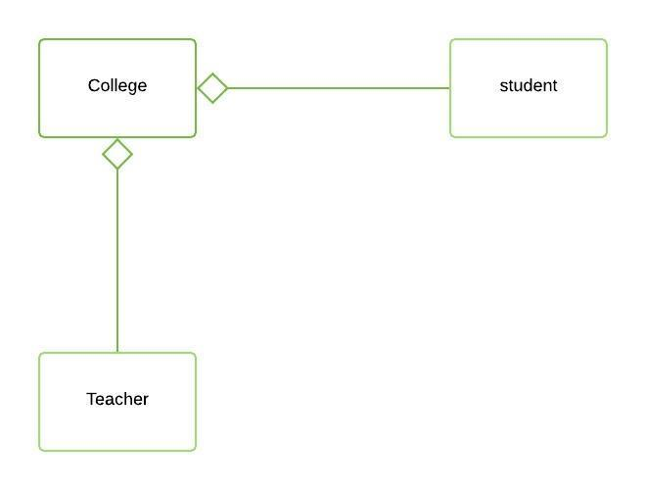
More on Aggregation…

Slide 21
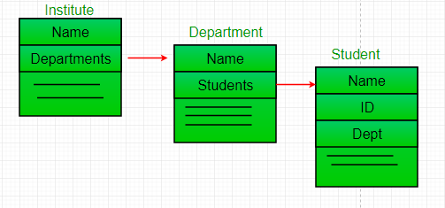
More on Aggregation…

Slide 22
More on Composition…
Composition refers to the relationship “part-of” between classes. It is a stronger form of association in which the contained objects’ lifecycle is strongly associated with the container object’s lifecycle.
The understanding of composition is crucial in the design of complex systems where objects of the system are composed of other objects.

Slide 23
More on Composition…
Composition is a type of association meaning one class “contains” another.
This association can be said to be a “part-of” relationship and would denote that the contained object is strongly connected with the containing object, the whole.
The parts cannot be without the whole.

Slide 24
More on Composition…
Composition is a restricted form of Aggregation in which two entities are highly dependent on each other.
It represents part-of relationship.
In composition, both entities are dependent on each other.
When there is a composition between two entities, the composed object cannot exist without the other entity.

Slide 25
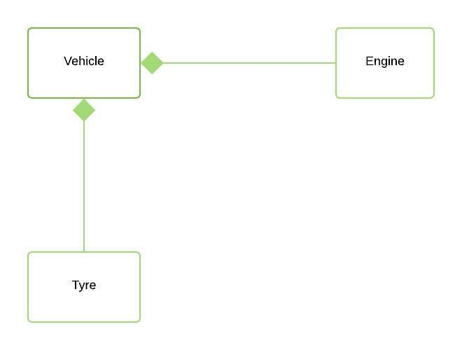
More on Composition…

Slide 26
Coupling & Cohesion
These two concepts are used together to measure the quality of our code.
They help ensure it is maintainable and scalable

Slide 27
Coupling…
Defines the degree of interdependence between software modules
Tight Coupling means that modules are closely connected and that changes in one can affect other modules
Loose Coupling means that modules are independent of each other and changes in one module have minimal impact on others
Best practice in OOP is to achieve loose coupling

Slide 28
Cohesion
This defines how effectively elements within one module or object work together to fulfil a single well-defined purpose
A High level of Cohesion means that elements within a module are tightly integrated and work together to achieve desired functionality

Slide 29
Coupling…
Tight coupling is when classes or modules have many dependencies on each other.
Changing code in one module has impacts on the operation of other modules
If the modules are tightly coupled, then if we change how we gather and store data on students, then that can have significant impacts on the fees and grants operation in the University
Traditionally many software systems were written an monolithic software systems where functions were very tightly coupled

Slide 30
Coupling….
Tight coupling makes it difficult to modify or extend our modules without affecting other modules
This will lead to an increased risk of bugs and unintended side effects
Deciding who is responsible for addressing the consequences is a challenge and the re-work can be very costly
https://www.enjoyalgorithms.com/blog/cohesion-and-coupling-in-oops
Notes:
https://www.enjoyalgorithms.com/blog/cohesion-and-coupling-in-oops

Slide 31
Example
class Car {
private Engine engine;
public Car() {
this.engine = new Engine();
}
public void start() {
engine.start();
}
public stop() {
engine.stop();
}
}

Slide 32
class Engine {
public void start() {
…
}
public void stop() {
…
}
}

Slide 33
Coupling
Car has a direct reference to the Engine class and calls the methods start() and stop directly on it.
If we want to modify or extend Engine, we also need to consider how it will impact the Car class.
If we change the method signatures of start or stop methods in class Engine, we need to change the corresponding method calls in Car class.
If we want to add specific types of engine, like Electric Engine or Hybrid engine, then matters get more complex.

Slide 34
Loose Coupling
Loose coupling is when classes or modules have minimal dependencies on each other and changes in one class are unlikely to affect the other.
This makes our code modular and reduces the risk of bugs
It makes the code easier to maintain

Slide 35
Design Patterns
Design patterns are like well-known recipes for common problems in software development
They’re not step-by-step instructions, but more like guidelines to help you solve these problems in a flexible and efficient way
These patterns gather the wisdom of the software development community, making it easier for developers to work together and create software that’s easy to maintain, adapt, and reuse
https://www.geeksforgeeks.org/design-patterns-in-object-oriented-programming-oop/

Slide 36
Design Patterns
Singleton Pattern
Factory Method Pattern
Abstract Factory Method Pattern
Builder Pattern
Adapter Pattern
Proxy Pattern
Decorator Pattern
Composite Pattern
Observer Pattern
Strategy Pattern
Command Pattern
State Pattern
Template Method Pattern
Visitor Pattern
Memento Pattern

Slide 37
Loose Coupling
We can overcome the challenges of tight coupling using certain Design Patterns, such as Dependency Injection (DI)
  https://www.geeksforgeeks.org/dependency-injectiondi-design-pattern/
Or we can use interfaces to decouple dependencies between classes

Slide 38
Example
class Car {
private Engine engine;
public Car(Engine engine) {
this.engine = engine();
}
public void start() {
engine.start();
}
public stop() {
engine.stop();
}
}

Slide 39
interface Engine {
void start();
void stop();
}

Slide 40
class DieselEngine implements Engine {
private Engine engine;
public car(Engine engine) {
this.engine = engine;
}
public void start() {
engine.start();
}
public void stop() {
engine.stop();
}

Slide 41
Interfaces
This can help us to create many concrete implementations of Engine interface, each with its own unique behaviour.
Electric Engine
Diesel Engine
Hybrid Engine
Car class now depends on the interface Engine (less likely to change) not on a specific implementation of the Engine (or a sub-class)
When we create an instance of the Car class, we pass in an instance of the Engine interface.
This also allows us to create instances of the Car class with different types of engines, without having to modify the Car class itself.

Slide 42
Interfaces
This makes each class easier to modify or extend without having to modify the other.
If we want to add new methods to the Engine Interface, we can do so without having to modify the Car class.
If we want to modify the behaviour of the ConcreteEngine class we can do so without having to modify the Car class.

Slide 43
Types of Coupling
Content Coupling
  When a module relies on the internal details of another module
Control Coupling
  When a module controls the flow of control in another module
Data Coupling
  When one module passes data to another module without knowing its internal structure
Stamp Coupling
  When one module uses only one part of the other module’s state

Slide 44
Types of Coupling…
Common Coupling
  When multiple modules share a common data structure
External Coupling
  When a module depends on external resources such as files or databases
Message Coupling
  When modules communicate with each other through messages

Slide 45
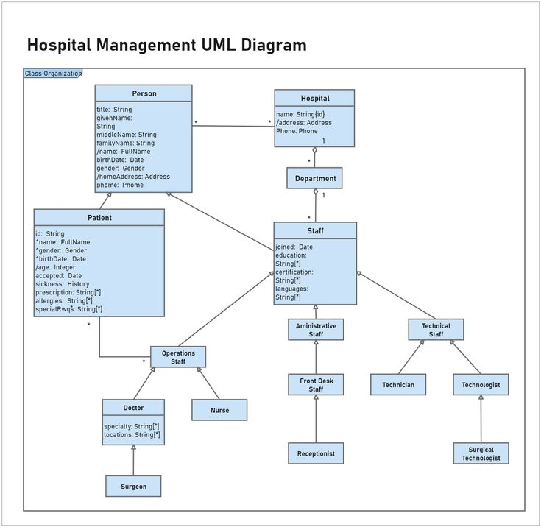
Hospital Management UML DIagram

Slide 46
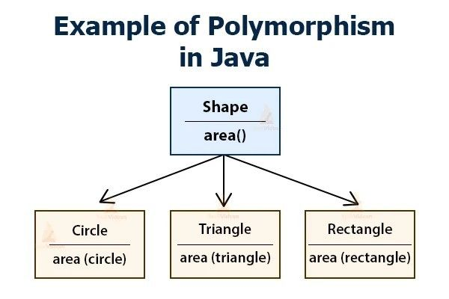
Polymorphism

Slide 47
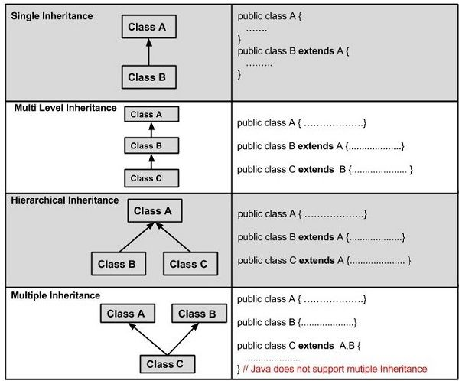
Inheritance

Slide 48
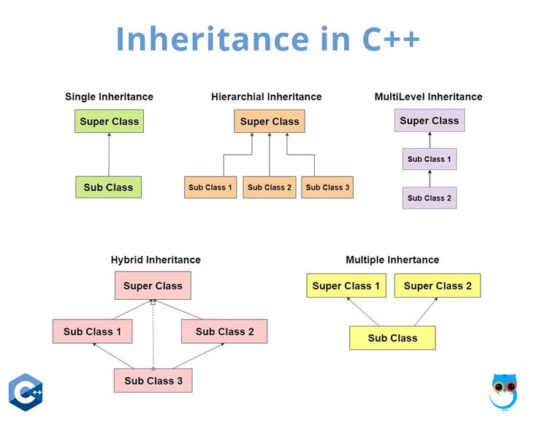
Inheritance in C++

Slide 49
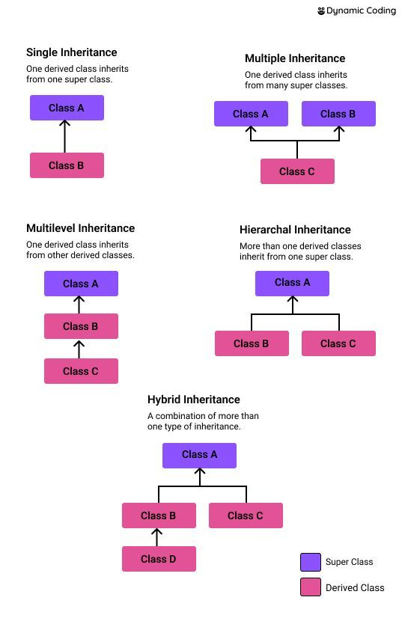
Inheritance Types

Slide 50
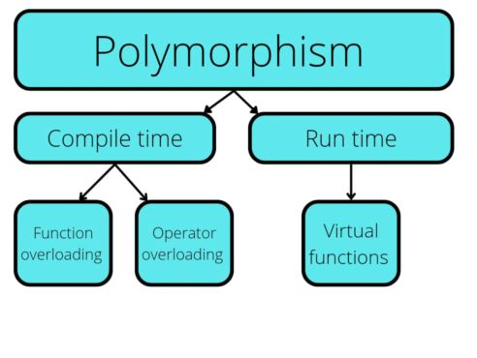
Polymporphism

Slide 51
Hospital Management UML Diagram

Slide 52
Visibility Modifiers in Java
Visibility modifiers allow us to limit the access that other code has to the member attributes in our classes
Modifier | Description
Default | Declarations are only visible with the package (defaults to private)
Private | Declarations are visible within the class only
Protected | Declarations are visible within the package or all sub-classes
Public | Declarations are visible everywhere

Slide 53
Example - Java

