Slide 1

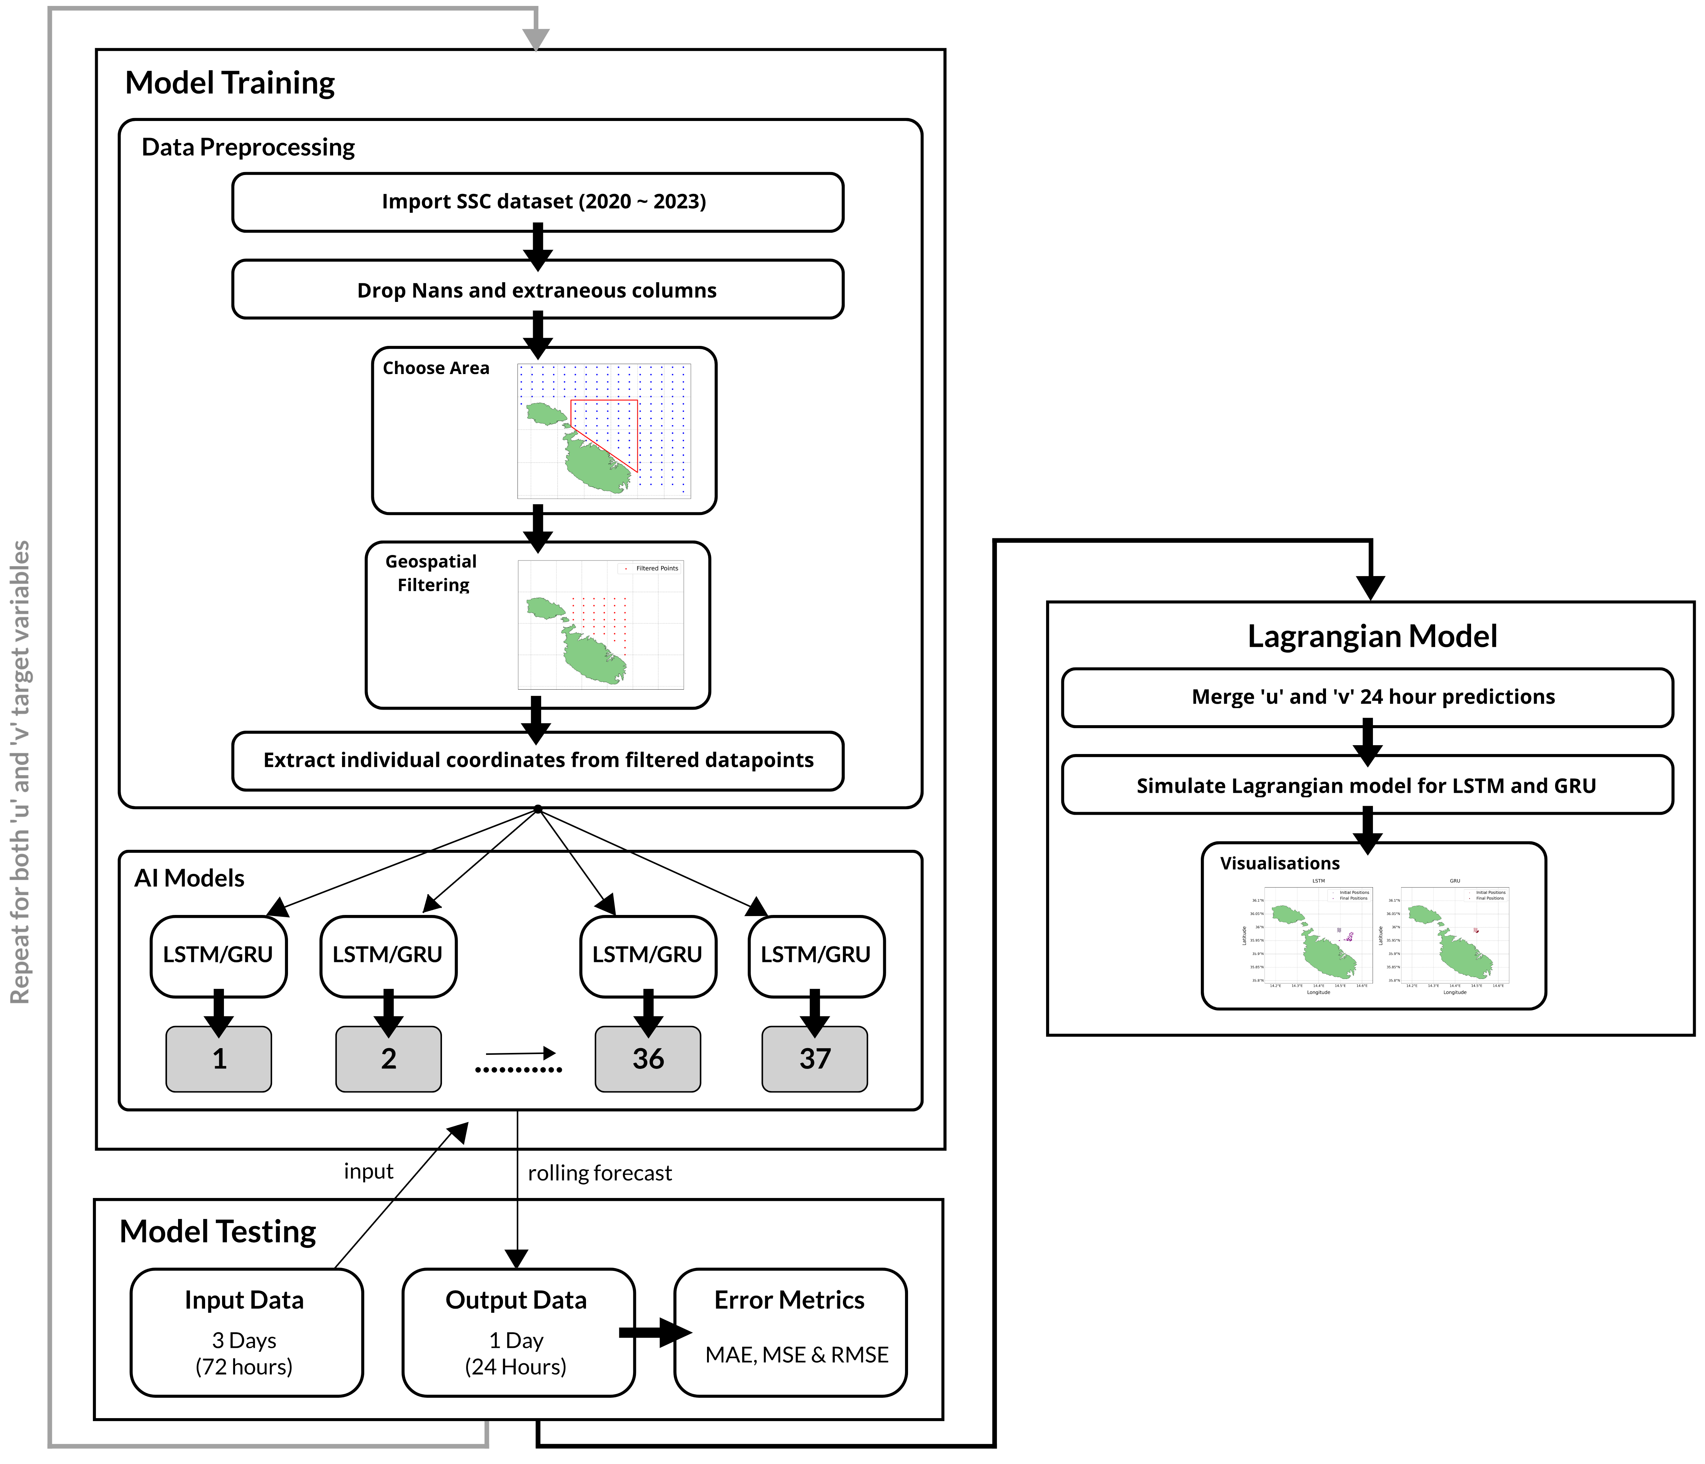
B.Sc. IT (Hons.)
Artificial Intelligence
Predictive modelling of sea debris around Maltese coastal waters
Mark Dingli
Supervisor: Dr Kristian Guillaumier
INTRODUCTION
Sea surface debris in the coastal waters of Malta presents a significant environmental challenge, endangering marine life, disrupting ecological balance, and compromising the integrity of coastal ecosystems. This problem is exacerbated by the lack of an effective system tailored to predict the movement of surface debris specifically for Malta. Addressing this gap, this project introduces a system that combines machine learning with a physics-based model to provide accurate predictions and simulations that can guide effective cleanup operations and inform long-term marine conservation strategies around Malta.
ARCHITECTURE DESIGN
AIM
The aim of this project is to create a system that simulates and predicts the movement of sea surface debris around the coastal waters of Malta, thereby supporting marine conservation efforts. To achieve this, a pipeline was created that leverages historical data to predict the next 24 hours of sea surface current velocities. These predictions are then used as inputs for a Lagrangian model, enabling it to simulate the movement of surface marine debris. Finally, a comparative evaluation of both LSTM and GRU models is conducted, focusing on their predictive accuracy and the quality of the visualizations to determine the best model. This approach seeks to offer valuable insights for marine conservation and enhance decision-making processes for managing marine debris around the Maltese Islands.
Figure 1 – Overview of entire pipeline
METHODOLOGY
Preprocess and integrate the SSC velocity datasets, ensuring compatibility and consistency for input into models.
Using historical SSC data, develop a physics-based Lagrangian model to simulate the movement of surface marine debris.
Integrate AI model predictions with the Lagrangian model to create simulations and visualizations of marine debris movement.
Conduct a comparative evaluation of both LSTM and GRU models, focusing on their predictive accuracy and the quality of the final visualisations
Develop both LSTM and GRU AI models.
RESULTS
The analysis included two key areas: error metrics evaluation and geospatial analysis, both of which confirmed the effectiveness and practical applicability of the models. Through a comparative evaluation, it was determined that the LSTM model outperforms the GRU model in predicting sea surface current velocities. This is evidenced by better results in error metrics such as MAE, MSE, and RMSE, providing more consistent and reliable predictions.The geospatial analysis further corroborated these findings, showing that LSTM generally maintained more consistent performance metrics, such as spread and skewness, when compared to GRU. Contrary to the initial hypothesis, the analysis did not conclusively prove that proximity to the coast and reduced data availability significantly degraded model performance. Even though coastal data points generally showed less accuracy, this was not universally the case, suggesting that other factors, such as the models’ capacity to handle sparse data and noise, play a critical role in prediction outcomes. These findings validate the effectiveness of the integrated approach by providing accurate predictions and simulations. This underscores the project's potential to improve marine conservation efforts and tackle surface debris issues in Malta.
CONCLUSIONS AND FUTURE WORK
In this FYP, we successfully developed and integrated AI models with a physics-based Lagrangian framework to predict and visualize the movement of sea surface debris around Malta's coastal waters over a 24-hour period. Moving forward, this project lays a solid foundation for future enhancements aimed at expanding the system’s capabilities and applications. A possible improvement is to integrate additional environmental factors such as wind and wave height to improve predictions. Additionally, the model’s applicability could be expanded to cover other scenarios, including jellyfish and plankton movements, search and rescue operations, and oil spill simulations. Further improvements in predictive accuracy could be achieved by adopting ensemble learning and advanced models like transformers. Increasing the geographical area of interest would allow for a more comprehensive analysis of marine debris dynamics and enable the validation of the Lagrangian model with historical drifter data. Finally, the development of a dedicated website to display enhanced visualizations could make the research outcomes more accessible and practical for ongoing marine conservation initiatives.
FINAL VISUALISATION EXAMPLE
Figure 2 – LSTM and GRU initial vs final debris movement
(4th August 2023).

