Slide 1
MonoGame Graphics
Customize Game Framerate, Resolution
And Add images (sprites) into our games!

Slide 2
Customizing graphical options
There are several graphical options and settings we can customize.
Some modify the look, while others modify the feel of the game
The following slides will walk you through, the what and how of each of the major customizations
NOTE: Major graphical changes (resolution and framerate) require two things:
  1) They should be done in the Initialize Method
  2) After ALL the changes, for them to take effect, use the command:
    _graphics.ApplyChanges();

Slide 3
Making the Mouse Pointer Visible
By default, the mouse cursor is visible. (Seen in the Game1() constructor method)
This is something you can turn on and off with the simple change of a bool variable.
  IsMouseVisible = true;
  IsMouseVisible = false;
Adding either of these lines in the game loop will change the mouse visibility during gameplay

Slide 4
Changing Game Resolution (Window Size)
By default, the game window has a resolution of 800x480 (800 width, 480 height)
To modify these values, we must change two values inside the Initialize Method
Potential Problem: It is possible you choose a size that is not compatible with the monitor or graphics card. That is why the command is PreferredBackBufferWidth.
protected override void Initialize()
{
_graphics.PreferredBackBufferWidth = 1000; ← Set the width to 1000
_graphics.PreferredBackBufferHeight = 800; ← Set the height to 800
_graphics.ApplyChanges(); ← Force the changes to take effect
base.Initialize();
}

Slide 5
Handling the Resolution Problem
Since the size changes may fail, instead we will detect and store the true values AFTER the graphical changes have been applied
Start by defining two global int variables
  int screenWidth;
  int screenHeight;
Now, we will store the newly set screen resolution in those variables in Initialize (after ApplyChanges)
protected override void Initialize()
{
_graphics.PreferredBackBufferWidth = 1000; ← Set the width to 1000
_graphics.PreferredBackBufferHeight = 800; ← Set the height to 800
_graphics.ApplyChanges(); ← Force the changes to take effect
screenWidth = _graphics.GraphicsDevice.Viewport.Width; ← store screen width
screenHeight = _graphics.GraphicsDevice.Viewport.Height; ← store screen height
base.Initialize();
}

Slide 6
Changing the Game’s Framerate (FPS)
The game updates and draws at a specific frequency, we call this the framerate
We measure it in frames per second (FPS), meaning how many frames are drawn per second
By default, a MonoGame project runs at 60 FPS
To modify this rate, we need 1 new global int variable and 3 lines of logic in the Initialize Method
  Begin by defining the variable and assigning it the desired frame rate, (e.g. 30 FPS): int targetFPS = 30;
The three lines of code will ensure the game will do its best to set the value and reach it while playing!
protected override void Initialize()
{
_graphics.SynchronizeWithVerticalRetrace = false; ← Turn off VSync
IsFixedTimeStep = true; ← Try to ensure equal frame time
TargetElapsedTime = TimeSpan.FromMilliseconds(1000.0f / targetFPS);
_graphics.ApplyChanges();
base.Initialize();
}
1000ms = 1 second
1000ms/30 = 33ms
33ms per frame

Slide 7
Putting it ALL Together
int screenWidth; ← To store the true screen width
int screenHeight; ← To store the true screen height
int targetFPS = 30; ← To store the desired frame rate, e.g. 30 FPS
protected override void Initialize()
{
_graphics.PreferredBackBufferWidth = 1000; ← Set the width to 1000
_graphics.PreferredBackBufferHeight = 800; ← Set the height to 800
_graphics.SynchronizeWithVerticalRetrace = false; ← Turn off VSync
IsFixedTimeStep = true; ← Try to ensure equal frame time
TargetElapsedTime = TimeSpan.FromMilliseconds(1000.0f / targetFPS); ← Set FPS
_graphics.ApplyChanges(); ← Force the changes to take effect
screenWidth = _graphics.GraphicsDevice.Viewport.Width; ← store screen width
screenHeight = _graphics.GraphicsDevice.Viewport.Height; ← store screen height
base.Initialize();
}

Slide 8
Adding Images (Sprites) to our Games: Notes
Adding images takes little code, but does require running the Builder project
IMAGE REQUIREMENTS
You can use several image types, including: png, jpg, bmp, gif
  png is preferred, as it is small in storage size and can handle transparent pixels (jpg and bmp cannot)
  Animated gif images will only show the first frame of animation. We will learn how to animate later.
There is a maximum image size, it mostly depends on the graphics card. Typically, 2000 pixels in any dimension is too big.
  Aim for the smallest, highest quality images since they will produce a smooth-running game!

Slide 9
Adding Images: To The BUILDER Project
Step 1: Images will be stored in the Builder Project → Builder/Assets/Images folder
We will use two categories of images:
  Sprites (all game images, e.g. characters, objects, environment items, weapons, animations, etc.)
  Background images (to cover all the space behind our gameplay). Technically, these are sprites too.
In Windows/MacOS, browse to your outer project folder, then into:
  Builder/Assets/Images
In the Images folder you will find two more folders, Sprites and Backgrounds
  Sort and Store all your game images in these two folders

Slide 10

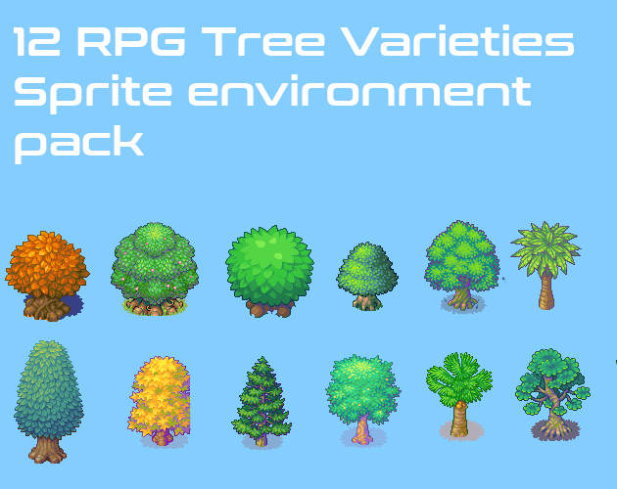
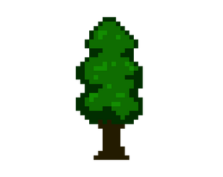

Adding Images: Get the Images Ready
Step 2: Find, Create and/or Edit your image (Once per image)
You can find images with google searches, e.g. “Mario Background Image”, “tree sprite png”
You can build your own in great tools like Photoshop, Photopea.com or the newbie friendly tool, Piskel
The perfect image has the object by itself, NO extra space around the object, and a transparent background
Use online tools like PhotoPea to crop (cut out) only the part of the image you need or to ensure the edges are tight to the object. YouTube is a great learning resource to learn how to do these things.
Remove backgrounds with PhotoPea, or online tools like removal.ai and remove.bg
PERFECT | Extra Objects | Extra Space | Non-Transparent BG

Slide 11
Adding Images: Add them to the Project
Step 3: Add Each Image to the Proper Folder (Once per image)
If it is a background image of any kind, put it in your newly created Backgrounds folder
All other images should be added to the newly created Sprites folder

Slide 12
Adding Images: Run the Builder Project
Step 4: After Adding All Images (You can add more later) Run the Builder Project
In VS Code:
  Click the Run and Debug icon on the left
    You should already have a configuration setup (if not refer to PASS0 or the How to Create New Programs topic on Google Classroom to set it up
  Click the drop-down arrow and choose the Builder Configuration you have setup
  Click Run and Debug
  If an error occurs: work through which items failed and retry the process until it succeeds
Step 5: Repeat this process whenever adding new images to your Builder Project folders

Slide 13

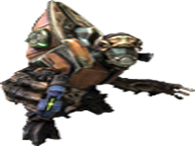

Adding Image: Coding
There are two new variable types we will need to learn to use images
Each of these variables will be declared globally
  Texture2D: An object to hold a loaded image. This is a reusable object. (like a stamp)
    Meaning, you could have 20 of the same tree image in your game. But you only need one Texture2D variable
  Rectangle: A rectangle is defined with an x, y position (its top left corner) and a width and height
    Each image shown will require its OWN Rectangle object. We commonly call this Rectangle a bounding box.
    Think of it like a picture frame that holds the image. The image will FILL the frame. Meaning it will stretch or compress the image to make it fit. See the images below for examples
Original Image (104x150) | Stretched Wide (200,150) | Compressed by ½ (52x75)

Slide 14
Adding Images: Coding
Step 1: Create the Texture2D to hold the image data and a Rectangle to know where and how big to draw the image
We typically add the text Img to the end of each Texture2D variable name to know it’s an image
For example, if I was setting up images for a grassy background and a tree sprite
  Texture2D grassyBGImg;
  Texture2D treeImg;
We typically add the text Rec to the end of each Rectangle variable name to know it’s a bounding box
For example, if I was setting up bounding boxes for the grassy background and 2 trees
  Rectangle grassyBGRec;
  Rectangle tree1Rec;
  Rectangle tree2Rec;

Slide 15
Adding Images: Coding – Load the Images
Step 2) Load the image data
In LoadContent, each Texture2D must be loaded, like how we loaded SpriteFonts previously
For Example, load in GrassyBG.jpg image and the tree.png image into the Texture2Ds we just created
  grassyBGImg = Content.Load<Texture2D>("Images/Backgrounds/GrassyBG");
  treeImg = Content.Load<Texture2D>("Images/Sprites/tree");
NOTICE how we did not need to include the extensions .jpg and .png
Possible Errors
If you get an error when compiling that says it cannot find your file, it is one of a few things:
  Most likely, you spelled something wrong in your file path during load. Look closely, it must be PERFECT!
  You forgot to RUN the Builder project

Slide 16
Adding Images: Coding – Rectangle Setup
Step 3) initialize (setup) the Rectangle to the desired position and size.
In LoadContent, each rectangle for every image to be drawn must be initialized (setup) by defining it with a position and size in the order (x, y, width, height) ← All values, must be integers
For Example, let’s start with our Grassy Background Image
The background’s position will be the top left of the screen (0,0)
Its size needs to be the whole screen, so use our screenWidth and screenHeight variables we created
  grassyBGRec = new Rectangle(0, 0, screenWidth, screenHeight);

Slide 17
Adding Images: Coding
Now, let’s initialize the Rectangles for our sprites, the two trees
The tree positions can be anywhere we want, play with them until you like their position
  Let’s choose (50,500) and (700,350) for our two trees (I chose these, so it looks like they are spaced out on the ground)
When setting the size of regular sprites, we have 3 choices:
  1) We can just choose numbers, e.g. 100,200 would be 100 wide and 200 high
  2) We can use the image’s real size by retrieving it from its Texture2D, e.g. treeImg.Width and treeImg.Height
  3) We can scale the image by multiplying the Texture2D data by a scaling value, like 0.8f. (the f means float)
    However, this will produce a float, and Rectangles can only use ints. So, we will need to cast the data to an int,
    e.g. (int)(treeImg.Width * 0.5f)
    It’s usually a good idea to use the same scaling value for both the width and height so they scale at the same rate
  tree1Rec = new Rectangle(50,500,treeImg.Width, treeImg.Height);
  tree2Rec = new Rectangle(700,350, (int)(treeImg.Width * 1.5f), (int)(treeImg.Height * 1.5f));

Slide 18
Adding Images: Coding
Step 4) Draw the Image as part of the spriteBatch
In the Draw method, start by beginning and ending your _spriteBatch
  _spriteBatch.Begin();
  _spriteBatch.End();
    NOTE: Only one set of Begin() and End() is needed in the Draw method. All drawing of all kinds is within them
Between them, for each image, we must call the _spriteBatch.Draw() method, which requires 3 parameters
  The Texture2D variable (image) being drawn
  The bounding box Rectangle to know where and how big to draw the image
  A Color, which acts as a light filter over the image. White light (Color.White) will give you the original image
    Remember, multiplying a colour by a float between 0 and 1 will add transparency,
    e.g. Color.White * 0.7f will make it 70% solid (opaque)
  Remember, images are drawn in order. First image drawn will be at the back layer, and so on.
    _spriteBatch.Draw(grassyBGImg, grassyBGRec, Color.White); ← Try Color.Red, what happens?
    _spriteBatch.Draw(treeImg, tree1Rec, Color.White);
    _spriteBatch.Draw(treeImg, tree2Rec, Color.White); ← Shares treeImg, but has its own Rectangle

