Slide 1
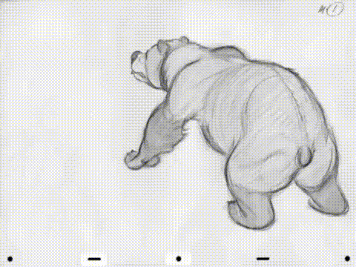
Frame Animation

Slide 2

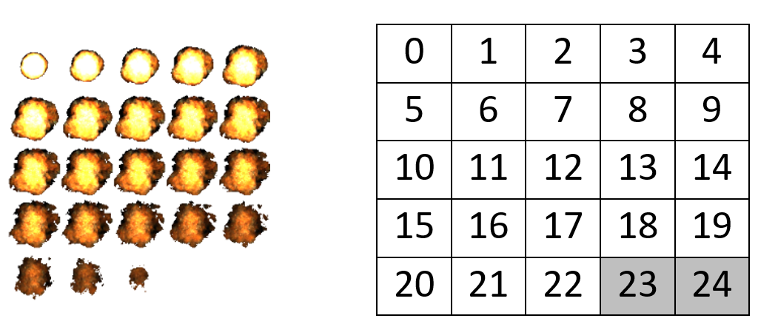
What is Frame Animation?
Frame animation in video games works the same as cartoons
  Display a sequence of images, called frames, over a period of time
  The speed of frame display is called the frame rate.
In video games, these frames are organized in a grid on a single image called a sprite sheet.
The frames are numbered starting at zero in the top left corner of the grid

Slide 3
About Sprite Sheets
Sprite Sheet images should be .png files so transparent backgrounds are possible
Each grid box (animation frame) in the sprite sheet should have the same dimensions
You will need to know key information about the sprite sheet grid:
  How many rows E.g. 5
  How many columns E.g. 5
  Number of used frames in the grid (frame count) E.g. 23

Slide 4
Where do the Sprite Sheets Come From?
There are a number of options to find, convert and create sprite sheets
Finding
  Online resources like: itch.io, Spriters Resource, Kenny’s Assets, Open Game Art
  A Google Search. E.g. “Running character sprite sheet”
Converting
  Convert from an animated gif to a sprite sheet: Online GIF Converter
Creating
  Easy to learn: Piskel
  More advanced tool: Photopea
  Various A.I. Tools

Slide 5

Animation 1.0
When the GameUtility was first created, the Animation library was written very quickly and was patched a number of times over the years.
However, over time it was found to be sometimes too cumbersome, limited and starting to show its age
This version of the Animation library is still in the GameUtility to ensure old software still works as intended
Going forward, everyone should be using the Animation 2.0 library. Simply called Anim

Slide 6

Animation 2.0: Anim
Anim is the redesigned and recoded Animation library that is more streamlined, capable and user friendly
It has a simpler structure to use that can be put to purpose faster compared to Animation 1.0
It also offers several enhancements and new functionality over Animation 1.0
For full details on what is possible with Animation 2.0 (Anim), see the
GameUtility Manual on our Google Classroom
Here you will find what it is, how it works and all of the possible options
and abilities with the library. Way more than we can go into here.

Slide 7
Using Anim: Setup and Storage
The First Step to using Anim is Setup and Preparation
  Ensure your image is suitable for use:
    A single animation per sprite sheet in a grid layout (although Anim does allow for multiple animations per sheet with some work)
    A transparent background and image format like .png that supports this
    No extra space around the used artwork, or within each frame of animation
    EVERY frame has matching widths and matching heights (same dimensions for each frame)
  Store the sprite sheets in the appropriate Builder/Assets project location
    Store them in your Builder/Assets/Images
      If they are an animated background they go in Backgrounds, otherwise store them in Sprites
  Rerun the Builder Program to compile your sprite sheet for use in your code

Slide 8
Using Anim: Basic Information Needed
To create an animation object, you need some key details, most of which can be found in the image:
  Number of Rows in the animation grid
  Number of Columns in the animation grid
  Number of Frames (frame count) in the full animation
  Duration the Animation should take to complete (in milliseconds)
  Number of times to repeat the Animation before stopping (repeat count), an int > 0 or use Anim.FOREVER
  Vector2 position of where the animation will start
  Start bool: true for immediate animation, false to trigger the animation later
  Size (Width and Height for one frame of animation to display as)
  Idle Frame Index (The frame to draw when the animation is inactive from 0 → frame count – 1, or Anim.NO_IDLE
  If a frame order other than 0 → frame count – 1 is wanted, record the frame index order desired to set later

Slide 9
Using Anim: Variables & Loading
For a basic animation, 3 variables are needed/recommended:
  A Texture2D to store the sprite sheet image
  A Vector2 to store the animations true position
  An Anim object to store the action Animation
In LoadContent:
  Load in the sprite sheet into the Texture2D
  Setup the location of the Vector2 position

Slide 10
Using Anim: Create Anim Object
The Basic Anim is meant to be simplified and then customized after setup.
As such, some data will have default values unless you choose to change them, these include:
  The frame sequence (specified by frame index numbers) – default sequence is 0 to frame count - 1
  Idle Frame Index – default is 0
  destRec (destination rectangle) frame dimensions (size) – default is image width and height
  Active bool (is animation immediately active or triggered later) – default it true
In Load Content, AFTER image is loaded and position is stored:
Create and store the Anim object into your created Anim object variable, e.g. fireAnim
  Generally: new Anim(Texture2D, rows, columns, frameCount, duration, repeatCount, position, active)
  For example: fireAnim = new Anim(fireImg, 6, 10, 60, 1000, Anim.FOREVER, firePos, true);

Slide 11
Using Anim: Set Optional Data
For example, assume you have an Anim named fireAnim
In LoadContent, AFTER the Anim Object has been created
Example 1: Set the idle frame index to NO_IDLE (instead of the default 0)
  fireAnim.IdleSeqIdx = Anim.NO_IDLE;
Example 2: Set the size of the animation to be half its original size
  fireAnim. SetSize(fireAnim.FrameWidth/2, fireAnim.FrameHeight/2);
Example 3: Set the size to screenWidth and screenHeight (for animated backgrounds) E.g. Anim called bgAnim
  bgAnim.SetSize(screenWidth, screenHeight;
Example 4: Set the animation sequence to be 0,1,2,3,2,1 (instead of just 0,1,2,3 for a 4-frame animation)
  fireAnim.SetFrameSequence(new int[]{0,1,2,3,2,1});
Example 5: Set the rotation angle of your animation (in radians), in this case to 45º = 0.785
  fireAnim.Angle = 0.785;

Slide 12
Using Anim – Update Logic
First, near the top of Update()
  Update all Animations: E.g. fireAnim.Update(gameTime);
Further down in Update in an appropriate location:
Optionally, this is also where you would perform various operations on the Anim objects. For example:
    Translate(float changeInX, float changeInY) ← Move the animation from its current location by specified amounts
    TranslateTo(float x, float y) OR TranslateTo(Vector2 pos)← Move the animation to a Specific point
    Angle = new angle ← Change the Anim’s rotation angle during gameplay
    OrbitRad(Vector2 orbitPoint, float radAngle, float orbitRadius) ← Orbit your Anim around a specified point given a radian angle
    OrbitDeg(Vector2 orbitPoint, float degAngle, float orbitRadius) ← Orbit your Anim around a specified point given a degree angle
    ResetAnim(bool activate) ← Restarts the animation in an ACTIVE or INACTIVE state
    TogglePause() ← Pause/Unpause an animation
    And so much more, check out the GameUtility Manual for more details!

Slide 13
Using Anim - Draw
There are two commands to Draw an Anim object, but multiple options for these commands
Option 1: Draw(SpriteBatch, Color, layerDepth, SpriteEffects)
  SpriteBatch and Color are required parameters, but layerDepth and SpriteEffects are optional
    E.g. fireAnim.Draw(_spriteBatch, Color.White)
  layerDepth can be used to modify what items are below and above others, typically 0 is used
  SpriteEffects is a collection of built in constants allowing you to flip your animation vertically or horizontally, use one of:
    SpriteEffects.None ← Draw in normal orientation
    SpriteEffects.FlipVertically ← Flips the image upside down
    SpriteEffects.FlipHorizontally ← Flips the image sideways
Option 2: DrawRotated(SpriteBatch, Color, bool centredRotation)
  This will draw an animation at its rotated angle (set previously), either rotated from its centre or its origin at its top left

Slide 14
Example: Fully Implement a Moving Animation called fireAnim
Global Variables
Texture2D fireImg;
Vector2 firePos;
Anim fireAnim;
Vector2 fireSpeed = new Vector2(150, -20); //Movement speed here is px/Sec.
LoadContent
fireImg = Content.Load<Texture2D>(“Images/Sprites/Fire”);
firePos = new Vector2(100,200);
fireAnim = new Anim(fireImg, 6, 10, 60, 1000, Anim.FOREVER, firePos, true);
fireAnim. SetSize(fireAnim.FrameWidth/2, fireAnim.FrameHeight/2);
Update
fireAnim.Update(gameTime);
firePos += fireSpeed * (float)gameTime.ElapsedGameTime.TotalSeconds;
fireAnim.TranslateTo(firePos);
Draw
fireAnim.Draw(_spriteBatch, Color.White);

Slide 15
Other Helpful Data in Every Anim Object (See Manual for More!)
Public Constants you can access
Animation States
public const int INACTIVE = 0
public const int ACTIVE = 1
public const int PAUSED = 2
public const int FINISHED = 3
Animation repetition and idle options
public const int FOREVER = -1
public const int NO_IDLE = -1
Rotation options for directional facing relative to orbital rotational centre
public const int DEFAULT = 0
public const int TOWARDS = 1
public const int AWAY = 2
Various Properties (Get on ALL, Set with = on some)
int State = INACTIVE //get only
int RepeatCount //get, set (Anim.FOREVER for infinite animation)
Vector2 Pos //get only
float Angle = 0f //get, set (Angle in radians)
Rectangle DestRec //get only (Draw box & Hit box when unrotated)
Rectangle Hitbox //get only (Hit box used for rotated Animations)
int SequenceIdx //get, set (0 -> frameSequence.Length-1)
int IdleSeqIdx //get, set (Anim.NO_IDLE or index from 0 -> frameSequence.Length-1)
int CurFrame //get only
Vector2 ScaleFactor //get only
int FrameWidth = 0 //get only
int FrameHeight = 0 //get only
int Duration = 1000 //get + set (>= 16)
string AnimName = "“ //get only

