Slide 1
Introduction to Programming
Review for Veterans – Overview for Rookies

Slide 2

The Basics
What is a program?
  An ordered series of steps to achieve a goal
    E.g. Microsoft Word, Fortnite, Google Chrome
This is similar to a recipe; the steps must be followed in order and precisely to get the correct final product
Another term for programming instructions is code. For example, we may say: “how many lines of code is your program?”

Slide 3
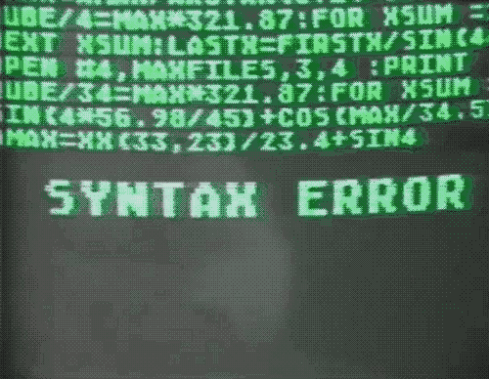
The Basics
What is a programming language?
  An artificial language, like English, designed to give instructions to a computer
    This language is made up of special words called keywords.
    Think of this like an English dictionary, if you try to use a word not in the dictionary on an essay you would get an error.
    The language must follow a set of rules, in English we call these rules grammar. In programming we call this set of rules the Syntax
      Syntax is the set of rules and formatting that govern programming instructions to ensure their validity so they can be recognized by the computer.
Examples of programming languages
  Turing, C, C#, C++, Java, Basic, HTML, Python, Cobol, Fortran

Slide 4
The Basics
What application do we use to write our programs?
  Typically, an Integrated Development Environment (IDE)
    Although, it is possible to write your programs in simple applications like Notepad, more applications would be required to run the code
  Most languages have their own unique IDE. For example, Java programmers tend to use eclipse, where C/C#/C++ programmers lean towards Visual Studio, or more recently Visual Studio Code (VS Code).

Slide 5
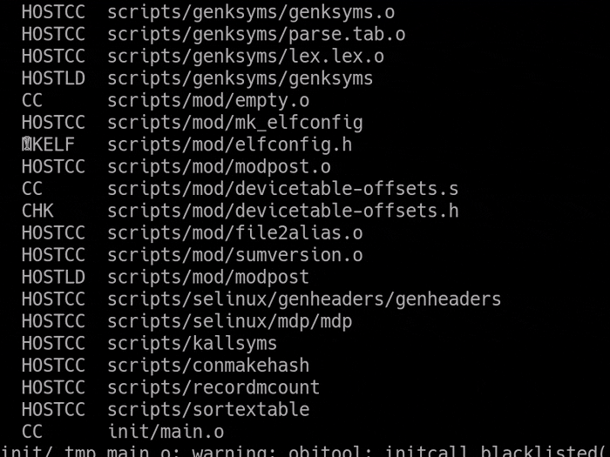
The Basics
How does a computer understand our code?
  It doesn’t…
We must use a translation tool called a compiler, which translates our instructions (source code) into binary (machine code), the only language computers understand.
A compiler is like what two people that speak different languages would require to communicate to one another

Slide 6







The Flow of Creating a Program
Gather information to know final goal and
specifications
Design the program and User Interface
according to your specifications
Write code in the IDE or editor
Compile code to binary
Test your code to meet specifications
Repeat steps 2 through 5 as necessary
Release your program to users
Support by fixing bugs, updating and releasing
expansions/downloadable content (DLC)
}Combined in IDE

Slide 7
Our Normal IDEs
In most years we use Visual Studio/VS Code for C# and eclipse for Java which are very powerful tools with a lot of capabilities:
  You can program in various languages
  A compiler is built-in to translate and test our code
  Colour based text highlighting to show different types of keywords
  A great autocomplete tool called intellisense
  The ability to pause running code and step through it one line at a time using a built-in error handling tool called a debugger
  It will give you fixing hints both when you try to compile as well as when you run (execute) your code.

