Slide 1
Translation…kinda
Scrolling Screens

Slide 2
What is it
A scrolling screen is a mechanism used by game programmers and animators for decades, and more recently, web developers as well.
We have to flip our thinking. We are used to translating the player through the game world. A scrolling screen does the opposite.
By having the player remain in one spot (stationary) on the screen and moving the background in a specified direction behind the player it gives the illusion the player is moving.
This is used in most platforming games like Super Mario Bros. but also in many modern mobile games like Jetpack Joyride or Flappy Bird.

Slide 3
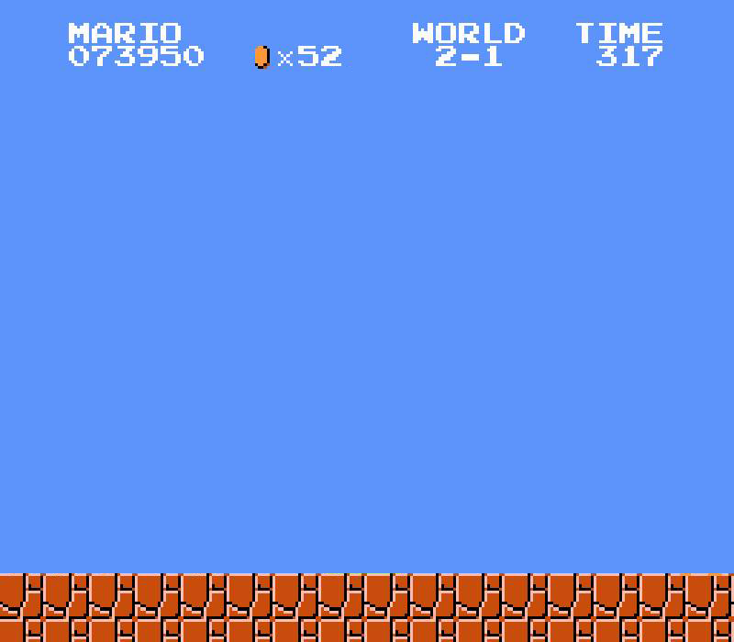
How it works
It is simple in concept, but can be used to produce a variety of effects
You need a background image that matches up on their ends, so the end of one is the beginning of the next as well.
This is so when they are lined up side by side you do not see a seam

Slide 4
How it works
Once you have found your background image, you need to load it into two separate Texture2D variables, as well as setup 2 destination rectangles and 2 Vector2 variables to store their true positions.
One will be located on the screen as normal, the other starting at the edge of the screen.
  So if you were creating a screen scrolling to the left, it would be located to the right with an x value of screenWidth (assuming you set it up)
Now, in Update() it is just a matter of moving both images every update by a desired “speed” the same way we translate any object. You will need to define speedMax and speed variables to track speed per second and speed per update.

Slide 5
How it works
Follow the same translation steps as always, with one addition:
1) Calculate the speed per update:
  speed = dir * speedMax * gameTime.ElapsedGameTime.TotalSeconds;
    dir will be -1 when the player is moving right and 1 when they move left
2) Add the speed to BOTH background true positions
3) Test both backgrounds to see if they have fully left the screen in either direction (<= -screenWidth or >= screenWidth)
  If so, add or subtract 2 * screenWidth to shift them to the opposite side
4) Set both background destination rectangle’s position to the true position variables (casted to ints)

Slide 6
The Conveyor Belt (Step 3)
Now we will set up a revolving conveyor belt of the two images.
As they both move to the side, eventually one will be totally off screen with an x value of <= -screenWidth or >= screenWidth
When this occurs move it to the opposite side of the screen, by adding or subtracting 2 screenWidths to it.
Do this same check for both images and they will alternate, creating the conveyor belt.
//Compare true positions for being fully offscreen
if (bg1Pos.X <= -screenWidth) { bg1Pos.X += 2 * screenWidth; } else if (bg2Pos.X <= -screenWidth) { bg2Pos.X += 2 * screenWidth; } | if (bg1Pos.X >= screenWidth) { bg1Pos.X -= 2 * screenWidth; } else if (bg2Pos.X >= screenWidth) { bg2Pos.X -= 2 * screenWidth; }

Slide 7
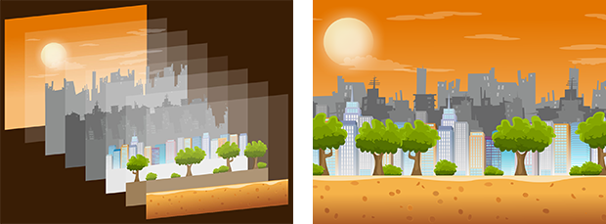
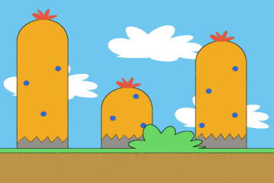
What else can you do?
Using this effect you can create a variety of results
By adding multiple layers of background moving at different speeds you can create an illusion of varying depths. This is called parallax.
  Have your farthest items at the back moving the slowest
  Gradually speed up as you come closer to the front
By using blurred images farther back you can create a depth of field, forcing the players eyes on the items in focus.

