Slide 1
String Manipulation
The Basics

Slide 2
Introduction
String manipulation is made up of two facets:
  Inspecting a string for certain traits (String analysis)
  Modifying a string into something new (String manipulation)
The next couple of lessons will cover many of these operations, but know that there are many more. See HERE for details
The key to working with string methods is that it is very similar to working with Convert methods and most Math methods.
  You are never manipulating the original string, as it is not changed. Instead, we create a new string that we can choose to use immediately or store for later.

Slide 3
What is a string exactly?
Remember from past lessons that strings are stored in memory as a collection of individual characters with an address, called an index.
The analogy we used in class was the hanging
“H-A-P-P-Y_B-I-R-T-H-D-A-Y” signs we see at birthday parties.
  Each character has a set position, and it cannot be reorganized
When we speak of manipulating a string, in truth, we are NOT changing the original string at all. We are making a new one!
  Then it is up to us to either store it in a new variable or overwrite the original
H | e | l | l | o |  | W | o | r | l | d | !
0 | 1 | 2 | 3 | 4 | 5 | 6 | 7 | 8 | 9 | 10 | 11

Slide 4
Explanation through Example
For each of the string commands you will be given a description and a small code example to demonstrate its use.
For each of the examples, assume we have previously setup the following code in the program:
string word = “Hello World!”;
string phoneNumber = “(555)-123-4567”
string newWord; ← Used to hold modified versions of word after manipulation

Slide 5
Inspection Operations
string word = “Hello World!”;
string phoneNumber = “(555)-123-4567”
string newWord;
We can inspect a string and look for certain traits, like length for example
Command | textA[index] where textA is a string literal or variable
Description | Gets a char version of the character in textA at index
Example | Console.Write(“Character: ” + word[6]); ← word[6] is ‘W’ Displays “Character: W”
Command | textA.Length
Description | Gets the number of characters in textA, including spaces
Example | Console.Write(“Length: ” + word.Length); Displays “Length: 12”
Command | textA.Contains(string textB)
Description | Does a true/false check to see if textB exists inside textA
Example | Console.Write(“Contains lo: ” + word.Contains(“lo”)); Displays “Contains lo: True”

Slide 6
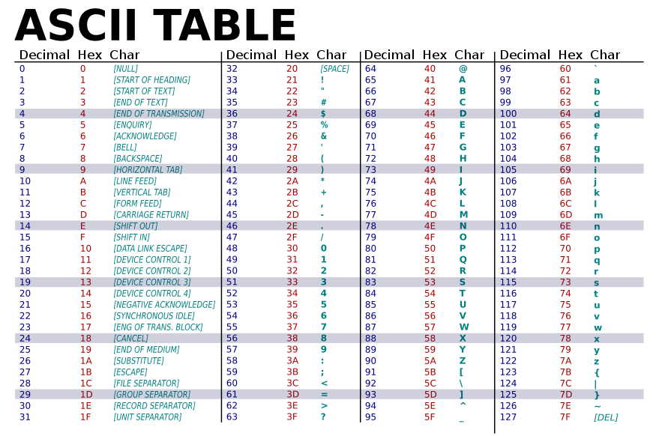
Text Representation in Computers
We know that computers cannot understand English
Characters are represented on the computer as numbers
Every character has a specific associated number
We can find these numbers in the Decimal column on ASCII (Ask-ee) table shown here

Slide 7
Text Representation in Computers
We can convert back and forth between the integer number and character versions with simple casting
NOTE: This only works on char data types, not strings
4 Examples:
int charNum = 121; //store ASCII number for ‘y’
char charLetter = (char)charNum; //Store the char ‘y’ in charLetter
Console.WriteLine((char)charNum); //Display y directly on the screen
string name = “Fred”;
Console.WriteLine((int)name[0]); //Retrieves the first letter, ‘F’ and Displays its ASCII value, 70
char charLetter = ‘y’
int charNum = (int)charLetter; //Stores the ASCII value of ‘y’, 121 in charNum
Console.WriteLine((int)charLetter); //Displays the ASCII value of ‘y’ on the screen
string name = “Fred”;
int charNum = (int)name[2]; //Retrieves the third letter, ‘e’ and stores its ASCII value, 121
int shiftedLetter = charNum + 2; //Shift the ASCII number 2 forward to 123
Console.WriteLine((char)shiftedLetter); //Displays the char for ASCII 123, ‘g’ on the screen

Slide 8
Convert Char to String
There may be times where you have a char but need it to be a string. Maybe to compare it to a string or possibly in hopes of concatenation.
Concatenating two chars will add their two ASCII values, not concatenate! Something you most likely do not want.
Example:
string word = “Fred” ← We know word[0] would really be ‘F’ → 70
Console.WriteLine(word[0] + word[1]); ← 70 + 114 and writes 184
Console.WriteLine(word[0].ToString() + word[1].ToString()); ← writes Fr
OR, you could use concatenation instead of the ToString() method
Console.WriteLine(“” + word[0] + word[1]); ← writes “Fr”

Slide 9
Inspection Operations
string word = “Hello World!”;
string phoneNumber = “(555)-123-4567”
string newWord;
Command | textA.IndexOf(string textB)
Description | Gets the index where textB is first found from the left in textA, or -1 if it is not found
Example | Console.Write(“Index of or: ” + word.IndexOf(“or”)); Displays “Index of or: 7” Console.Write(“Index of w: ” + word.IndexOf(“w”)); Displays “Index of w: -1” ← little w does not exist in the string so -1 is returned
Command | textA.LastIndexOf(string textB)
Description | Gets the index where textB is last found from the left in textA, or -1 if it is not found
Example | Console.Write(“Last Index of l: ” + word.LastIndexOf(“l”)); Displays “Last Index of l: 9”

Slide 10
Inspection Operations
string word = “Hello World!”;
string phoneNumber = “(555)-123-4567”
string newWord;
Command | textA.CompareTo(string textB)
Description | Alphabetically compares textA against textB and indicates which comes first: -1 result means textA is first, 0 means they are the same, 1 means textB is first
Example | Console.Write(“What’s first: ” + word.CompareTo(“abc”)); ← Displays “What’s first: 1” This command is tricky, normally lowercase comes before uppercase, but only if the letters do not match at all: E.g. “Hi” vs. “hi” → “hi” comes first E.g. “He” vs “hi” → “He” comes first, the “e” beats the “i”
Command | textA.Equals(textB)
Description | Does a true/false check to see if textA and textB have the exact same value
Example | Console.Write(“Same: ” + word.Equals(phoneNumber)); Displays “Same: False”

