Slide 1
Basic Design
IPO Charts

Slide 2
Design Intro
A computer only does 4 basic operations, which follows the acronym I.P.S.O.
INPUT: Reads data from the user into the computer
PROCESSING: Manipulates or changes that input data
STORAGE: Stores the results of the processing for later user
OUTPUT: Gives feedback to the user informing them of the results

Slide 3
Design Intro
Typically Processing and Storage occur together, so we can shorten the acronym to I.P.O.
  Input
  Processing & Storage
  Output
Nearly every program you create in this course will follow these basic operations in that order exactly.
As the programs grow in scale you may repeat this process multiple times in the same program.

Slide 4
Design Intro
So when faced with a problem to solve, it is a two stage procedure:
  Brainstorm what is done in each of the I, P, and O portions of the program. To do this we will use a graphical organizer called an IPO Chart
  Program each of the I, P, O portions in order, column by column from top to bottom…that’s it.
    Meaning, fully do your Input column from top to bottom, before moving to the next column to program it, top to bottom
It is important to realize that all forms of design are meant to be language independent
  Meaning there should be no ties to any specific programming languages
  This means, no code should ever appear
  You should be able to hand your design to a programmer of any language and they will then interpret the correct commands to use in their chosen language

Slide 5
IPO Charts
They are called IPO charts because this acronym represents the column headers of the chart
So what goes in each column?
VARIABLES LOGIC FEEDBACK
You may need to do processing that the existing Keywords do not describe, e.g. rounding. Make up your own keywords that are clear and intuitive.
E.g. SET displayNum = ROUND(num)
INPUT (Input, calculation variables and constants) | PROCESSING & STORAGE (Data Retrieval and Logic) | OUTPUT (Final Text Feedback only, NOT prompts)
This column consists of:
  Constants
  Input variables
  Calculation variables
This column consists of Program logic
(not code, but rather simple instructions)
  Data Request and Retrieval
  Calculations
  Comparisons
  Or any other required actions
This column consists of the EXACT text
(or other form of output) that is to be
shown to the user as feedback
NOT INPUT PROMPTS, just FEEDBACK
This section helps us determine the name and type of required constants and variables
Use quotations and concatenation if
needed
For EACH variable, give a type and
a descriptive name, like a definition
  E.g. double classAverage
For constants, use CAPS and assign it a value (no const needed, that is code)
  E.g. double GRAVITY = 9.81
The logic should be in order, meaning Data
Request and Retrieval should almost
always be first.
Use one bullet for each piece of processing
Keywords to use: DISPLAY
Example:
DISPLAY “The area of the circle is” + circleArea
Keywords to use: ASK/READ, SET,
CALCULATE, INCREMENT, DECREMENT

Slide 6
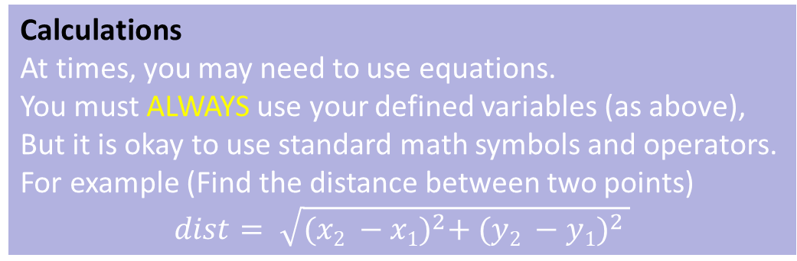
Example Program Design
Create a program that will calculate difference in travel time from earth to mars between a rocket and a light speed laser. To do this, you will ask the user for the speed of the rocket in km/s. You know that the speed of light is about 300 000 km/s and mars is about 63 million km away. Report your findings.
INPUT (Input, calculation variables and constants) | PROCESSING & STORAGE (Data Retrieval and Logic) | OUTPUT (Final Text Feedback only, NOT prompts)
double LIGHT_SPEED = 300000
double MARS_DIST = 63000000
ASK/READ rocketSpeed
DISPLAY “Rocket travel time” +
rocketTime + “s.”
DISPLAY “Light travel time” +
lightTime + “s.”
DISPLAY “The rocket took ” +
timeDiff + “ more seconds”
CALCULATE rocketTime = MARS_DIST / rocketSpeed
CALCULATE lightTime = MARS_DIST / LIGHT_SPEED
CALCULATE timeDiff = rocketTime - lightTime
double rocketSpeed
double rocketTime
double lightTime
double timeDiff
Calculations
At times, you may need to use equations.
You must ALWAYS use your defined variables (as above),
But it is okay to use standard math symbols and operators.
For example (Find the distance between two points)
$$dist= \sqrt{{(x2 −x1)}^{2}+ {(y2 −y1)}^{2} }$$

