Slide 1
Errors in Programming
a.K.A. Bugs

Slide 2
Introduction
Now that we have completed a little over half of the course you have had your own experience in dealing with errors
Today’s lesson will focus on identifying the 3 types of errors and what we can do to solve them

Slide 3
Types of Errors: Compiler Errors (also known as Syntax Errors)
Errors that prevent your program from running, occur as a result of bad syntax
These are the most common types of errors, but usually the easiest to fix
Most compiler errors are caused by mistakes that you make when typing code
  E.g. Forgetting a semi-colon or a bracket, or spelling a word incorrectly
  For example: You may misspell a keyword, leave out some necessary punctuation, or try to use a variable before it is defined
    E.g. bol testVariable; ← Here bool is misspelled

Slide 4
Find the Compiler Errors
ERRORS
int phoneNumber;
int age = 21;
phneNumber = 4165551234;
If (age => 18)
WriteLine(You are over 18)
}

Slide 5
Types of Errors: Runtime Errors
Errors that occur while your program runs, usually when your program attempts an impossible operation, e.g. Convert “boat” to int
These errors cause our programs to crash while running, not nice…
Common Examples:
  Divide an int or byte by Zero (dividing a double by 0 gives the value infinity)
  Trying to convert incompatible data
    E.g. “boat” or “6.7” to an int
  Trying to access an index of a string that does not exist
    E.g. IF String word = “Hello” then word[10] would be a runtime error
  A Stack overflow error (running out of memory) – we won’t see this much, yet

Slide 6
Find the Runtime Errors
ERRORS
//Assume the user typed 685.50
int payPerHour = 0;
int totalPay = 0;
int hours = 0;
Console.Write(“How much money did you earn: ”);
totalPay = Convert.ToInt32(Console.ReadLine());
payPerHour = totalPay / hours;
Console.WriteLine("Your pay is $" + payPerHour + "per hour");

Slide 7
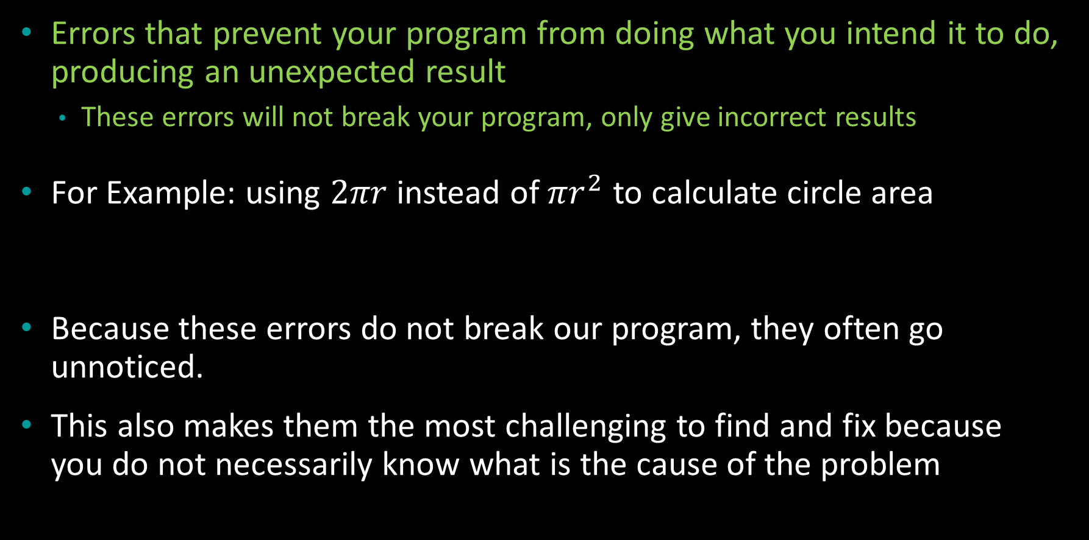
Types of Errors: Logic Errors ☹
Errors that prevent your program from doing what you intend it to do, producing an unexpected result
  These errors will not break your program, only give incorrect results
For Example: using $2πr$ instead of $πr^{2}$ to calculate circle area
Because these errors do not break our program, they often go unnoticed.
This also makes them the most challenging to find and fix because you do not necessarily know what is the cause of the problem

Slide 8
Find the Logic Errors
double radius = 0;
double area;
area = 2 * Math.PI * radius;
Console.WriteLine(“The area is: ” + radius);
radius is still 0, it needs a proper value
Wrong equation, PI * radius²
Wrong variable displayed

Slide 9
Tips to Solve Errors
Compiler Errors
  Always start with the top error
  Fix one error at a time, then test again…many may disappear
Runtime/Logic Errors
  A runtime error will tell you where the issue was in the error message
  A logic error you have to discover it exists, then track down the line with the problem
  For both types of errors we use the same techniques:
    Analyse the line with the error on it by looking at the method calls and the data give to those methods
      Check their type first, then their values
      Work your way backwards until you found how the value was determined to find the issue
      Step through your code one line at a time
      Make use of temporary output statements to display variable values (or use Variable windows if you are using Visual Studio or Eclipse to write code)

