Slide 1

Web Design Fundamentals
PROJECT
DATE
WEEK 13
CLIENT
MARK DODGSON

Slide 2
Document Strucure

Slide 3

Document Structure
<!DOCTYPE html>
<html>
<head>
<title>Title of page</title>
</head>
<body>
</body>
</html>

Slide 4
Using the “div” tag to create HTML structure

Slide 5
Using the “div” tag
<div></div>
<div class=”header”>
</div>
.header {
width: 300px;
height: 300px;
color: red;
}

Slide 6
Linked & Embedded
Stylesheets

Slide 7

Embedding CSS Styles
Embedded Styles (added in the head tags)
Embedded styles only apply to
the HTML on the current page.
<style type=”text/css”>
p { color: red; }
h1 { color: blue; }
</style>

Slide 8
Linked CSS Stylesheets
Linked Style Sheet (separate page)
<link href="global.css" rel="stylesheet" type="text/css" />
Linked Style Sheet are named with
a .css extention (ie. global.css)
Linked Style Sheet are added in the head tags
Linking a style sheet means that you can control the presentation of site consisting
of multiple pages from 1 file.

Slide 9
CSS Syntax

Slide 10
CSS Syntax
p {
color: red;
}
.header {
background-color: red;
}
#wrapper {
width: 960px;
}

Slide 11
Hyperlinks

Slide 12
Hyperlinks
Hyperlinks have an opening and a closing tag
<a href=”http://www.mohawkcollege.ca”>link</a>
They are inline tags

Slide 13
Hyperlinks
Absolute path hyperlinks
Relative path hyperlinks
Email hyperlinks

Slide 14
Absolute Path Hyperlinks
They are the full path including the protocol
http://www.mohawkcollege.ca

Slide 15
Relative Path Hyperlinks
These are links within your folder structure. They are relative to the location of your current page.
They are not links to external websites
products/computers.html

Slide 16
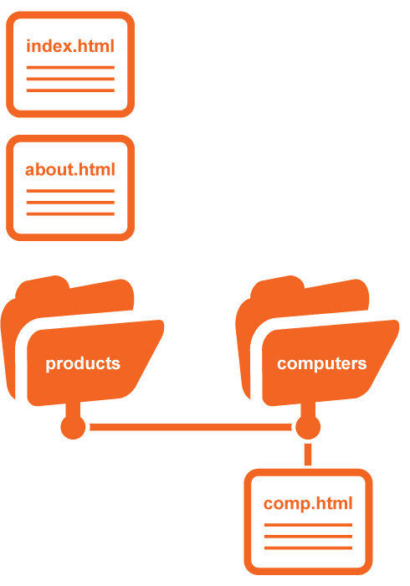
Moving Forward
(link from index.html or about.html to comp.html)
products/computers/comp.html
Moving Backwards
(link on comp.html
links to index.html)
../../index.html

Slide 17
Email hyperlinks
These are links to an email address.
<a href=”mailto:info@mohawkcollege.ca”>Email Us</a>
They can also contain subject line information
<a href=”mailto:info@mohawkcollege.ca?subject=Looking For Information”>Email Us</a>

Slide 18
Creating Horizontal
Site Navigation

Slide 19
Creating Horizontal
Site Navigation
<ul>
<li><a href=”index.html”>Home</a></li>
<li><a href=”about.html”>About</a></li>
<li><a href=”mailto:info@mohawkcollege.ca”>Contact</a></li>
</ul>
To make the navigation horizontal you need
to add the “display” property to the “li” tag.
If you have added a CSS “Reset” file the bullets may not show up. To add them,
you would have to add the “list-style-type” property to the “li” tag.
li {
display: inline;
list-style-type: disc;
}

Slide 20
Adding Images

Slide 21
Adding Images
Adding an images is very similar to adding a hyperlink. You can add an image in a couple of ways, which include Absolute & Relative paths.
Image tags are similar to <br /> and <hr />
in that they self terminate. The closing tag
is built in.
<img src=”http://www.mohawkcollege.ca/images/photo.jpg” />
<img src=”images/photo.jpg” />

Slide 22
Comments in HTML & CSS

Slide 23
Comments in HTML & CSS
HTML
<!-- this is my comment -->
CSS
/* This is my comment */

Slide 24
CSS Floats

Slide 25
CSS Floats
HTML normally flows content from the top
of the browser to the bottom stacking each element on top of each other.
The float property allows you to position
content by moving it to the right or left.
It also allows other content to flow around items such as images.

Slide 26
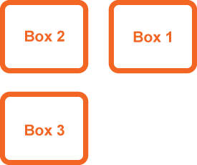
CSS Floats
.box1 { float: right; }
Box 1 is now floating and is taken out of
the regular flow of the document. Box 2 & 3 now move up to fill the space that the floated element used to occupy.
Floating an element removes it from normal document flow.

Slide 27

CSS Floats
.box1 { float: left; }
Box 1 is now floating and is taken out
of the regular flow
of the document.
Box 2 & 3 see this
as empty space
and move up to
fill it, hiding box 2
behind box 1.

Slide 28
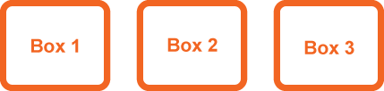
CSS Floats
div { float: left; }
Floating a series
of divs would put
them side-by-side.
This technique is commonly used with navigation, by turning a list of links into
a horizontal menu.
This technique is used to create columns.

Slide 29
Positioning

Slide 30
Positioning
Relative
Absolute
Fixed
Static
Inherit

Slide 31
Positioning (Relative)
Positioning an element “Relative” keeps
it within the normal flow of the document.
A relative positioned element is positioned
relative to its normal position.
You can use top or bottom, and left or right to move the element relative to where it would normally occur in the document.

Slide 32
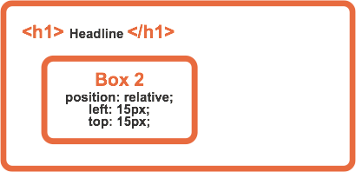
Positioning (Relative)
div {
position: relative;
top: 15px;
left: 15px;
}

Slide 33
Positioning (Absolute)
Positioning an element “Absolute” takes it out of the normal flow of the document (similar to floats).
To position an item “absolute” it needs to be
within an element that has “relative” positioning.
By default the browser has relative positioning.
An absolute position element is positioned relative to the first parent element that has a position of relative. If no such element is found, the containing block is <html>.

Slide 34
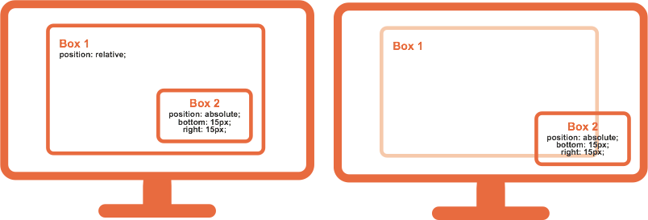
Positioning (Absolute)
Box 1 has been given position:relative;
Box 2 is now relative to Box 1
Box 1 doesn’t have
any positioning
Box 2 is now relative to the next item that is relative. In this case it’s the browser window.

Slide 35
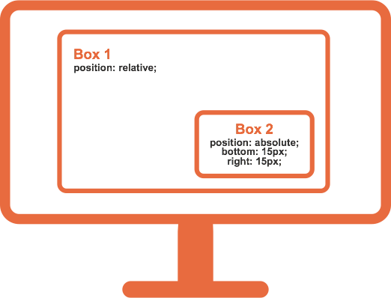
Positioning (Absolute)
div {
position: absolute;
bottom: 15px;
right: 15px;
}

Slide 36
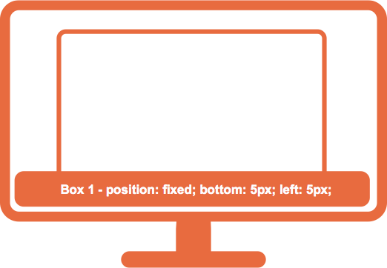
Positioning (Fixed)
An element with fixed position is positioned relative to the browser window.
It will not move even if the window is scrolled:

Slide 37
Background Property

Slide 38
Background Property
CSS background properties are used to
define the background effects of an element.
Backgrounds add Colour and Images
behind the elements content.

Slide 39
Background Properties
CSS properties used for background effects:
background-color: blue;
background-image: url(images/pattern.jpg);
background-repeat: repeat-x;
background-position: top;

Slide 40

Background Property
You can control the position of an image
div {
background-image: url(star.jpg);
background-repeat: no-repeat;
background-position: bottom right;
}

Slide 41

Background Property
You can control the position of an image
div {
background-image: url(star.jpg);
background-repeat: repeat-x;
}

Slide 42
Properties to remember

Slide 43
Properties to remember
width: 960px;
height: 400px;
color: red;
background-color: black;
border-bottom: 5px solid;
margin: 0 auto;
margin-top: 20px;
padding: 20px;
display: inline;
float: left; (right)
clear: both;
position: absolute; (relative)
list-style-type: disc; (if a reset is being used)

Slide 44
Things To Remember

Slide 45
Things To Remember
Double check your spelling.
If you open a tag it must close.

