Slide 1

Web Design Fundamentals
PROJECT
DATE
WEEK 4
INSTRUCTOR
MARK DODGSON

Slide 2


Topics
Week Three Recap.
How to add images
Anatomy of a CSS style
How to embed CSS styles
How to write CSS styles

Slide 3
Hyperlinks

Slide 4
Hyperlinks
Hyperlinks have an opening and a closing tag
<a href=”http://www.mohawkcollege.ca”>link</a>
They are inline tags

Slide 5
Hyperlinks
Absolute path hyperlinks
Relative path hyperlinks
Anchor tag hyperlinks
Email hyperlinks

Slide 6
Absolute Path Hyperlinks
They are the full path including the protocol
http://www.mohawkcollege.ca

Slide 7
Relative Path Hyperlinks
These are links within your folder structure. They are relative to the location of your current page.
They are not links to external websites
products/computers.html

Slide 8

Moving Forward
(link from index.html or about.html to comp.html)
products/computers/comp.html
Moving Backwards
(link on comp.html
links to index.html)
../../index.html

Slide 9
Anchor Tag Links

Slide 10
Anchor Tag Hyperlinks
These are links to content within the
same page you are currently viewing.
There are 2 components,
the hyperlink and the named anchor.
You need to create a named anchor for a particular section. <a name="tips"></a> or <a name=”tips” />
To link to the specific section you
create a hyperlink using a fragment.
<a href="#tips">Visit The Tips Section</a>

Slide 11
Email Hyperlinks

Slide 12
Email hyperlinks
These are links to an email address.
<a href=”mailto:info@mohawkcollege.ca”>Email Us</a>
They can also contain subject line information
<a href=”mailto:info@mohawkcollege.ca?subject=Looking For Information”>Email Us</a>

Slide 13
Adding Images

Slide 14
Adding Images
Adding an images is very similar to adding a hyperlink. You can add an image in a couple of ways, which include Absolute & Relative paths.
Image tags are similar to <br /> and <hr /> in that they self terminate. The closing tag is built in.
<img src=”http://www.mohawkcollege.ca/images/photo.jpg” />
<img src=”images/photo.jpg” />

Slide 15
Adding Images
Images are required by the specifications
to include the “Alt tag”.
<img src=”photo.jpg” alt=”this is a logo” />
Images should include a title.
<img src=”photo.jpg” alt=”this is a logo” title=”this is the title” />
Images should include the dimensions.
<img src=”photo.jpg” alt=”this is a logo” title=”this is the title” width=”125” height=”50” />

Slide 16
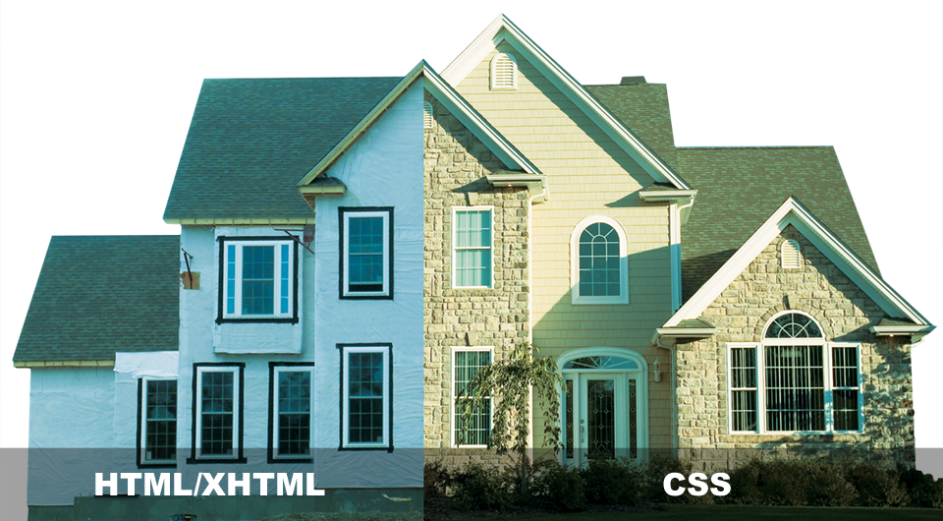
Applying CSS
PROJECT
DATE
WEEK 4
INSTRUCTOR
MARK DODGSON

Slide 17
What is CSS?
Cascading Style Sheets is a style sheet language developed to control the presentation of markup language documents.
CSS is a collection of formatting rules.

Slide 18
Anatomy of a CSS Style

Slide 19
Anatomy of a CSS Style
Selector
Declaration Block
p { color: red; }
Property
Value

Slide 20
Anatomy of a CSS Style
CSS styles have a Selector and a Declaration Block which has Properties and a Values
The selector is the HTML tag
that you want to modify (ex. <p>)
The Declaration is what you want to apply
to the HTML tag (ex. color: yellow;)
Each Declaration has a Property such
as color and a value such as red

Slide 21
Anatomy of a CSS Style
p {
color: red;
}
p { color: red; }

Slide 22
Anatomy of a CSS Style
p {
color: red;
font-size: 13px;
font-family: arial;
}
p { color: red; font-size: 13px; font-family: arial; }

Slide 23
Element Selectors

Slide 24
Element Selectors
These are very broad and would apply
to all p, h1 or in this case ul elements.
p { color: red; }
h1 { color: red; }
ul { color: red; }

Slide 25
Class Selectors
Classes are html attributes that can be added to any html element.
You name the class anything you want.
You can apply it as many times
on a page as you want.
HTML
<h2 class=”subhead”>My Subhead</h2>
CSS
.subhead { color: red; }

Slide 26
ID Selectors
ID selectors are similar to class selectors except for 1 very important difference. An ID must be unique to the page. If you ad an ID to an HTML element, no other element on the page can have that same ID.
HTML
<h2 id=”wrapper”>My Subhead</h2>
CSS
#wrapper { font-size: 13px; }

Slide 27
HTML Example
p { color: red; }
h1 { color: blue; }
<html>
<head>...</head>
<body>
<p>Some content</p>
<h1>Heading</h1>
<p>More content</p>
</body>
</html>

Slide 28
Embedding CSS Styles

Slide 29
Embedding CSS Styles
Embedded Styles (added in the head tags)
<style type=”text/css”>
p { color: red; }
h1 { color: blue; }
</style>

Slide 30
CSS Cascade (Hierarchy)

Slide 31
CSS Cascade (order)
(VERY IMPORTANT)
Styles are read by the browser
from TOP to BOTTOM or in the
order they are applied.

Slide 32
CSS Cascade (order)
If you link 2 CSS style sheets in the head tag, the 2nd style sheet takes presidence.
The last style in the style sheet takes presidence
over earlier versions of the style.
(ex. If you write a style for an <h1> tag and then you write another style for <h1> further down in the style sheet, the second version of the style is the one that will take presidence)
If you link a style sheet that has a style for an <h1> tag, and you apply an inline style to the <h1> tag within the document the inline style will take presidence.

Slide 33
2 New Generic HTML Tags

Slide 34
Generic HTML Tags
DIV is a block level tag
<div> Content goes Here </div>
SPAN is an inline level tag
<span> Content goes Here </span>
By default they don’t do anything.
With CSS you have the ability to
make them do whatever you like.

Slide 35
HTML Example
<html>
<head>...</head>
<body>
<div class=”sidebar”>
<h1>Heading</h1>
<p>More content</p>
</div>
</body>
</html>
.sidebar { width: 75px; }

