Slide 1

Web Design Fundamentals
PROJECT
DATE
WEEK 5
INSTRUCTOR
MARK DODGSON

Slide 2


Topics
Week Four Recap.
Writing CSS Targeting Selectors
Types of Selectors
CSS Cascade (Order)
CSS Shorthand (Margins)

Slide 3
Adding Images

Slide 4
Adding Images
Adding an images is very similar to adding a hyperlink. You can add an image in a couple of ways, which include Absolute & Relative paths.
Image tags are similar to <br /> and <hr /> in that they self terminate. The closing tag is built in.
<img src=”http://www.mohawkcollege.ca/images/photo.jpg” />
<img src=”images/photo.jpg” />

Slide 5
Adding Images
Images are required by the specifications
to include the “Alt tag”.
<img src=”photo.jpg” alt=”this is a logo” />
Images should include a title.
<img src=”photo.jpg” alt=”this is a logo” title=”this is the title” />
Images should include the dimensions.
<img src=”photo.jpg” alt=”this is a logo” title=”this is the title” width=”125” height=”50” />

Slide 6
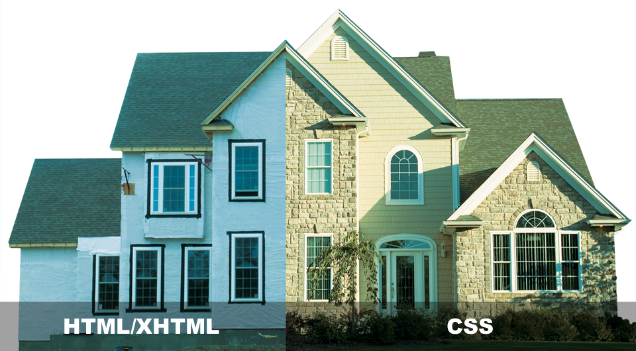
Applying CSS
PROJECT
DATE
WEEK 4
INSTRUCTOR
MARK DODGSON

Slide 7
What is CSS?
Cascading Style Sheets is a style sheet language developed to control the presentation of markup language documents.
CSS is a collection of formatting rules.

Slide 8
Anatomy of a CSS Style

Slide 9
Anatomy of a CSS Style
Selector
Declaration Block
p { color: red; }
Property
Value

Slide 10
Anatomy of a CSS Style
p {
color: red;
font-size: 13px;
font-family: arial;
}
p { color: red; font-size: 13px; font-family: arial; }

Slide 11
Element Selectors

Slide 12
Element Selectors
These are very broad and would apply to all p, h1 or in this case ul elements.
p { color: red; }
h1 { color: red; }
ul { color: red; }

Slide 13
Class Selectors

Slide 14
Class Selectors
Classes are html attributes that can be added to any html element.
You name the class anything you want.
You can apply it as many times on a page as you want.
HTML
<h2 class=”subhead”>My Subhead</h2>
CSS
.subhead { color: red; }

Slide 15
ID Selectors

Slide 16
ID Selectors
ID selectors are similar to class selectors except for 1 very important difference. An ID must be unique to the page. If you ad an ID to an HTML element, no other element on the page can have that same ID.
HTML
<h2 id=”wrapper”>My Subhead</h2>
CSS
#wrapper { font-size: 13px; }

Slide 17
HTML Example
p { color: red; }
h1 { color: blue; }
<html>
<head>...</head>
<body>
<p>Some content</p>
<h1>Heading</h1>
<p>More content</p>
</body>
</html>

Slide 18
Embedding CSS Styles

Slide 19
Embedding CSS Styles
Embedded Styles (added in the head tags)
<style type=”text/css”>
p { color: red; }
</style>

Slide 20
CSS Cascade (order)

Slide 21
CSS Cascade (order)
(VERY IMPORTANT)
CSS cascade is very important when you want to style a very specific element on a page.
HTML
<p><em>copy to come</em></p>
<div>Here is some <em>copy</em></div>
CSS
div em { color: red; }

Slide 22
CSS Shorthand

Slide 23

CSS Shorthand
div {
margin-top: 5px;
margin-right: 20px;
margin-bottom: 5px;
margin-left: 20px;
}
div {
margin: 5px 20px 5px 20px
}

Slide 24
CSS Shorthand (Center)
div {
width: 960px;
margin-top: 0;
margin-right: auto;
margin-bottom: 0;
margin-left: auto;
}
div {
width: 960px;
margin: 0 auto 0 auto;
}

Slide 25
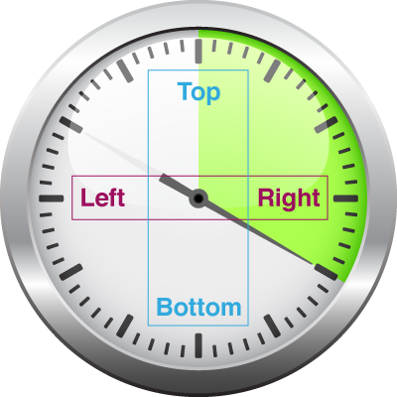
CSS Shorthand (Center)
div {
width: 960px;
margin-top: 0;
margin-right: auto;
margin-bottom: 0;
margin-left: auto;
}
div {
width: 960px;
margin: 0 auto;
}

