Slide 1

Web Design Fundamentals
PROJECT
DATE
WEEK 6
INSTRUCTOR
MARK DODGSON

Slide 2


Topics
Week Five Recap.
Styling Multiple Selectors at Once.
Using Web Safe Fonts
CSS Floats

Slide 3
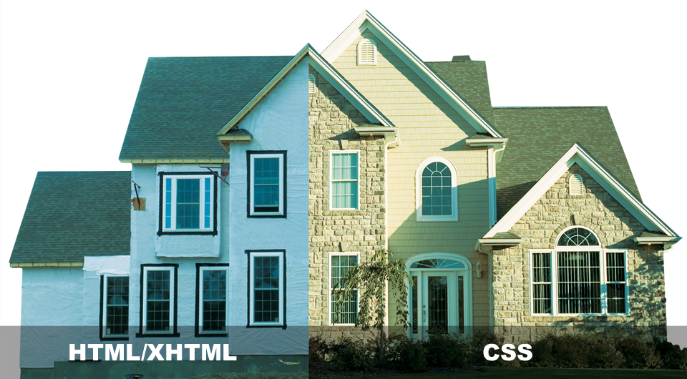
Applying CSS
PROJECT
DATE
INSTRUCTOR
MARK DODGSON

Slide 4
What is CSS?
Cascading Style Sheets is a style sheet language developed to control the presentation of markup language documents.
CSS is a collection of formatting rules.

Slide 5
Anatomy of a CSS Style

Slide 6
Anatomy of a CSS Style
Selector
Declaration Block
p { color: red; }
Property
Value

Slide 7
Anatomy of a CSS Style
p {
color: red;
font-size: 13px;
font-family: arial;
}
p { color: red; font-size: 13px; font-family: arial; }

Slide 8
Element Selectors

Slide 9
Element Selectors
These are very broad and would apply to all p, h1 or in this case ul elements.
p { color: red; }
h1 { color: red; }
ul { color: red; }

Slide 10
Class Selectors

Slide 11
Class Selectors
Classes are html attributes that can be added to any html element.
You name the class anything you want.
You can apply it as many times on a page as you want.
HTML
<h2 class=”subhead”>My Subhead</h2>
CSS
.subhead { color: red; }

Slide 12
ID Selectors

Slide 13
ID Selectors
ID selectors are similar to class selectors except for 1 very important difference. An ID must be unique to the page. If you ad an ID to an HTML element, no other element on the page can have that same ID.
HTML
<h2 id=”wrapper”>My Subhead</h2>
CSS
#wrapper { font-size: 13px; }

Slide 14
HTML Example
p { color: red; }
h1 { color: blue; }
<html>
<head>...</head>
<body>
<p>Some content</p>
<h1>Heading</h1>
<p>More content</p>
</body>
</html>

Slide 15
Embedding CSS Styles

Slide 16
Embedding CSS Styles
Embedded Styles (added in the head tags)
<style type=”text/css”>
p { color: red; }
</style>

Slide 17
CSS Cascade (order)

Slide 18
CSS Cascade (order)
(VERY IMPORTANT)
CSS cascade is very important when you want to style a very specific element on a page.
HTML
<p><em>copy to come</em></p>
<div>Here is some <em>copy</em></div>
CSS
div em { color: red; }

Slide 19
CSS Shorthand

Slide 20
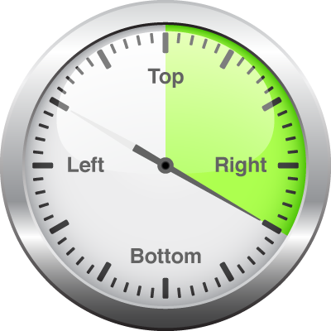
CSS Shorthand
div {
margin-top: 5px;
margin-right: 20px;
margin-bottom: 5px;
margin-left: 20px;
}
div {
margin: 5px 20px 5px 20px
}

Slide 21
CSS Shorthand (Center)
div {
width: 960px;
margin-top: 0;
margin-right: auto;
margin-bottom: 0;
margin-left: auto;
}
div {
width: 960px;
margin: 0 auto 0 auto;
}

Slide 22
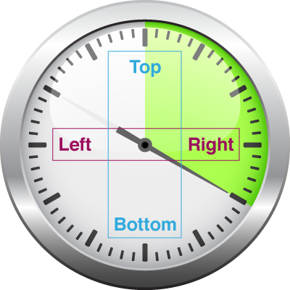
CSS Shorthand (Center)
div {
width: 960px;
margin-top: 0;
margin-right: auto;
margin-bottom: 0;
margin-left: auto;
}
div {
width: 960px;
margin: 0 auto;
}

Slide 23
Styling Multiple
Selectors at once

Slide 24
Styling Multiple
Selectors at Once
You have the ability to write CSS styles that apply to multiple tags.
h1, h2, h3, h4, h5, h6 {
color: #ffffff;
}

Slide 25
Web Safe Fonts

Slide 26
Web Safe Fonts
Users have to have the font you have chosen on their computer for it to render correctly.
Using web safe fonts eliminates or reduces the chances of your site not looking like you want it to.
When choosing adding fonts to a CSS style you have the ability to supply backups in case the user doesn’t have a particular font.
p { font-family: Arial, Helvetica, san-serif; }

Slide 27
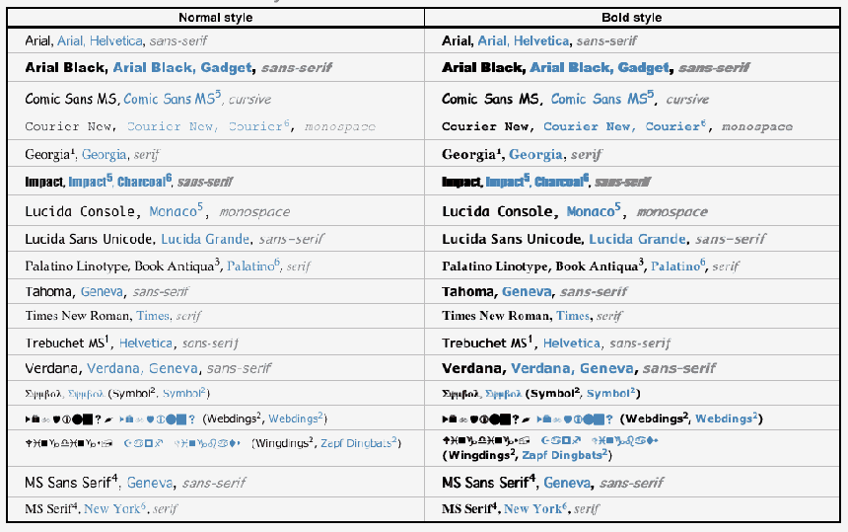
Mac/PC Web Safe Fonts

Slide 28
CSS Floats

Slide 29
CSS Floats
By Far the most popular
CSS formatting technique.
HTML normally flows content from the top
of the browser to the bottom stacking each element on top of each other.
The float property allows you to position
content by moving it to the right or left.
It also allows other content to flow around items such as images.

Slide 30

CSS Floats
Block level elements are like boxes and they stack from top
to bottom.

Slide 31
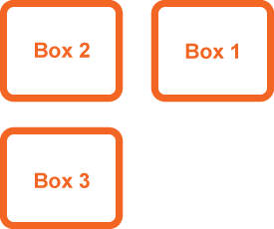
CSS Floats
.box1 { float: right; }
Box 1 is now floating and is taken out of
the regular flow of the document. Box 2 & 3 now move up to fill the space that the floated element used to occupy.
Floating an element removes it from normal document flow.

Slide 32

CSS Floats
.box1 { float: left; }
Box 1 is now floating and is taken out
of the regular flow
of the document.
Box 2 & 3 see this
as empty space
and move up to
fill it, hiding box 2
behind box 1.

Slide 33

CSS Floats
img { float: left; }
Inline elements such as the <p> tag wrap around a floated item.
Aenean eu leo quam. Pellentesque ornare sem lacinia quam venenatis vestibulum. Integer posuere erat a ante venenatis dapibus posuere velit aliquet senean eu leo quam.
Aenean eu leo quam. Pellentesque ornare sem lacinia quam venenatis vestibulum.

Slide 34

CSS Floats
div { float: left; }
Floating a series
of divs would put
them side-by-side.
This technique is commonly used with navigation, by turning a list of links into
a horizontal menu.
This technique is used to create columns.

