Slide 1

Web Design Fundamentals
PROJECT
DATE
WEEK 8
INSTRUCTOR
MARK DODGSON

Slide 2


Topics
Linking CSS Style Sheets
Understanding CSS Reset
CSS Positioning

Slide 3
Linking CSS Style Sheets

Slide 4
Linking CSS Style Sheets
Linked Style Sheet (separate page)
<link href="global.css" rel="stylesheet" type="text/css" />
Linked Style Sheet are named with
a .css extention (ie. global.css)
Linked Style Sheet are added in the head tags
Linking a style sheet means that you can control the presentation of site consisting
of multiple pages from 1 file.

Slide 5
Linking CSS Style Sheets
http://www.csszengarden.com

Slide 6
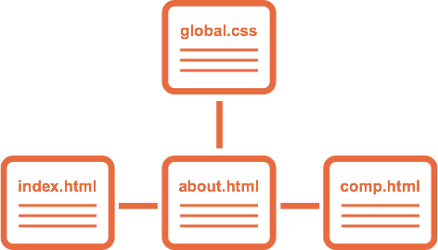
Linking CSS Style Sheets

Slide 7
CSS Reset

Slide 8
CSS Reset
By default the browser automatically adds styles to elements on the page.
headings and paragraphs have margins.
Links have underlines and colour defaults.
When writing CSS you may find that your styles don’t look correctly. This is because the styles in some cases are being added on top of the browsers default styles.

Slide 9
CSS Reset
A CSS reset is a style sheet that you link to your page that sets all of the major HTML tags to a value of “0”.
Once all default styles have been removed, any styles you create are applied in the manner in which you want them to preview.

Slide 10
Positioning

Slide 11
Positioning
Relative
Absolute
Fixed
Static
Inherit

Slide 12
Positioning (Relative)
Positioning an element “Relative” keeps
it within the normal flow of the document.
A relative positioned element is positioned
relative to its normal position.
You can use top or bottom, and left or right to move the element relative to where it would normally occur in the document.

Slide 13
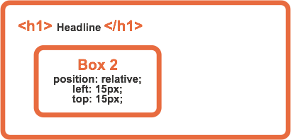
Positioning (Relative)

Slide 14
Positioning (Relative)
div {
position: relative;
top: 15px;
left: 15px;
}

Slide 15
Positioning (Absolute)
Positioning an element “Absolute” takes it out of the normal flow of the document (similar to floats).
To position an item absolute it needs to be within an element that is relatively positioned.
By default the browser has relative positioning.
An absolute position element is positioned relative to the first parent element that has a position of relative. If no such element is found, the containing block is <html>.

Slide 16
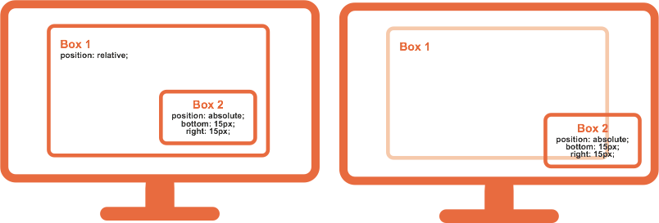
Positioning (Absolute)
Box 1 has been given position:relative;
Box 2 is now relative to Box 1
Box 1 doesn’t have
any positioning
Box 2 is now relative to the next item that is relative. In this case it’s the browser window.

Slide 17
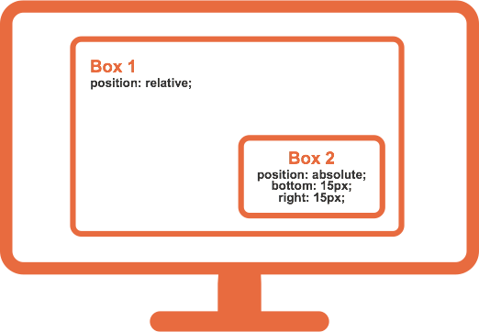
Positioning (Absolute)
div {
position: absolute;
bottom: 15px;
right: 15px;
}

Slide 18
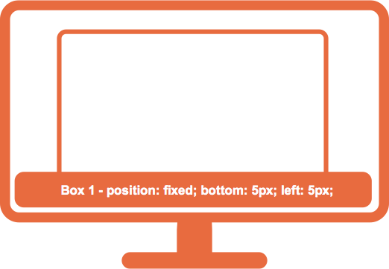
Positioning (Fixed)
An element with fixed position is positioned relative to the browser window.
It will not move even if the window is scrolled:

Slide 19
Positioning (Static)
HTML elements are positioned static by default.
A static positioned element is always positioned according to the normal flow of the page.
Static positioned elements are not affected
by the top, bottom, left, and right properties.

