Slide 1

Web Design Fundamentals
PROJECT
DATE
FALL 2011
INSTRUCTOR
MARK DODGSON

Slide 2


Topics
What is Web Design
Web Design Workflow
What is HTTP?
Anatomy of the URL
What is FTP?
What is HTML & XHTML
(Why you should favour XHTML)
What are Doctypes?

Slide 3
What Is Web Design?

Slide 4
What Is Web Design?
For the purpose of this course we will refer to
web design as the visual part of web design.
This is called “Front End Web Development”.
This will include planning & structuring content,
user interface design and client side interactivity.
A large part of front end development requires minimal scripting and little to no programming at all.
Very few designers can do everything. Most designers specialize in a part of the process. (ie. front end design, information architecture, backend programming, etc.)
Notes:
It has recently sparked a debate on Wikipedia.
Content created by web designers can be consumed in browsers, on mobile phones, RSS readers, printers, etc. Web design is not only for the browser, but for all user experiences.
Then you have to consider what type of content you are creating. Is it hypertext, images, videos, all of the above, does it require you to pull information from databases, are you going to sell stuff on your site. Or does it require you to link to other services such as Twitter, Facebook, Google Maps and Flickr.
Taken at the highest level, Web Design can be a pretty big umbrella.
Many new web designers are often overwhelmed by the array of choices and the amount of knowledge that they need to master.
Terms like HTML, CSS, PHP, JSP, FTP, and Ajax can be intimidating
More that once I've heard, "I just want to design a simple site. Do I really need to learn all this stuff?" Well, depending upon what you're doing, maybe not. However, if you don't have a solid understanding of how the Web works, who you're trying to reach and what technologies are involved in creating your site, chances are your design isn't going to work either, whether it's simple or not.
So, does that mean that you have to learn everything before you start to create websites? Well, no, not exactly.
'just-in-time' learning

Slide 5
Web Design Workflow

Slide 6
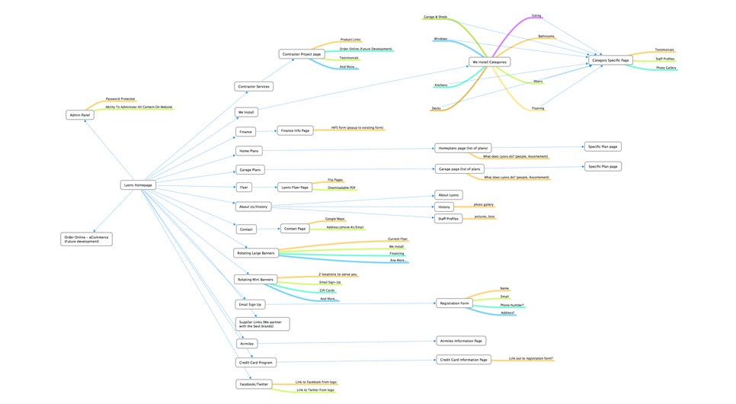
Site Map
PROJECT
DATE
STAGE 1
CLIENT

Slide 7
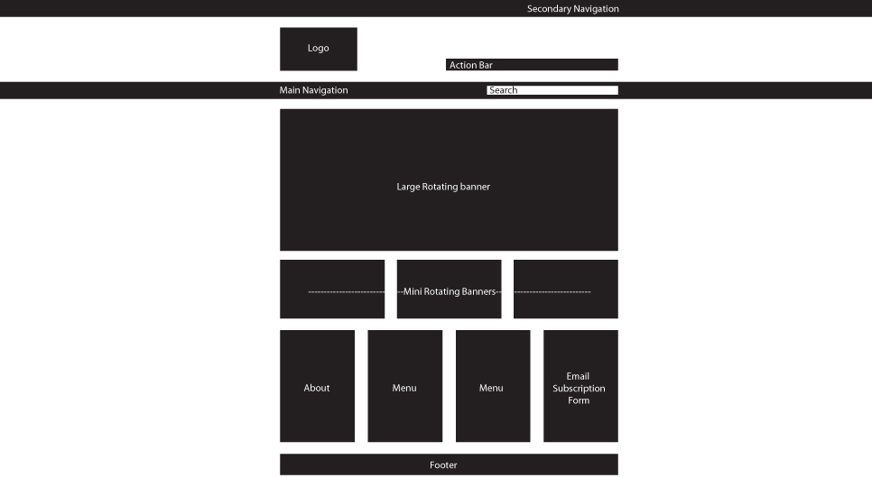
Rough Layout
PROJECT
DATE
STAGE 2
CLIENT

Slide 8
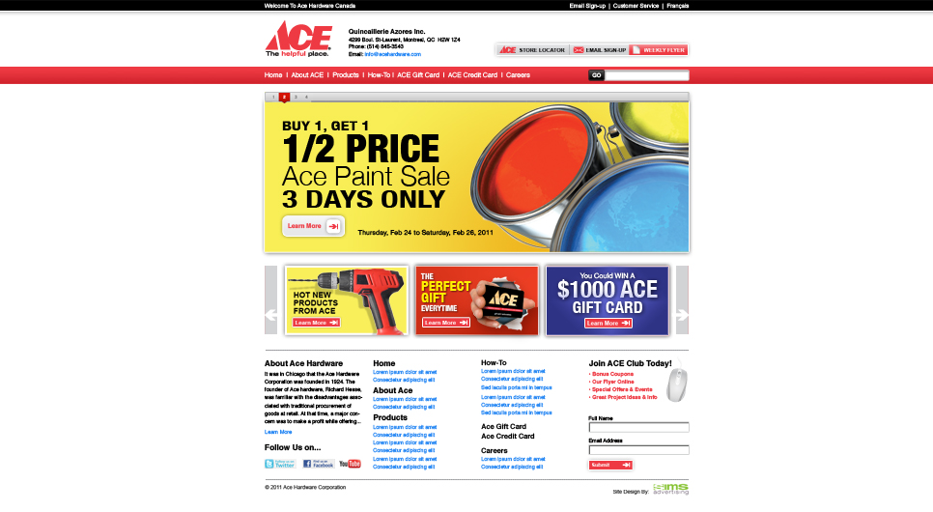
Photoshop Mockups
PROJECT
Designed to scale
DATE
STAGE 3
CLIENT

Slide 9
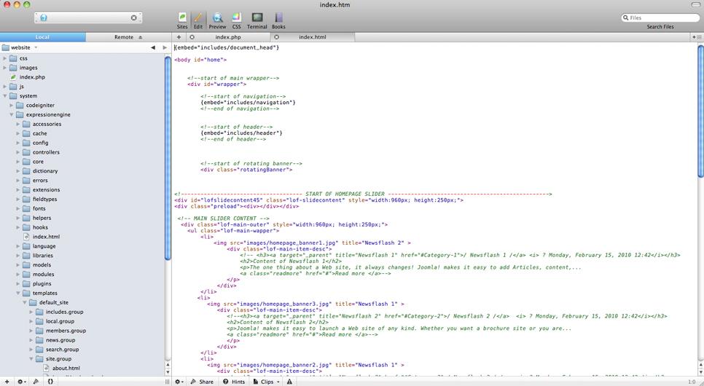
write HTML & CSS
PROJECT
DATE
STAGE 4
CLIENT

Slide 10

Test, Test, Test
PROJECT
Include older versions
DATE
STAGE 5
CLIENT

Slide 11
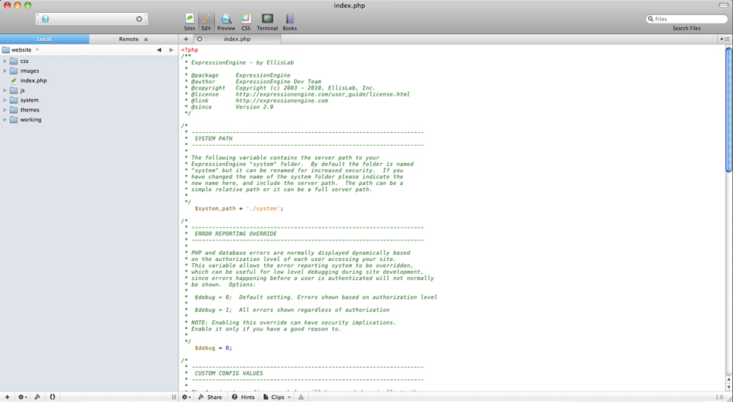
CMS Integration
PROJECT
DATE
STAGE 6
CLIENT

Slide 12
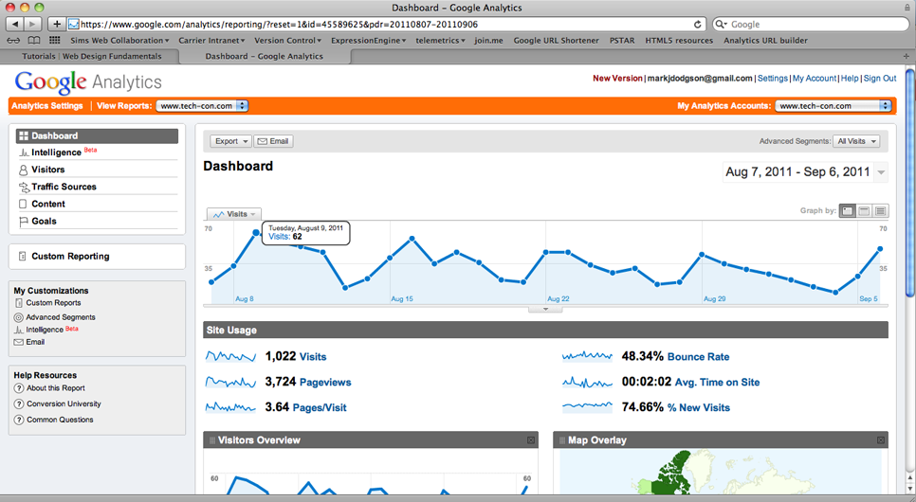
Analytics
PROJECT
DATE
STAGE 7
CLIENT

Slide 13
What is HTTP?

Slide 14
What is HTTP?
HTTP – HyperText Transfer Protocol
It defines how messages are formatted and transmitted, and what actions Web servers and browsers should take in response to various commands
When you enter a URL in your browser, this sends an HTTP command to the Web server directing it to fetch and transmit the requested Web page.

Slide 15
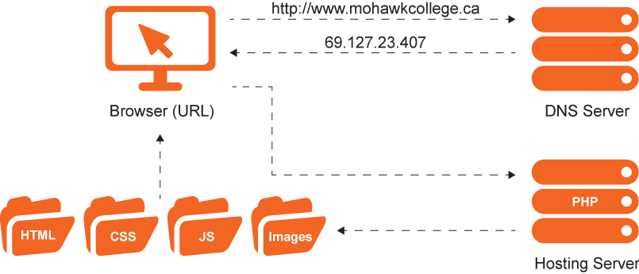
What is HTTP?

Slide 16
Anatomy of the URL
How, Where, What

Slide 17
Anatomy of the URL
http://mohawkcollege.ca/calendar/gdpDigital.html
Protocol (How) / Domain Name (Where) / Path (What)
The protocol declares how your web browser should communicate with a web server when sending or fetching a web page or document.
The domain name is a unique reference that identifies a web site on the internet.
The path refers to a file or directory on the web server.

Slide 18
Continued...
http://mohawkcollege.ca/searchResults.html?cx=006438288321204886443=UTF-8&q=test
Protocol / Domain Name / Path / Query
A query is commonly found in the URL of dynamic pages (ones which are generated from database or user-generated content) and is represented by a question mark followed by one or more parameters.
The query directly follows the domain name,
path or port number.

Slide 19
What is FTP?

Slide 20
What is FTP?
FTP – File Transfer Protocol
FTP is a protocol for uploading and downloading files from the client to the server.

Slide 21
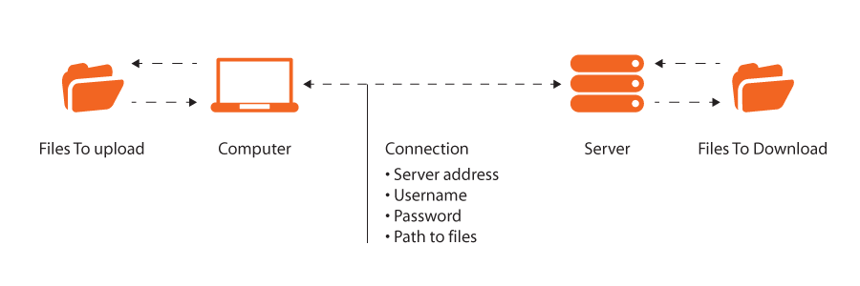
What is FTP?

Slide 22
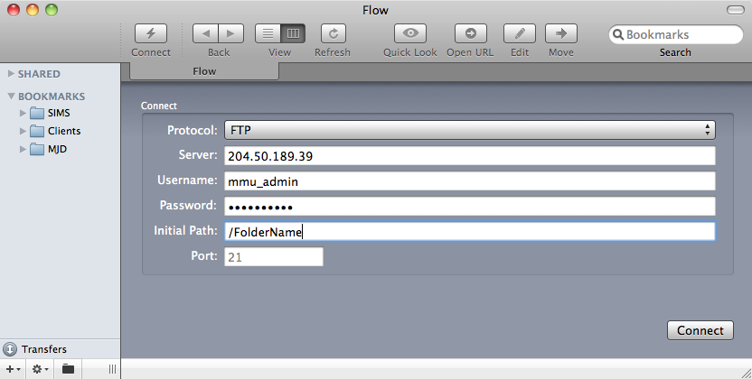
Typical FTP Client

Slide 23
What are the differences between FTP & HTTP?

Slide 24
What are the differences between FTP & HTTP?
FTP - is a protocol used to upload files from a workstation to a FTP server or download files from a FTP server to a workstation.
HTTP - is a protocol used to transfer files from a Web server onto a browser in order to view a Web page that is on the Internet.
FTP - When ftp appears in a URL it means that the user is connecting to a file server and not a Web server and that some form of file transfer is going to take place.
HTTP - When http appears in a URL it means that the user is connecting to a Web server and not a file server. The files are transferred but not downloaded, therefore not copied into the memory of the receiving device.

Slide 25
Differences Continued...
FTP - is a two-way system as files are transferred back and forth between server and workstation.
HTTP - is a one-way system as files are transported only from the server onto the workstation's browser.
FTP - files are transferred from one device to another and copied into memory
HTTP - only transfers the contents of a web page into a browser for viewing.

Slide 26
What is HTML?

Slide 27
What is HTML?
HTML is HyperText Markup Language.
Hyperlinks are what fueled the dramatic
growth of the internet.
HTML 4 grew from the need for presentation.
One of the major flaws with HTML is it takes
a lot of computing power to render pages in
a consistent manner. That's where XHTML
comes into play.
Notes:
HTML was developed by scientist in the early 90s to share documents over the internet. One of the great features of HTML is the ability to hyperlink .
Hyperlinking was such an incredibly way to share information that internet began to grow in popularity incredibly quickly.
As it grew it became less of a scientific medium.
Users didn't want just words and images they wanted presentation. HTML was extended to meet those needs.
HTML 4 grew from the need for presentation. In some cases it still takes a lot of work to achieve certain things online, but it is available. HTML 4 is by no means perfect, it some serious flaws. Fortunately most people would never notice.
As a designer/front end developer it's your job to make sure that the user doesn't notice the flaws. We'll be covering more on this during the semester.

Slide 28
What is XHTML?

Slide 29

What is XHTML?
XHTML is eXtensible HyperText Markup Language
  Not actually extensible
HTML with stricter rules
Notes:
The X is there because it's based upon XML (extensible markup language), so it's technically an extension of XML.

Slide 30
Why favour
XHTML over HTML

Slide 31
Basic HTML page
<title>Title of the document</title>
<body>
The content of the document...
</body>

Slide 32
Basic XHTML page
<!DOCTYPE html PUBLIC "-//W3C//DTD XHTML 1.0 Transitional//EN" "http://www.w3.org/TR/xhtml1/DTD/xhtml1-transitional.dtd">
<html>
<head>
<title>Title of the document</title>
</head>
<body>
The content of the document......
</body>
</html>

Slide 33
Why Favour
XHTML over HTML?
HTML is forgiving of sloppiness
XHTML requires strict usage
Stricter usage = better interoperability =
websites work better on more devices
Notes:
By forcing code to follow more strict guidelines it makes it easier to write browsers that will preview your site and be less taxing on your computer and servers. This will increase load times, increase your ability to help users with special need (ie. the blind) and will help with your SEO (search engine optimization)
Why the changes?
One goal of SGML (and its offspring like HTML) is to separate the markup instructions (the formatting instructions) from the content of a file. This allows users to see and hear the content even if their document viewer or reader does not use the same formatting instructions as the designer. For example, many people view web sites using PDAs and cell phones. The old HTML 4 standards forces those small screen devices to act as if they are computer monitors. The old standard means web pages are either distorted or cut off. The new standard allows for the designer to have one set of formatting instructions if the person is using a standard monitor, another set if they are using a cell phone, another if they are printing, another if they are using a screen reader, etc.
The new standard also gives the web site designer an enormous amount of control and flexibility. This control and flexibility is not only in the original design of a page but also in any subsequent style changes. For example, changing the font in an html page used to require multiple edits in every file that was part of a site and was not normally done without a compelling reason. Changing the font now can be a simple matter of one edit in one file.
XHTML requires strict usage. You must follow the guideline for writing code. Following these rules will result in sites that are more consistent across multiple browsers and work on mobile devices. As a designer it's your job to make sure that sites look the same across all of the major browsers, and some of these browsers can be a real challenge (ie. Internet explorer). By following XHMTL you'll be saving yourself development time in the long run. Don't worry though, It's not much more work to write XHTML.

Slide 34
Versions of
HTML & XHTML

Slide 35
Versions of
HTML & XHTML
HTML 4.01 – The most recent version of HTML
XHTML 1.0 – Based on HTML 4.01 (Used Most)
XHTML 1.1 – Stripped down, very strict,
and relies on CSS for all layout
XHTML 2.0 – Clean break
from HTML (Abandoned in 2006)
HTML 5 – The next version

Slide 36
What are Doctypes?

Slide 37
What are Doctypes?
The doctype declaration is not an HTML tag; it is an instruction to the web browser about what version of the markup language the page is written in.
The doctype declaration (DTD) refers to a Document Type Definition (DTD).
The DTD specifies the rules for the markup language, so that the
browsers render the content correctly.
The doctype declaration should be the very first
thing in an HTML document, before the <html> tag.
Quirks and Standards Compliance modes are the two
methods that browsers can use to interpret your CSS.
Quirks mode enables your browser to behave as
if it is an older browser, such as Internet Explorer 5.
If you don't use a DOCTYPE your site will run in quirks mode.
Notes:
The reason for this is that when Netscape 4 and Internet Explorer 4 implemented CSS, they did not match the W3C standard. IE5 fixed a few of these bugs, but also brought with it some misinterpretations of the W3C standard, such as the box model bug.
Web developers had to work with the browser bugs to build their websites and therefore created websites using code that also does not completely match the W3C standards.
Browser vendors now faced a problem when releasing their updated browsers. If they created a completely W3C compliant browser, many websites would break because they were not coded to the W3C standards, they were coded to the standards of the older browsers.
The solution provided by the vendors was to create a browser that can switch between compliance modes.
Therefore, modern browsers can now interpret CSS in quirks mode for the older website that was not coded to the W3C standard, or in standards compliance mode for a modern website coded to the W3C standard.
Switching modes
In order to specify which mode you require a browser to interpret your CSS, you place DOC TYPE code at the head of your HTML document. This code informs the browser whether to use quirks mode or standards compliance mode and enables you to ensure that your website is displaying correctly across the various browsers.

Slide 38
Doctypes Continued...
<!DOCTYPE html PUBLIC "-//W3C//DTD XHTML 1.0 Transitional//EN" "http://www.w3.org/TR/xhtml1/DTD/xhtml1-transitional.dtd">
<html>
<head>
<title>Title of the document</title>
</head>
<body>
The content of the document......
</body>
</html>

Slide 39
Doctypes Continued...
HTML 4.01 Strict
<!DOCTYPE HTML PUBLIC "-//W3C//DTD HTML 4.01//EN" "http://www.w3.org/TR/html4/strict.dtd">
HTML 4.01 Transitional
<!DOCTYPE HTML PUBLIC "-//W3C//DTD HTML 4.01 Transitional//EN" "http://www.w3.org/TR/html4/loose.dtd">
HTML 4.01 Frameset
<!DOCTYPE HTML PUBLIC "-//W3C//DTD HTML 4.01 Frameset//EN" "http://www.w3.org/TR/html4/frameset.dtd">

Slide 40
Doctypes Continued...
XHTML 1.0 Strict
<!DOCTYPE html PUBLIC "-//W3C//DTD XHTML 1.0 Strict//EN" "http://www.w3.org/TR/xhtml1/DTD/xhtml1-strict.dtd">
XHTML 1.0 Transitional
<!DOCTYPE html PUBLIC "-//W3C//DTD XHTML 1.0 Transitional//EN" "http://www.w3.org/TR/xhtml1/DTD/xhtml1-transitional.dtd">
XHTML 1.0 Frameset
<!DOCTYPE html PUBLIC "-//W3C//DTD XHTML 1.0 Frameset//EN" "http://www.w3.org/TR/xhtml1/DTD/xhtml1-frameset.dtd">

Slide 41
Doctypes Continued...
HTML 5
<!DOCTYPE html>

